Slide 1

DESIGN AND ANALYSIS OF REMOTE CONTROLLED WATER BODY CLEANING VEHICLE
Sl. No | Name | Register Number | Email id
1 | BHARANI KUMAR A | 212221080013 | bharanikumarr18@gmail.com
2 | CHARVIK ASHWIN | 212221080015 | charvikashwin@gmail.com
Project Guide : Dr. R. SELVAM ME., Ph.D.,
Project Coordinator : Dr. G. MANIMARAN ME., Ph.D.,

Slide 2
INTRODUCTION
Water pollution poses significant risks to aquatic ecosystems, biodiversity, and public health, with rivers, lakes, and ponds becoming dumping grounds for plastics, chemicals, and non-biodegradable materials. This pollution impacts water quality, making it unsafe for drinking, farming, and recreation, and disrupts aquatic life and agriculture. Traditional manual cleaning methods, while effective on a small scale, are costly, labor-intensive, and unsustainable for larger water bodies.
Automated solutions like trash boats and skimmers show promise but face high operational costs and scalability issues, particularly for smaller water bodies. This project aims to design and simulate a remote-controlled vehicle to efficiently collect floating waste from small to medium-sized water bodies. Using Fusion 360, advanced simulations will analyze the design’s buoyancy, stability, and waste collection efficiency, enabling rapid, cost-effective development without a physical prototype. The eco-friendly vehicle offers a scalable, practical solution for addressing water pollution sustainably.

Slide 3
LITERATURE REVIEW
Sl. No. | Author Name | Title & Year | Inferences
1 | Kumar. A & Sharma. P | Robotic Waste Collection in Aquatic Environments (2020) | The study emphasizes the negative impact of floating waste on aquatic ecosystems, highlighting the need for solutions to address water pollution.
2 | Allen. K & Wilson. S. | Waste Collection and Recycling Technologies. Environmental Engineering (2021) | The book emphasizes the inefficiency of traditional manual cleaning processes, especially in urban water bodies with limited accessibility.

Slide 4
LITERATURE REVIEW
Sl. No. | Author Name | Title & Year | Inferences
4 | Patel. D | The Role of Remote Control in Water Body Clean-up. | It advocates for the development of automated systems to address water pollution, providing a foundation for the project's focus on automated water cleaning solutions.
3 | Singh. V & Gupta. R | Sustainability in Water Pollution Management. | It calls for scalable and automated solutions in waste management, justifying the importance of the project focused on water pollution control.
ABSTRACT-ICAAMMER25115

Slide 5
OBJECTIVES
Design a Cleaning Vehicle: Design a remote-controlled vehicle that can collect floating waste from small to medium water bodies like ponds and lakes.
Optimized with Simulation: Utilize Fusion 360 to simulate the vehicle's structure, propulsion, buoyancy, and waste collection system for optimal functionality without a physical prototype.
Develop an eco-friendly solution that reduces labor and environmental impact compared to traditional cleaning methods.
Design an affordable and scalable vehicle to effectively clean up different water bodies.
Improve access for small water bodies: Work out a system that works effectively in small, enclosed water bodies that are otherwise ignored in the current cleanup efforts.

Slide 6
Problem Statement
Problem: Water pollution in rivers, lakes, and ponds harms ecosystems and public health, with plastics and non-biodegradable waste degrading water quality.
Current Limitations: Traditional cleaning methods are not scalable or cost-effective; existing automated solutions have high operational costs and limited effectiveness in smaller bodies of water.
Proposed Solution: Design and fabricate remote-controlled cleaning vehicle for small to medium-sized water bodies using simulation tools to optimize performance, reduce costs, and provide an eco-friendly, scalable solution.
ABSTRACT-ICAAMMER25115

Slide 7
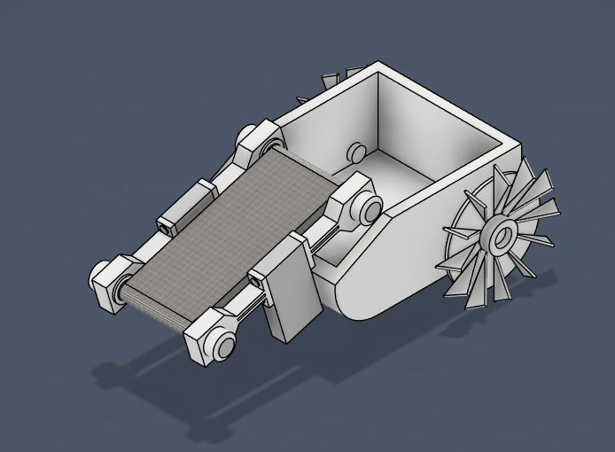
3D DESIGN USING FUSION 360
3D MODEL
7
8

Slide 8
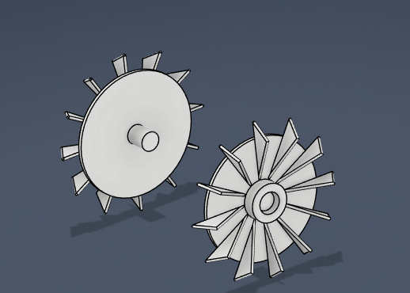
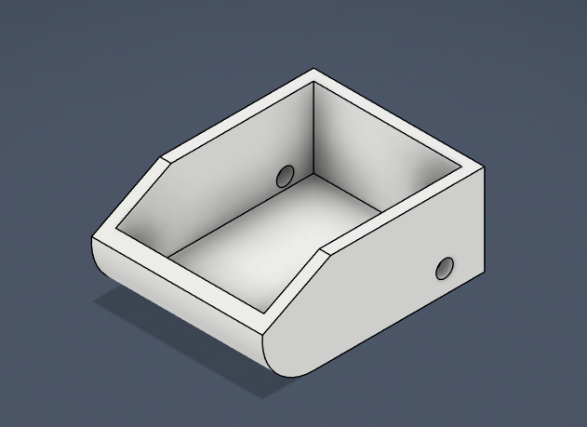
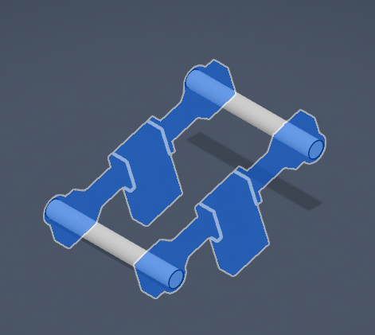
3D DESIGN USING FUSION 360
3D MODEL
PADDLE WHEELS
BASE
CONEYOR ROD
8
8

Slide 9
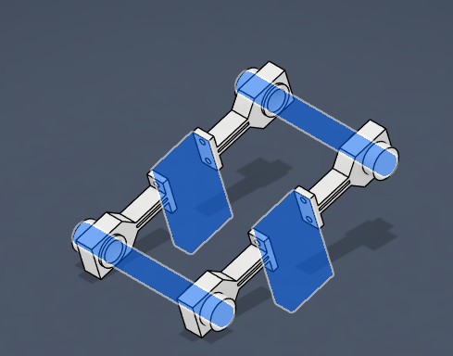
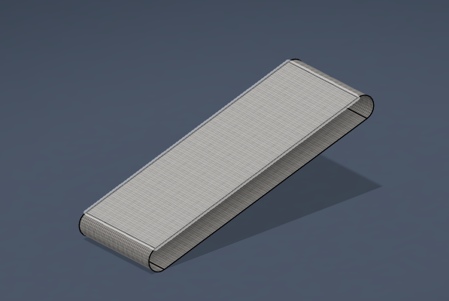
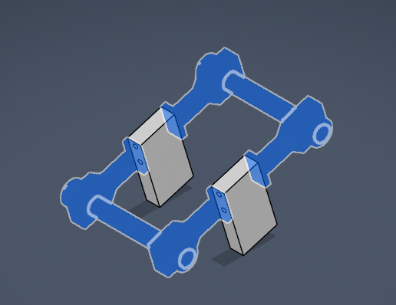
3D DESIGN USING FUSION 360
ROD CONNECTORS
CONVEYOR BELT
WOODEN BLOCKS
9
8

Slide 10
Results
This discussion covers a water cleaning vehicle that removes floating debris from water bodies. It is designed using Fusion 360 and gives importance to strength, efficiency, and cost-effectiveness, with durable corrosion-resistant steel. Simulations verified the stability and effectiveness of collecting waste in tough conditions.
Future upgradations will include self-navigating, using solar power, and even better sorting of waste. Scaling to more massive water bodies may expand its scope. Co-opting government, NGOs, and private agencies is needed to implement.
In a nutshell, this water cleaning vehicle comes with prospects for strong possibility in aiding water pollution-related issues through providing support and healthier ecosystems of aquatic regions for many future generations.

Slide 11
FUTURE SCOPE
Municipal & Industrial Use – Used for cleaning lakes, rivers, and ports to remove floating waste.
AI & Automation – AI-powered waste detection and autonomous operation with IoT monitoring.
Solar Power & Sustainability – Solar panels for energy efficiency and waste segregation for recycling.
Oil Spill & Disaster Cleanup – Adapted for oil spill absorption and flood debris removal.
Research & Education – Used in marine pollution studies and as a learning project for students.
Startup & Business Potential – Can be developed into a commercial product for environmental cleanup services.

Slide 12
References
Smith, J., & Walker, T. (2019). Environmental Impact of Water Pollution. Environmental Science Journal, 34(2)
Kumar, A., & Sharma, P. (2020). Robotic Waste Collection in Aquatic Environments. Robotics and Automation, 37(3), 115-128.
Patel, D. (2022). The Role of Remote Control in Water Body Clean-up. Journal of Environmental Technology, 48(6), 73-82.
Singh, V., & Gupta, R. (2020). Sustainability in Water Pollution Management. Journal of Environmental Sustainability, 25(2), 76-88.
Harris, T., & Evans, L. (2017). Innovative Solutions for Water Body Clean-up. International Journal of Environmental Innovation, 28(3), 189-202.
Patel, D. (2022). The Role of Remote Control in Water Body Clean-up. Journal of Environmental Technology, 48(6), 73-82.

Slide 13
Thank You

