Slide 1
Examination Guide
iSAQB® Certification Program
Certified Professional for Software Architecture
Foundation Level (CPSA-F®)
Based on the CPSA-F Examination Rules 2020
Refers to V 5.1 of the CPSA-F curriculum

Slide 2
Copyright Notice
© (Copyright), International Software Architecture Qualification Board e.V. (iSAQB® e.V.) 2020
This Guide may only be used subject to the conditions stated in the iSAQB Foundation Level Curriculum, especially:
If you are a trainer or training provider, it shall be possible for you to use the documents and/or curricula once you have obtained a usage license. Please address any enquiries to info@isaqb.org.
The International Software Architecture Qualification Board e.V. (iSAQB e.V.) has exclusive entitlement to these copyrights. The abbreviation "e.V." is part of the iSAQB’s official name and stands for registered association, which describes its status as a legal entity according to German law. For the purpose of simplicity, iSAQB e.V. shall hereafter be referred to as iSAQB without the use of said abbreviation.
(C) iSAQB e.V.

Slide 3
About this Guide
This Guide adds information to the examination rules as published by iSAQB.
This guide only provides explanation – and does NOT replace or overrule the official examination rules.
The official examination rules have precedence over everything stated here.
(C) iSAQB e.V.

Slide 4
The Curriculum
The curriculum standardizes the contents and their relative priorities
for all Accredited CPSA-F Trainings.
iSAQB Accredited Trainers must know and understand the curriculum,
especially all R1 and R2 learning goals.
Individuals who want to obtain the CPSA-F certificate should read
through it.
The learning goals listed in the curriculum are grouped into chapters
and detailed with learning items.
The curriculum informs about the relevance of learning goals and
learning items with respect to the examination.
(C) iSAQB e.V.

Slide 5
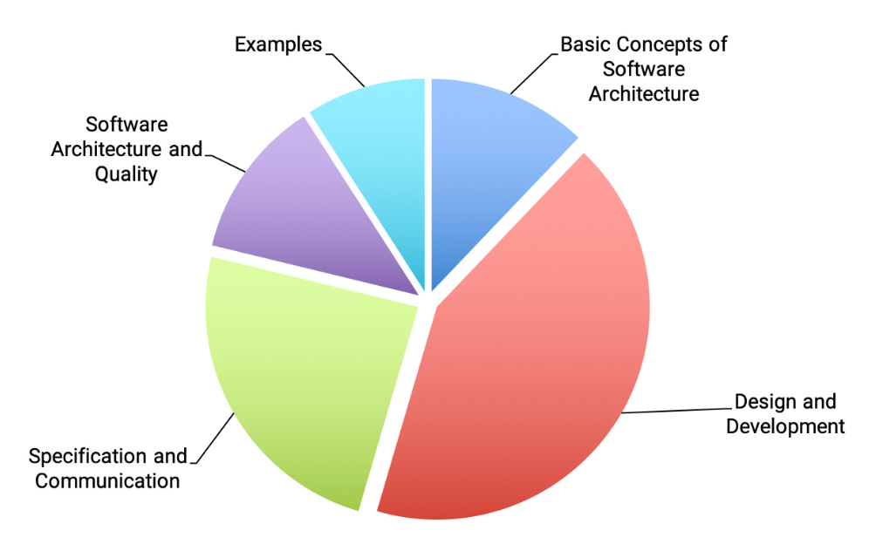
Structure and Relative Size in the iSAQB® Foundation Level Curriculum
The sizes of segments indicate the relative proposed duration of the topics in CPSA-F trainings.
(C) iSAQB e.V.

Slide 6
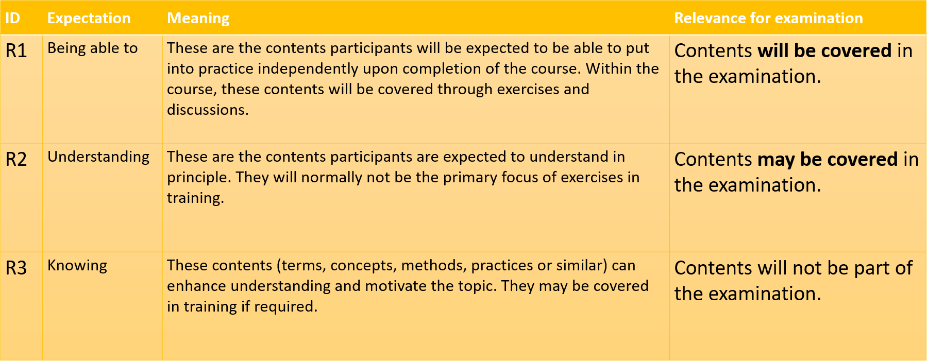
Explanation of Relevance Levels
(C) iSAQB e.V.

Slide 7
Formalities of CPSA-F® Examination
Required:
Be there 10 minutes in advance.
Passport or any other official document with participants name and image on it.
Multiple Choice:
75 min (plus 15 min extra, if examination taken in foreign language)
About 40 questions – depending on the exam sheet you‘ll get
Each question has max 1-2 points
At least 60% of the achievable points required for passing
During examination:
Don't ask questions
No use of notes, books, mobile devices etc.
The room is not to be left
No talk about examination topics
(C) iSAQB e.V.

Slide 8
The Structure of Examination Questions
Type of questions:
Single-Choice,
Pick Multiple,
Choose Category
Max. points for
this question
Question 1 A-Question: Select one option. – 1 point
­­­­­ID: Q-20-04-01
How many definitions of “software architecture” exist?
Question No. + ID
Question
☐ | Exactly one for all kinds of systems.
☐ | (b) One for every kind of software system (e.g. “embedded”, “real-time”, “decision support”, “web”, “batch”, …)
☐ | (c) A dozen or more different definitions.
Answer options to choose from according
to the type of the question.
(C) iSAQB e.V.

Slide 9
A-Question (Single-Choice, Single Correct Answer)
Question 1 A-Question: Select one option. – 1 point
­­­­­ID: Q-20-04-01
How many definitions of “software architecture” exist?
☐ | Exactly one for all kinds of systems.
☐ | (b) One for every kind of software system (e.g. “embedded”, “real-time”, “decision support”, “web”, “batch”, …)
☐ | (c) A dozen or more different definitions.
no choice -> 0 points
correct choice -> all points
wrong choice, no choice or to many choices -> 0 points
(C) iSAQB e.V.

Slide 10
A-Question (Single-Choice, Single Correct Answer)
Question 1 A-Question: Select one option. – 1 point
­­­­­ID: Q-20-04-01
How many definitions of “software architecture” exist?
☐ | Exactly one for all kinds of systems.
☐ | (b) One for every kind of software system (e.g. “embedded”, “real-time”, “decision support”, “web”, “batch”, …)
☐ | (c) A dozen or more different definitions.
X
correct choice -> 1 point
correct choice -> all points
wrong choice, no choice or to many choices -> 0 points
(C) iSAQB e.V.

Slide 11
A-Question (Single-Choice, Single Correct Answer)
Question 1 A-Question: Select one option. – 1 point
­­­­­ID: Q-20-04-01
How many definitions of “software architecture” exist?
X
☐ | Exactly one for all kinds of systems.
☐ | (b) One for every kind of software system (e.g. “embedded”, “real-time”, “decision support”, “web”, “batch”, …)
☐ | (c) A dozen or more different definitions.
wrong choice -> 0 points
correct choice -> all points
wrong choice, no choice or to many choices -> 0 points
(C) iSAQB e.V.

Slide 12
A-Question (Single-Choice, Single Correct Answer)
Question 1 A-Question: Select one option. – 1 point
­­­­­ID: Q-20-04-01
How many definitions of “software architecture” exist?
X
☐ | Exactly one for all kinds of systems.
☐ | (b) One for every kind of software system (e.g. “embedded”, “real-time”, “decision support”, “web”, “batch”, …)
☐ | (c) A dozen or more different definitions.
X
too many selected -> 0 points
correct choice -> all points
wrong choice, no choice or to many choices -> 0 points
(C) iSAQB e.V.

Slide 13
P-Question (Pick Multiple)
Question 38 P-Question: Choose the two most appropriate indicators. – 2 points
ID: Q-20-04-29
You try to analyze your architecture quantitatively. Which are the TWO most appropriate
indicators for architectural problem areas?
☐ | High coupling of components.
☐ | (b) Inappropriate names of public methods.
☐ ☐ ☐ | (c) Missing comments. (d) Error clusters. (e) Number of test cases per component.
no selection -> 0 points
correct answer -> add 1/n of max points
wrong answer -> deduct 1/n of max points
(but only down to 0 points overall)
too many selections -> 0 points
fewer selections -> 0 points added/deducted
worst case is 0 points
(C) iSAQB e.V.

Slide 14
P-Question (Pick Multiple)
Question 38 P-Question: Choose the two most appropriate indicators. – 2 points
ID: Q-20-04-29
You try to analyze your architecture quantitatively. Which are the TWO most appropriate
indicators for architectural problem areas?
X
☐ | High coupling of components.
☐ | (b) Inappropriate names of public methods.
☐ ☐ ☐ | (c) Missing comments. (d) Error clusters. (e) Number of test cases per component.
2 correct -> 1 + 1 = 2 points
X
correct answer -> add 1/n of max points
wrong answer -> deduct 1/n of max points
(but only down to 0 points overall)
too many selections -> 0 points
fewer selections -> 0 points added/deducted
worst case is 0 points
(C) iSAQB e.V.

Slide 15
P-Question (Pick Multiple)
Question 38 P-Question: Choose the two most appropriate indicators. – 2 points
ID: Q-20-04-29
You try to analyze your architecture quantitatively. Which are the TWO most appropriate
indicators for architectural problem areas?
X
☐ | High coupling of components.
☐ | (b) Inappropriate names of public methods.
☐ ☐ ☐ | (c) Missing comments. (d) Error clusters. (e) Number of test cases per component.
X
1 correct, 1 wrong -> 0 points
correct answer -> add 1/n of max points
wrong answer -> deduct 1/n of max points
(but only down to 0 points overall)
too many selections -> 0 points
fewer selections -> 0 points added/deducted
worst case is 0 points
(C) iSAQB e.V.

Slide 16
P-Question (Pick Multiple)
Question 38 P-Question: Choose the two most appropriate indicators. – 2 points
ID: Q-20-04-29
You try to analyze your architecture quantitatively. Which are the TWO most appropriate
indicators for architectural problem areas?
X
☐ | High coupling of components.
☐ | (b) Inappropriate names of public methods.
☐ ☐ ☐ | (c) Missing comments. (d) Error clusters. (e) Number of test cases per component.
1 correct, 1 omitted -> 1 point
correct answer -> add 1/n of max points
wrong answer -> deduct 1/n of max points
(but only down to 0 points overall)
too many selections -> 0 points
fewer selections -> 0 points added/deducted
worst case is 0 points
(C) iSAQB e.V.

Slide 17
P-Question (Pick Multiple)
Question 38 P-Question: Choose the two most appropriate indicators. – 2 points
ID: Q-20-04-29
You try to analyze your architecture quantitatively. Which are the TWO most appropriate
indicators for architectural problem areas?
☐ | High coupling of components.
☐ | (b) Inappropriate names of public methods.
☐ ☐ ☐ | (c) Missing comments. (d) Error clusters. (e) Number of test cases per component.
X
X
both wrong -> 0 points
correct answer -> add 1/n of max points
wrong answer -> deduct 1/n of max points
(but only down to 0 points overall)
too many selections -> 0 points
fewer selections -> 0 points added/deducted
worst case is 0 points
(C) iSAQB e.V.

Slide 18
P-Question (Pick Multiple)
Question 38 P-Question: Choose the two most appropriate indicators. – 2 points
ID: Q-20-04-29
You try to analyze your architecture quantitatively. Which are the TWO most appropriate
indicators for architectural problem areas?
X
☐ | High coupling of components.
☐ | (b) Inappropriate names of public methods.
☐ ☐ ☐ | (c) Missing comments. (d) Error clusters. (e) Number of test cases per component.
X
too many selected -> 0 points
X
correct answer -> add 1/n of max points
wrong answer -> deduct 1/n of max points
(but only down to 0 points overall)
too many selections -> 0 points
fewer selections -> 0 points added/deducted
worst case is 0 points
(C) iSAQB e.V.

Slide 19
K-Questions (Choose Category, Allocation Questions)
Question 19 K-Question: Select “Contained” or “Avoided” for each line. – 1 point
­­­­­ID: Q-20-04-22
You document a component of your software architecture. Which information should be
contained in your black box description and which information should be avoided?
Contained Avoided
☐ | ☐ | (a) | Interfaces.
☐ ☐ | ☐ ☐ | (b) (c) | Responsibility. Internal structure.
☐ | ☐ | (d) | Hints for the implementation.
no selection -> 0 points
mark 1 answer per row (or none if
not sure)
there is always one correct answer
in each row
correct mark -> add 1/n of max points
wrong mark -> deduct 1/n of max points
(but only down to 0 points overall)
worst case is 0 points
(C) iSAQB e.V.

Slide 20
K-Questions (Choose Category, Allocation Questions)
Question 19 K-Question: Select “Contained” or “Avoided” for each line. – 1 point
­­­­­ID: Q-20-04-22
You document a component of your software architecture. Which information should be
contained in your black box description and which information should be avoided?
Contained Avoided
X
☐ | ☐ | (a) | Interfaces.
☐ ☐ | ☐ ☐ | (b) (c) | Responsibility. Internal structure.
☐ | ☐ | (d) | Hints for the implementation.
X
4 correct -> 4 x 0,25 = 1 point
X
X
mark 1 answer per row (or none if
not sure)
there is always one correct answer
in each row
correct mark -> add 1/n of max points
wrong mark -> deduct 1/n of max points
(but only down to 0 points overall)
worst case is 0 points
(C) iSAQB e.V.

Slide 21
K-Questions (Choose Category, Allocation Questions)
Question 19 K-Question: Select “Contained” or “Avoided” for each line. – 1 point
­­­­­ID: Q-20-04-22
You document a component of your software architecture. Which information should be
contained in your black box description and which information should be avoided?
Contained Avoided
X
☐ | ☐ | (a) | Interfaces.
☐ ☐ | ☐ ☐ | (b) (c) | Responsibility. Internal structure.
☐ | ☐ | (d) | Hints for the implementation.
X
3 correct, 1 wrong -> 3 x 0,25 – 0,25 = 0,5 points
X
X
mark 1 answer per row (or none if
not sure)
there is always one correct answer
in each row
correct mark -> add 1/n of max points
wrong mark -> deduct 1/n of max points
(but only down to 0 points overall)
worst case is 0 points
(C) iSAQB e.V.

Slide 22
K-Questions (Choose Category, Allocation Questions)
Question 19 K-Question: Select “Contained” or “Avoided” for each line. – 1 point
­­­­­ID: Q-20-04-22
You document a component of your software architecture. Which information should be
contained in your black box description and which information should be avoided?
Contained Avoided
X
☐ | ☐ | (a) | Interfaces.
☐ ☐ | ☐ ☐ | (b) (c) | Responsibility. Internal structure.
☐ | ☐ | (d) | Hints for the implementation.
X
2 correct, 2 wrong -> 2 x 0,25 – (2 x 0,25) = 0 points
X
X
mark 1 answer per row (or none if
not sure)
there is always one correct answer
in each row
correct mark -> add 1/n of max points
wrong mark -> deduct 1/n of max points
(but only down to 0 points overall)
worst case is 0 points
(C) iSAQB e.V.

Slide 23
K-Questions (Choose Category, Allocation Questions)
Question 19 K-Question: Select “Contained” or “Avoided” for each line. – 1 point
­­­­­ID: Q-20-04-22
You document a component of your software architecture. Which information should be
contained in your black box description and which information should be avoided?
Contained Avoided
X
☐ | ☐ | (a) | Interfaces.
☐ ☐ | ☐ ☐ | (b) (c) | Responsibility. Internal structure.
☐ | ☐ | (d) | Hints for the implementation.
X
1 correct, 3 wrong -> 0,25 – 3 x 0,25 = 0 points
X
X
mark 1 answer per row (or none if
not sure)
there is always one correct answer
in each row
correct mark -> add 1/n of max points
wrong mark -> deduct 1/n of max points
(but only down to 0 points overall)
worst case is 0 points
(C) iSAQB e.V.

Slide 24
K-Questions (Choose Category, Allocation Questions)
Question 19 K-Question: Select “Contained” or “Avoided” for each line. – 1 point
­­­­­ID: Q-20-04-22
You document a component of your software architecture. Which information should be
contained in your black box description and which information should be avoided?
Contained Avoided
X
☐ | ☐ | (a) | Interfaces.
☐ ☐ | ☐ ☐ | (b) (c) | Responsibility. Internal structure.
☐ | ☐ | (d) | Hints for the implementation.
X
2 correct, 2 omitted -> 2 x 0,25 = 0,5 points
mark 1 answer per row (or none if
not sure)
there is always one correct answer
in each row
correct mark -> add 1/n of max points
wrong mark -> deduct 1/n of max points
(but only down to 0 points overall)
worst case is 0 points
(C) iSAQB e.V.

Slide 25
Thank you for your interest!
If you have any questions, please contact info@isaqb.org and ask for the Foundation Level Working Group (FLWG).
Remarks or questions concerning specific learning goals can be left in our public GitHub repository, where the FLWG maintains the curriculum:
https://github.com/isaqb-org/curriculum-foundation.
You may open an issue in our public issue tracker:
https://github.com/isaqb-org/curriculum-foundation/issues.
(C) iSAQB e.V.

