Slide 1
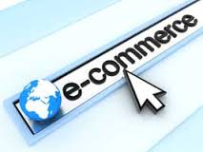
LetsGift.com
(E-Commerce Website Implemented using Megento
Bharti Bachani(10103518)
Bharat Issar(10103548)

Slide 2
What is E-Commerce?
Though there exists no standard definition for the
term e-commerce, it is generally used in the sense
of denoting a method of conducting business
Through electronic means rather than through
conventional physical means. Such electronic
means include ‘click & buy’ methods using computers
as well as ‘m-commerce’ which make use of various
mobile devices or smart phones.

Slide 3
E-Commerce Driving Factors:
Reduced search and transaction cost
Reduced process lead-time and faster time to market
Increased customer service
Improved convenience and shopping experience
Increased information transparency
Knowledge generation
Novel products and services

Slide 4
E-commerce can be classified as:
C2C (Consumer to Consumer):This kind of transaction takes place via online classified Ads or auctions or by selling personal services online.
Ex: ebay.com auctions
B2B(Business to Business): This takes place when a company wants to conduct a commercial activity with another business firm online. This is done when companies have all their operations computerized and now they want to go to a higher stage by linking their customers and vendors. This is done by the use of supply chain software linked to the ERP application.
Ex: Altra, FreeMarkets
B2C (Business to Consumer):This is the most common form of E-Commerce in which a variety of goods ranging from apparels, footwear, stationery, gifts, and services like travel booking, online matrimonial and digital downloads are available. This mode provide the consumer with services like information gathering, comparing and buying or selling goods online.
Ex: shaadi.com, makemytrip.com, shopclues.com, flipkart.com

Slide 5
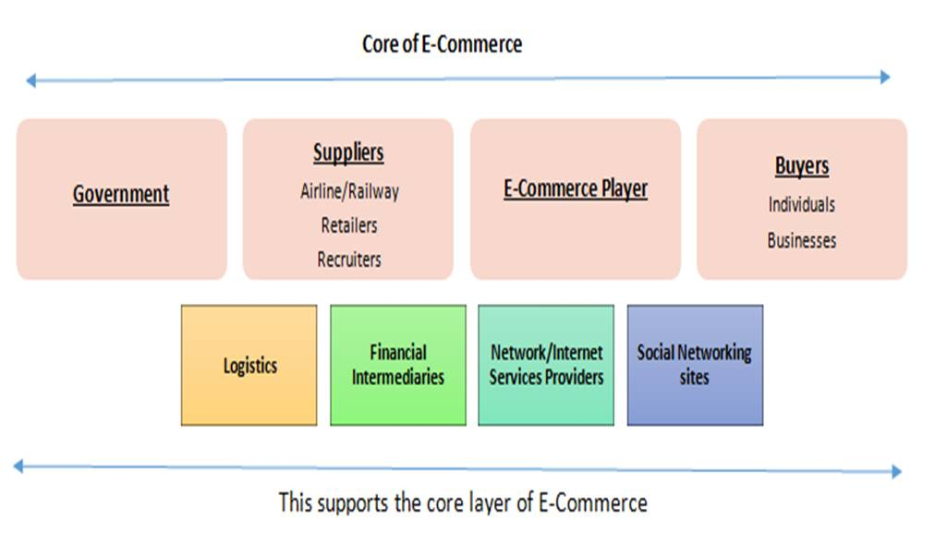

Slide 6
Upcoming Trends:
Internet Penetration: With an exponential increase in internetusage,
there’s an increasing PC and broadband penetration, coupledwith
the declining prices of PCs. Tablets and smartphones have given a new
meaning toconnectivity and user experience.
M-Commerce: India has more than900 million mobile users, of which around 300 million use data services. Thisis expected to grow 1200 million by 2015. Also, more than 100 millionmobile users are expected to use 3G and 4G connectivity in the coming few years. Of the total 90 million mobile users, only 27 million are active on theInternet.
Sell everything online: Even as e-tailers gear up to meet the pressures of same-day-shipping and next-day-delivery, the trend throws up another opportunity. With streamlined logistics and supply chain management, e-tailers could look at expanding the width of product range.

Slide 7
Building customer confidence:Trust and transparency is paramount.As Indian shoppers, it is in our very nature to be wary of the over-zealous salesperson, choosing to see and feel the products ourselves before deciding to invest in a new purchase. This cautiousness extends in the way we approach online buying as well.

Slide 8
Platform used:
Magento the content, looks and functionality of their eCommis an open source e-commerce platform that besides having rich features, offers users unparalleled flexibility to manage erce store. Moreover, it offers a spontaneous administration interface that includes a robust marketing, search engine optimization and catalogue-management tools to give merchants the power to create sites customized as per their unique business requirements.

Slide 9
Features of Magento:
Increase Control
Control every facet of your store, from merchandising to promotions and more.
Increase ROI
Magento's commercial open source business model yields a superior product at a low cost.
Increase Growth
Magento's feature-set and flexibility enable merchants to increase revenue.
Marketing Promotions Tools
Flexible Coupons (pricing rules) with ability to restrict to stores, customer groups, time period, products, and categories.
Catalog Promotional Pricing
Site Management
Control multiple websites and stores from one Administration Panel
Web Services API for easy integration between Magento and any third-party application
A/B and Multivariate Testing

Slide 10
Product Browsing
Multiple Images Per Product
Product Image Zoom-in Capability
Checkout
One-Page Checkout
Checkout without account/Guest Checkout
Shipping to multiple addresses in one order
Shipping
Shipping to multiple addresses in one order
Multiple shipments per order
Free Shipping
Customer Service
Feature-rich Customer Accounts
Order Tracking from Account
Customer Accounts
Re-orders from account
Downloadable Products
Recently ordered items

Slide 11
Top 10 Ecommerce in India:
Flipkart
eBay India
Snapdeal
Amazon India
Myntra
Shopclues
Dominos
freecharge
Jabong
Tradus

Slide 12
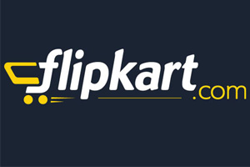
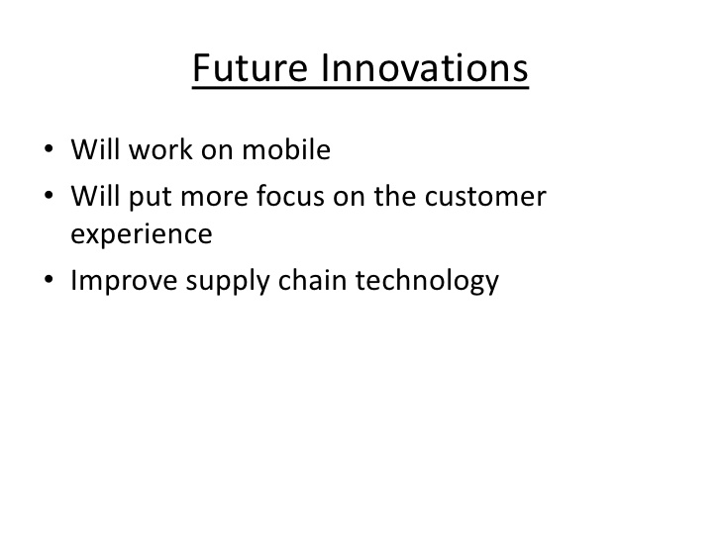
Flipkart
Flipkart is the most popular Indian e-commerce company. They are headquartered in Bangalore, Karnataka. It was founded by Sachin Bansal and Binny Bansal in 2007.

Slide 13
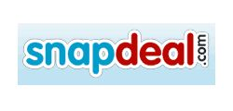
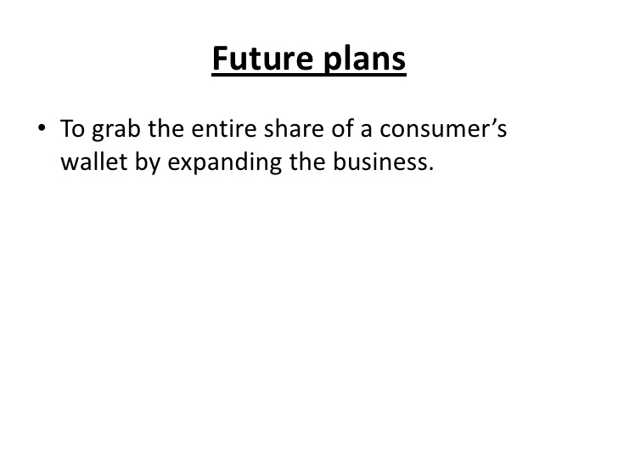
Snapdeal
Snapdeal is one of the leading online shopping website, headquartered in New Delhi, India. The company was started by Kunal Bahl, a wharton graduate and Rohit Bansal an alumnus of IIT Delhi in February 2010.

Slide 14
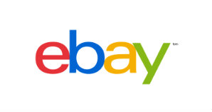
Ebay
Ebay india is the indian version of the internationally accepted American multinational internet consumer-to-consumer corporation. It was founded in 1995, and became a notable success story of E-commerce; it is now a multi-billion dollar business with operations localized in over thirty countries.

Slide 15
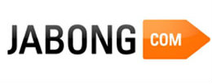
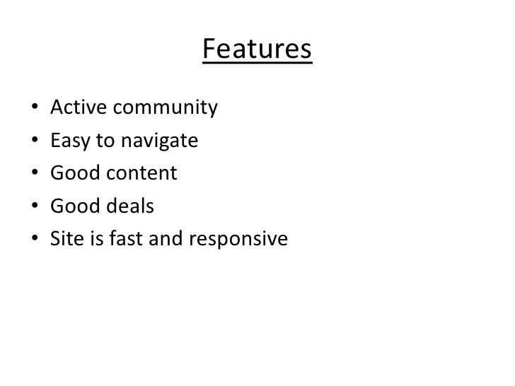
Jabong.com
Jabong.com is an indian fashion and lifestyle online store,it retails apparel, sneakers, gadgets, beauty products, fragrances, house gadgets along with style and also life style products.Jabong has made a huge progress in a very short time period.

Slide 16

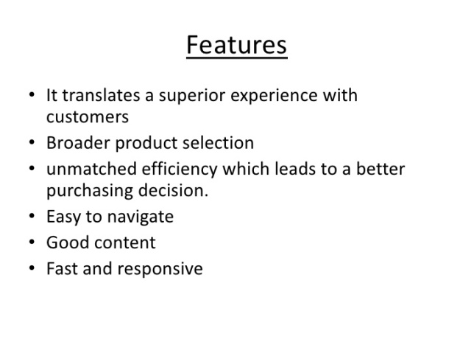
Myntra.com
Myntra.com is an Indian online shopping store of fashion and casual lifestyle products, headquartered in Bangalore. Myntra was established by Mukesh Bansal, Ashutosh Lawania, and Vineet Saxena in February 2007. All three are IIT alumni.

Slide 17
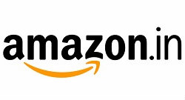
Amazon.in
Amazon.in is the indian version of internationally accepeted online retailer giant amazon.com. They are the largest online retailer, having the biggest collection in earth. Their headquarters in india is situated at Bangalore, Karnataka. They started their operations in india since 2012 february. Amazon launched with books and movies & TV and then expanded their offerings to include kindle of E-readers,Tablets and ebooks; computer accessories; Mobiles & accessories; Cameras & Photography And portable media players.

Slide 18

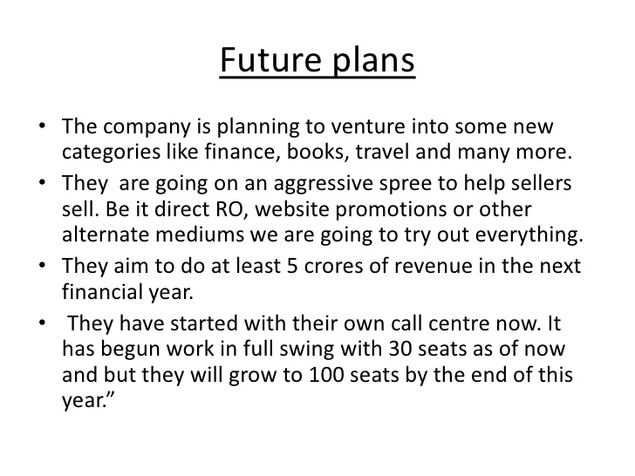
Naaptol
One another online shopping portal in india. Established in 2008. This is one of india’s largest shopping portal based on comparison. naaptol started its operation as product research and price comparison engine.

Slide 19
Novelty
Responsive Web Design
The Internet took off quicker than anyone would have predicted, growing like crazy. Now, for the past few years, mobile growth has exploded onto the scene. The growth of mobile Internet usage is also far out pacing that of general Internet usage growth.These days it is hard to find someone who doesn’t own a mobile device, or multiple, connected to the Internet. In the UK there are more mobile phones than people, and should trends continue mobile Internet usage will surpass that of desktop Internet usage within the year.

Slide 20
Powerful search & navigation
When visiting your online store, customers are facing a huge database of hundreds if not thousands of your products, so without sales associates, signs or reference products that you find in a physical store, you need to rely heavily on the power & intelligence of your search box. Amazon has a very powerful on-site search & navigation that offers relevant product suggestions, corrects your spelling mistakes, offers synonymous results (cellphone and mobile), and filters that help you fine-tune your search (by size, brand, price range etc).
Search Box
A visible search box placed in the top navigation menu or in the top right-hand corner of every page of your site is a must. You should make it as easy as possible for your customers to quickly find what they need without having to browse the entire site.

Slide 21
Facebook Integration
Facebook is a market of nearly 1 billion people. That’s the biggest market on the internet which is completely free for anyone to access. But many don’t seem to realise that.
It’s so easy for something to go viral on Facebook. And this is because whenever a Facebooker “likes” something or “shares” something on your site, it goes out to all their friends and subscribers. If the title and thumbnail of that link is enticing enough, a lot of their friends will click on it. Even if it’s not that enticing, someone will click on it.
Easy to navigate

Slide 22
Large, plentiful and detailed product images
Nothing beats holding a product in your own hands to feel confident in your purchasing decisions. So to counteract this possible friction point, Zappos places huge importance on their images by providing large, high-quality images of each product, at every angle, with the ability to zoom in to such detail that you almost feel like you're touching it. Additionally (and amazingly) they also provide videos of people interacting with the products to get a feel for it in 3 dimensional space.
Use of quality photography
Ecommerce is all about buying with your eyes, as most of the time you won't get to see or touch the real thing until it's been delivered. Having plenty of photos is a guaranteed way to attract more business, so plan a product page layout in mind. Will you have a product slide show? Or tiled thumbnails. Just as important is the quality of these images, as blurry or pixelated photos will be a major put off as well as bringing down the quality of the site.

Slide 23
Thank you

