Slide 1
Probabilistic Topic Models Tutorial: NLP Summer School IIT Kharagpur Jun 19 2017
Indrajit Bhattacharya
Senior Scientist
Data and Decision Sciences Department
TCS Innovation Labs

Slide 2
Plan for today
Why topic models?
What can topic models do?
What are topic models?
How does one use (and extend) topic models?
How do algorithms find topics using topic models?

Slide 3
WHY topic models?

Slide 4
Analyzing Text Data: Motivation
Dream: Capturing all of documented human knowledge in a compact structured format and using it for reasoning
Open Domain Question Answering: IBM’s Watson in Jeopardy
Passing Exams: Aristo, Euclid Projects at the Allen Institute for AI
Significantly more knowledge available as unstructured text than in structured tables
How do we create structure from text documents?

Slide 5
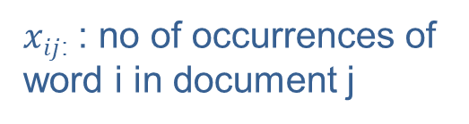

Naïve Structure from Text
Bag of words representation
Why does this not work?
words
m
n
documents
$$X$$
$xij$: : no of occurrences of word i in document j

Slide 6
Text Data: Characteristics
Large no of (not independent) dimensions
Formal vocabulary: > 250K words in OED
Informal vocabulary: typos, abbreviations, slangs
Domain specific: >14K diseases, ~2M recorded species
Dependence among dimensions: Synonymy, Polysemy
Sparse nature
Very few distinct words in individual documents
Twitter: 140 characters!
Naive search using “cricket” will not retrieve documents mentioning “T20” or “ODIs” or “Kohli”…
… but will retrieve documents about a certain insect

Slide 7
Text Data: Characteristics
Very Large corpora
WWW: 30 trillion pages indexed by Google
Facebook: 750 million comments per day
Twitter: 500 million tweets per day
Wikipedia: 45 million pages
NYT: 13 million articles
Great for statistical analysis (if the algorithms scale…)

Slide 8
Extracting Structure from Text
Knowledge Graphs, Ontologies
Handcrafted
WordNet, OpenCyc, WikiData, Freebase, …
Automated
Google Knowledge Graph/Vault, NELL, …
Statistical Models of Text Corpora / Topic Models

Slide 9
Latent Dirichlet Allocation (LDA)
Blei, Ng, Jordan, Latent Dirichlet Allocation, Journal Machine Learning Research, 2003
~19K citations (7.5K in Dec 2013, 4K in Dec 2011,…)
Numerous applications
Document Analysis and Natural Language Processing,
Image Processing and Computer Vision,
Social Network Analysis, Music Analysis, Biology …
Still multiple papers in leading conferences every year

Slide 10
Applications of topic models

Slide 11
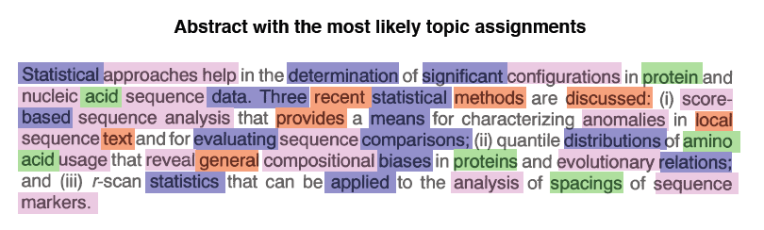
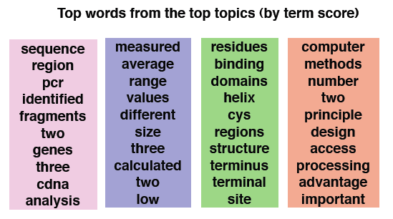
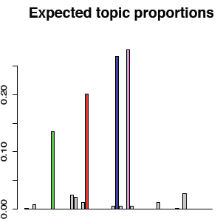
Example: Topics in a ‘Science’ Paper
statistics
genomic sequences
binding sites
computer algorithms
Blei 2009

Slide 12
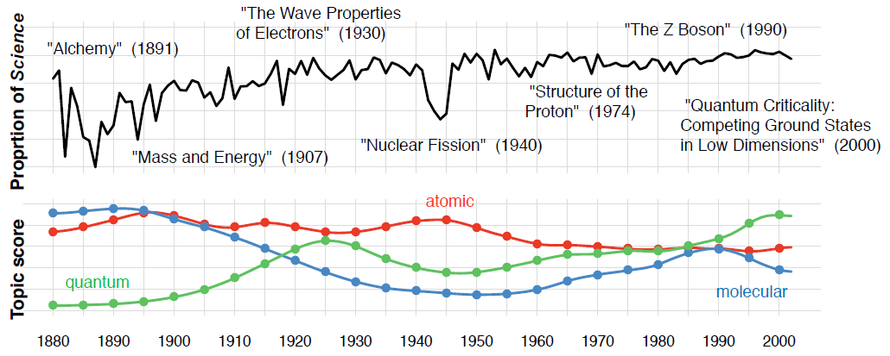
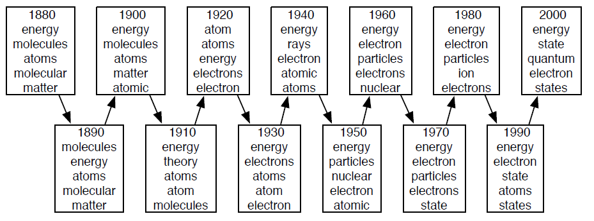
Example: Topic Evolution over Time
Science Archive (1880-2002)
Blei 2009
12

Slide 13
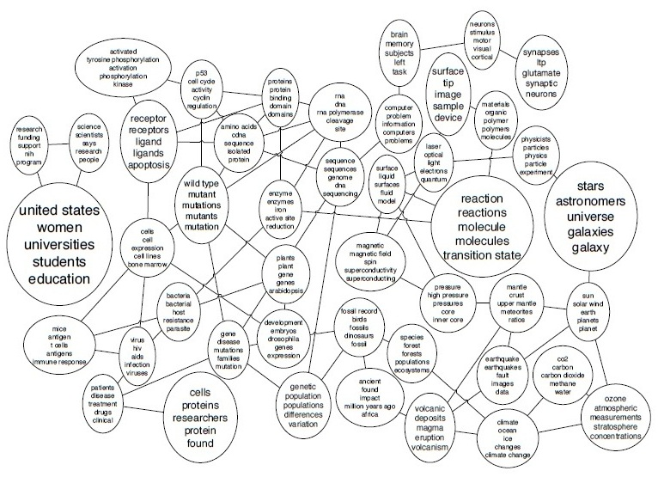
Example: Correlated Topics
Science (1990-1999)
Blei 2009

Slide 14
Example: Sentiments in Product Reviews
battery, charge, batteries, alkaline, shutter, door, charger, casing, aa, life
long, good, great, high, easy, lasting, ever, best, impressive, fine
clear, great, loved, amazing, crystal, excellent, good, brilliant, high, happy
images, clarity, camera, brightness, focus, pics, autofocus, quality, shots, video
0.45
0.9
Battery
Portability
Image Q.
0.1
ease, portability, size, lightweight, travel, straps, camera, design, trips, carry
0.55
terrible, troubling, unhappy, never, tough, short, awful, disappointing, last
awful, unclear, pathetic, never, useless, low, expect, least, ok, blurry
0.3
0.7
great, easy, carry, little, light, good, recommend, liked, use, carried
tough, heavy, carry, bad, huge, awful, less, never, limited, bulk
Lakkaraju 2011

Slide 15
Example: Multilingual News Analysis
research, technology, management training, science, education, Bengal, knowledge, India system
তথ্য সরকারি রাজ্য সংক্রান্ত কলকাতা দফতরের কেন্দ্রীয় অভিযোগ সরকার রাজ্যের
Politics.
Politics.
Congress, party, minister, singh, CPM, BJP, sabha, MPs, Left, government
সাংসদ বিজেপি প্রশ্ন সংসদে
কমিটির দলের বিরুদ্ধে কথা সংসদের
সাংসদদের
State Govt
Higher Edu.
World, France cup, Zidane, final, Italy, French, sports, match, team
জিদান জিদানের বিশ্বকাপ ফ্রান্স ফ্রান্সের ফুটবল ফরাসি ম্যাচ জিদানকে গোল
Cent, business crore, market bank, companies, company, services, million, industry
Districts
জেলা নিজস্ব সংবাদদাতা পুলিশ অভিযোগ এলাকায় জেলার স্থানীয় এলাকার গ্রামে
Football WC.
Football WC.
Business
Telegraph
Anandabazar
Dubey 2011

Slide 16
What are topic models?

Slide 17


Text Data
Document Corpus:
Sequence of M documents
Document is sequence of N_{i} words
Observed variables:
$Xij$ takes values from finite vocabulary of V words
This is the first document …
This second one comes next …
The last document comes at the end …
$$X=\{X_{11},…,X_{1n_{1}},…,X_{m1},…,X_{mn_{m}}\}$$

Slide 18
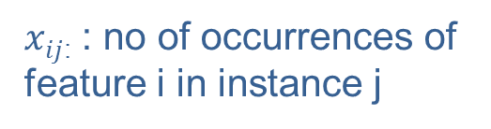
Beyond Text: Discrete Data
m
n
X
$xij$: : no of occurrences of feature i in instance j
Bag of words representation
Transactional data, movie ratings, images, graphs…

Slide 19
Latent Variable Models: Basic Intuition
k
m
m
k
θ
n
X
≈
n
Φ
×
prob of topic in doc
#occ of word in doc
prob of word in topic
Embed documents in lower dimension ‘topic’ space

Slide 20
Latent Variable Models: Basic Intuition
Cricket (sport)
Insects
Cricket
Kohli
…
Cricket
Moth
…
Embed documents in lower dimension ‘topic’ space
Topic: “Combination” of word dimensions
Brings together “related” words
Document: “Combination of topics”
Perform tasks in the topic space

Slide 21
Non-probabilistic Topic Models
Latent Semantic Analysis / SVD for discrete data
Categorical PCA
Non-negative Matrix Factorization

Slide 22
Why Probabilistic?
Interpretability
Priors for limited data settings
Model selection
Modularity
Standard techniques for learning / inference
(Because we can ☺)

Slide 23
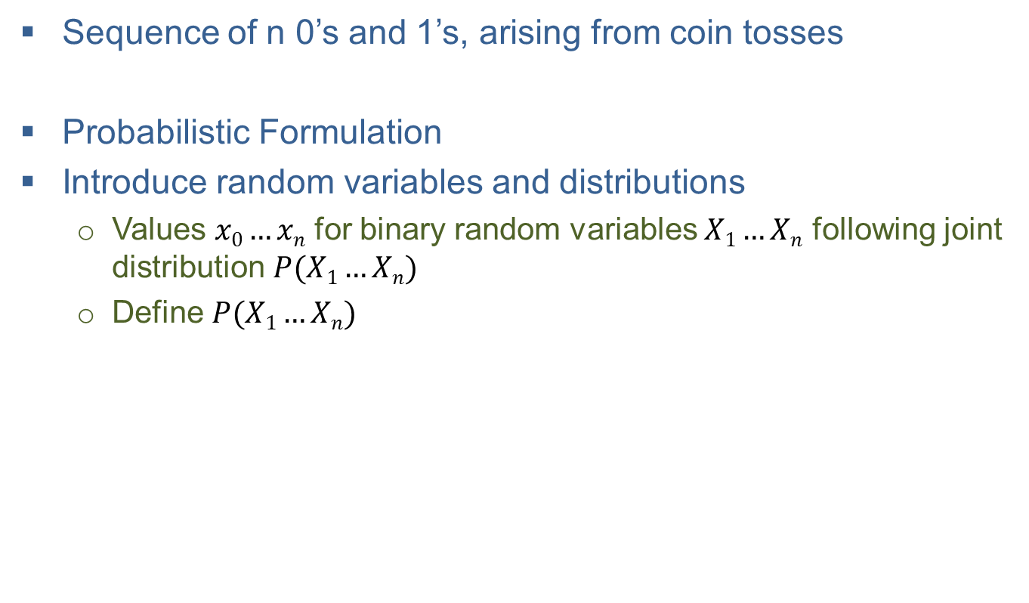
Basics: Probabilistic Formulation
Sequence of n 0’s and 1’s, arising from coin tosses
Probabilistic Formulation
Introduce random variables and distributions
Values $x0…xn$ for binary random variables $X1…Xn$ following joint distribution $P(X1…Xn)$
Define $P(X1…Xn)$

Slide 24

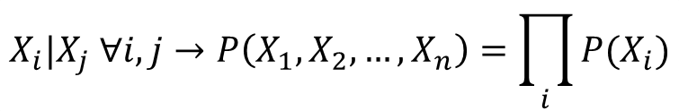

Basics: Probability Model
Assume appropriate independences
Assume distribution family
Assume identically distributed
$$X_{i}|X_{j} ∀i,j→P\left(X_{1},X_{2},…, X_{n}\right)=\prod_{i}{P(X_{i})}$$
$$X_{i}∼Ber\left(p_{i}\right)∀i$$
$$p_{i}=p∀i$$

Slide 25
Basics: Graphical Model / Plate Notation
Nodes: Random Variables
(Missing) Edges: Conditional Independences
X₁
X₂
X₃
X_{n}
No assumptions
X₁
X₂
X₃
X_{n}
Independent
p
X_{i}
Independently and
Identically distributed
n

Slide 26

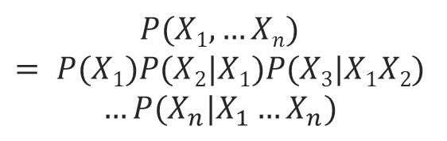

Basics: Factorization
Graphical model ≡ Factorization of joint distribution
$$P(X1,…Xn)$$
$$= P(X1)P(X2|X1)P(X3|X1X2)$$
$$…P(X_{n}|X_{1}…X_{n})$$
X₁
X₂
X₃
X_{n}
X₁
X₂
X₃
X_{n}
$$P(X1;p1)…P(X_{n};p_{n})$$
p
X_{i}
$$P(X1;p)…P(X_{n};p)$$
n

Slide 27
Basics: Generative Process
Generative Process: Sample from joint distribution
Directed graphical models ≡ Generative process
X₁
X₂
X₃
X_{n}
For each position i
Sample X_{i} from P(X_{i}|X₁…X_{i-1})
X₁
X₂
X₃
X_{n}
For each position i
Sample X_{i} from P(X_{i};p_{i})
p
X_{i}
For each position i
Sample X_{i} from P(X;p)
n

Slide 28
Probabilistic LVMs for Discrete Data
Probabilistic Latent Semantic Analysis (Hofmann 99)
Inference of population structure using multilocus genotype data, (Pritchard 00) (>19K citations)
Discrete PCA (Buntine 04) & exp. family PCA (Collins 02)
Latent Dirichlet Allocation (Blei 03)
Gamma Poisson Model (Canny 04)

Slide 29

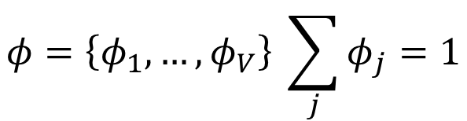
Unigram Model
Coin toss model for V-dimensional discrete random variables
Generate each word in each doc by tossing a ‘topic coin’
$$φ=\left\{φ_{1},…,φ_{V}\right\} \sum_{j}{φ_{j}=1}$$
X
N
M
Φ

Slide 30
Unigram Model: Properties
Problems:
Word order does not matter, even across documents
Single topic for entire corpus
No distinction between documents

Slide 31



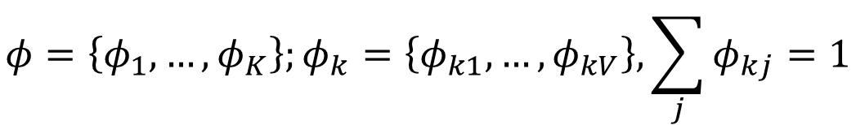
Mixture of Unigrams
Assume K topics
Corpus specific mixture over topics θ
Document specific choice of topic $Zi$
$$φ=\left\{φ_{1},…,φ_{K}\right\};φ_{k}=\left\{φ_{k1},…,φ_{kV}\right\}, \sum_{j}{φ_{kj}=1}$$
Z
θ
X
$$φ$$
N
M

Slide 32
Mixture of Unigrams: Properties
Improvement
Sensitive to moving words across documents
Issues
Exactly one topic for each document

Slide 33

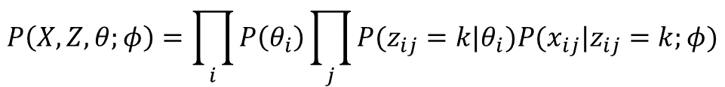
Probabilistic Latent Semantic Analysis (pLSA)
Allow multiple topics for each document
Document specific mixture over topics θ_{i}
Word specific choice of topic $Zij$
Admixture model
θ
Z
$$P\left(X,Z,θ;φ\right)=\prod_{i}{P\left(θ_{i}\right)\prod_{j}{P(z_{ij}=k|θ_{i})P(x_{ij}|z_{ij}=k;φ)}}$$
W
Φ
N
M

Slide 34
pLSA: Properties
Improvement
Allows multiple topics for each document
Issues:
No generative process for mixture of topics: No (principled) way to deal with new unseen documents
No. of parameters grows (linearly) with no. of docs

Slide 35
LDA: Generative Process
Generative process for topic mixture for each document
Generative process for each topic
θ
α
Z
η
W
Φ
N
T
M

Slide 36
LDA: Generative Process - Example
Topic 1
Topic 2
money 0.40 bank 0.40 loan 0.20
river 0.60 bank 0.30 stream 0.10
1.0
0.0
0.5
0.5
0.0
1.0
money
bank
loan
money
bank
bank
river bank stream
bank river river
stream bank
bank money
money loan
river loan stream
bank money
Doc 1
Doc 2
Doc 3
Steyvers 2007

Slide 37
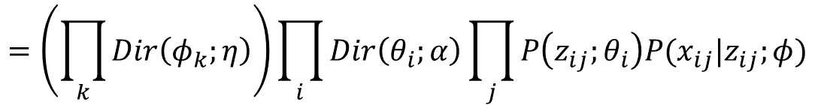

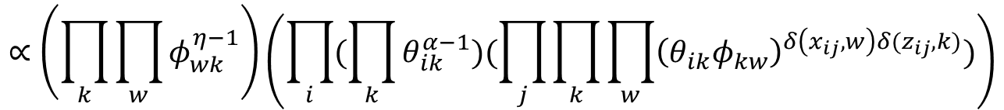
LDA: Joint Distribution
Place a prior over topic mixture variable
Dirichlet Prior
Similar prior over topic distributions Φ_{k}
$$P\left(Z,θ,X,Φ;α,η\right)$$
$$=\left(\prod_{k}{Dir\left(φ_{k};η\right)}\right)\prod_{i}{Dir\left(θ_{i};α\right)\prod_{j}{P\left(z_{ij};θ_{i}\right)P(x_{ij}|z_{ij};φ)}}$$
$$∝\left(\prod_{k}{\prod_{w}{φ_{wk}^{η−1}}}\right)\left(\prod_{i}{(\prod_{k}{θ_{ik}^{α−1}})(\prod_{j}{\prod_{k}{\prod_{w}{{\left(θ_{ik}φ_{kw}\right)}^{δ\left(x_{ij},w\right)δ(z_{ij},k)}}}})}\right)$$

Slide 38
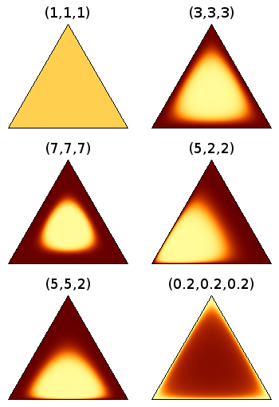

LDA: Role of Dirichlet Prior
Lighter = higher density
$$p\left(θ\right)∝θ_{1}^{α_{1}−1}θ_{2}^{α_{2}−1}…θ_{K}^{α_{K}−1}$$
Image from http://cs.stanford.edu/~ppasupat/a9online/1080.html

Slide 39
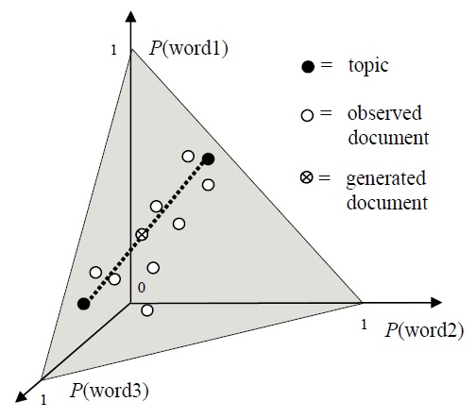
LDA: Geometric Interpretation
Steyvers 2007

Slide 40
LDA: Exchangeability
Exchangeable set of random variables
Any permutation of assignment has the same probability
Words are exchangeable within a document
(Documents are also exchangeable within a corpus)
Theorem (de Finetti):
Joint distribution of a document must take the following form

Slide 41
Part II: Analysis using LDA

Slide 42
Resources: Implementation
LDA-C: Princeton
Mallet: UMass
LDA in R: Princeton
Matlab TM Toolbox: UCI
Python (ScikitLearn)
Multi-threaded: Nallapati
pLDA: Google
Online: Princeton
Hadoop: Yahoo!
Apache Spark
Vowpal Wabbit

Slide 43

Output of LDA
Estimates of topic distributions $φ_{k}$,
Estimates of document-specific topic mixtures $θ_{i}$
Estimates of word-specific topics $z_{ij}$
Topic 1
Topic 2
money 0.40 bank 0.40 loan 0.20
river 0.60 bank 0.30 stream 0.10
1.0
0.0
0.5
0.5
0.0
1.0
money
bank
loan
money
bank
bank
river bank stream
bank river river
stream bank
bank money
money loan
river loan stream
bank money
Doc 1
Doc 2
Doc 3

Slide 44
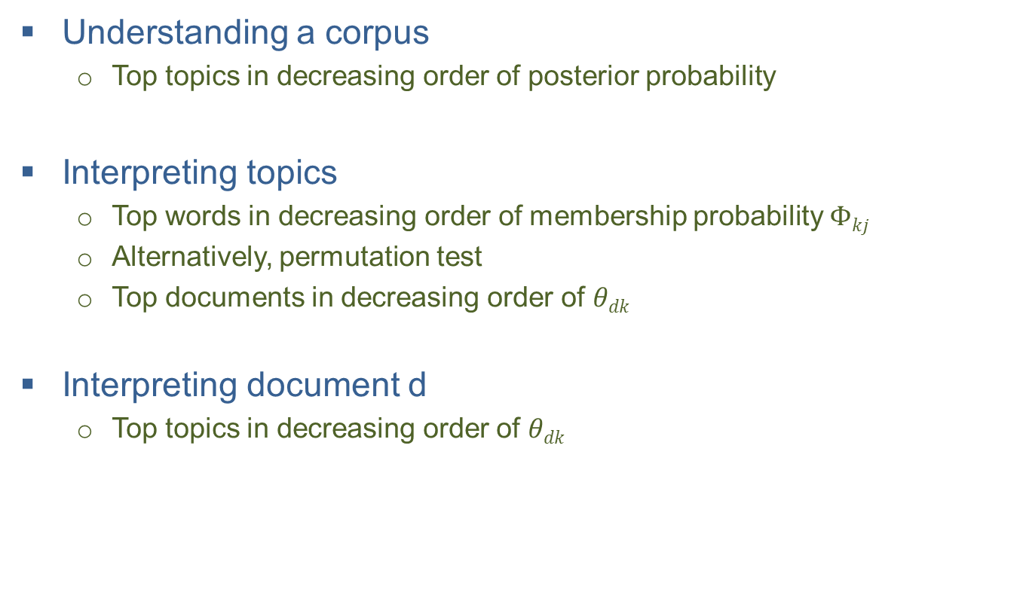
Analyzing a Corpus
Understanding a corpus
Top topics in decreasing order of posterior probability
Interpreting topics
Top words in decreasing order of membership probability $Φkj$
Alternatively, permutation test
Top documents in decreasing order of $θdk$
Interpreting document d
Top topics in decreasing order of $θdk$

Slide 45
Interpreting Topics
Bad news (as should be expected…)
Human interpretability of topics often negatively correlated with generalization ability (Chang 09)
Labeled LDA (Ramage 09)
Force mapping between topics and labels assigned to documents
Subset of topics observed for each document: constrain topic labels for document to come from this fixed set

Slide 46
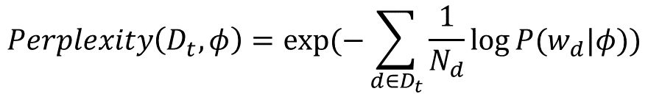
Evaluating Performance
Perplexity for test corpus
Measure of how badly model fits test corpus
Lower values better
$$Perplexity\left(D_{t},φ\right)=exp⁡(−\sum_{d∈D_{t}}{\frac{1}{N_{d}}\log{P(w_{d}|φ)}})$$

Slide 47
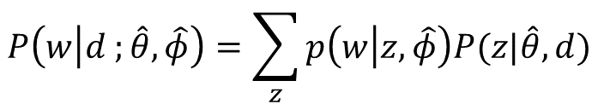
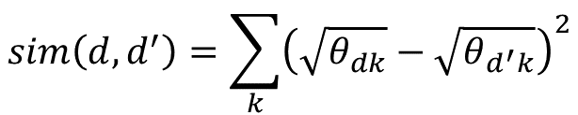
Analysis using LDA: IR
Ranking documents given query document
Ranking documents given query word (Wei 06)
Similarly, ranking words given a query word
$$sim\left(d,d^{′}\right)=\sum_{k}{{\left(\sqrt{θ_{dk}}−\sqrt{θ_{d^{′}k}}\right)}^{2}}$$
$$P\left(w | d ;\hat{θ},\hat{φ}\right)=\sum_{z}{p\left(w | z,\hat{φ}\right)P(z|\hat{θ},d)}$$

Slide 48
Analysis using LDA: Classification
Use topic representation instead of words (Blei 03)
Discriminative LDA (Lacoste-Julien 08)
Supervised LDA (Blei 07)

Slide 49
Analysis using LDA: Author Interests
Topical Interests of authors
Given documents labeled with authors
Analyze author’s topic preference
Author Topic Model (Rosen-Zvi 04)
Sample author for each word in document
Sample topic from author specific topic distribution

Slide 50
Analysis using LDA: Topic Correlations
Topic Correlations
For any two topics, proportion of co-occurring documents
Dirichlet distribution does not have independent covariance parameters
Correlated Topic Model (Blei 05)
Logistic normal prior with full covariance matrix

Slide 51
Analysis using LDA: Topic Correlations
Topic Correlations
For any two topics, proportion of co-occurring documents
Dirichlet distribution does not have independent covariance parameters
Pachinko Allocation (Li et al 2006)
DAG structure to define mixtures over topics

Slide 52
Analysis using LDA: Trends over Time
Topics over time
Use document time stamps to solve multiple (independent) LDA problems; plot θ_{d}(t), φ_{k}(t)
Assumes independence between φ(t) and φ(t+1)
Dynamic Topic Model (Blei 06)
Markov independence between parameters of logistic normal prior

Slide 53
Analysis using LDA: Predicting Citations
Predicting Citations
Use topic space for prediction
Relational Topic Models (Chang 09)
Explicitly model citation variable as function of topics of document pairs

Slide 54
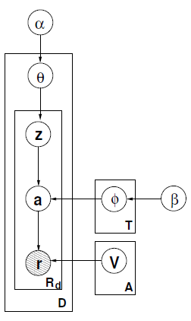
Analysis using LDA: Author Resolution
Entity Resolution
Use topical interests to determine if two author names correspond to the same author
LDA-ER (Bhattacharya 05)
LDA: Topic mixtures independent of author names
ATM: Topic mixtures distinct for different author names and identical for same author names
Additional (unobserved) layer to distinguish authors from names

Slide 55
INFERENCE for LDA

Slide 56
LDA: Inference and Learning
Topic 1
Topic 2
?
?
?
?
?
?
?
?
money bank loan bank money money loan
money bank bank river loan stream bank money
river bank stream bank river river stream bank
Doc 1
Doc 2
Doc 3

Slide 57
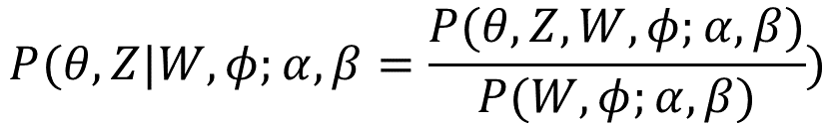

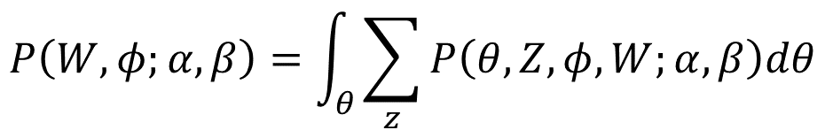
LDA: Inference Problem
Given topics
Determine topic mixture for each document
Determine topic for each word
Inference is hard (in general) for LDA (Sontag 11)
Intractable due to coupling between $θ$ and $φ$
$$P(θ,Z|W,φ;α, β=\frac{P(θ,Z,W,φ;α,β)}{P(W,φ;α,β)})$$
$$P\left(W,φ;α,β\right)=\int_{θ}{\sum_{z}{P\left(θ,Z,φ,W;α,β\right)dθ}}$$

Slide 58
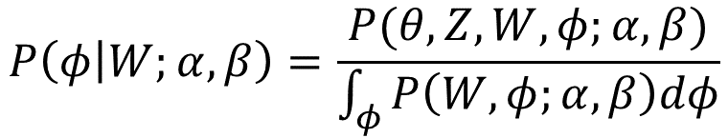
LDA: Learning problem
Given corpus, determine K topics
Involves inference as a sub-task
Learning is hard, polytime under restrictions (Arora 12, Anandkumar 12)
$$P\left(φ | W;α,β\right)=\frac{P(θ,Z,W,φ;α,β)}{\int_{φ}{P\left(W,φ;α,β\right)dφ}}$$

Slide 59
Algorithms for LDA
ML EM (Hofmann 99), MAP EM (Chien 08)
Collapsed Gibbs Sampling (Griffiths 04)
Variational Bayes (Blei 03)
Collapsed Variational Bayes (Teh 06)
Stochastic Collapsed Variational Bayes (Foulds 15)
Tensor Factorization (Arora 12; Anandkumar 12)
Neural variational inference (Srivastava 17)
…
Unified view and comparison (Asuncion 09)

Slide 60
Monte Carlo Inference
Prediction is an integration operation
Monte Carlo Integration: Law of Large numbers
Assumption: Possible to draw samples from p(θ)

Slide 61
Markov Chain Monte Carlo & Gibbs Sampling
Set up (homogeneous) ergodic Markov Chain Kernel for which p(θ) is the stationary distribution
Ensures that in the limit samples will be from p(θ)
Gibbs Sampling Transition Kernel
Assume efficient sampling from conditional distributions
Nice asymptotic theoretical properties
Many practical issues, e.g. “mixing time”

Slide 62
Collapsed Gibbs Sampling
Integrate out continuous variables when possible
Empirically often mixes faster than uncollapsed sampler

Slide 63

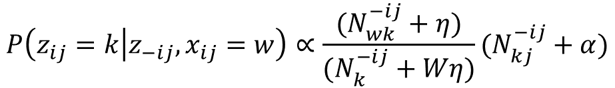
Collapsed Gibbs Sampling for LDA
Collapse the θ and Φ variables by integration
Sample z_{ij} from conditional distribution given all z’s
$$P\left(z_{ij}=k | z_{−ij},x_{ij}=w\right)∝\frac{(N_{wk}^{−ij}+η)}{(N_{k}^{−ij}+Wη)}(N_{kj}^{−ij}+α)$$

Slide 64
Collapsed Gibbs Sampling for LDA
Reject initial samples (Burn in period)
Sample topics to estimate posterior distribution
Detecting convergence is tricky!
(Randomly) Initialize topic
Initialize <W,T> and <D,T> counts
Repeat until convergence
For each word of each document
Sample new topic from conditional distribution
Update <W,T> and <D,T> counts

Slide 65


Estimating Topics from Samples
Estimate topics from topic assignment to words
Conditional expectation given samples
$$φ_{t}^{j}=\frac{n_{ij}^{WT}+β}{\sum_{k}{n_{ij}^{WT}+Wβ}}$$
$$θ_{j}^{d}=\frac{n_{dj}^{DT}+α}{\sum_{k}{n_{dk}^{DT}+Tα}}$$

Slide 66
Setting Hyper-parameters
Cross validation
Optimize over hyperparameters η and α
Fixed point update such as Newton Raphson
Empirical Bayes

Slide 67
Setting number of topics
Cross Validation
Use non parametric priors: eg HDP (Teh 06)

Slide 68
Parallel and Online Algorithms
Uncollapsed GS and VB can be readily parallelized
(Newman 09, Smola 10)
Online GS: no guarantees (Canini 09)
Online VB (Hoffman 10)

Slide 69
Exploiting Sparsity
All documents do not contain all topics
All topics do not contain all words
Exploit sparsity to speed up sampling algorithms
MCMC (Yao 09, Li 14)
Stochastic Variational (Mimno 12)

Slide 70
Topic Modeling: Research Directions

Slide 71
Topics Models meet Deep Learning
Traditional Variational Inference
Approximate posterior distribution with a simpler variational distribution
Neural variational inference (Srivastava 17, Miao 17, Cong 17)
Parameterize variational distribution with a deep neural network
Bayesian Deep Learning, NIPS 2016 Workshop

Slide 72
Topic Models meet Knowledge Graphs
How do we define topics given background knowledge represented as knowledge graphs?
Define topics using the KG structure (Hu 16)
Define topics using embeddings of KG nodes (Yao 17)

Slide 73
References
T. Hofmann. Probabilistic latent semantic analysis. UAI, 1999.
J. Pritchard, M Stephens, P Donnelly, Inference of population structure using multilocus genotype data, Genetics, 2000
M. Collins, S. Dasgupta, and R. E. Schapire. A generalization of principal component analysis to the exponential family. NIPS, 2002.
D. Blei, A. Ng, and M. Jordan. Latent dirichlet allocation. JMLR, 2003.
W. Buntine and A. Jakulin. Applying discrete pca in data analysis. UAI, 2004.
J. Canny. Gap: A factor model for discrete data. SIGIR, 2004.
M. Rosen-Zvi, T. Griffths, M. Steyvers, and P. Smyth. The author-topic model for authors and documents. UAI, 2004.
T. Griffiths and M. Steyvers. Finding scientific topics. PNAS, 2004.
D. Blei and J. Lafferty. Correlated topic models. NIPS, 2005.
D. Blei and J. Lafferty. Dynamic topic models. ICML, 2005.
I. Bhattacharya and L. Getoor. A latent dirichlet model for unsupervised entity resolution. SDM, 2005.
W Li and A McCallum, Pachinko allocation: DAG-structured mixture models of topic correlations, ICML 2006
X. Wei and W. Croft. Lda-based document models for ad-hoc retrieval. SIGIR, 2006
Y. Teh, D. Newman, and M. Welling. A collapsed variational bayesian inference algorithm for latent dirichlet allocation. NIPS, 2006.
Y Teh, M Jordan, M Beal, D. Blei, Hierarchical Dirichlet Process, JASA 2006

Slide 74
References
M. Steyvers and T. Griffiths. Probabilistic topic models, 2007
D. Blei and J. McAuliffe. Supervised topic models. NIPS, 2007.
J. Chien and M. Wu. Adaptive bayesian latent semantic analysis. IEEE Trans on Audio, Speech, and Language Processing, 2008.
S. Lacoste-Julien, F. Sha, and M. Jordan. Disclda: Discriminative learning for dimensionality reduction and classification. NIPS, 2008.
D. Blei and J. Lafferty. topic models. In Text Mining: Classification, Clustering, and Applications, 2009.
D. Newman, A. Asuncion, P. Smyth, and M. Welling. Distributed algorithms for topic models. JMLR, 2009.
J. Chang and D. Blei. Relational topic models for document networks. AISTATS, 2009.
D. Ramage, D. Hall, R. Nallapati, and C. Manning. Labeled lda: A supervised topic model for credit attribution in multi-labeled corpora. EMNLP, 2009.
K. Canini, L. Shi, and T. Griffiths. Online inference of topics with latent dirichlet allocation. AISTATS, 2009.
L. Yao, D. Mimno, and A. McCallum. Efficient methods for topic model inference on streaming document collections. KDD’09
A. Smola and S. Narayanamurthy. An architecture for parallel topic models. VLDB, 2010.
M. Hoffman, D. Blei, and F. Bach. Online learning for latent dirichlet allocation. NIPS, 2010.
H. Lakkaraju, C. Bhattacharyya, I. Bhattacharya, and S. Merugu. Exploiting coherence for the simultaneous discovery of latent facets and associated sentiments. SDM, 2011.

Slide 75
References
A. Dubey, I. Bhattacharya, M. Das, T. Faruquie, and C. Bhattacharyya. Learning dirichlet processes from partially observed groups. ICDM, 2011.
D. Sontag and D. Roy. Complexity of inference in latent dirichlet allocation. NIPS, 2011.
S. Arora, R. Ge, R. Kannan, and A. Moitra. Computing a nonnegative matrix factorization - provably. STOC, 2012.
A. Anandkumar, D. P. Foster, D. Hsu, S. Kakade, and Y. Liu. Two svds suffice: Spectral decompositions for probabilistic topic modeling and latent dirichlet allocation. NIPS, 2012.
D. Mimno, M. Hoffman and D. Blei. Sparse stochastic inference for latent Dirichlet allocation. ICML, 2012
M. Hoffman, D. Blei, C. Wang, and J. Paisley. Stochastic variational inference. JMLR, 2013.
A. Li, A. Ahmed, S. Ravi, and A. Smola. 2014. Reducing the sampling complexity of topic models. KDD 2014
Z Hu, G Luo, M Sachan, E Xing, and Z Nie. 2016. Grounding topic models with knowledge bases. IJCAI 2016
A. Srivastava and C. Sutton, Autoencoding variational inference for topic models, ICLR 2017
Yi Miao, E. Grefenstette, P. Blunsom, Discovering Discrete Latent Topics with Neural Variational Inference, ICML 2017
Deep Latent Dirichlet Allocation with Topic-Layer-Adaptive Stochastic Gradient Riemannian MCMC, Y. Cong, B. Chen, H Liu, M. Zhou, ICML 2017
L Yao, Y Zhang, B Wei, Z Jin, R Zhang, Y Zhang, Q Chen, Incorporating Knowledge Graph Embeddings into Topic Modeling, AAAI 2017

Slide 76
Questions? indrajitb@gmail.com

