Slide 1




SMART INDIA HACKATHON 2026
Problem Statement ID – 26058
Problem Statement Title- Development of a Low-Power, Real-Time Adaptive Software-Defined Sonar Transmitter Payload for Autonomous Underwater Vehicles (AUVs)
Theme- Robotics and Drones
PS Category - Hardware
Team ID-
Team Name (Registered on portal) - Project Poseidon

Slide 2
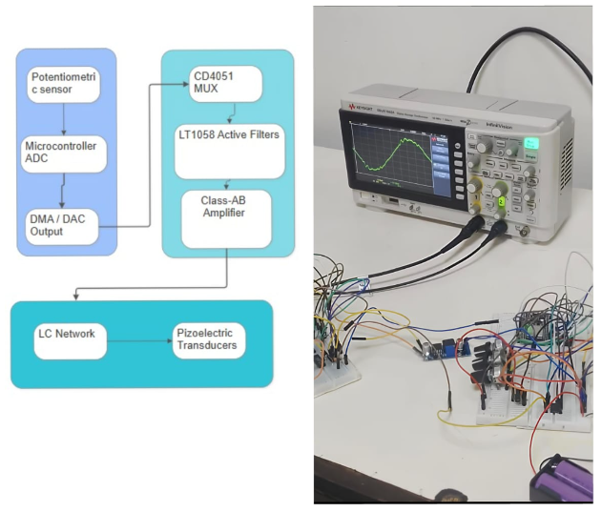
Adaptive Software-Defined Sonar Transmitter for AUVs
Project Poseidon
Flow Diagram
Prototype
Problem Resolution:
Replaces traditional fixed-frequency sonar with a dynamically adaptive SDR-style hardware payload.
Ingests real-time environmental data (turbidity, depth, temperature) to mathematically synthesize and output optimized physical acoustic waveforms on the fly.
Unique Value Propositions:
Modular 3-Mode Architecture: Automatically transitions between LFM Chirp, Geometric Sweep, and Barker-13 Phase-Coded pulses based on water conditions.
Strict Resolution Lock: Bandwidth is dynamically corrected via real-time acoustic velocity calculations to guarantee a 2 cm mapping resolution.
Zero-Latency Execution: Hardware-level Ping-Pong buffering and Direct Memory Access (DMA) ensure continuous transmission without stalling the CPU.
@SIH Idea submission- Template
2
Notes:
2

Slide 3
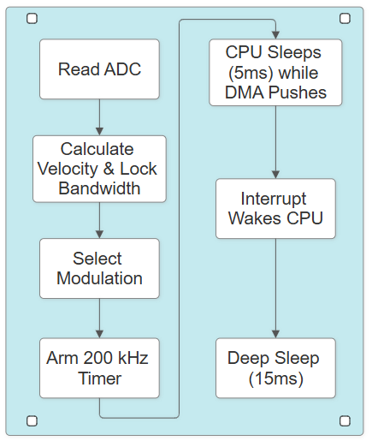
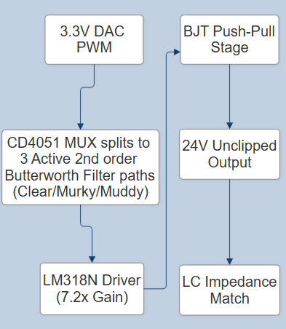
Project Poseidon
TECHNICAL APPROACH
Firmware State Machine
Processing & Synthesis: Microcontroller computes fcenter and Tpulse using Q15 math and LUTs, applying Blackman/Tukey digital windows to a 100-sample buffer.
Power-Optimized Delivery: CPU completely offloads transmission to the DMA and hardware timers (200 kHz ZOH), minimizing active power draw.
Analog Hardware: CD4051 MUX dynamically routes the signal through specialized LT1058 Sallen-Key low-pass filters. The LT1122 and BJT output stage drives a distortion-free 24V peak-to-peak signal into an LC matched transducer.
Analog Signal Pipeline
@SIH Idea submission- Template
3
Notes:
3

Slide 4

FEASIBILITY AND VIABILITY
Project Poseidon
Technical Feasibility: The CPU computes velocity and frequency boundaries well within standard microcontroller limits. Ping-Pong buffering allows background calculation without stalling active DMA transmission.
Execution Timing: Hardware timers strictly enforce the 5 microsec Zero-Order Hold (ZOH) interval, decoupling physical acoustic timing from software overhead.
System Stability: Mathematical hysteresis and Exponential Moving Average (EMA) filtering on the ADC ensure stable logic transitions, preventing chatter around thresholds (e.g., 2.4V Turbidity).
Risk / Challenges
Solutions
Buffer Underrun: DMA finishes before next array is ready. | Map DMA EOF to instantly swap Ping-Pong buffer pointers at the hardware level.
Math Bottlenecks: Float calculations stall CPU. | Utilize fixed-point Q15 math and pre-calculated SRAM Lookup Tables (LUTs).
Slew Rate Limits: Op-Amps fail to track Barker-13 phase inversions. | Pair high-slew Op-Amps (10V/mus) with the Tukey digital window to protect chips.
@SIH Idea submission- Template
4
Notes:
4

Slide 5
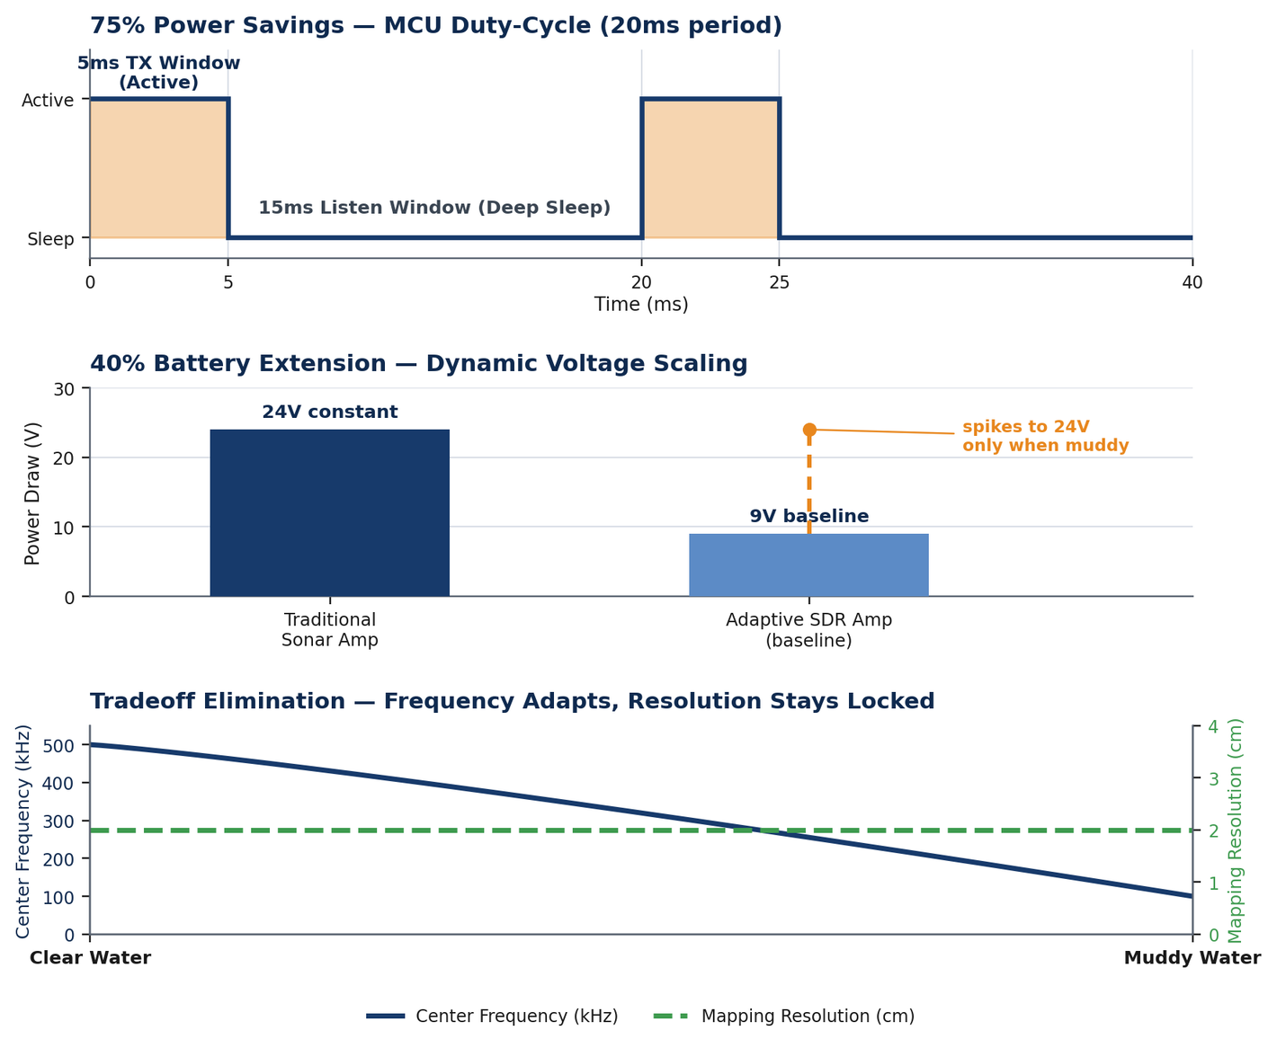
IMPACT AND BENEFITS
Project Poseidon
Solves the Sonar Tradeoff: Dynamic frequency shift (100–500 kHz) adapts autonomously to turbidity while mathematical bandwidth correction locks resolution at 2 cm.
Drastic Power Reduction: CPU deep-sleeps for 15ms every 20ms cycle, yielding a 75% duty-cycle savings. Future Dynamic Voltage Scaling (9V to 24V) projects a 40% battery life extension.
Hardware Longevity: Two-stage analog/digital filtering eliminates sidelobes, and LC impedance matching cancels capacitive reactance, maximizing acoustic output and protecting the transducer.
@SIH Idea submission- Template
5
Notes:
5

Slide 6
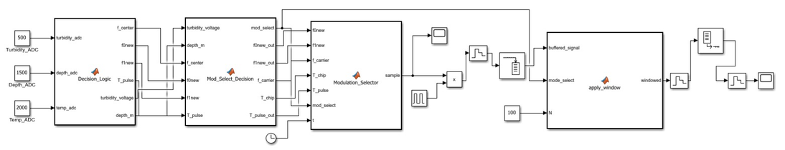
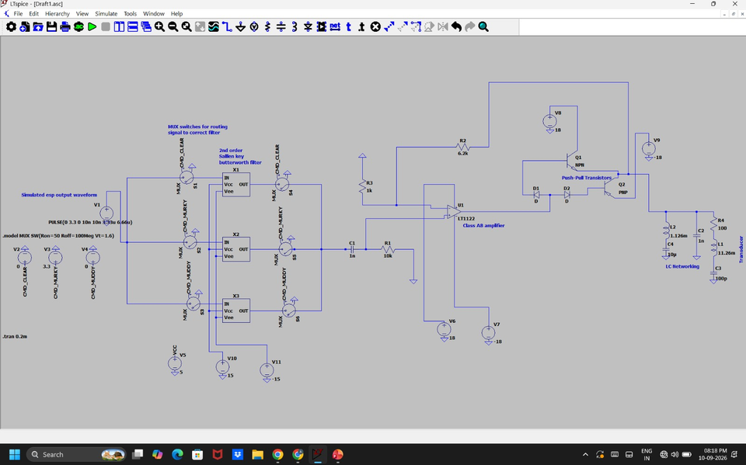
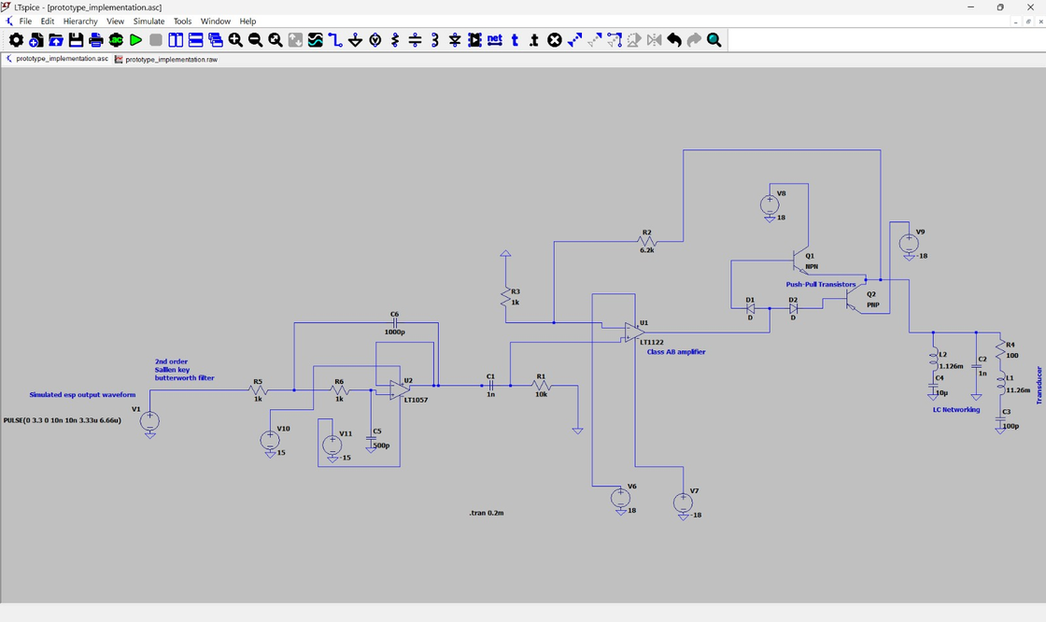
RESEARCH AND REFERENCES
Project Poseidon
Future Scope
Dynamic Voltage Scaling: Future iterations will utilize a digitally controlled DC-DC boost converter tied to a GPIO to dynamically adjust the final amplifier's power supply rail based on environmental conditions, optimizing efficiency.
Ping Pong Buffering: Power Optimization technique that utilizes two buffers to minimize CPU active time and latency issues. Linking them with DMA can remove need of CPU’s manual swap.
References-
An Ultra-Low Power and Flexible Acoustic Modem Design to Develop Energy-Efficient Underwater Sensor Networks
Lump Circuit Modeling and Matching Consideration on Acoustical Telemetry Transmitters
“Analysis of the Sallen-Key Architecture" (SLOA024) - Texas Instruments
@SIH Idea submission- Template
6
Notes:
6

