Slide 1
Milk Production in India: 2001-02 to 2023-24
Summary KPIs, trends, state rankings and anomalies
Generated report

Slide 2
Key Points
Key National KPIs
All‑India milk production (2023-24): 239299 ('000 tonnes)
YoY growth (2022-23 -> 2023-24): 3.78 %
CAGR (2001-02 -> 2023-24): 4.63 % per year

Slide 3
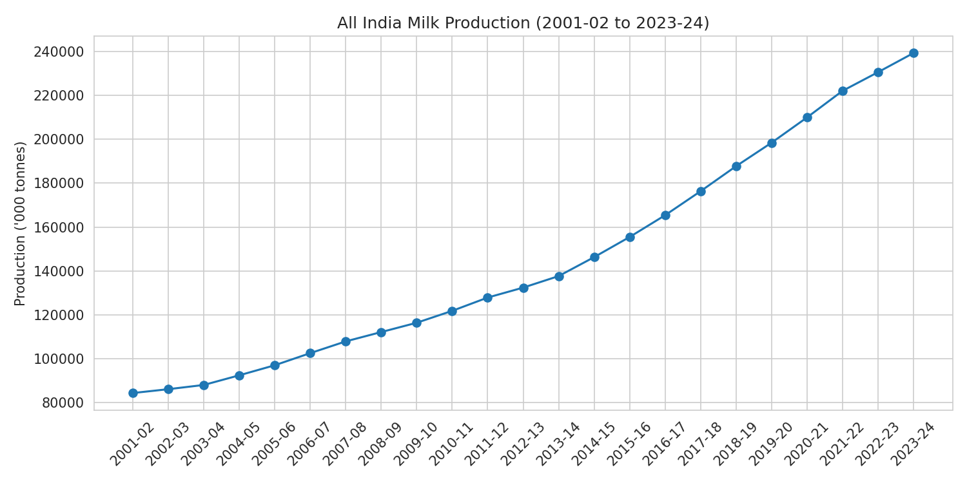
All‑India Trend (2001‑02 to 2023-24)

Slide 4
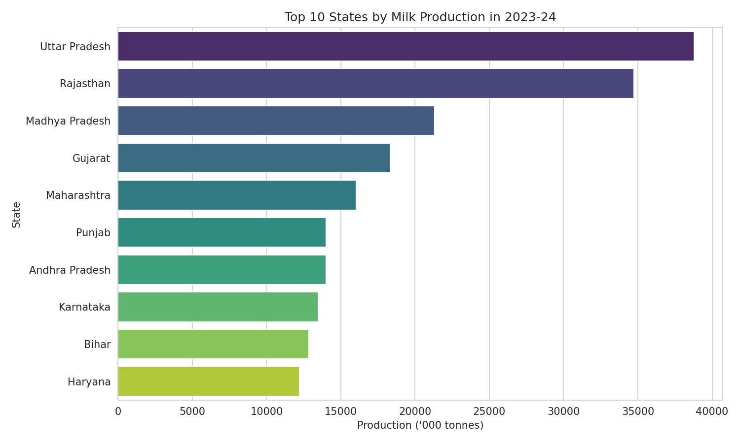
Top 10 States by Production (2023-24)

Slide 5
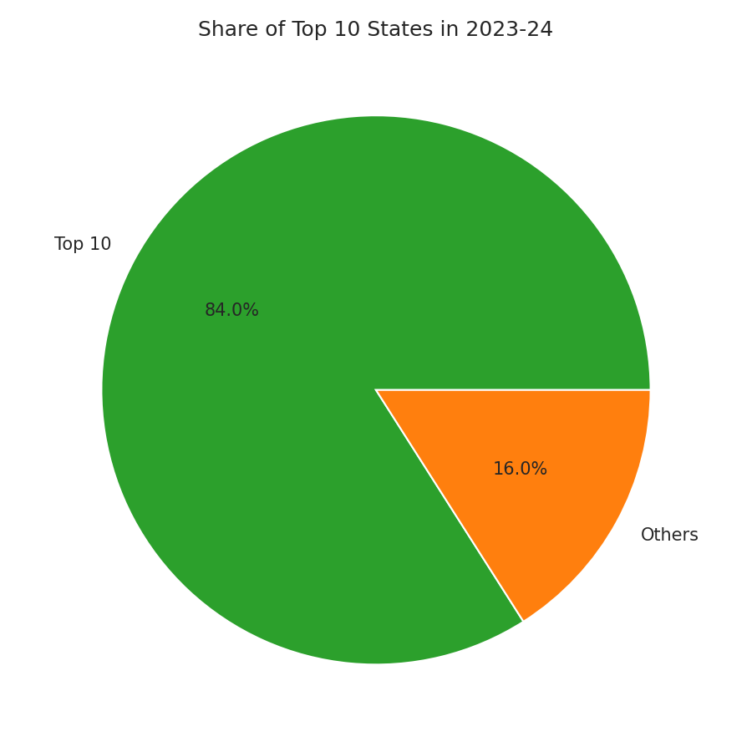
Share: Top 10 vs Others (2023-24)

Slide 6
Top 10 States — Production (2023-24)
State | 2023-24
Uttar Pradesh | 38780.0
Rajasthan | 34733.0
Madhya Pradesh | 21326.0
Gujarat | 18312.0
Maharashtra | 16045.0
Punjab | 14000.0
Andhra Pradesh | 13994.0
Karnataka | 13463.0
Bihar | 12853.0
Haryana | 12220.0

Slide 7
Top states by CAGR (2001-02 -> 2023-24)
State | CAGR
Bihar | 0.0742
Rajasthan | 0.0705
Madhya Pradesh | 0.0655
Jharkhand | 0.0546
Gujarat | 0.0531
Odisha | 0.0485
Karnataka | 0.048
Tripura | 0.047
Chhattisgarh | 0.0457
Uttar Pradesh | 0.0452

Slide 8
Data Quality & Anomaly
1) Rows with unusually large YoY changes (e.g., Arunachal Pradesh, Andhra Pradesh) may be OCR or reporting issues. Confirm against source PDF.
2) Some union territories show decimals or truncated values (Chandigarh 58.87, Ladakh 29.31, Lakshadweep 0.39). Verify source.
3) Top 3 states contribute ~40% of national production — these dominate national trends.

