Slide 1


ICAI · AICITSS – ADVANCED INFORMATION TECHNOLOGY · PROJECT PRESENTATION
GSTiQ
Artificial Intelligence & the Goods and Services Tax Act, 2017
Input Tax Credit (ITC) and Reverse Charge Mechanism (RCM) — an AI-powered suite for a CA office
Scan to open the live app
humaregrouponekaproject.online
Submitted by GROUP ONE
Dudhat Ankur
ICAI Reg. No. WRO0738763
Hariom Bhati
ICAI Reg. No. CRO0694015
Law as on 29-10-2026 · all client data is fictitious
Bharat Lakhnotra
ICAI Reg. No. WRO0752641
Takshil Chodvadiya
ICAI Reg. No. WRO0758843
Notes:
Good morning. We are Group One. Our project is GSTiQ - an AI-powered suite that helps a CA office manage Input Tax Credit and Reverse Charge under the GST Act, 2017. Introduce each member by name. The QR code opens the live web app - the audience can follow the demo on their phones. Tip: during the presentation click 'Menu' at the top-right of any slide to jump back to the agenda.

Slide 2








Agenda — click any tile to jump there
01
02
03
Why this project
The law: ITC & RCM
The solution: GSTiQ
Problems a CA office faces with ITC & RCM
Sec 16, 17(5), 9(3)/9(4), Rules 36–88D, GST 2.0
Architecture, modules, workflow
04
05
06
Artificial intelligence
Data, demo & testing
Conclusion
Six models and how they are used
Dummy data, import/export, quiz, live demo
Benefits and future features
Quick jump
Case quiz
Live demo
Testing
Q & A
Notes:
This agenda is a clickable menu. Click a section title or its icon to jump to that section; the 'Quick jump' buttons go straight to the quiz, the live demo, testing, or Q&A. Every slide has a 'Menu' button (top right) that returns here, so we can answer questions in any order.

Slide 3

Group One — the team behind GSTiQ
Menu
DA
HB
BL
TC
Dudhat Ankur
Hariom Bhati
Bharat Lakhnotra
Takshil Chodvadiya
ICAI Registration No.
WRO0738763
ICAI Registration No.
CRO0694015
ICAI Registration No.
WRO0752641
ICAI Registration No.
WRO0758843
Course
AICITSS – Advanced Information Technology (ICAI)
Topic
AI & GST Act, 2017 – Input Tax Credit & Reverse Charge
Deliverable
GSTiQ web app, Python engine, SQL database, Excel model + VBA, AI notebook, report
Live at
humaregrouponekaproject.online · github.com/Bharat4871/GST-RECO
Notes:
Group One has four members (read names and registration numbers). Suggested split for presenting: Section 1 & 2 (problem and law) - one member; Section 3 (solution and modules) - one member; Section 4 (AI) - one member; Section 5 & 6 (data, quiz, live demo, testing and conclusion) - one member. Change this to match your own division of work.

Slide 4

Why this project
Menu
01
What goes wrong with Input Tax Credit and Reverse Charge in a real CA office — and what we set out to automate.
Notes:
Section 1. We start with the practical problem, then our objectives.

Slide 5




ITC and RCM are checked bill by bill — by hand
Menu
Books never match GSTR-2B
IN OUR DEMO PRACTICE OF 5 CLIENTS
Invoice numbers typed differently, wrong GSTINs, suppliers who file late or not at all.
₹2.41 Cr
Blocked credits hide in ledgers
GST paid on 609 purchase bills
Cars, food, gifts, club fees and construction are claimed by mistake under Sec 17(5).
₹70.22 L
Reverse charge is missed
Freight, legal fees, rent from unregistered landlords, director fees — tax and self-invoice forgotten.
ITC at risk — not in GSTR-2B, unpaid or supplier default
₹85.24 L
Deadlines are unforgiving
Sec 16(4) time limit, Rule 37 (180 days), Rule 37A, DRC-01C notices and interest u/s 50.
ITC already claimed that is not eligible today
Notes:
Four recurring problems. In our own demo dataset of five fictitious clients, GSTiQ found ₹70.22 L of ITC at risk and ₹85.24 L already claimed but not eligible today - exactly the kind of exposure that leads to DRC-01C notices, interest and penalty. Doing this manually for every client every month is slow and error-prone.

Slide 6


Six objectives we set for GSTiQ
Menu
01
02
03
Decide ITC eligibility
Reconcile with AI
Handle RCM end to end
Test every bill against Sec 16, 17(5) and Rules 36(4), 37, 37A — with a reason.
Match books with GSTR-2B even when numbers, GSTINs or dates differ.
Decide applicability, time of supply, cash payment and self-invoice.
04
05
06
Prepare returns
Use AI where it helps
Fit the office workflow
GSTR-3B Tables 3.1(d) & 4, Rule 42/43, set-off, DRC-01C, interest.
Classify expenses, flag anomalies, score vendors, forecast ITC, answer questions.
Import Excel/CSV/portal JSON, export MIS & letters, work fully offline.
Notes:
These six objectives drove every design decision. The rule engine is the authority for legal decisions; AI supports it where the data is messy.

Slide 7
The law: ITC & RCM
Menu
02
The provisions GSTiQ encodes — Sections 16, 17(5), 9(3), 9(4) and the Rules that reverse or restrict credit. Position as on 29-10-2026.
Notes:
Section 2 - the law. Everything here is encoded as data in one knowledge base that both the browser engine and the Python engine read.

Slide 8
Section 16: conditions for taking ITC
Menu
16(2)(a)
Possession of tax invoice or debit note
SECTION 16(4) — TIME LIMIT
30 November
16(2)(aa)
Invoice reflected in GSTR-2B (Rule 36(4))
16(2)(b)
Goods or services actually received
following the end of the financial year, or the annual return if filed earlier. ITC of FY 2025-26 lapses after 30-11-2026 — only 32 days left on 29-10-2026.
16(2)(ba)
ITC not restricted in GSTR-2B (Sec 38)
16(2)(c)
Tax actually paid to Government by supplier
Relief provisions
16(5): FY 2017-18 to 2020-21 ITC allowed up to 30-11-2021.
16(6): ITC on registrations revoked after cancellation.
GSTiQ shows a live countdown for every unclaimed bill.
16(2)(d)
Recipient has filed return u/s 39
2nd proviso
Pay supplier within 180 days, else reverse (Rule 37)
Notes:
Section 16 has the core conditions - including clause (aa), which makes GSTR-2B the gatekeeper, and clause (ba) added later. The 180-day payment rule is in the second proviso, operated by Rule 37. Section 16(4) is the hard time limit: for FY 2025-26 the last date is 30 November 2026. GSTiQ shows this countdown on the dashboard.

Slide 9











Section 17(5): credits that are blocked
Menu
17(5)(a)–(ab)
17(5)(b)(i)
17(5)(b)(ii)
17(5)(b)(iii)
Motor vehicles ≤ 13 seats
Food, beauty, health services, insurance
Club, health & fitness membership
Travel benefits to employees (LTC)
17(5)(c)
17(5)(d)
17(5)(e)
17(5)(fa)
Works contract for immovable property
Own construction incl. plant or machinery*
Supplies taxed under composition
CSR expenditure
17(5)(g)
17(5)(h)
17(5)(i)
How GSTiQ checks
HSN/SAC + narration keywords + usage, with the exceptions (e.g. cement for a works-contract client).
Goods or services for personal use
Goods lost, stolen, destroyed, gifted, free samples
Tax paid u/s 74 (fraud demand)
* Finance Act 2025 amended 17(5)(d) retrospectively from 01-07-2017 to read “plant or machinery”, after the Supreme Court’s Safari Retreats ruling.
Notes:
Section 17(5) lists credits that are blocked even if all Section 16 conditions are met. GSTiQ detects each one from the HSN/SAC code, keywords in the narration and the usage field - and applies the exceptions, for example a motor car bought by a dealer for resale, or cement used by a works-contractor client for its own outward supply. Note the Finance Act 2025 amendment to 17(5)(d) after Safari Retreats.

Slide 10







Reverse charge: the recipient pays the tax
Menu
Goods transport agency
Advocate / legal services
Director’s fees
1
Time of supply u/s 12(3) / 13(3)
LEGAL BASIS
Sec 9(3) CGST / 5(3) IGST
Notified goods & services (Notfn 13/2017 & 4/2017-CT(R), 10/2017-IT(R))
Sec 9(4) CGST / 5(4) IGST
Specified supplies from unregistered persons (e.g. promoters)
Sec 49(4)
RCM tax is paid only in cash — never from the credit ledger
Security (non-body corporate)
Rent from unregistered landlord (5AB)
Renting of motor vehicle
2
Pay in cash with GSTR-3B (3.1(d))
Sponsorship
Import of services
Metal scrap (goods)
Self-invoice within 30 days (Rule 47A)
3
GSTiQ’s wizard covers all 23 notified entries
4
Take ITC in same return (4A(3))
Notes:
Under reverse charge the recipient pays the tax. Section 9(3) covers notified supplies - common ones in a CA office are GTA freight, advocate fees, director sitting fees, security from a non-corporate supplier, commercial rent from an unregistered landlord (Entry 5AB from 10-10-2024; composition tenants excluded from 16-01-2025) and import of services. The compliance chain on the right is what GSTiQ tracks: time of supply, cash payment, self-invoice within 30 days for unregistered suppliers, and ITC in the same return.

Slide 11





Rules that restrict or reverse ITC
Menu
Rule 36(4)
Rule 37
Only credit shown in GSTR-2B can be claimed
Supplier unpaid for 180 days → add ITC to output tax with interest; re-avail on payment
Rule 37A
Rules 42 & 43
Supplier filed GSTR-1 but not GSTR-3B by 30 Sept → reverse by 30 Nov
Common credit used for exempt or non-business supplies is reversed (D1, D2, Tm, Te)
Rule 86B
Rule 88D
Taxable supply above ₹50 lakh a month → at least 1% of tax in cash
ITC in 3B exceeds 2B by ₹25 lakh and 20% → DRC-01C intimation
Notes:
These rules either restrict credit to GSTR-2B or force reversals. GSTiQ applies all of them automatically: Rule 37 and 37A reversals appear with due dates; Rule 42 and 43 are computed with the full formula (T, T1 to T4, C1, C2, D1, D2, C3); Rule 86B and the DRC-01C check of Rule 88D appear in the GSTR-3B builder.

Slide 12

Latest changes GSTiQ already follows
Menu
GST 2.0 rates
Invoice Management System
Sec 17(5)(d) amended
57th GST Council
From 22-09-2025
IMS on the GST portal
Finance Act 2025
08-10-2026 — proposed
Slabs rationalised to 5%, 18% and 40%. A bill charging 12% after this date is flagged as a rate error.
Accept, reject or keep pending each supplier invoice before GSTR-2B is generated on the 14th. GSTiQ stores the IMS action per invoice.
“Plant or machinery” — retrospective from 01-07-2017, overriding the Safari Retreats judgment on own-construction ITC.
ITC-related recommendations are shown as proposed and not applied until notified. The knowledge base marks them separately.
Notes:
Our law position is as on 29 October 2026. GST 2.0 rates from 22 September 2025; the Invoice Management System; the Finance Act 2025 amendment to 17(5)(d); and the 57th GST Council recommendations of 8 October 2026, which we show only as proposals until they are notified.

Slide 13
The solution: GSTiQ
Menu
03
One knowledge base, two engines (browser JavaScript and Python), a CA-office web app, and outputs in Excel, SQL, JSON and Word.
Notes:
Section 3 - how we built the solution.

Slide 14
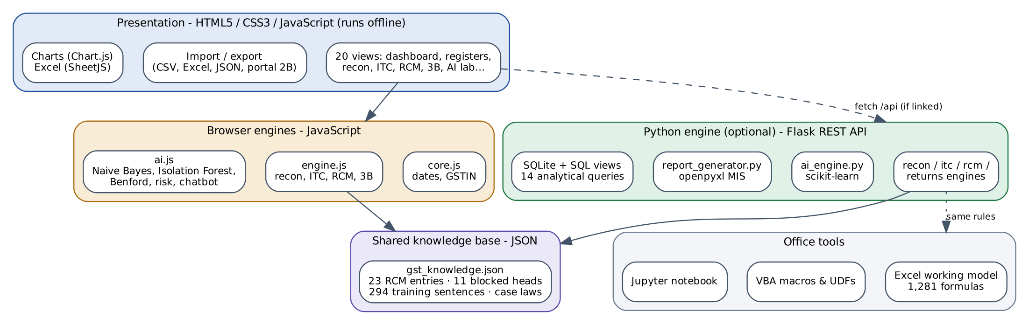
Architecture: one law base, two engines
Menu
Knowledge base
The GST law as data (JSON): rates, conditions, 17(5) list, 23 RCM entries, deadlines, chatbot answers.
Two identical engines
JavaScript runs in any browser offline; Python adds ML, SQL and Excel. A test proves both agree on all 609 bills.
Many outputs
Web app, REST API, SQLite database, Excel MIS with formulas, VBA, Jupyter notebook and Word report.
Notes:
The heart of GSTiQ is a single knowledge base - the law written as structured data. Two engines read it: a JavaScript engine inside the web app, and a Python engine with machine learning, SQL and Excel reporting. Because they share the same rules, our cross-language test confirms both give identical results on all 609 bills.

Slide 15






Technology stack — eight languages and tools
Menu
HTML5 · CSS3
Single-page app, light/dark, mobile
JavaScript
Rule engine, AI, import/export in browser
Python
Flask API, pandas, scikit-learn, openpyxl
SQL (SQLite)
Tables, views, 14 analytical queries
Excel + VBA
1,281-formula model, UDFs and macros
Jupyter · JSON
AI notebook, law base, portal 2B format
≈ 8,023 lines in total, excluding data and libraries
Notes:
We used the right tool for each job: HTML, CSS and JavaScript for an app that runs anywhere without installation; Python for machine learning and reports; SQL for analysis; Excel with formulas and VBA because that is what a CA office already uses; Jupyter to document the models; and JSON for the law base and the GST portal format.

Slide 16

A month-end workflow in six clicks
Menu
01
02
03
04
05
06
Import
Reconcile
Evaluate ITC
Reverse charge
GSTR-3B & set-off
Report
Purchase register (Excel/CSV) and GSTR-2B portal JSON with smart column mapping
Four-pass AI matching of books with GSTR-2B; IMS actions
Status + reason for every bill; deadlines and reversals
RCM register, time of supply, interest, self-invoices
Tables 3.1(d) & 4, Rule 42/43, optimal set-off, DRC-01C
Client MIS workbook, review report, vendor follow-up letters
Everything updates instantly: change one bill or one IMS action and the reconciliation, ITC status, GSTR-3B and dashboard recalculate together.
Notes:
This is how an article assistant uses GSTiQ at month end - six steps instead of days of spreadsheet work.

Slide 17
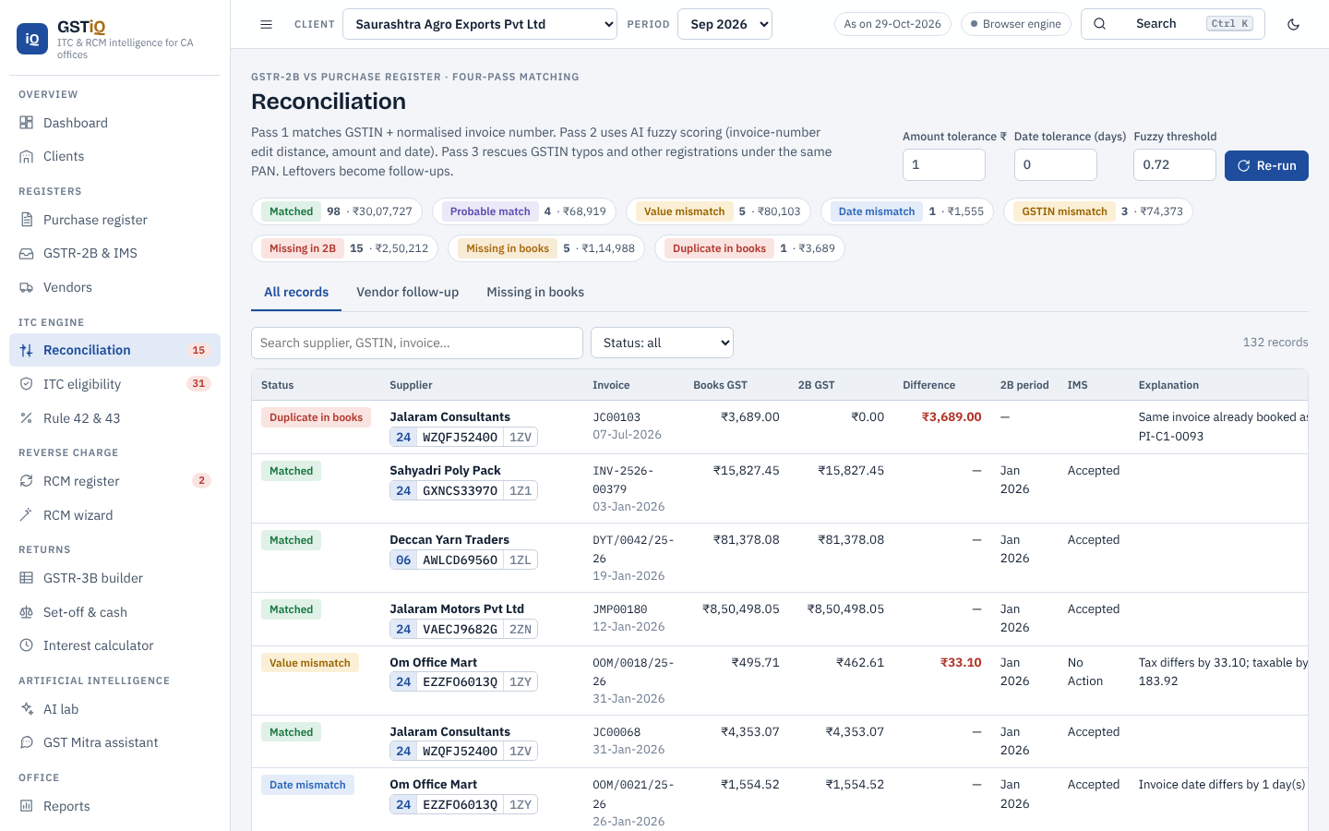
Reconciliation: books vs GSTR-2B in four passes
Menu
1
Exact key
Normalised GSTIN + invoice number (INV/045 = inv-45)
2
AI fuzzy match
Score = 50% invoice similarity + 35% amount + 15% date; match if ≥ 0.72
3
GSTIN rescue
Same PAN or ≤ 2 character typo in GSTIN
4
Leftovers
Missing in GSTR-2B / missing in books; duplicates flagged first
Reconciliation screen — follow-up tab
Tolerances are adjustable · vendor letters are generated for every gap
Notes:
Exact matching fails in practice because suppliers write invoice numbers differently. Our four-pass method first normalises keys, then uses an AI similarity score combining invoice number, amount and date, then rescues GSTIN typos using PAN, and finally lists what is missing on either side. For every gap GSTiQ drafts a follow-up letter to the vendor.

Slide 18
ITC eligibility: a status and a reason for every bill
Menu
12 checks, in priority order
Duplicate → time-barred 16(4) → blocked 17(5) → RCM unpaid → not received → not in 2B / IMS rejected → Rule 37 → Rule 37A → mismatch → eligible.
Explained in plain words
Clicking a bill opens a drawer showing each condition with a tick or cross and the section that applies.
Flags beyond the status
Excess claim, invalid GSTIN, GST 2.0 rate error, missing self-invoice, proposed 57th Council relaxations.
Notes:
Across 609 demo bills: ₹134.15 L eligible, ₹70.22 L at risk, ₹29.94 L blocked under 17(5), ₹5.20 L deferred and ₹1.82 L lapsed under 16(4). The order of checks matters - for example a duplicate is caught before anything else, and a time-barred bill is never shown as eligible.

Slide 19
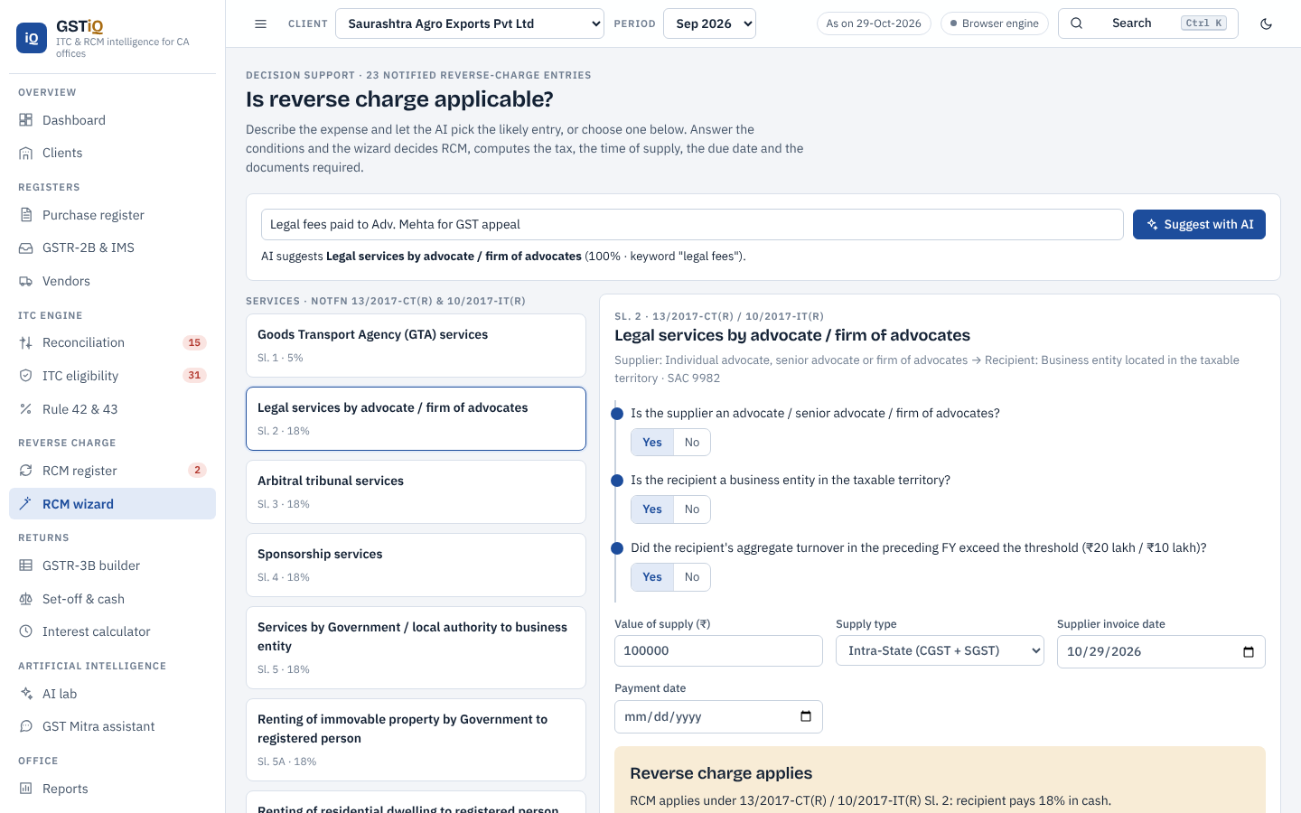
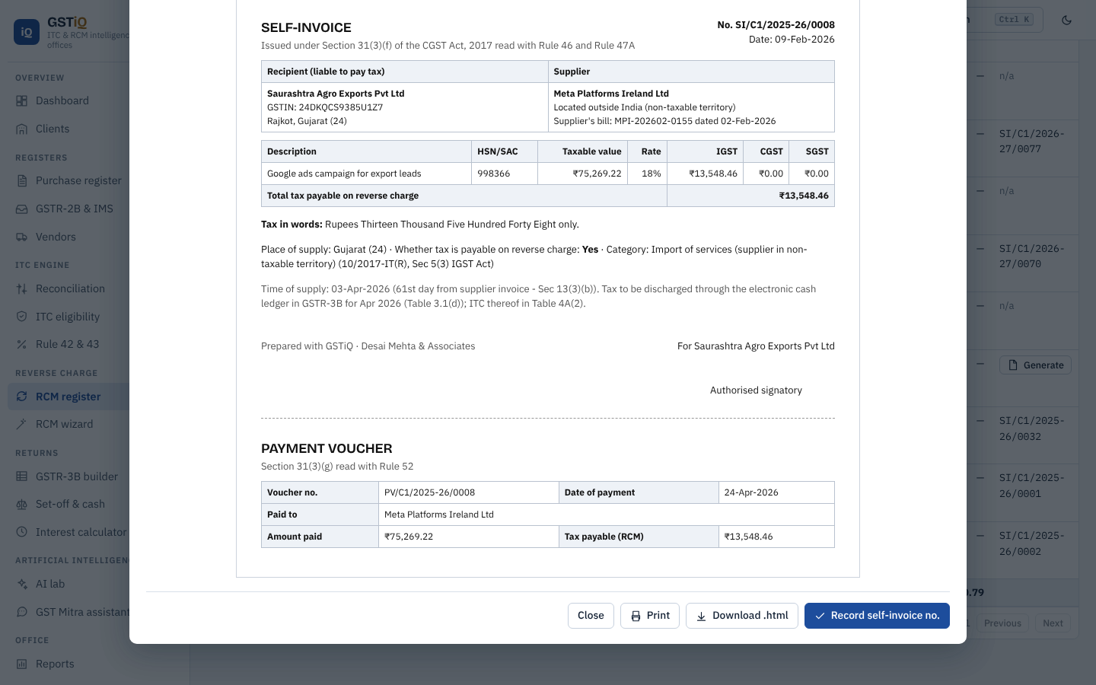
RCM wizard, register and self-invoice
Menu
RCM wizard — answer 2–3 questions, get the verdict and tax
Self-invoice generated under Rule 47A
23 notified entries in the wizard · ₹31.15 L RCM tax tracked in the demo · time of supply, due date and interest u/s 50 per bill
Notes:
The RCM wizard asks two or three yes/no questions taken from the notification - for example for legal services: is the supplier an advocate, is the recipient a business entity, is its turnover above the threshold - and returns the verdict with the tax amount. The register then tracks time of supply, the due date, payment and interest, and generates the self-invoice and payment voucher.

Slide 20
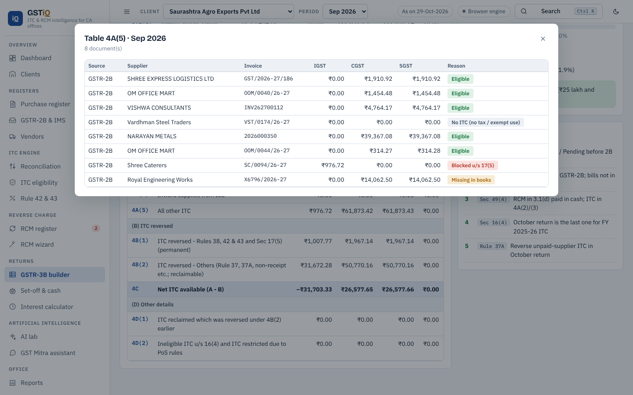
GSTR-3B builder, Rule 42/43, set-off and DRC-01C
Menu
₹3,716.03
Rule 42 reversal (D1) for Saurashtra Agro, Sep-2026 — identical in Python, JavaScript and Excel
+355.7%
ITC claimed (₹36.87 L) above GSTR-2B (₹8.09 L) — DRC-01C triggered for TechNova, Aug-2026
Optimal
Set-off order u/s 49, 49A, 49B & Rule 88A — IGST first, minimising cash; negative credit added to liability
GSTR-3B Table 4 with drill-down to the bills behind each figure
Notes:
The GSTR-3B builder maps every bill to the right table as per Circular 170/02/2022. Rule 42 is computed with the full formula and our three implementations agree to the paisa. The DRC-01C check of Rule 88D caught a planted case where TechNova claimed 355% more than GSTR-2B. The set-off follows the legal order and picks the combination that minimises cash.

Slide 21
Artificial intelligence
Menu
04
Where rules end and judgement begins: six models that read narrations, spot unusual bills, rank suppliers, forecast credit and answer questions.
Notes:
Section 4 - the AI layer. Key message: the law decides; AI assists and flags for human review.

Slide 22




Six AI models, each with a job
Menu
Expense classifier
Anomaly detection
Benford’s law
Reads ledger narrations and predicts eligible / blocked (17(5)) / RCM. Naive Bayes in browser; TF-IDF + Logistic Regression in Python — 85.0% 5-fold CV, 18 classes.
Isolation Forest on value, vendor deviation, round sums, Sundays, e-way bill threshold — plus forensic rules for near-duplicates.
First-digit test with chi-square and MAD (Nigrini bands) to spot manipulated invoice values.
Vendor risk score
ITC forecast
GST Mitra chatbot
Cancelled GSTIN, late GSTR-1/3B, missing in 2B, new registration → grades A to D with action.
Trend regression (60%) + 3-month moving average (40%) with a 90% band to plan cash.
TF-IDF retrieval over 44 curated answers, plus live answers from the client’s own data.
Notes:
Each model has a clear job. The classifier helps when narrations are messy. Anomaly detection and Benford's law are audit tools - similar in spirit to what the GST department does with BIFA and ADVAIT. Vendor risk tells the office whom to chase. The forecast helps cash planning. GST Mitra answers questions in plain language.

Slide 23
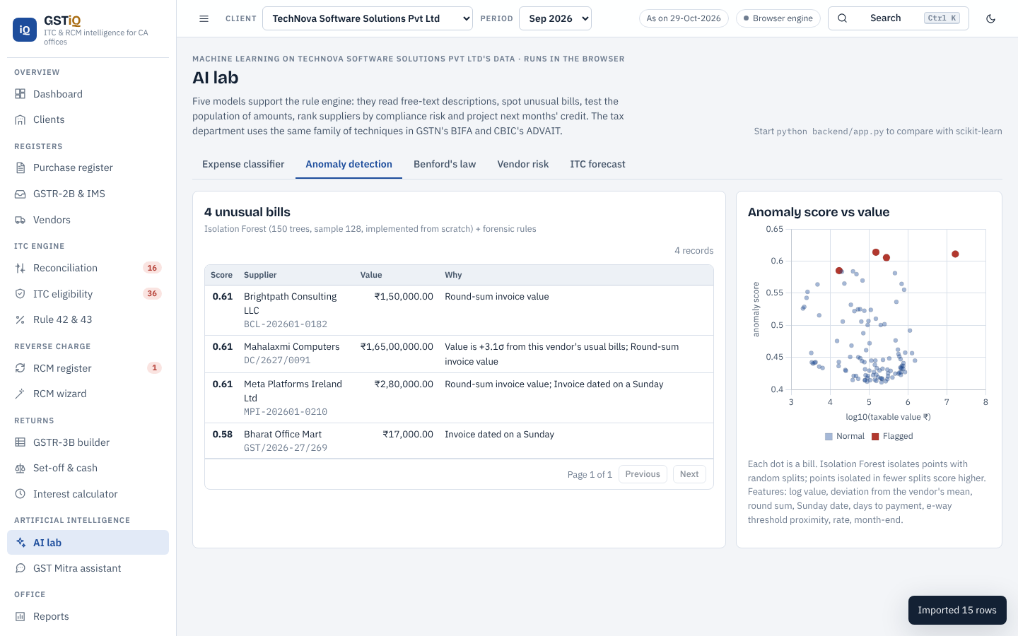
AI results on our data
Menu
AI lab — anomaly detection tab
85.0%
97.4%
294
Human in the loop
AI never changes a legal decision. Disagreements with the rule engine are shown for the CA to review.
mean accuracy
agreement with rule engine
training sentences
Notes:
The classifier averages 85% accuracy on unseen sentences across five folds, and agrees with the rule engine on blocked versus not-blocked for 97.4% of real register lines. The anomaly tab lists unusual bills with reasons. Our principle: AI flags, the CA decides.

Slide 24
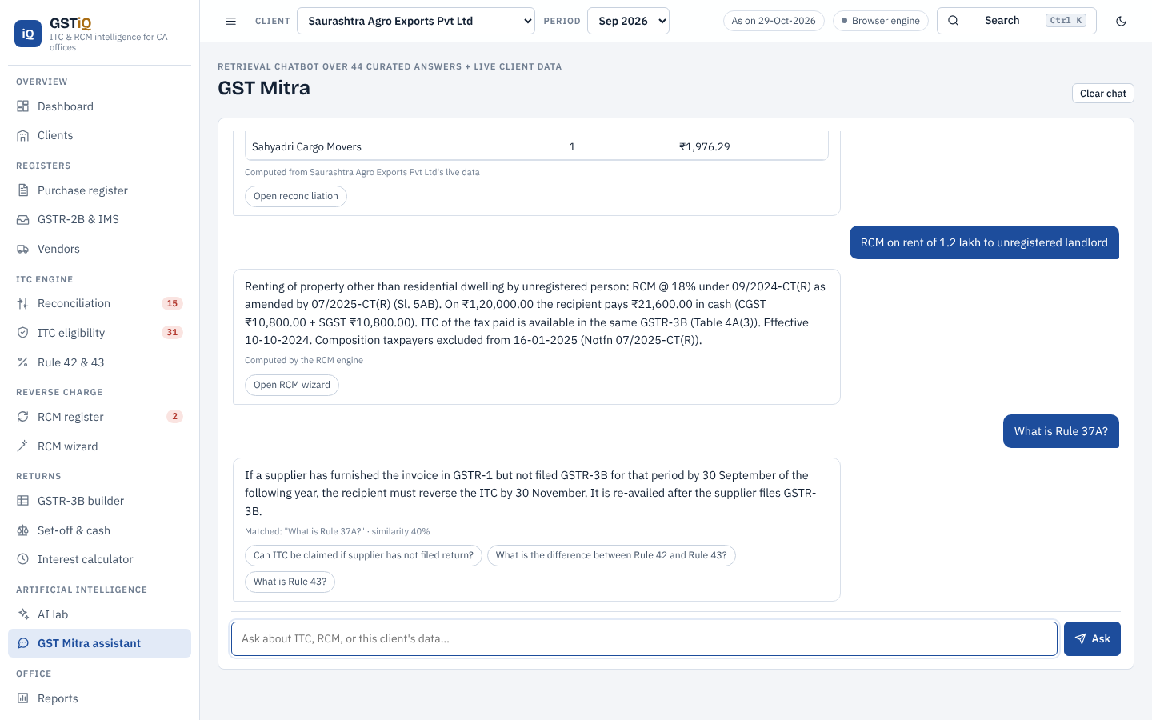
GST Mitra — ask in plain language
Menu
“Is RCM applicable on rent from an unregistered landlord?”
Yes for commercial property from 10-10-2024 (Entry 5AB), composition tenants excluded from 16-01-2025.
“Can I pay reverse charge from the credit ledger?”
No — Sec 49(4): RCM is paid in cash; ITC follows in the same return.
“How much ITC is at risk for this client?”
Answered from the client’s live data with the bills behind it.
GST Mitra assistant inside the app
Notes:
GST Mitra uses TF-IDF retrieval over a curated question bank, so every answer cites the section, rule or notification. It also recognises data questions and answers from the selected client's figures.

Slide 25
Data, demo & testing
Menu
05
Realistic dummy data with planted errors, import and export in every office format, an audience quiz, the live demo and how we proved it works.
Notes:
Section 5 - data, an interactive quiz, the live demo, and testing.

Slide 26
Dummy data built to catch real-world mistakes
Menu
5
133
609
474
clients — Gujarat, Maharashtra, Karnataka
vendors with filing behaviour
purchase bills, Jan–Sep 2026 + late bills
GSTR-2B records with IMS actions
Planted errors the engine must find
Invoice number format differs
Value mismatch
Date mismatch
GSTIN typo
Supplier did not file
Cancelled supplier
Duplicate entry
Unpaid > 180 days (Rule 37)
Supplier 3B default (37A)
Unpaid RCM
Missing self-invoice
12% rate after GST 2.0
₹1.65 Cr claim not in 2B (DRC-01C)
Time-barred bill
New client test — Gir Polymers Pvt Ltd: 49 bills (Excel) + September GSTR-2B (portal JSON) imported through the app; all planted errors were caught.
Notes:
All names and GSTINs are fictitious but GSTINs carry valid check digits. We deliberately planted fourteen kinds of errors so we could prove the engine finds each one. We also created a brand-new client, Gir Polymers, and imported its Excel register and portal JSON through the app as a real office would.

Slide 27
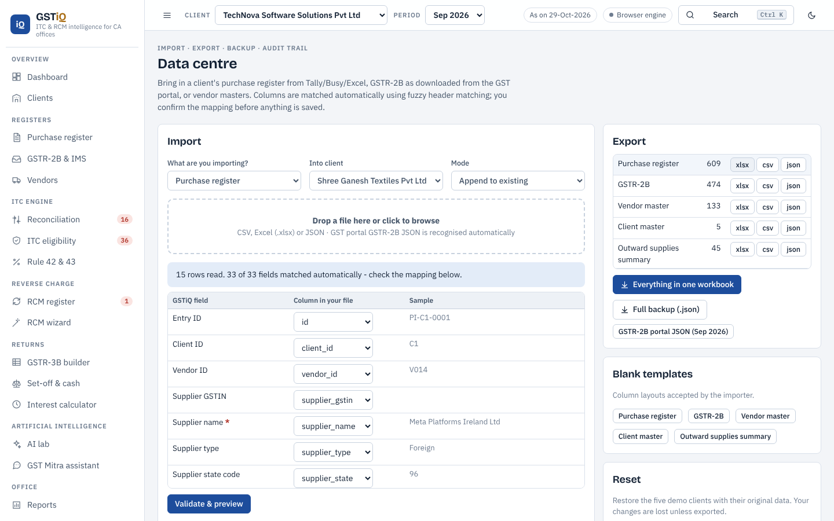
Import and export in every format an office uses
Menu
Import
Excel (.xlsx), CSV, GST portal GSTR-2B JSON, full backup; columns matched automatically; validation before saving
Export
Client MIS workbook (7 sheets), review report, vendor letters, self-invoice, portal JSON, CSV/Excel of every register
Excel model + VBA
1,281 live formulas: ITC register, RCM calculator, Rule 42/43, set-off, interest; VBA UDFs such as GSTIN_VALID()
SQL & API
Smart column mapping — any column names are recognised
SQLite schema with views and 14 queries; Flask REST API so other tools can call the engine
Notes:
Offices have data in many shapes, so import is forgiving: column names like 'Bill No' or 'Party GSTIN' are mapped automatically, and the GST portal's GSTR-2B JSON is recognised directly. Outputs go to Excel, HTML, text letters and JSON. The separate Excel model and VBA show the same logic in the tool every CA already knows.

Slide 28
Audience quiz — will GSTiQ allow the ITC?
Menu
Click a case to reveal GSTiQ’s verdict. Each answer slide has a button to come back here.
Case 1
Case 2
A company buys a 5-seater car for its Managing Director. GST ₹4.96 lakh. ITC?
Godown rent ₹65,000 a month from an unregistered landlord; tenant is a regular taxpayer.
Reveal ›
Reveal ›
Case 3
Case 4
Bill dated 10-02-2025 found unclaimed on 29-10-2026. Can ITC still be taken?
Supplier filed GSTR-1 for Jan-2026 but not GSTR-3B by 30-09-2026. ITC already claimed.
Reveal ›
Reveal ›
Notes:
Interactive part: ask the audience to vote on each case, then click 'Reveal' (or the case title) to jump to the hidden answer slide. Each answer slide has a 'Back to quiz' button. Answers: 1 blocked u/s 17(5)(a); 2 RCM applies - pay 18% in cash, issue self-invoice, ITC in same return; 3 lapsed u/s 16(4) - deadline was 30-11-2025; 4 reverse under Rule 37A by 30-11-2026, re-avail when supplier files.

Slide 29

Live demo — click to open any screen
Menu
LIVE WEB APP
humaregrouponekaproject.online
Live app
Scan on your phone
Dashboard ↗
Reconciliation ↗
ITC eligibility ↗
RCM wizard ↗
Source code
GitHub repository
GSTR-3B builder ↗
AI lab ↗
GST Mitra ↗
Import / export ↗
Works offline too: double-click OPEN_ME_GSTiQ_App.html
Notes:
Demo script (5 minutes): 1) Dashboard - show AI insights and the 16(4) countdown. 2) Reconciliation - open the follow-up tab and show a fuzzy match. 3) ITC eligibility - click a blocked bill to show the rule-by-rule drawer. 4) RCM wizard - legal services, answer the questions, show the verdict. 5) GSTR-3B - drill into Table 4. 6) AI lab - classify 'Diwali gifts to dealers'. 7) GST Mitra - ask about RCM on rent. 8) Import - drop the Gir Polymers Excel file. Every button on this slide opens that screen directly in the browser. If there is no internet, use OPEN_ME_GSTiQ_App.html from the project folder.

Slide 30
Testing: how we proved it works
Menu
Test | What it checks | Result
Law unit tests | 23 cases: 16(4), 17(5), Rule 37/37A, RCM, set-off, DRC-01C, reconciliation | All pass
Cross-language | Python and JavaScript engines on all 609 bills and GSTR-3B for 20 client-months | Identical
Browser UI test | Opens all 18 screens, clicks, imports and exports in headless Chromium | 0 JS errors
New-client import | Gir Polymers Excel + portal JSON imported through the real UI | All errors caught
Excel recalculation | 1,454 formulas recalculated in LibreOffice | 0 errors
Notebook & API | Jupyter notebook executed; Flask endpoints called | Pass
Live website | humaregrouponekaproject.online over HTTPS | Online
Notes:
We tested at every level: law-specific unit tests, a cross-check that the two engines agree, a browser test that opens every screen, an end-to-end import of a new client, Excel recalculation, the notebook and the API. Debugging found and fixed real bugs - for example an Excel sheet-picker issue during import.

Slide 31
Conclusion
Menu
06
What a CA office gains with GSTiQ today, and the features that can be added next.
Notes:
Section 6 - conclusion.

Slide 32

What changes for a CA office
Menu
Today (manual)
With GSTiQ
Month-end ITC review
Days of spreadsheet matching
Minutes, with every gap listed
Blocked credits
Found at audit — with interest
Flagged the day the bill is entered
Reverse charge
Missed rent, freight, legal fees
Wizard + register + self-invoice
Deadlines
Remembered by individuals
Countdown, calendar and alerts
Vendor follow-up
Phone calls without data
Risk grade + ready letter
Review by partner
Re-checks samples
Reads the reason for every bill
Notes:
The real benefit is time and risk: what took days now takes minutes, and problems are found when the bill is entered rather than at audit or in a notice.

Slide 33


Future features that can be added
Menu
Direct GSTN connection
Invoice OCR & QR check
Multi-user cloud workspace
Fetch GSTR-2B and IMS actions automatically through GSP APIs — no downloads.
Read scanned bills and verify e-invoice IRN and signed QR codes instantly.
Partner, manager and article logins with review and approval steps.
LLM-powered GST assistant
GSTR-9 / 9C & e-way bills
Mobile alerts
A large language model answering from GSTiQ’s own law base and client data.
Annual return reconciliation and e-way bill matching on the same engine.
Deadline and ITC-at-risk alerts to clients by WhatsApp, SMS or e-mail.
Notes:
GSTiQ is built so that new features plug into the same knowledge base and engines. Features that can be added next: a direct GSTN connection through GSP APIs, OCR for scanned invoices with e-invoice QR verification, a multi-user cloud workspace for the whole office, a large-language-model assistant grounded on our law base, GSTR-9/9C and e-way bill reconciliation, and mobile alerts to clients.

Slide 34
Menu
Thank you
Questions and discussion are welcome
GROUP ONE
Dudhat Ankur
ICAI Reg. No. WRO0738763
Hariom Bhati
ICAI Reg. No. CRO0694015
Try GSTiQ now
Bharat Lakhnotra
ICAI Reg. No. WRO0752641
Takshil Chodvadiya
ICAI Reg. No. WRO0758843
Live app: humaregrouponekaproject.online Code: github.com/Bharat4871/GST-RECO
Notes:
Thank the faculty and the audience. Invite questions; use the Menu button to jump to any section that a question relates to.

Slide 35

Case 1 — GSTiQ’s verdict
Menu
Why
Motor vehicles for transport of persons with seating capacity of 13 or less (including driver) are blocked.
Exceptions: further supply of such vehicles, transport of passengers, imparting driving training — none apply here.
ITC on repairs and insurance of this car is also blocked u/s 17(5)(ab).
BLOCKED
No ITC — Section 17(5)(a)
What GSTiQ shows: status ‘Blocked u/s 17(5)(a)’ from HSN 8703 and the narration; if the ITC was claimed, a red flag to reverse it in Table 4B(1).
Back to quiz
Next case ›
Notes:
Hidden slide - shown only when its case is clicked on the quiz slide. Use 'Back to quiz' or 'Next case'.

Slide 36
Case 2 — GSTiQ’s verdict
Menu
Why
Entry 5AB of Notfn 13/2017-CT(R) (inserted by 09/2024, from 10-10-2024): renting of commercial property by an unregistered person to a registered person.
Composition tenants are excluded from 16-01-2025 (Notfn 07/2025) — this tenant is a regular taxpayer.
Pay ₹11,700 a month in cash (Sec 49(4)), issue a self-invoice within 30 days (Rule 47A), report in 3.1(d) and claim in 4A(3).
RCM APPLIES
Tenant pays 18% GST in cash; ITC in the same return
What GSTiQ shows: RCM register entry with time of supply, due date and interest; a ‘self-invoice missing’ flag until one is generated.
Back to quiz
Next case ›
Notes:
Hidden slide - shown only when its case is clicked on the quiz slide. Use 'Back to quiz' or 'Next case'.

Slide 37
Case 3 — GSTiQ’s verdict
Menu
Why
The invoice belongs to FY 2024-25.
Last date to claim was 30-11-2025 (or the annual return for FY 2024-25, if filed earlier).
On 29-10-2026 the credit can no longer be taken; it becomes a cost.
LAPSED
Time-barred under Section 16(4)
What GSTiQ shows: status ‘Lapsed u/s 16(4)’ with the deadline that was missed; the dashboard counts lapsed ITC so the client sees the loss.
Back to quiz
Next case ›
Notes:
Hidden slide - shown only when its case is clicked on the quiz slide. Use 'Back to quiz' or 'Next case'.

Slide 38
Case 4 — GSTiQ’s verdict
Menu
Why
Rule 37A: if the supplier has furnished GSTR-1 but not GSTR-3B for the period by 30 September of the next FY, the recipient reverses the ITC.
Reversal is made in a return filed on or before 30 November (Table 4B(2)).
The ITC can be re-availed once the supplier files GSTR-3B.
REVERSE
Reverse under Rule 37A by 30-11-2026; re-avail later
What GSTiQ shows: status ‘Reverse – Rule 37A’, the amount in the dashboard insights and a vendor follow-up letter to the supplier.
Back to quiz
Go to live demo ›
Notes:
Hidden slide - shown only when its case is clicked on the quiz slide. Use 'Back to quiz' or 'Next case'.

