Slide 1
Adaptive Delta Modulation (ADM)
An Advanced Technique in Digital Signal Processing
• Addresses limitations of standard Delta Modulation (DM)
• Adaptive step size reduces slope overload and granular noise
• Efficient for dynamic signal variations

Slide 2
Introduction to ADM
• ADM dynamically adjusts step size based on signal variations
• Designed to overcome limitations of standard DM
• Used in voice and data communication systems

Slide 3
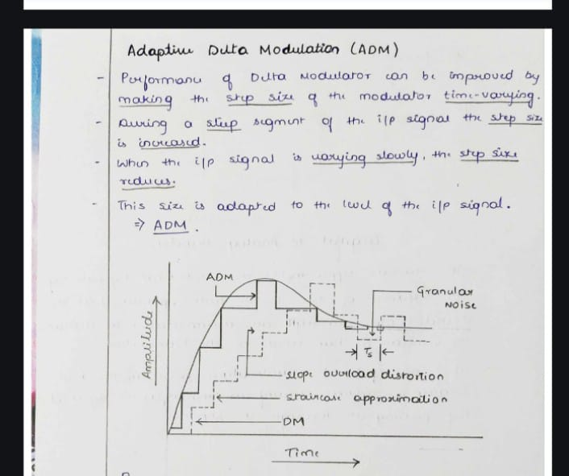

Slide 4
Working Principle
• Step size increases for rapid signal changes
• Step size decreases for slow signal changes
• Tracks the signal with better accuracy

Slide 5
Transmitter in ADM
• Encodes signal with variable step size
• Step size is adjusted based on past quantizer outputs
• Reduces quantization error

Slide 6
Receiver in ADM
• Uses step size control logic to mirror transmitter
• Accumulator reconstructs the signal
• Low-pass filter smoothens the output waveform

Slide 7
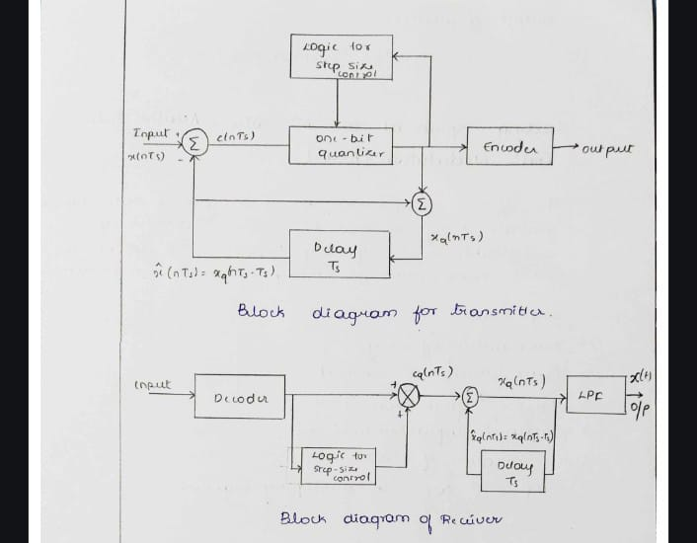

Slide 8
Advantages of ADM
• Improved Signal-to-Noise Ratio (SNR)
• Wider dynamic range
• Better performance in low-bandwidth systems

Slide 9
Applications of ADM
• Voice communication systems
• Wireless systems
• Data transmission over limited bandwidth

Slide 10
Conclusion
• ADM is an efficient alternative to standard DM
• Provides better signal fidelity and dynamic adaptability
• Suitable for modern communication systems

