Slide 1
ONLINE REGRESSION CALCULATOR
NAME : BHARAT MUNDHRA
REGISTER NO. : 36110166
DEPARTMENT : CSE
SECTION : C
NAME OF THE GUIDE : Ms. B. KEERTHI SAMHITHA, M. Tech.,

Slide 2
Abstract
Children explore websites for fun as well as to learn.
They feel very interesting to learn in an interactive way.
Many interactive designing elements and layouts are present which can hold child’s attraction towards the website.
So the kids not only learn but they enjoy the way of learning.

Slide 3
introduction
It is a calculator for regression related calculation.
It can do prediction for given datasets.
It can plot graphs for analysing the behaviour of equations.
Inputs are given in the textboxes. On clicking ‘calculate’, it will
display the output/results.

Slide 4
objectives
Increased EFFICIENCY in calculation results.
Give KNOWLEDGE about the calculation process.
Reducing large amount of TIME from doing manual calculation.
Build interaction and EASY TO USE.

Slide 5
Architectural view
HOME PAGE
Mean Calculation Page
Slope-Intercept
Page
Plot for Equation
Regression Page
Distance-Midpoint Page

Slide 6
IMPLEMENTATIONs
The scripting languages used for making the website are HTML5, CSS3 and JavaScript.
These are some implementations done in the entire project :
1. Background colours and images
2. Font style, colour and size
3. Margins and Alignments
4. Audio
5. Buttons
6. Links
7. Formulas
8. Local Storage
9. Graphs

Slide 7
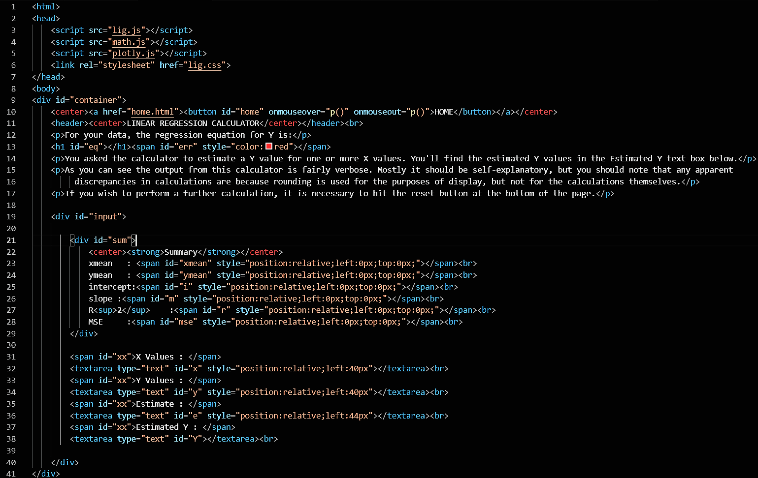
Code sample
Code for Home page :

Slide 8
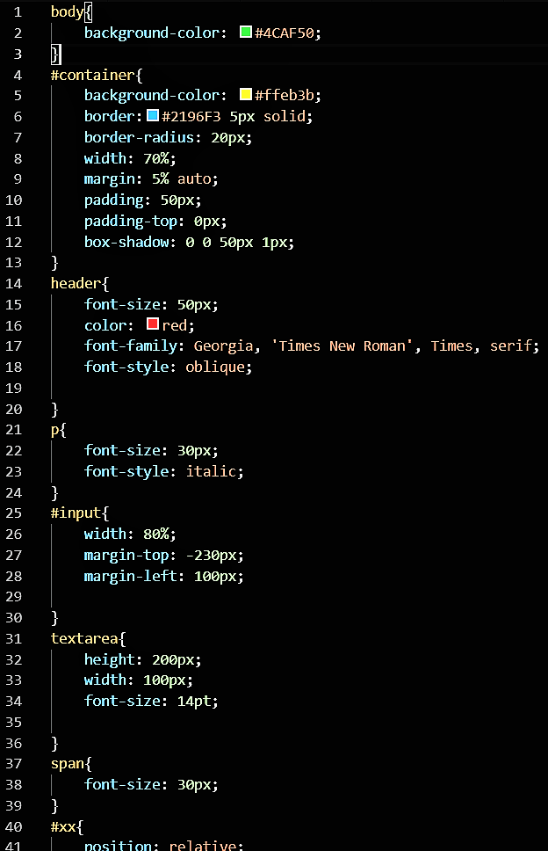
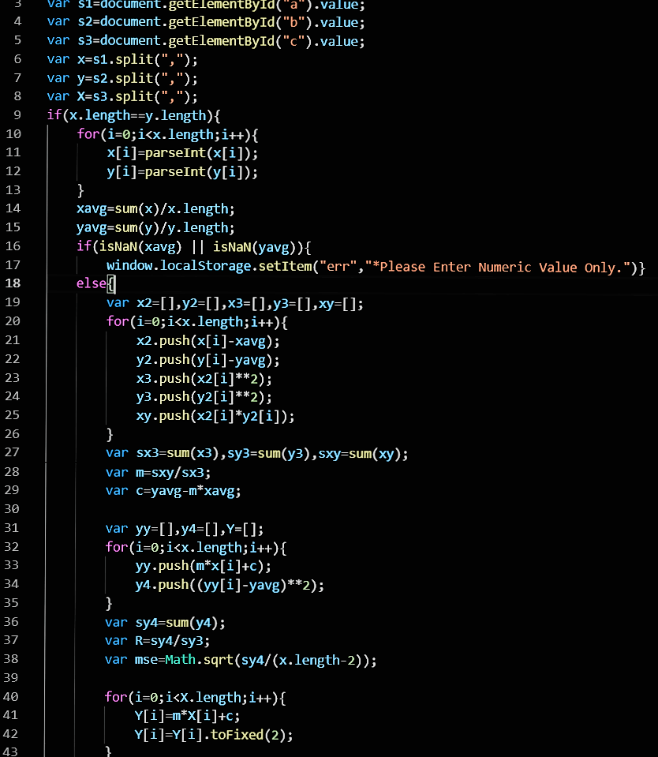
Code for CSS file :
Code for JavaScript file :

Slide 9
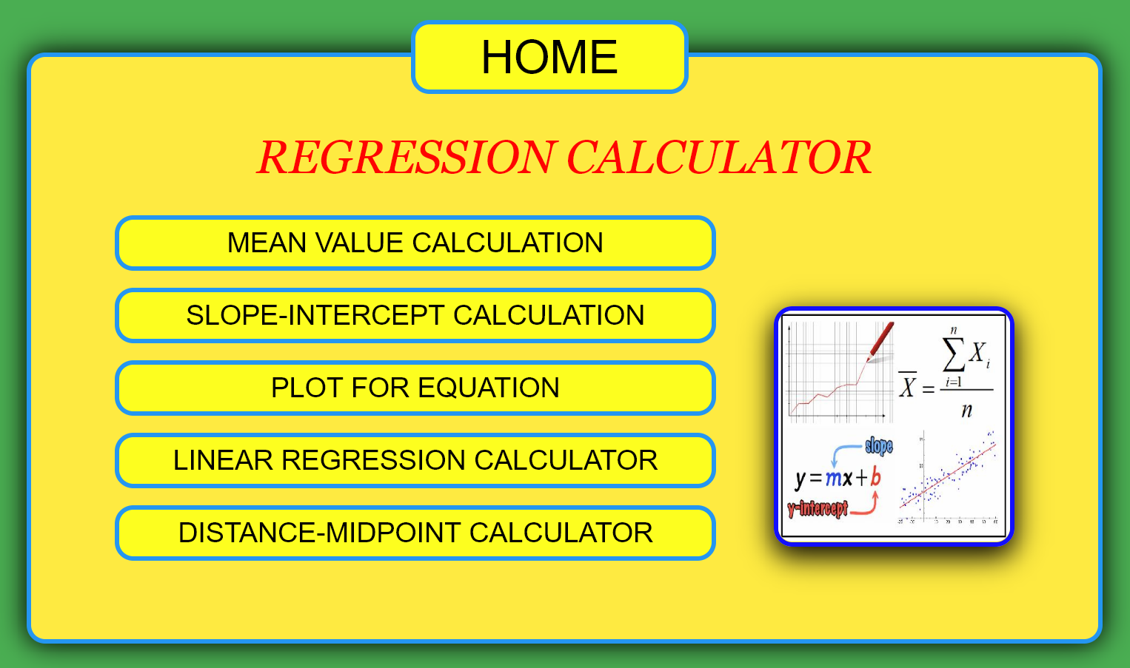
RESULTS & DISCUSSIONS
HOME PAGE :
All the links of other pages are present in the form of Buttons with related images(displayed when hover).

Slide 10
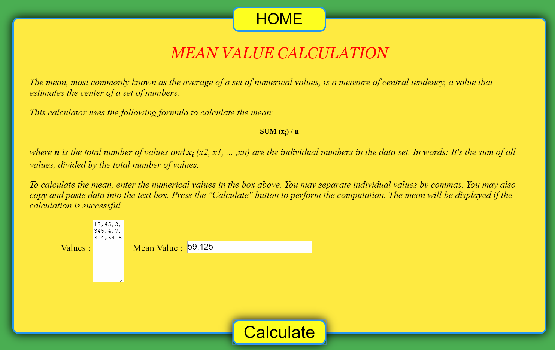
MEAN CALCULATION PAGE :
Input values(integer or decimal) are given in ‘Values’ field ,each value separated with a comma(,). On clicking the ‘Calculate button below, the mean values will be printed as an Output.

Slide 11
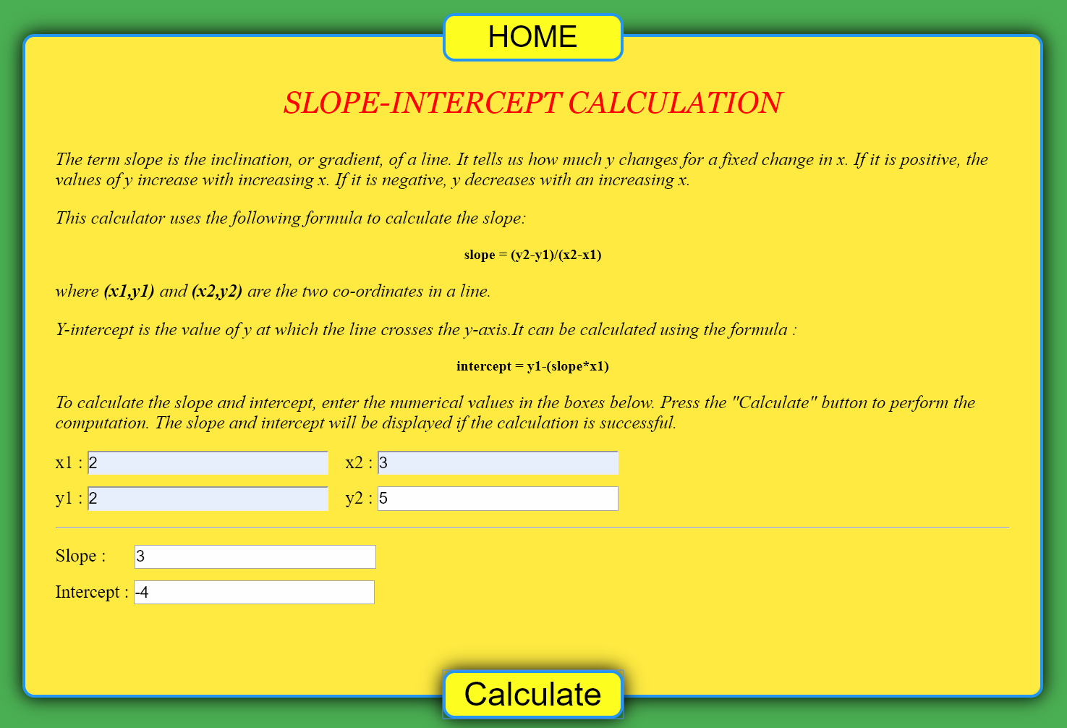
SLOPE-INTERCEPT PAGE :
It calculate slope and intercept for any 2 coordinate points (x₁,y₁) and (x₂,y₂). All the values should be given in the labelled textbox given accordingly.

Slide 12
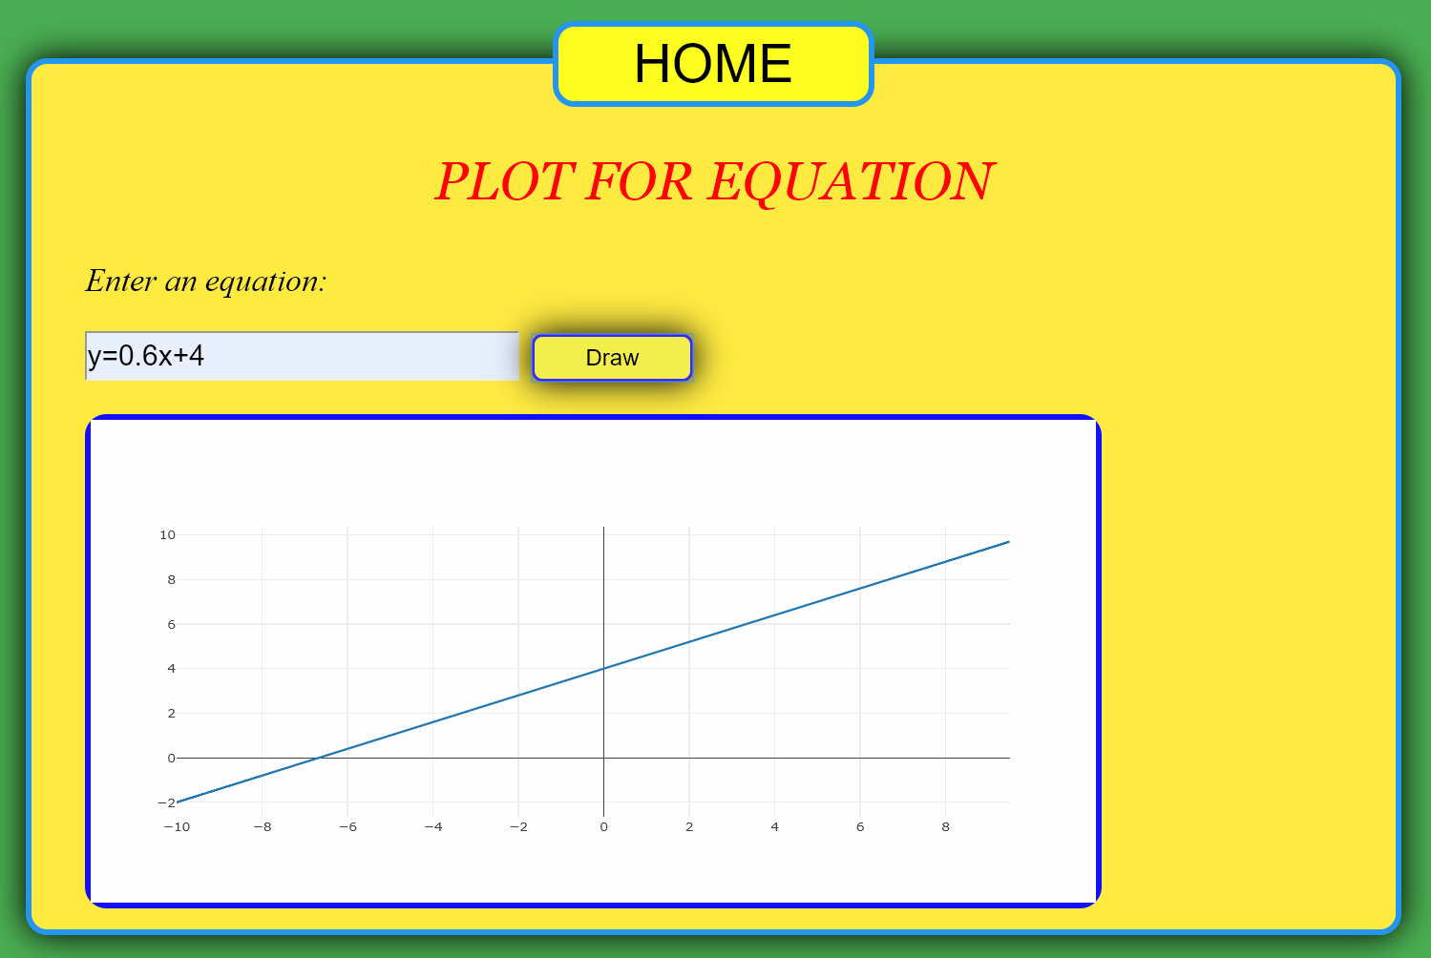
PLOT FOR EQUATION PAGE:
Any valid Equation can be given in the textbox. On clicking the ‘Draw’ button, the given equation will compile and a graph for the equation is plotted and displayed.

Slide 13
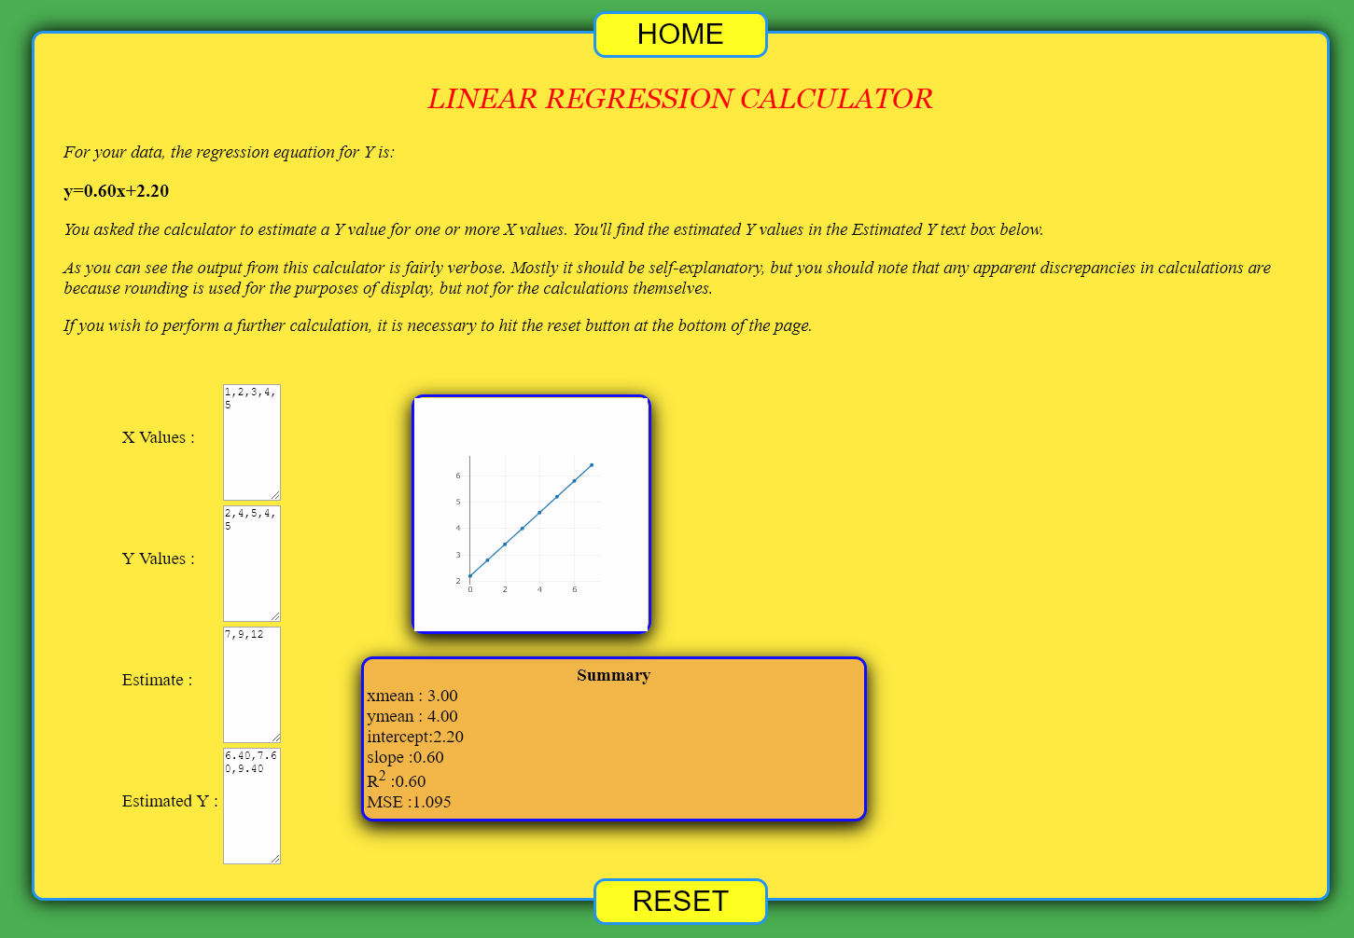
LINEAR REGRESSION PAGE:
Dataset are given to the x and y values textbox with an estimate x value(s). The calculator will give the estimate y value(s) for x and the equation along with the graph. It also provide some of the important information related to the calculations.

Slide 14
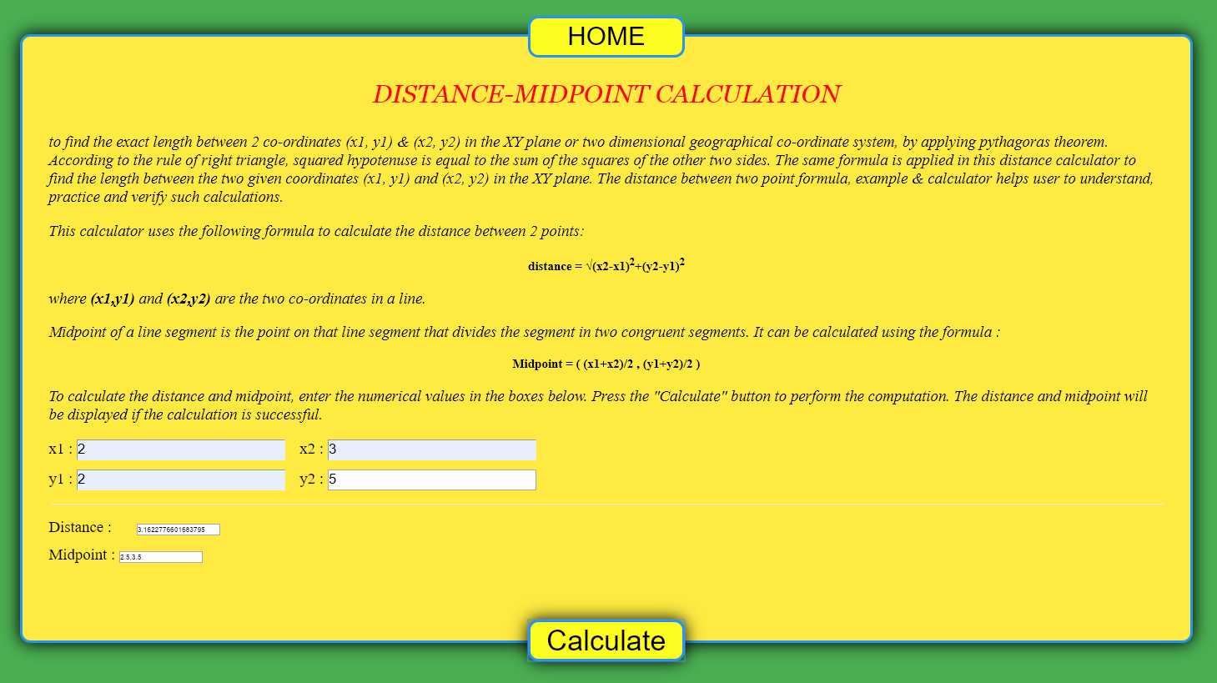
DISTANCE-MIDPOINT PAGE:
The coordinate points (x₁,y₁) and (x₂,y₂) are given in the labelled textbox. On clicking the ‘calculate’ button, the distance between the 2 points are calculated. It also finds the midpoint of the 2 coordinates.

Slide 15
CONCLUSION
Thus, this calculator is specially for solving regression problem which is the most common concept of machine learning.
It also performs other calculations related to it.
It is used because manual calculation for large dataset is very inconvenient and time consuming.
In future, many other concepts of machine learning and some related calculations can be added.
The source code for the computational part is public, so that users can see in detail how the result is calculated.

Slide 16
REFERENCES
https://www.stackoverflow.com
https://www.tutorialspoint.com
https://www.w3.org/TR/css3
https://www.w3.org/TR/html5
https://www.w3school.com

Slide 17
Thank you

