Slide 1
myproject_tableau
File created on: 27-11-2022 6.52.46 PM
Project made by
Bharat Sonone

Slide 2
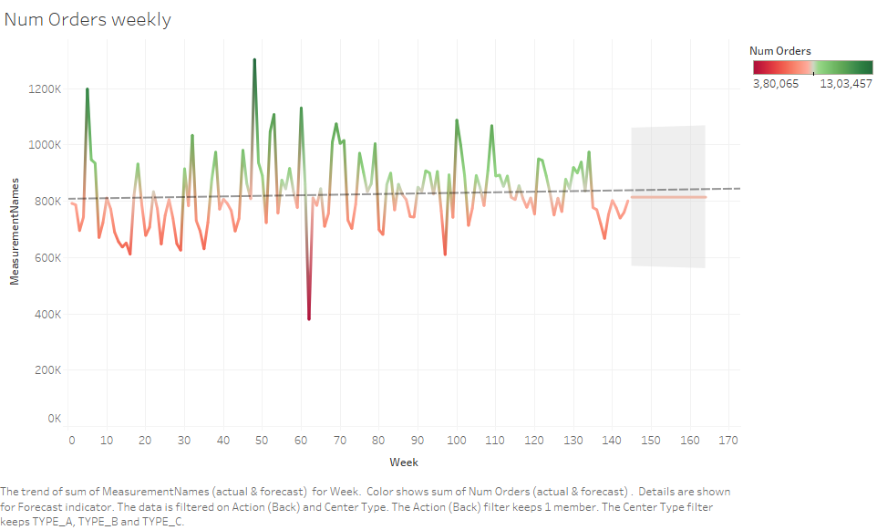

Slide 3
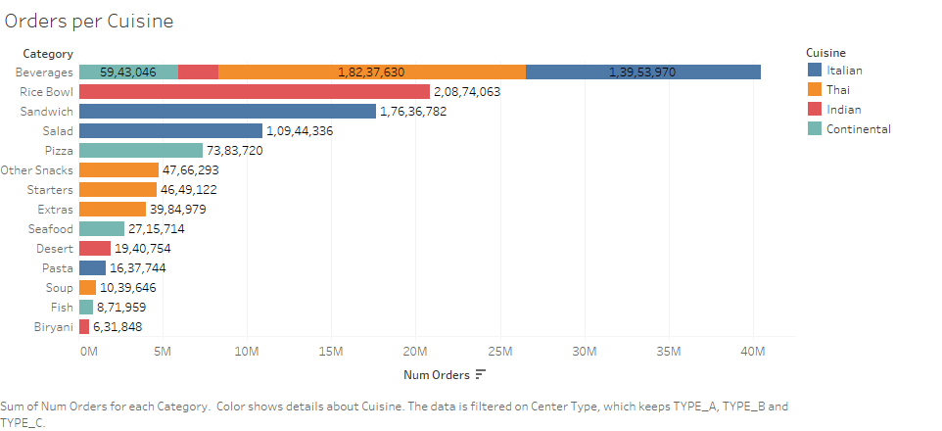

Slide 4
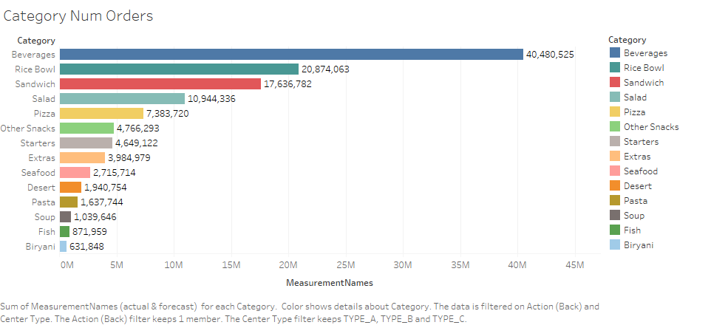

Slide 5
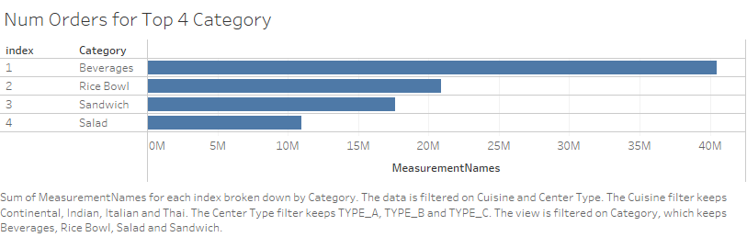

Slide 6
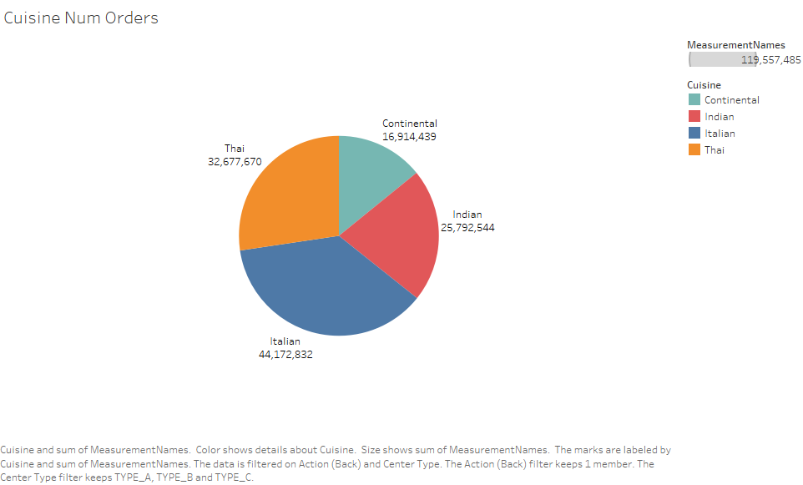

Slide 7
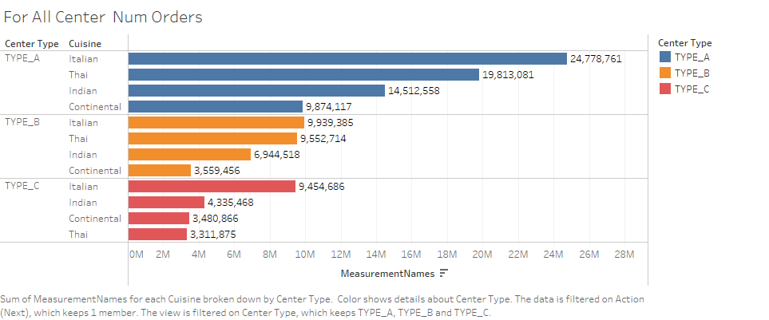

Slide 8
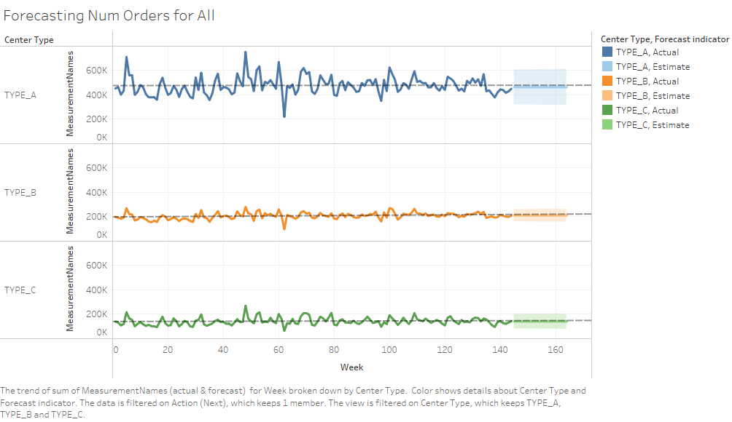

Slide 9
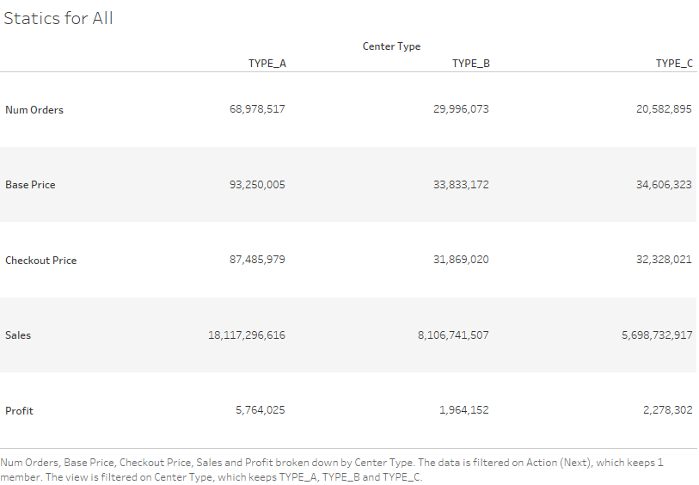

Slide 10
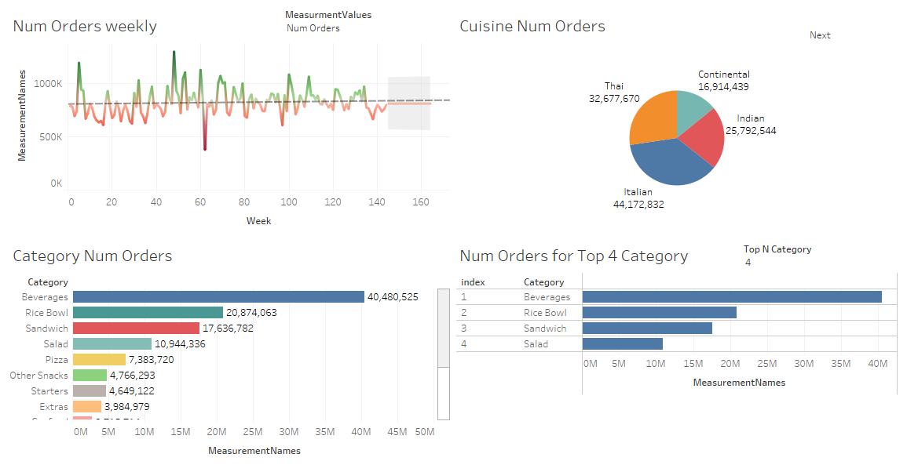

Slide 11
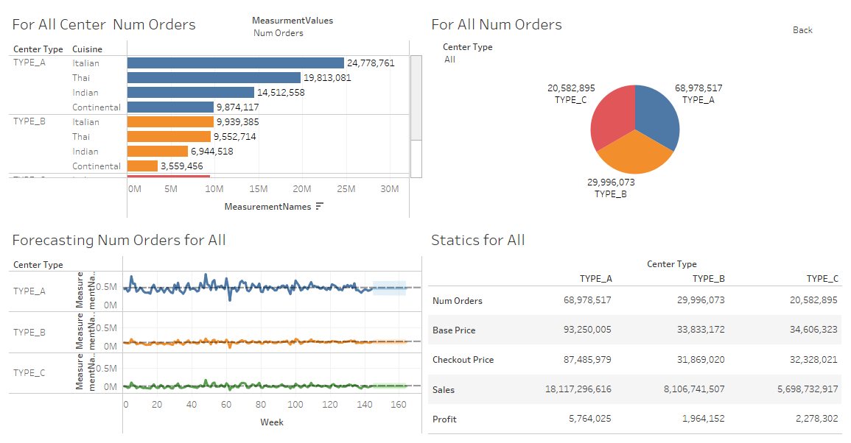

Slide 12
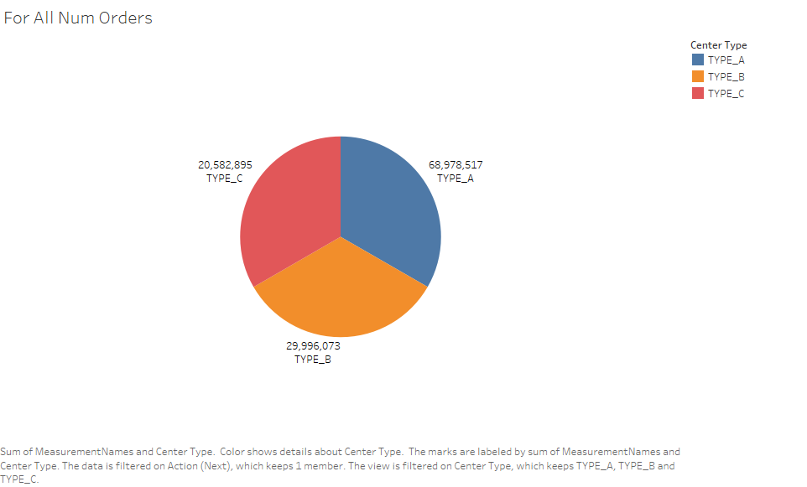

Slide 13
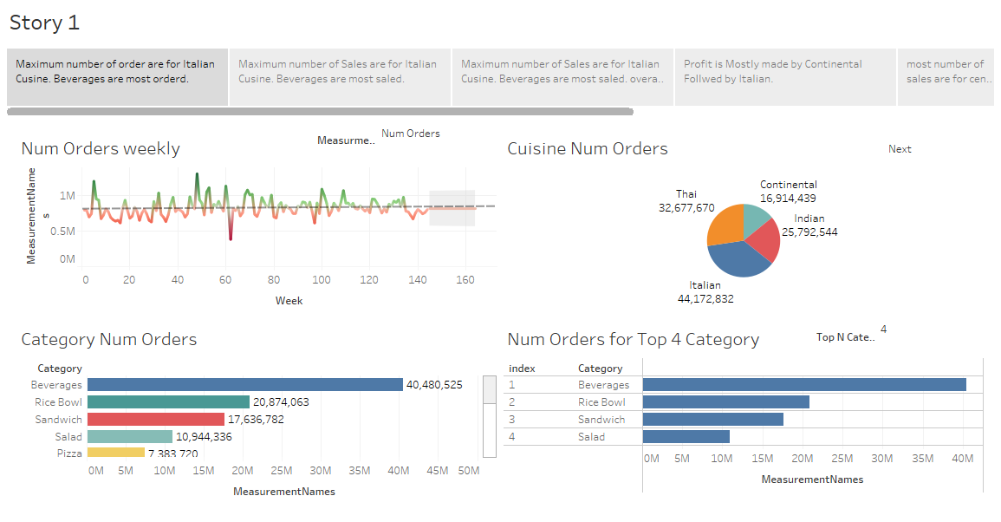

Slide 14
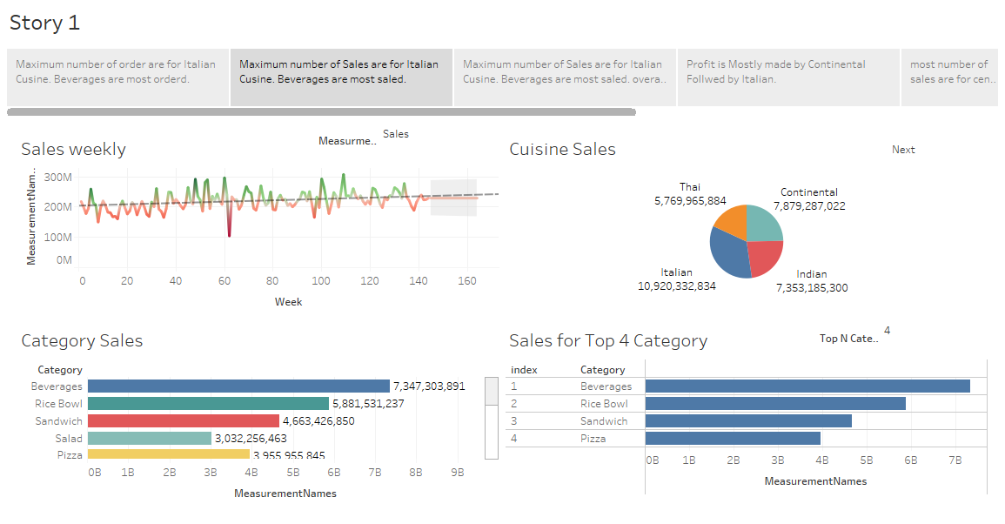

Slide 15
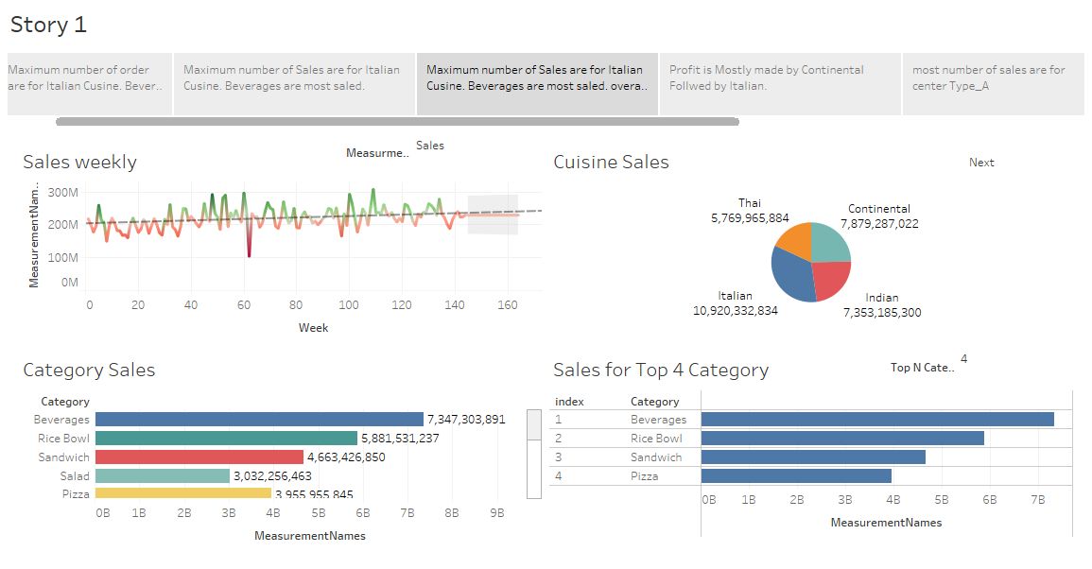

Slide 16
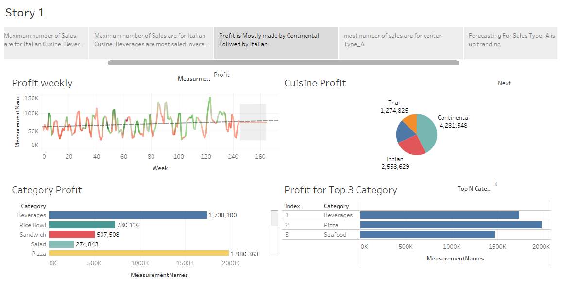

Slide 17
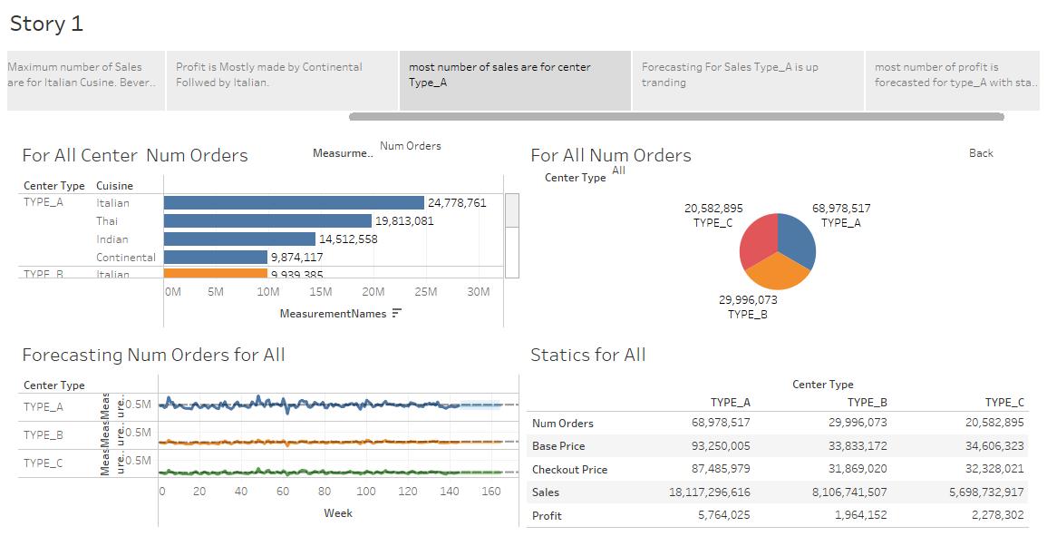

Slide 18
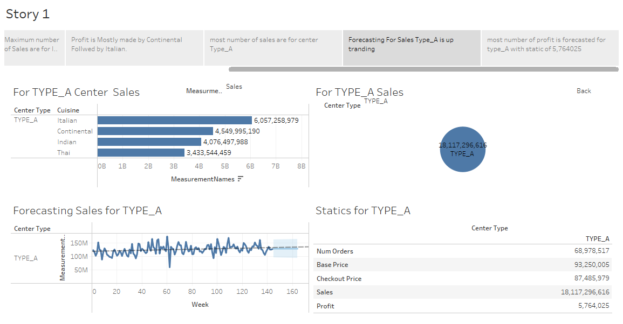

Slide 19
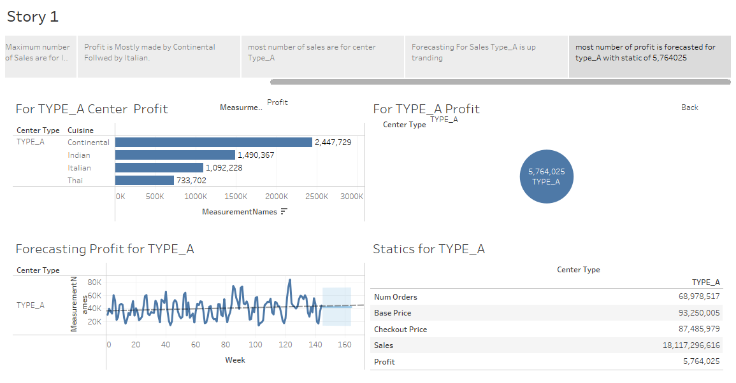

Slide 20
Summary
Observation’s are made in detailed view as follows
Maximum number of order and Sales are for Italian Cuisine. Beverages are most ordered. Line chart is used Dashboard and Story is made for impactful visualization.
Profit is Mostly made by Continental Followed by Italian.
most number of sales are for center Type_A category
Forecasting For Sales Type_A is up trending upwards. Forecasting is made for each measure values as number of orders profit.
most number of profit is forecasted for type_A with static of 5,764025
Various Charts ,Parameters and Filters have been used For better Visualization multilevel dashboard story have been use for impact

