Slide 1
EDA Project Play Store App Review Analysis

Slide 2
Points for Discussion
Objective
Data Summary
Defining the success of an app
Android version compatibility
Paid app vs Free app
Correlation between various parameters
App Category analysis
App Genres analysis
App Content rating analysis
App Rating analysis
App Reviews analysis
App Reviews sentiment analysis
Statistical insights
Top 100 Revenue making app analysis
Conclusion

Slide 3
Objective
To do investigations on data so as to discover patterns, to spot anomalies, to find conclusions with the help of statistics and graphical representations.
To find all the key parameters that is responsible to success of an app.
To find insights of how each parameter is affecting the app-making businesses.
To dig deeper and exploring all the possible hidden opportunities available that can drive the app-making businesses to success.

Slide 4
Data Summary
Play Store Data Description
App: It contains the app name.
Category: It assigns the app a category.
Rating: It contains the average rating given to the app by its users.
Reviews: It displays the number of people who have left a review for the relevant app.
Size: It contains the amount of disc space necessary to install the relevant app.
Installs: It displays the number of times the app was downloaded.
Type: It specifies if an app is free or paid.
Price: It gives the price of the app required to install the app.
Content rating: It specifies whether or not an app is appropriate for all age groups.
Genres: It specifies the genre(s) to which the app belongs.
Last updated: It indicates when the most recent update was released.
Current Ver: It displays the current version of the app.
Android Ver: It provides the Android version of the corresponding app.
User Reviews Data Description
App : It contains the name of the app with a short description (optional).
Translated_Review: It contains the English translation of the review dropped by the user of the app.
Sentiment: It gives the attitude/emotion of the writer. It can be ‘Positive’, ‘Negative’, or ‘Neutral’.
Sentiment_Polarity: It gives the polarity of the review. Here 1 means ‘Positive statement’ and -1 means a ‘Negative statement’.
Sentiment_Subjectivity: This value gives how close a reviewer’s opinion is to the opinion of the general public.

Slide 5

Defining the success of an app
The success of a free app can be defined by the number of installs, while the success of a paid app can be defined by the number of installs and the revenue that it generates.
Moreover the app’s ratings, reviews also an important parameter as it shows the public interest.
So, in our analysis, we are primarily focused on all of the key aspects and insights related to increasing the number of installs and revenue.

Slide 6
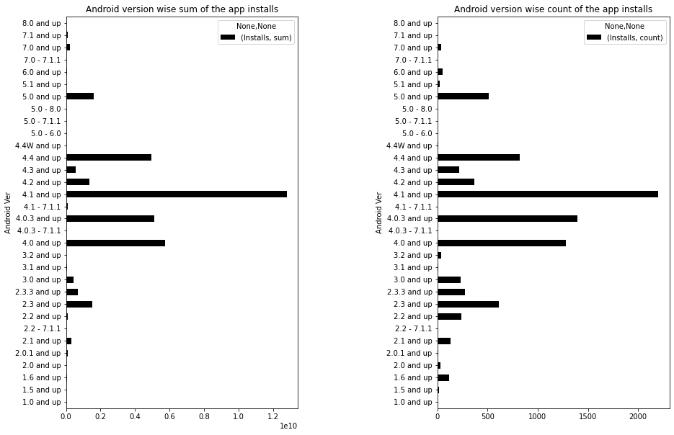

Android version compatibility
The most of the app available on play store supports the android version 4.x and up and also the mostly users are using the apps that is compatible till version 4.x.
It might possible that most android users are using device with android version 4.x.
Therefore, the new app should also be compatible till android version 4.x.

Slide 7
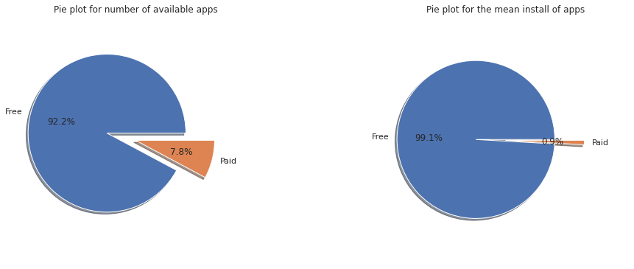
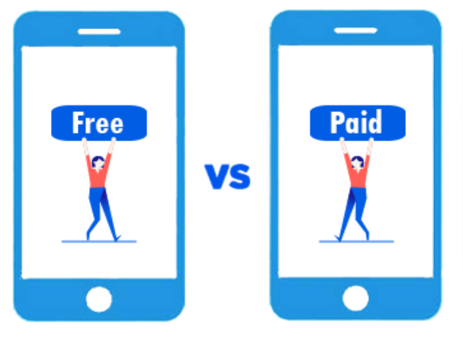
Paid app vs Free app
Key points:
The number of paid apps is 7.8 percent of the total available apps.
The average install of paid apps is 0.9 percent of the average install of all apps.
Since the percentage of available free apps is lesser than the percentage of average install of free apps therefore the free apps are in more demand as compared to paid apps.

Slide 8
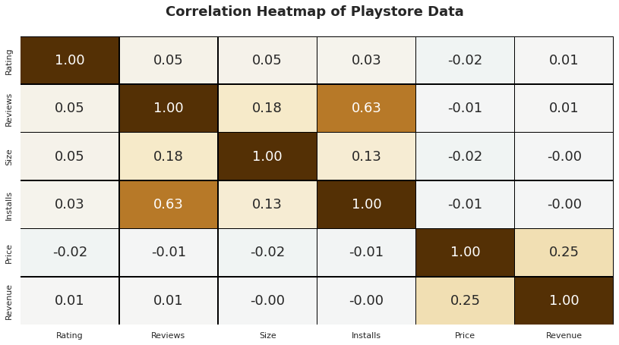
Correlation between various parameters.
Key points:
The Reviews and Installs columns have a strong positive correlation. This shows that higher the install the higher will be the reviews.
Price is slightly inversely connected to Rating, Reviews, and Installs. This means that as the app's price rises, the average rating, total number of reviews, and Installs decrease significantly.
The Rating column has a minor positive correlation with the Installs and Reviews columns. This suggests that as the average user rating rises, so will the number of app installs and reviews.

Slide 9
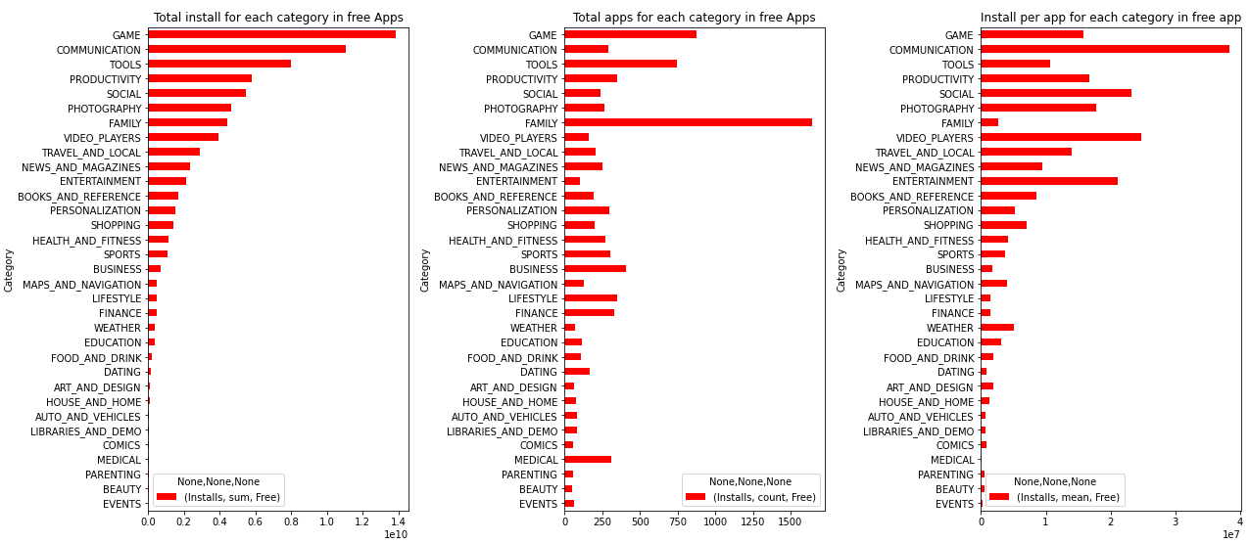
App Category analysis: Free apps (Install analysis)
Top Categories for free apps by total installs.
Game
Communication
Tools
Productivity
Social
Photography
Top Categories for free apps by mean installs.
Communication
Video player
Social
Entertainment
Photography
Productivity
Key points:
From first bar plot, the top 6 free apps category that has maximum number of total installs are: Game, Communication, Tool, Productivity, Social, Photography. But from second bar plot, among above top 6 free apps category, the number of available apps for Communication, Productivity, Photography and Social is relatively low. Hence the demand of these apps is high as total install by user is high but available apps for user is less.
The third bar plot shows that the mean install per app. Here greater the average install per app means that the demand for that category is high.

Slide 10
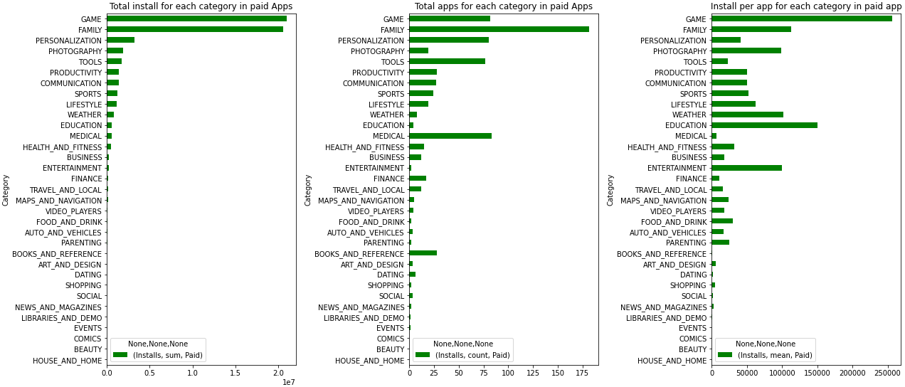
App Category analysis: Paid apps (Install analysis)
Top Categories for paid apps by total installs.
Game
Family
Personalization
Photography
Tools
Productivity
Top Categories for paid apps by mean installs.
Game
Education
Family
Weather
Entertainment
Photography
Key points:
From first bar plot, the top 6 paid apps category that has maximum number of total installs are: Game, Family, Personalization, Photography, Tools, Productivity. But from second bar plot, among above top 6 paid apps category, the number of available apps for Game, Personalization, Photography, Tools, and Productivity is relatively low. Hence the demand of these apps is high as total install by user is high but available apps for user is less.
The third bar plot shows that the mean install per app. Here greater the average install per app means that the demand for that category is high.

Slide 11
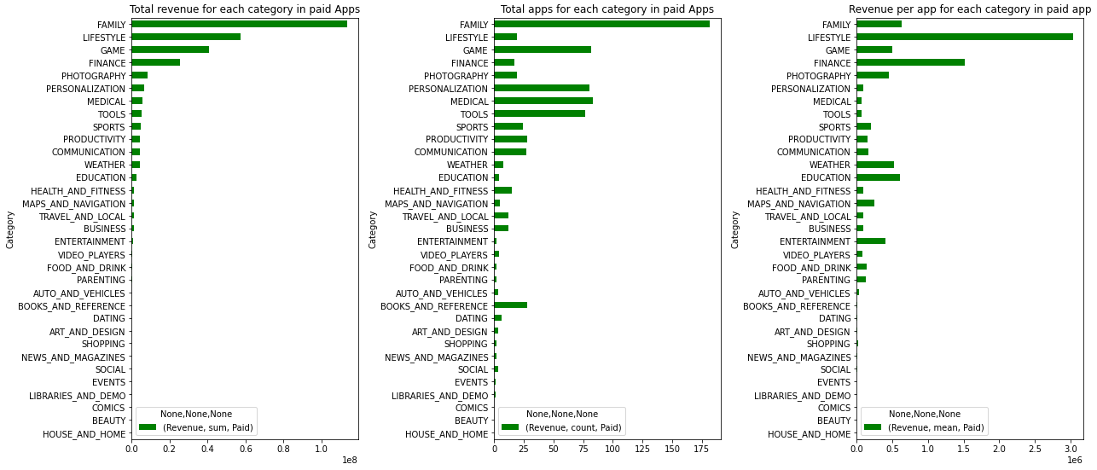
App Category analysis: Paid apps (Revenue analysis)
Top Categories for paid apps by total installs.
Game
Family
Personalization
Photography
Tools
Productivity
Top Categories for paid apps by mean installs.
Game
Education
Family
Weather
Entertainment
Photography
Key points:
From first bar plot, the top 6 paid apps category that has maximum number of total installs are: Game, Family, Personalization, Photography, Tools, Productivity. But from second bar plot, among above top 6 paid apps category, the number of available apps for Game, Personalization, Photography, Tools, and Productivity is relatively low. Hence the demand of these apps is high as total install by user is high but available apps for user is less.
The third bar plot shows that the mean install per app. Here greater the average install per app means that the demand for that category is high.

Slide 12
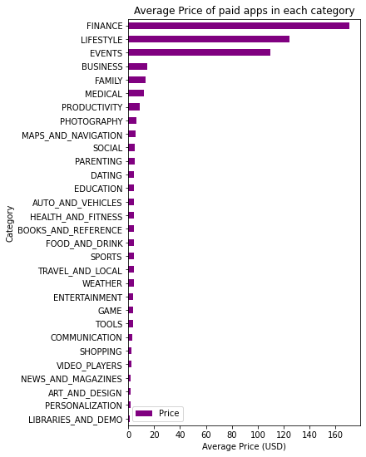
App Category analysis: Paid apps (Price analysis)
For the paid apps the top 5 highest average price categories are:
Finance
Lifestyle
Events
Business
Family

Slide 13
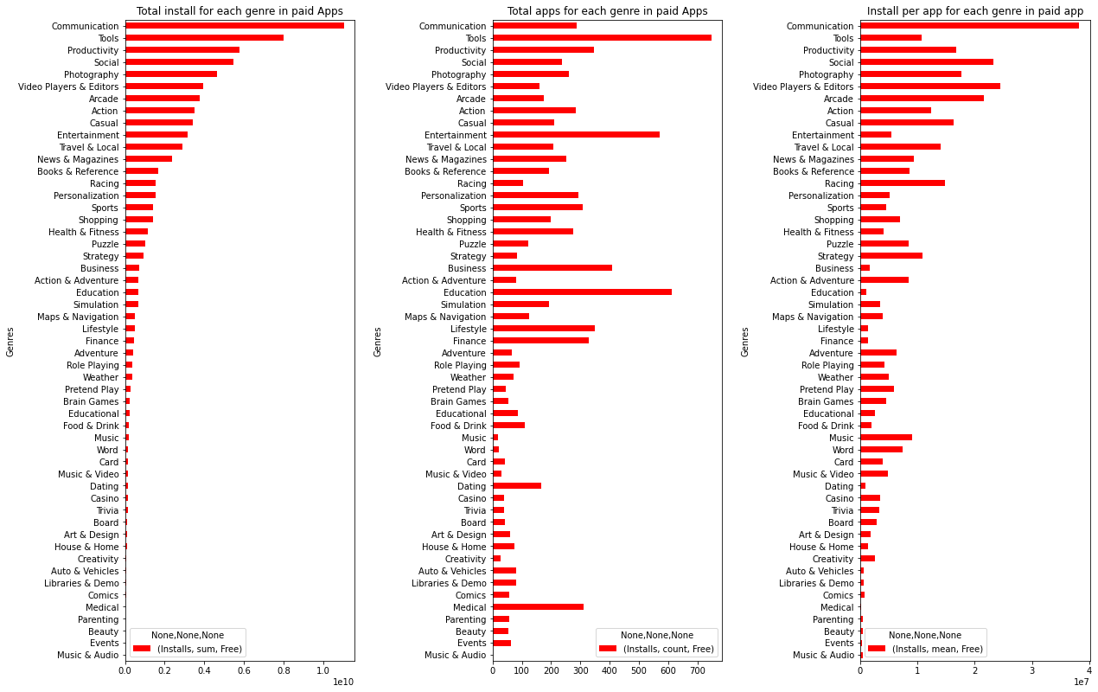
App genre analysis: Free apps (Install analysis)
Top Categories for free apps by total installs.
Communication
Tools
Productivity
Social
Photography
Top Categories for free apps by mean installs.
Communication
Video player & Editors
Social
Arcade
Photography
Key points:
The first plot gives the total install of all apps of that particular genre. The second plot gives the total apps available in that genre. The third gives the average app install in that genre.
If the total installs are high but apps are less then it means that genre is in demand. Also, greater the average install per app tells that the apps for that genre is in demand.

Slide 14
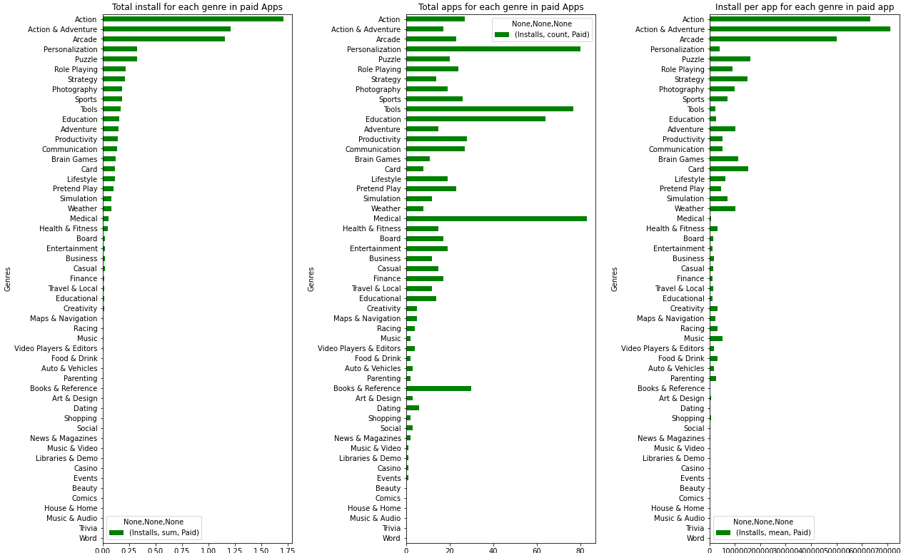
App genre analysis: Paid apps (Install analysis)
Top Categories for paid apps by total installs.
Action
Action & Adventure
Arcade
Personalization
Puzzle
Top Categories for paid apps by mean installs.
Action & Adventure
Action
Arcade
Puzzles
Role play
Key points:
The first plot gives the total install of all apps of that particular genre. The second plot gives the total apps available in that genre. The third gives the average app install in that genre.
If the total installs are high but apps are less then it means that genre is in demand. Also, greater the average install per app tells that the apps for that genre is in demand.

Slide 15
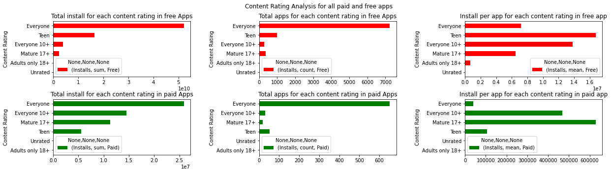
App content rating analysis: Free and Paid apps using Install
Key points:
Top 5 total revenue making genres are Arcade; Action & adventure, Lifestyle, Action, Finance, Entertainment
Top 5 genres with maximum number of available apps are Role Playing, Action, Finance, Lifestyle, Entertainment
Top 5 per mean revenue making genres are Arcade; Action & adventure, Lifestyle, Finance, Action, card; Action & adventure

Slide 16
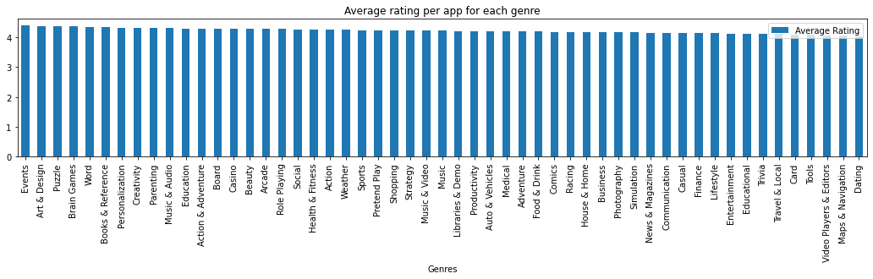
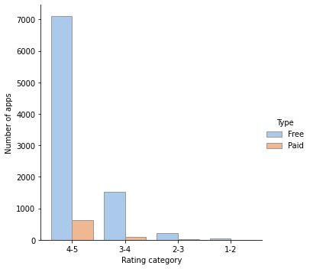
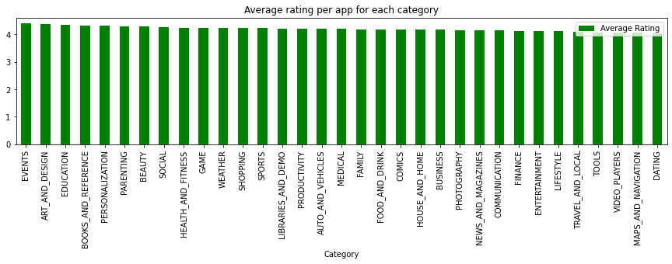
App rating analysis
 | Highest rating | Lowest rating
Genre | 1. Events 2. Art & Design 3. Puzzles | 1. Dating 2. Maps & Navigation 3. Video player & Editors
Category | 1. Events 2. Art & Design 3. Education | 1. Dating 2. Maps & Navigation 3. Video players

Slide 17
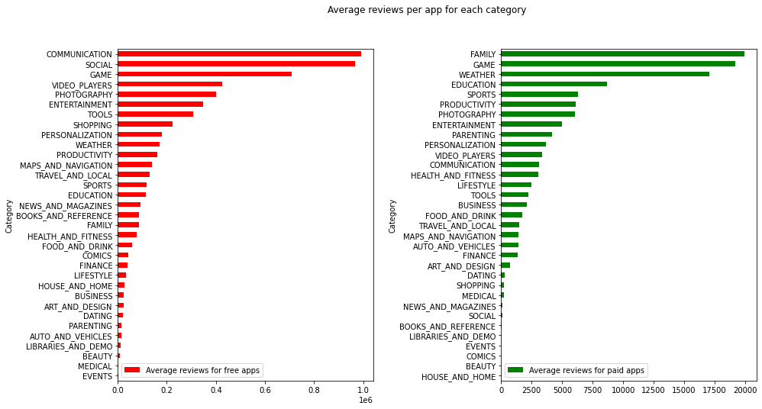
App reviews analysis
In free apps, the highest reviews are in the following categories.
1. Communication
2. Social
3. Game
4. Video players
5. Photography
In paid apps, the highest reviews are in the following categories.
1. Family
2. Game
3. Weather
4. Education
5. Sports

Slide 18
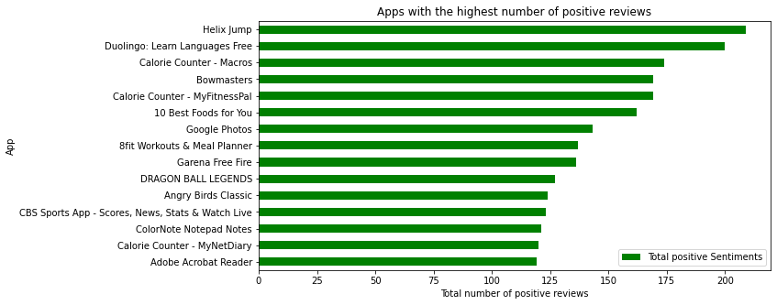
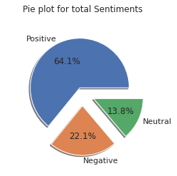
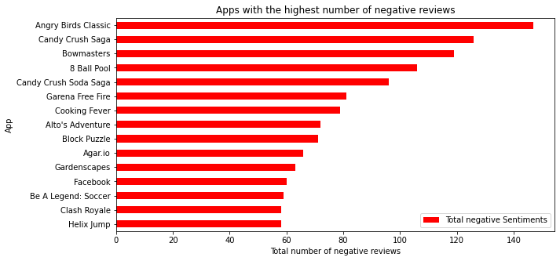
App Review’s sentiment analysis: Review’s sentiment
Key point:
As an average, for an app there are a total of 64.1% positive reviews, 13.8% of negative reviews, and 22.1% of negative reviews.

Slide 19
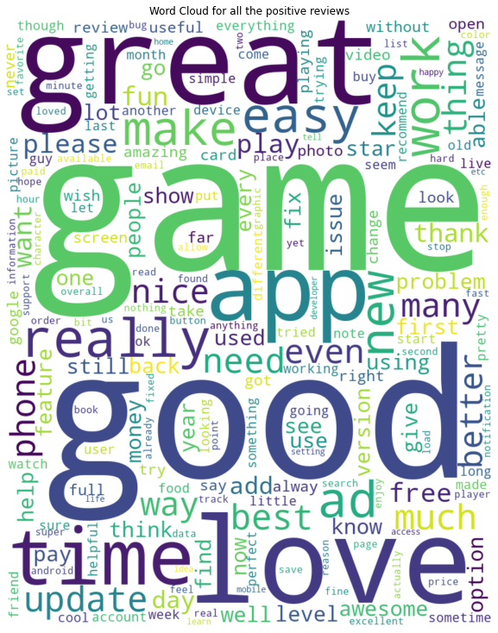
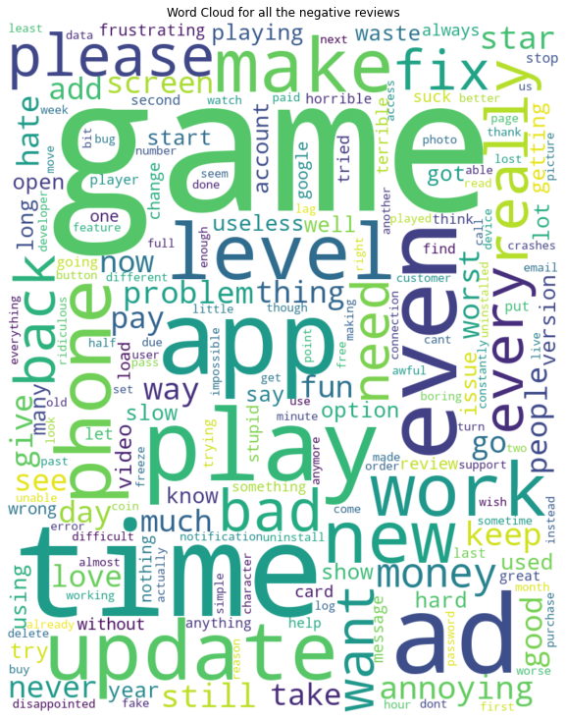

App Review’s sentiment analysis: Word Cloud
The most used words for the positive and negative reviews are shown in the form of word cloud.
The first cloud gives the positive reviews while the second cloud gives the negative reviews.

Slide 20
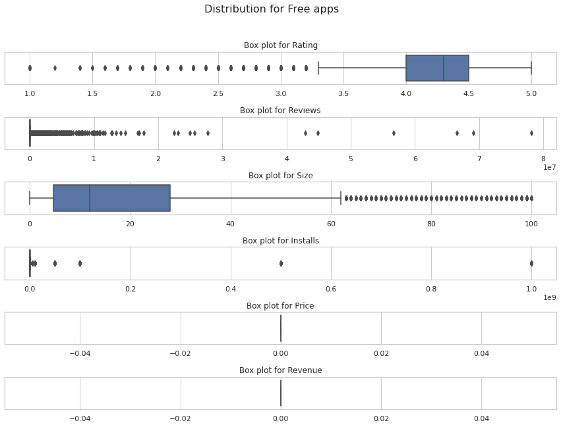
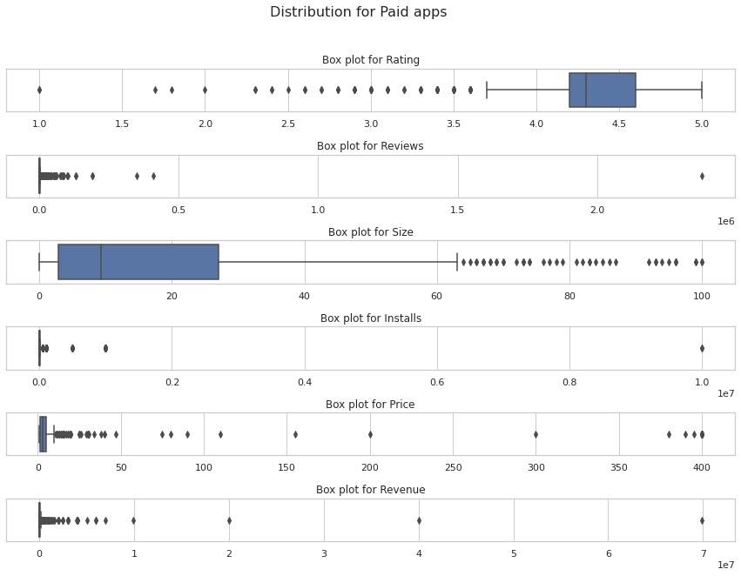


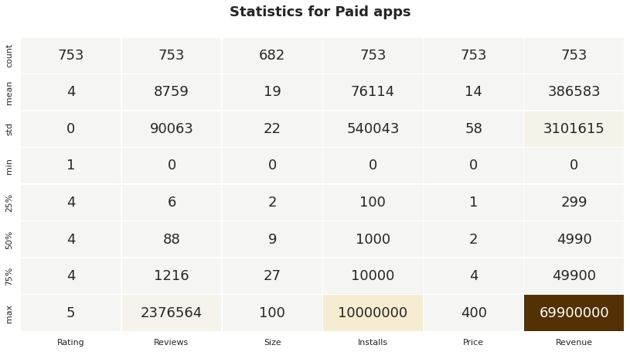
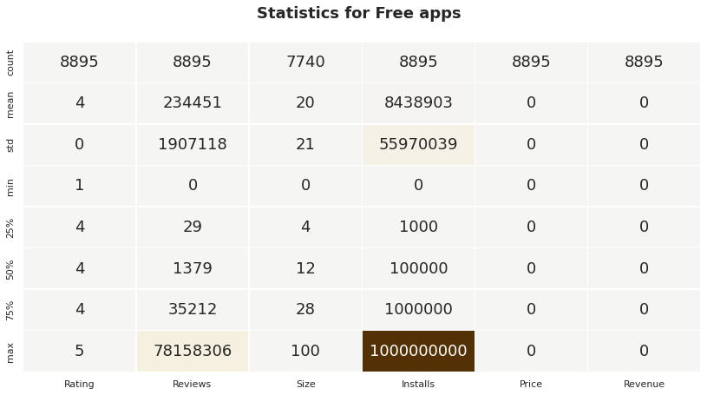
Statistical analysis of Free and Paid apps
Key points:
Rating is left skewed for both free and paid apps, therefore there are only few apps for which the rating is very less.
Review is right skewed for both free and paid apps, therefore there are only few apps for which the review is very high.
Size is right skewed for both free and paid apps, therefore there are only few apps for which the size is very high.
Installs is right skewed for both free and paid apps, therefore there are only few apps for which the install is very high.
For paid apps the price and revenue is also right skewed, therefore there are only few paid apps for which the price and revenue is very high.
For paid apps, median rating is 4, median reviews is 88, median size is 9 MB, median installs are 1000, median price is $2, median revenue is $4990.
For free apps, median rating is 4, median reviews is 1379 , median size is 12 MB, median installs are 100000.

Slide 21
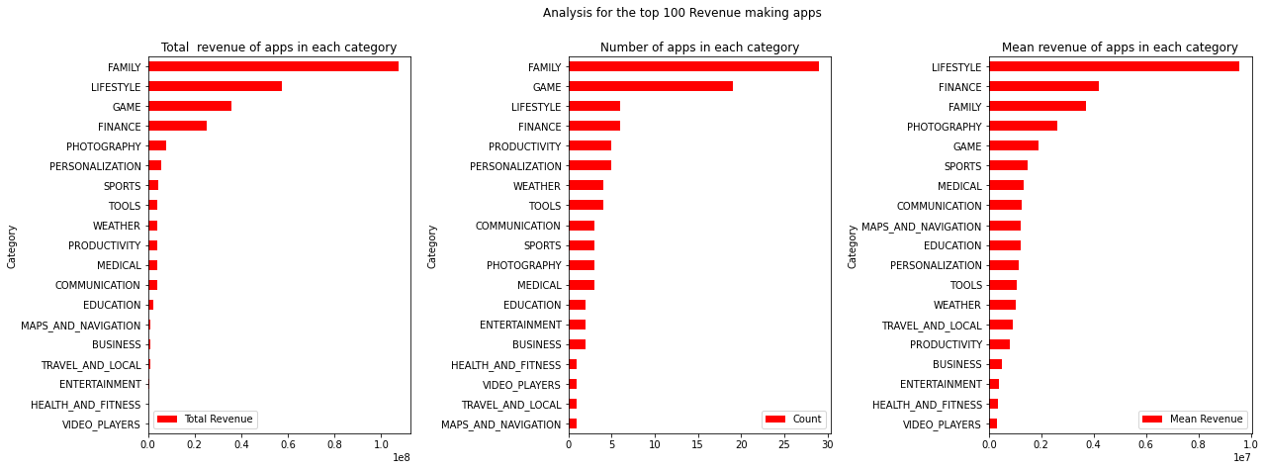
Top 100 Revenue making apps: Category (Revenue analysis)
Key points:
Top 5 total revenue making category are Family, Lifestyle, Game, Finance, Photography
Top 5 category with maximum number of available apps are Family, Lifestyle, Game, Finance, Photography
Top 5 per mean revenue making category are Lifestyle, Finance, Family, Photography, Game

Slide 22
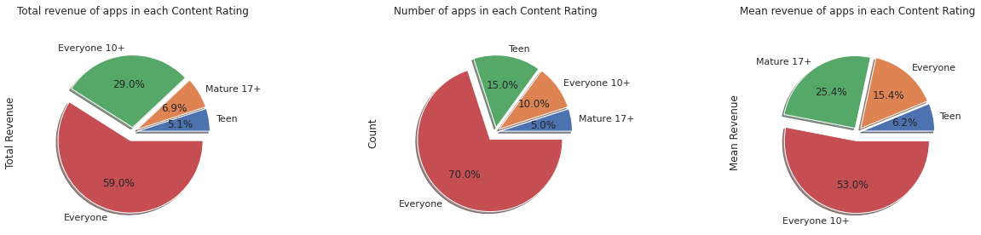
Top 100 Revenue making apps: Content rating (Revenue analysis)
Key points:
The maximum total revenue comes from the category Everyone, and Everyone 10+
The maximum apps are in the category Everyone, and Teen.
The maximum revenue per app comes from Everyone 10+, and Mature 17+.

Slide 23
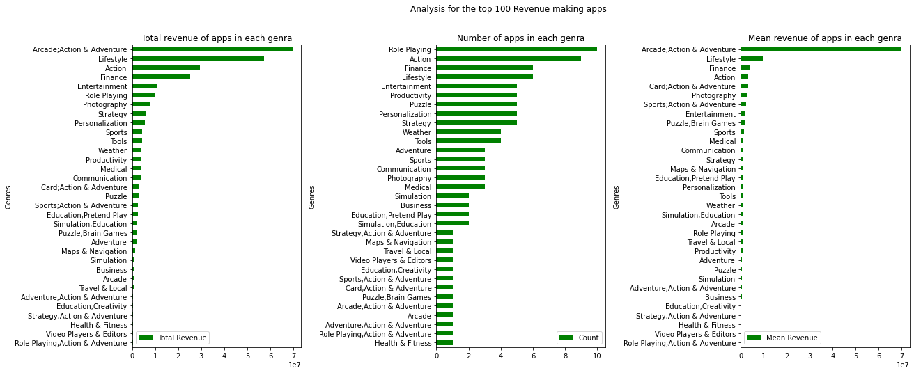
Top 100 Revenue making apps: Genres (Revenue analysis)
Key points:
Top 5 total revenue making genres are Arcade; Action & adventure, Lifestyle, Action, Finance, Entertainment
Top 5 genres with maximum number of available apps are Role Playing, Action, Finance, Lifestyle, Entertainment
Top 5 per mean revenue making genres are Arcade; Action & adventure, Lifestyle, Finance, Action, card; Action & adventure

Slide 24

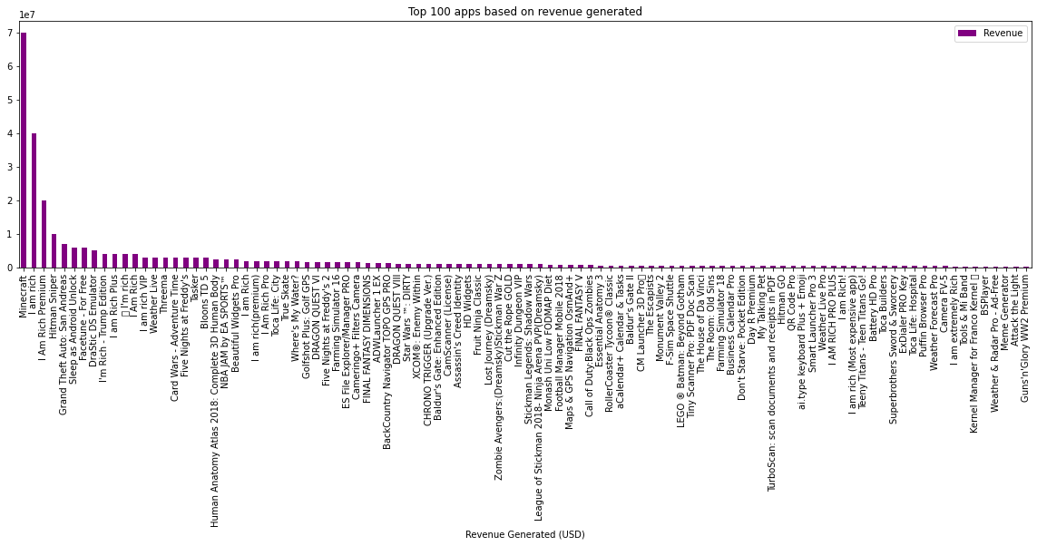
Top 100 Revenue making apps: App list
Top 5 Revenue making apps are:
Minecraft
I am rich
I Am Rich Premium
Hitman Sniper
Grand Theft Auto: San Andreas

Slide 25
Conclusion
The app engagement and success can be expressed with the app’s total installs and the revenue it generating.
The demand of free apps is higher than the paid apps, so you can give priority to free apps.
In free apps, the category of Communication, Social, Game, Productivity, and Tools will be the best choice to increase the app install.
In paid apps, the category of Game, Family, Photography, Personalization, and Tools will be the best choice to increase the app install.
In paid apps, the category of Lifestyle, Finance, Family, Game, Photography will be the best choice to increase the app Revenue.
In free apps, the genre of Communication, Social, Productivity, Photography and Tools will be the best choice to increase the app install.
In paid apps, the genre of Action, Action & Adventure, Arcade will be the best choice to increase the app Revenue.
In Free apps, the content rating of Everyone, and Teen will increase the app installs and in paid apps, the content rating of Everyone 10+, Mature 17+ will increase the app installs.
An quality app in the lowest rating apps genre or category like Dating, Maps & Navigation, Video players can give a fruitful result.
Apps like Helix Jump, Duolingo, Calorie Counter, Bowmasters, 10 Best foods for you, google photos, Bfit Workouts & Meal Planner have highest number of positive reviews.
The median size of paid apps is 9 MB, and the median price of paid app is $2. The median size of free app is 12 MB.
In top 100 revenue making apps, apps from the category Lifestyle, Finance, and Family have highest average revenue per app.
In top 100 revenue making apps, apps from the content rating Everyone, Everyone 10+ making highest total revenue but apps for Everyone 10+, Mature 17+ are very limited therefore the average revenue per app in content rating Everyone 10+, Mature 17+ is highest. These two category should be preferred.
In top 100 revenue making apps, apps from the genre Arcade;Action & Adventure, Lifestyle, Finance have highest average revenue per app.

Slide 26

Thank you for your attention.
Have a good day!

