Slide 1
NoSQL Databases
Architecture, CRUD and practical demonstrations
Redis / Cassandra / MongoDB / Neo4j
Bharat Yadav | BT24GCS397
CS 3102 · Dimensional and NoSQL Databases · NIIT University
Screenshots captured on 29 October 2026
Notes:
Source screenshots and manifest: D:\GitHub Repo\University Projects\Seminar\Dimensional-and-NoSQL-Databases-Seminar\screenshots
The images document the demonstrations captured on 29 October 2026.

Slide 2
Seminar scope
Four database models
Explore Redis, Cassandra, MongoDB and Neo4j through the same student and course example.
Practical work
Install with Docker Compose, run CLI and Python CRUD, verify sample data, and retain original screenshots.
Evaluation
Compare strengths, disadvantages and industry applications. Explain the limits of a local deployment.
02
Notes:
Sources:
Local project: D:\GitHub Repo\University Projects\Seminar\Dimensional-and-NoSQL-Databases-Seminar

Slide 3
NoSQL and relational databases
NoSQL
A family of databases with key–value, document, wide column and graph models. Choose a model around the data and the queries.
RDBMS
Tables, keys, constraints and SQL support structured relationships and transactions. Relational systems can also scale and store JSON.
Where the difference matters
Flexible records, very large write workloads or repeated graph traversals may favor a NoSQL model. No database is best for every task.
03
Notes:
Sources:
Local project: D:\GitHub Repo\University Projects\Seminar\Dimensional-and-NoSQL-Databases-Seminar

Slide 4
Four NoSQL data models
Database | Model | Student representation | Query interface
Redis | Key–value | Hash at seminar:student:101 | redis-cli commands
Cassandra | Wide column | Row partitioned by student_id | CQL / cqlsh
MongoDB | Document | BSON document in students | mongosh / drivers
Neo4j | Graph | Student → ENROLLED_IN → Course | Cypher / Browser
04
Notes:
Comparison based on the project configuration and official database documentation.
https://redis.io/docs/latest/operate/oss_and_stack/management/persistence/
https://cassandra.apache.org/doc/latest/cassandra/architecture/dynamo.html
https://www.mongodb.com/docs/manual/reference/bson-types/
https://neo4j.com/docs/getting-started/whats-neo4j/

Slide 5
Consistency and transactions
CAP during a network partition
A distributed service cannot guarantee both linearizable consistency and availability for every request when communication is partitioned.
ACID and BASE
ACID describes transaction guarantees. BASE describes designs that may accept temporary inconsistency. NoSQL does not automatically mean no transactions.
The local demonstration
One instance per database on one laptop. It demonstrates APIs and persistence, but does not demonstrate cluster failover or a CAP partition experiment.
05
Notes:
Sources:
https://cassandra.apache.org/doc/latest/cassandra/architecture/dynamo.html
https://www.mongodb.com/docs/v8.0/data-modeling/enforce-consistency/transactions/
https://neo4j.com/docs/getting-started/whats-neo4j/
Local project: D:\GitHub Repo\University Projects\Seminar\Dimensional-and-NoSQL-Databases-Seminar

Slide 6
Windows installation with Docker Compose
1 Start Docker Desktop
Use the WSL 2 backend and Linux containers. Check docker version, docker compose version and docker info.
2 Prepare the project
Open PowerShell in the repository. Run scripts/setup.ps1 for initial setup, or scripts/start.ps1 for an existing installation.
3 Verify the databases
Run scripts/verify.ps1 -CheckSample. Open the shells with scripts/cli.ps1 -Database redis, cassandra, mongodb or neo4j.
06
Notes:
Sources:
https://docs.docker.com/engine/storage/volumes/
Local project: D:\GitHub Repo\University Projects\Seminar\Dimensional-and-NoSQL-Databases-Seminar

Slide 7
Images, ports and persistent storage
Database | Pinned image | Host ports | Named volume
Redis | redis:7.4.12-alpine | 6379 | redis_data
Cassandra | cassandra:5.0.9 | 9042 | cassandra_data
MongoDB | mongo:8.0.34 | 27017 | mongodb_data / mongodb_config
Neo4j | neo4j:5.26.32-community | 7474 / 7687 | neo4j_data / neo4j_logs
07
Notes:
Comparison based on the project configuration and official database documentation.
https://redis.io/docs/latest/operate/oss_and_stack/management/persistence/
https://cassandra.apache.org/doc/latest/cassandra/architecture/dynamo.html
https://www.mongodb.com/docs/manual/reference/bson-types/
https://neo4j.com/docs/getting-started/whats-neo4j/

Slide 8
Redis concepts
Data types
Strings store a value; hashes store fields; lists preserve order; sets keep unique members; sorted sets associate members with scores.
Caching and TTL
A time to live removes a key after a specified interval. The demo reads a cache value, waits for expiry and checks that the key is absent.
Persistence and Pub/Sub
The project enables AOF everysec plus RDB snapshots. Pub/Sub delivers live messages to subscribers; disconnected subscribers cannot replay them.
08
Notes:
Sources:
https://redis.io/docs/latest/operate/oss_and_stack/management/persistence/
https://redis.io/docs/latest/develop/pubsub/
Local project: D:\GitHub Repo\University Projects\Seminar\Dimensional-and-NoSQL-Databases-Seminar

Slide 9
Cassandra concepts
Partitioning and CQL
The partition key determines data placement. In university.students, student_id is the partition key. CQL looks like SQL but access patterns drive table design.
Replication and consistency
Replication factor is the number of stored copies. A consistency level controls the acknowledgments required for an operation. LOCAL_QUORUM needs a local majority.
What RF 1 demonstrates
Both LOCAL_ONE and LOCAL_QUORUM require one replica here. The successful commands do not establish resilience to node failure or compare real quorum behavior.
09
Notes:
Sources:
https://cassandra.apache.org/doc/latest/cassandra/architecture/dynamo.html
https://cassandra.apache.org/doc/latest/cassandra/developing/data-modeling/data-modeling_logical.html
Local project: D:\GitHub Repo\University Projects\Seminar\Dimensional-and-NoSQL-Databases-Seminar

Slide 10
MongoDB concepts
BSON documents
Documents can contain nested objects, arrays and typed values such as dates and ObjectIds. BSON is the binary representation used by MongoDB.
Schema flexibility
Documents can have different optional fields. The demo adds a project field. Validation can enforce required fields and types when the application needs them.
Indexes and atomicity
The unique student_id index supports lookup and rejects duplicates. IXSCAN is forced by a hint in the demo. Single-document writes are atomic; this standalone server does not support multi-document transactions.
10
Notes:
Sources:
https://www.mongodb.com/docs/manual/reference/bson-types/
https://www.mongodb.com/docs/manual/core/write-performance/
https://www.mongodb.com/docs/v8.0/data-modeling/enforce-consistency/transactions/
Local project: D:\GitHub Repo\University Projects\Seminar\Dimensional-and-NoSQL-Databases-Seminar

Slide 11
Neo4j concepts
Property graph
Nodes represent entities; labels group them; properties store attributes. Directed, typed relationships connect nodes and can also have properties.
Cypher patterns
MATCH finds patterns, CREATE adds data, SET updates properties and DETACH DELETE removes a node with its relationships. MERGE matches or creates a pattern.
Student enrollment
A Student node for Bharat Yadav is connected to Course CS3102 by ENROLLED_IN. Graph traversal retrieves the connected course directly.
11
Notes:
Sources:
https://neo4j.com/docs/getting-started/whats-neo4j/
https://neo4j.com/docs/getting-started/cypher/intro-tutorial/
Local project: D:\GitHub Repo\University Projects\Seminar\Dimensional-and-NoSQL-Databases-Seminar

Slide 12
Database comparison
Database | Data model | Main strength | Main limitation | Typical use
Redis | Key–value with rich types | Fast memory access; TTL | RAM cost; durability needs configuration | Cache; session state
Cassandra | Wide column | Distributed writes and replication | Query driven schema; cluster operations | Events; time series
MongoDB | BSON documents | Nested data and flexible fields | Indexes and duplication add cost | Content; product catalogs
Neo4j | Property graph | Relationship traversal and patterns | Memory and graph modeling costs | Fraud; knowledge graphs
12
Notes:
Comparison based on the project configuration and official database documentation.
https://redis.io/docs/latest/operate/oss_and_stack/management/persistence/
https://cassandra.apache.org/doc/latest/cassandra/architecture/dynamo.html
https://www.mongodb.com/docs/manual/reference/bson-types/
https://neo4j.com/docs/getting-started/whats-neo4j/

Slide 13
Redis and Cassandra in industry
Redis | Twitter and session stores
Timeline caching reduces repeated work. Session IDs can map to expiring server-side state. The GitHub session example in the brief is a design scenario: its 2013 article describes ActiveRecord sessions, not proof of a Redis session deployment.
Cassandra | Netflix
The 2022 RENO engineering article describes Cassandra as persistent storage for device notifications, allowing devices to poll later.
Cassandra | Uber
Uber’s 2018 M3 article describes early Cassandra time-series storage and its later move to M3DB. This is a historical example of the workload, rather than a claim about the present stack.
13
Notes:
Sources:
https://www.infoq.com/presentations/real-time-twitter/
https://github.blog/news-insights/the-library/modeling-your-app-s-user-session/
https://netflixtechblog.com/rapid-event-notification-system-at-netflix-6deb1d2b57d1
https://www.uber.com/py/en/blog/m3/
Local project: D:\GitHub Repo\University Projects\Seminar\Dimensional-and-NoSQL-Databases-Seminar

Slide 14
MongoDB and Neo4j in industry
MongoDB | Forbes and eBay
Forbes uses MongoDB for content management. Documents fit articles and evolving metadata. A 2017 eBay case describes customer-facing applications and resilient database deployments.
Neo4j | Financial fraud
Connect accounts, devices, addresses and transfers. Shared identities, suspicious paths and transaction cycles help investigators find related activity.
Neo4j | E-commerce knowledge graphs
Connect products, categories, brands and customer interests. Relationship queries support discovery and explainable recommendations; the exact model depends on the application.
14
Notes:
Sources:
https://www.mongodb.com/solutions/customer-case-studies/forbes
https://www.mongodb.com/company/blog/technical/ebay-building-mission-critical-multi-data-center-applications-with-mongodb
https://neo4j.com/use-cases/fraud-detection/
https://neo4j.com/use-cases/knowledge-graph/
Local project: D:\GitHub Repo\University Projects\Seminar\Dimensional-and-NoSQL-Databases-Seminar

Slide 15
Python CRUD with official database drivers
Run the demonstration
scripts/python-demo.ps1 builds a Python 3.12 client image and runs redis-py, cassandra-driver, PyMongo and the Neo4j driver.
What the program checks
Create a temporary student, read semester 5, update to semester 6 and delete the test record. Neo4j also creates and traverses the enrollment relationship.
Repeatable execution
A fresh test ID avoids changing permanent student 101. Parameterized queries and environment variables keep data and credentials out of query text.
15
Notes:
Sources:
https://neo4j.com/docs/getting-started/cypher/intro-tutorial/
https://www.mongodb.com/docs/v8.0/data-modeling/enforce-consistency/transactions/
Local project: D:\GitHub Repo\University Projects\Seminar\Dimensional-and-NoSQL-Databases-Seminar

Slide 16
Results and limitations
Verified results
Four healthy services; successful real queries; shared student sample and relationship present. Python CRUD passed in all four databases.
Durability demonstration
Named volumes preserve data when containers are recreated. Redis also needs persistence enabled to restore in-memory records.
Limits of this experiment
One host and one instance per database; Cassandra RF 1; standalone MongoDB; no failover, production load test or performance ranking.
16
Notes:
Sources:
https://docs.docker.com/engine/storage/volumes/
https://redis.io/docs/latest/operate/oss_and_stack/management/persistence/
https://www.mongodb.com/docs/v8.0/data-modeling/enforce-consistency/transactions/
Local project: D:\GitHub Repo\University Projects\Seminar\Dimensional-and-NoSQL-Databases-Seminar

Slide 17
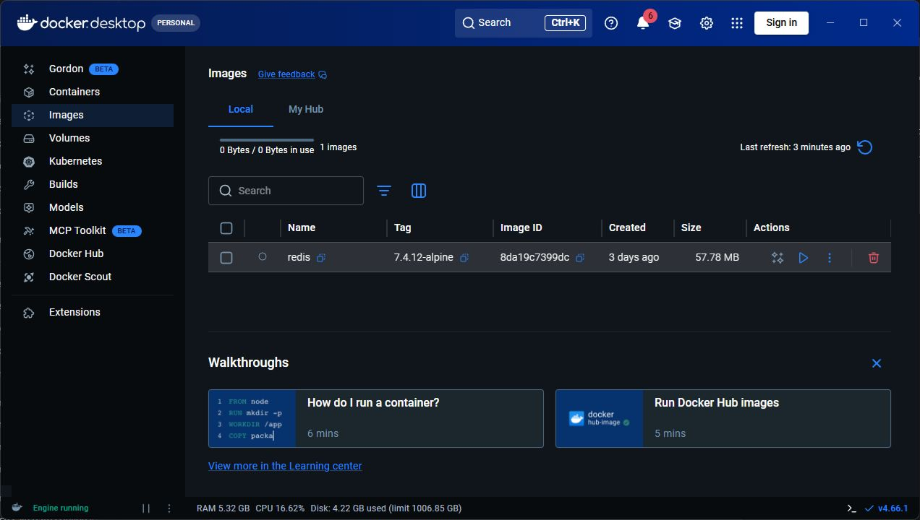
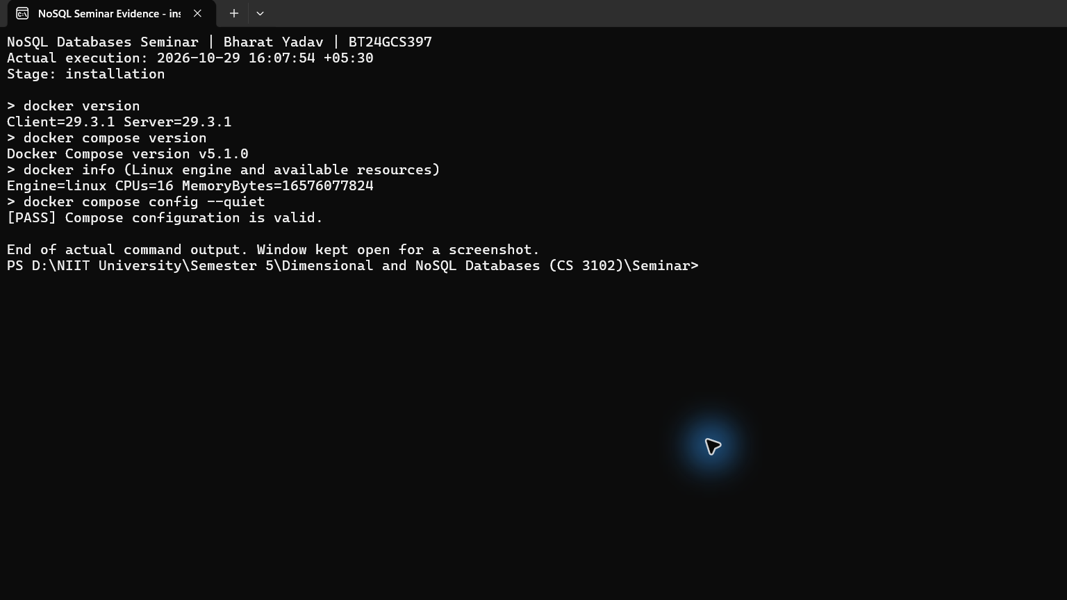
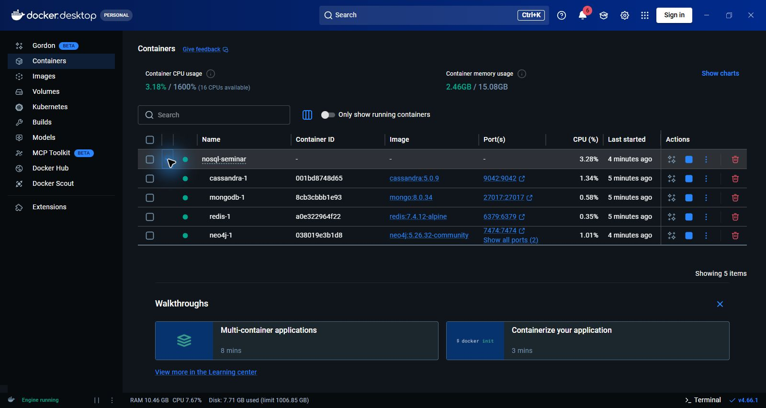
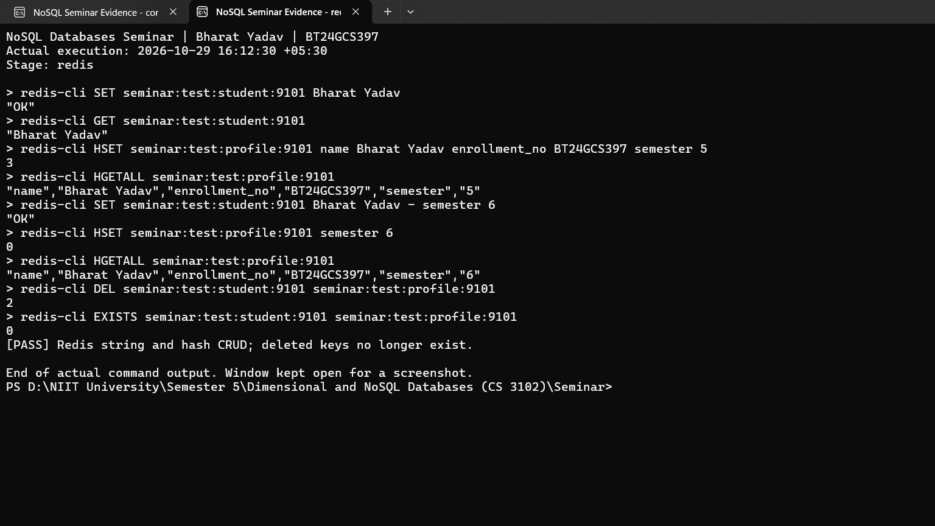
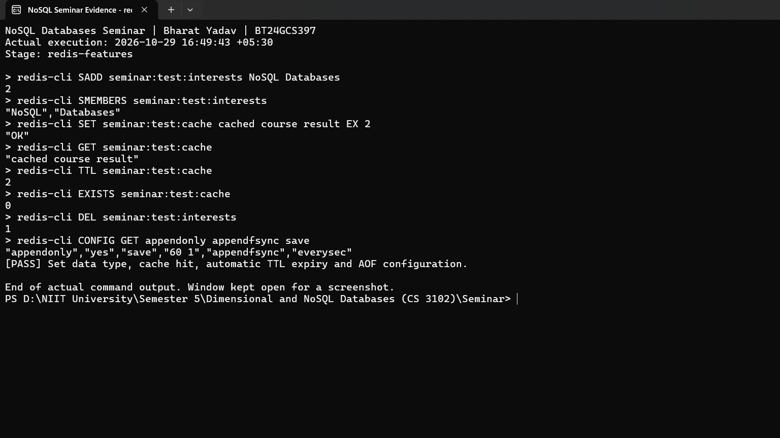
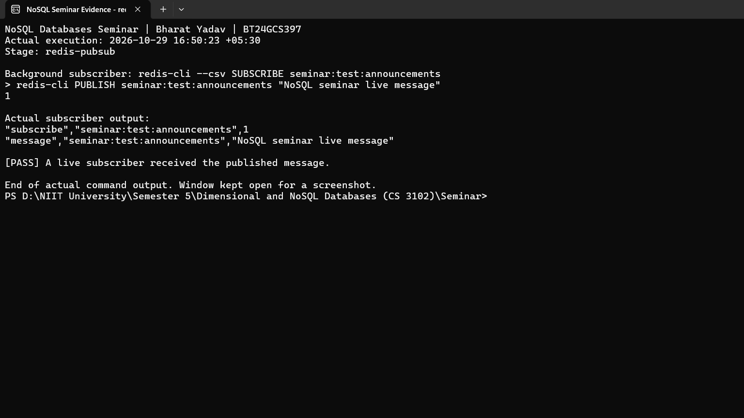
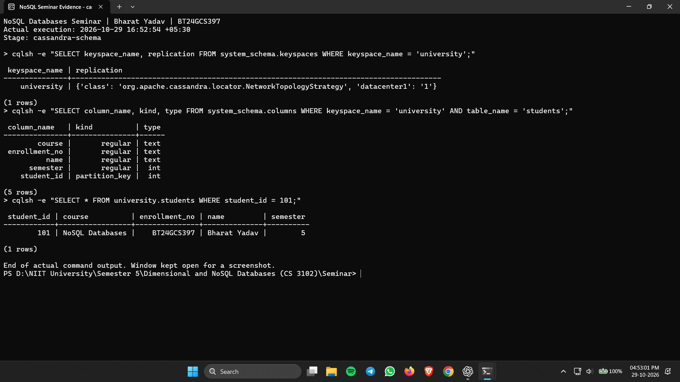
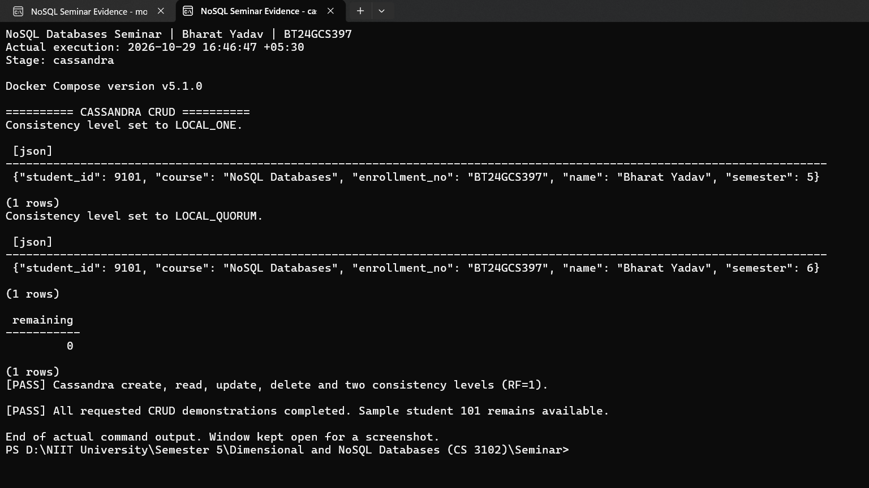
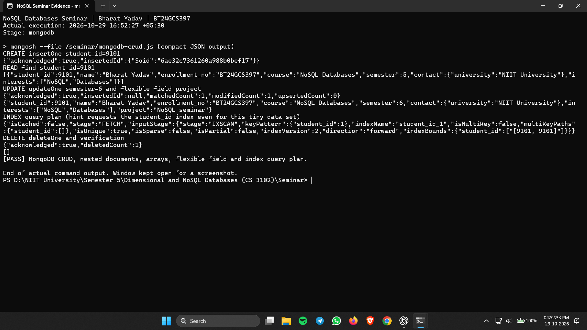
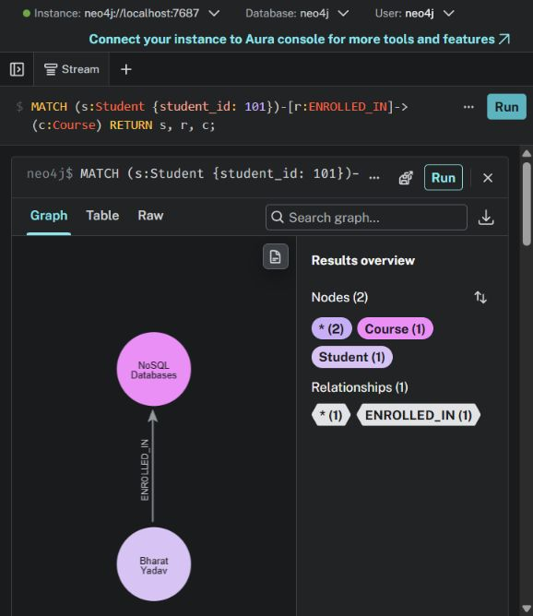
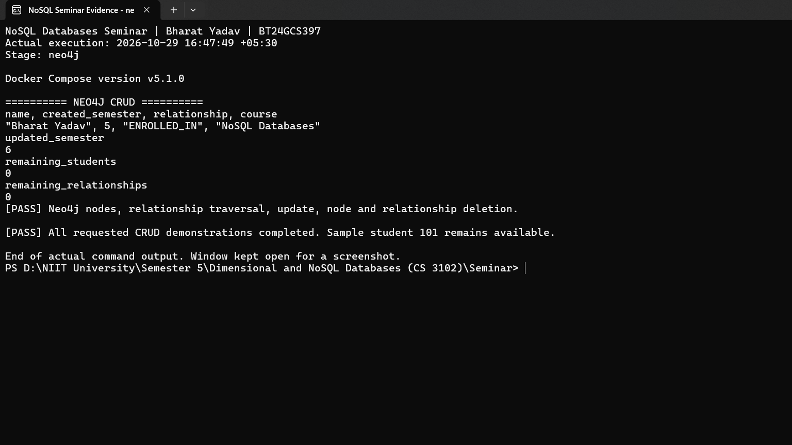
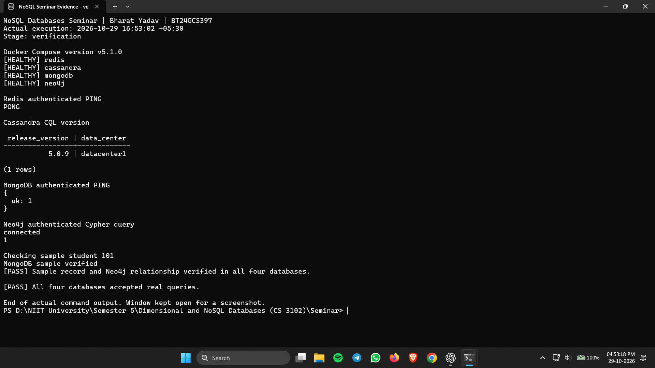
All captured screenshots
12 original captures · Enlarged views follow
01 Initial download
02 Installation checks
03 Running containers
04 Redis CRUD
05 Redis cache and AOF
06 Redis Pub/Sub
07 Cassandra schema
08 Cassandra CRUD
09 MongoDB CRUD and index
10 Neo4j graph
11 Neo4j CRUD
12 Final verification
17
Notes:
1. D:\GitHub Repo\University Projects\Seminar\Dimensional-and-NoSQL-Databases-Seminar\screenshots\00_docker_desktop_initial.png
SHA-256: 6ff0ab466462b7b1b528ceb99f9095e92cbb8cd0a945bc1030727eeeac77c971
2. D:\GitHub Repo\University Projects\Seminar\Dimensional-and-NoSQL-Databases-Seminar\screenshots\01_docker_installation.png
SHA-256: 3914dd04cdd1d79f17e20c14c90c340d4a7f5169bf11626037c1dfa654425a8d
3. D:\GitHub Repo\University Projects\Seminar\Dimensional-and-NoSQL-Databases-Seminar\screenshots\02_docker_containers.png
SHA-256: a988397474ad312ce87fafb1f8cd58e5f79c78b28fda905fad9be760459d5049
4. D:\GitHub Repo\University Projects\Seminar\Dimensional-and-NoSQL-Databases-Seminar\screenshots\03_redis_create_update_delete.png
SHA-256: 3a8fb80124f4743dc494c76121feb2a7c406aa01df01e90eded9b683d9a28fbd
5. D:\GitHub Repo\University Projects\Seminar\Dimensional-and-NoSQL-Databases-Seminar\screenshots\04_redis_cache_ttl_persistence.png
SHA-256: 8bdc18d23bbfa405913c41c6e8fcbab4afce2fd71c98d1e4ac08347c00c682b8
6. D:\GitHub Repo\University Projects\Seminar\Dimensional-and-NoSQL-Databases-Seminar\screenshots\05_redis_pubsub.png
SHA-256: 35035c15a013eebec5bebd00d259eda2c47b00f5442ff11caa4414a984bf1d31
7. D:\GitHub Repo\University Projects\Seminar\Dimensional-and-NoSQL-Databases-Seminar\screenshots\06_cassandra_keyspace.png
SHA-256: 9332868d97c2995cb4be4c54b144506acc1d6ebe96b5d6b25b48b603f95577e0
8. D:\GitHub Repo\University Projects\Seminar\Dimensional-and-NoSQL-Databases-Seminar\screenshots\07_cassandra_crud.png
SHA-256: e136039a63e62e4729d1b8c73f6254ed476ada96c1e50ea145b2f4a5f8af7951
9. D:\GitHub Repo\University Projects\Seminar\Dimensional-and-NoSQL-Databases-Seminar\screenshots\08_mongodb_crud_indexing.png
SHA-256: a5725ba860e2451de4e0cf5e059f389d8f78b475015475210f0aa8bc16996f67
10. D:\GitHub Repo\University Projects\Seminar\Dimensional-and-NoSQL-Databases-Seminar\screenshots\12_neo4j_graph_visualization.jpg
SHA-256: bc45b6d8ce7fe7e98dbbdec11c2490e0e2b66ac13ab8de4b4abdca74a832d5a2
11. D:\GitHub Repo\University Projects\Seminar\Dimensional-and-NoSQL-Databases-Seminar\screenshots\13_neo4j_update_delete.png
SHA-256: 1f09890c76c8b4c228c8205f7bb7ed9ae52c5bcd2a803f0bccfcb5ae2a114089
12. D:\GitHub Repo\University Projects\Seminar\Dimensional-and-NoSQL-Databases-Seminar\screenshots\15_all_databases_verified.png
SHA-256: d048f270501412b6266a6407ef84e684368ade9274427be5c88b79c2cc3d8c19

Slide 18
Docker Desktop: initial setup
Docker Desktop during the initial image download, before all four services were ready.
18
Notes:
Docker Desktop during the initial image download, before all four services were ready.
Source: D:\GitHub Repo\University Projects\Seminar\Dimensional-and-NoSQL-Databases-Seminar\screenshots\00_docker_desktop_initial.png
SHA-256: 6ff0ab466462b7b1b528ceb99f9095e92cbb8cd0a945bc1030727eeeac77c971
Capture-file timestamp: 2026-10-29T16:07:24.3493284+05:30
Caption source: D:\GitHub Repo\University Projects\Seminar\Dimensional-and-NoSQL-Databases-Seminar\SCREENSHOT_GUIDE.md

Slide 19
Docker and Compose installation
Live Docker client/server details, Linux engine resources and Compose configuration validation.
19
Notes:
Live Docker client/server details, Linux engine resources and Compose configuration validation.
Source: D:\GitHub Repo\University Projects\Seminar\Dimensional-and-NoSQL-Databases-Seminar\screenshots\01_docker_installation.png
SHA-256: 3914dd04cdd1d79f17e20c14c90c340d4a7f5169bf11626037c1dfa654425a8d
Capture-file timestamp: 2026-10-29T16:08:05.9184986+05:30
Caption source: D:\GitHub Repo\University Projects\Seminar\Dimensional-and-NoSQL-Databases-Seminar\SCREENSHOT_GUIDE.md

Slide 20
Four database containers
The expanded nosql-seminar project shows Redis, Cassandra, MongoDB and Neo4j with their images and ports.
20
Notes:
The expanded nosql-seminar project shows Redis, Cassandra, MongoDB and Neo4j with their images and ports.
Source: D:\GitHub Repo\University Projects\Seminar\Dimensional-and-NoSQL-Databases-Seminar\screenshots\02_docker_containers.png
SHA-256: a988397474ad312ce87fafb1f8cd58e5f79c78b28fda905fad9be760459d5049
Capture-file timestamp: 2026-10-29T16:11:16.9977381+05:30
Caption source: D:\GitHub Repo\University Projects\Seminar\Dimensional-and-NoSQL-Databases-Seminar\SCREENSHOT_GUIDE.md

Slide 21
Redis: create, read, update and delete
String and hash commands create and update test records; deletion is confirmed by EXISTS returning zero.
21
Notes:
String and hash commands create and update test records; deletion is confirmed by EXISTS returning zero.
Source: D:\GitHub Repo\University Projects\Seminar\Dimensional-and-NoSQL-Databases-Seminar\screenshots\03_redis_create_update_delete.png
SHA-256: 3a8fb80124f4743dc494c76121feb2a7c406aa01df01e90eded9b683d9a28fbd
Capture-file timestamp: 2026-10-29T16:12:45.8106761+05:30
Caption source: D:\GitHub Repo\University Projects\Seminar\Dimensional-and-NoSQL-Databases-Seminar\SCREENSHOT_GUIDE.md

Slide 22
Redis: cache expiry and persistence
The cache key expires after its TTL; the configuration shows appendonly enabled and appendfsync everysec.
22
Notes:
The cache key expires after its TTL; the configuration shows appendonly enabled and appendfsync everysec.
Source: D:\GitHub Repo\University Projects\Seminar\Dimensional-and-NoSQL-Databases-Seminar\screenshots\04_redis_cache_ttl_persistence.png
SHA-256: 8bdc18d23bbfa405913c41c6e8fcbab4afce2fd71c98d1e4ac08347c00c682b8
Capture-file timestamp: 2026-10-29T16:49:51.3846285+05:30
Caption source: D:\GitHub Repo\University Projects\Seminar\Dimensional-and-NoSQL-Databases-Seminar\SCREENSHOT_GUIDE.md

Slide 23
Redis: publish and subscribe
A concurrent subscriber receives the published message; the publisher reports one subscriber.
23
Notes:
A concurrent subscriber receives the published message; the publisher reports one subscriber.
Source: D:\GitHub Repo\University Projects\Seminar\Dimensional-and-NoSQL-Databases-Seminar\screenshots\05_redis_pubsub.png
SHA-256: 35035c15a013eebec5bebd00d259eda2c47b00f5442ff11caa4414a984bf1d31
Capture-file timestamp: 2026-10-29T16:50:29.8826853+05:30
Caption source: D:\GitHub Repo\University Projects\Seminar\Dimensional-and-NoSQL-Databases-Seminar\SCREENSHOT_GUIDE.md

Slide 24
Cassandra: keyspace and partition key
NetworkTopologyStrategy uses one replica in datacenter1; student_id is the partition key.
24
Notes:
NetworkTopologyStrategy uses one replica in datacenter1; student_id is the partition key.
Source: D:\GitHub Repo\University Projects\Seminar\Dimensional-and-NoSQL-Databases-Seminar\screenshots\06_cassandra_keyspace.png
SHA-256: 9332868d97c2995cb4be4c54b144506acc1d6ebe96b5d6b25b48b603f95577e0
Capture-file timestamp: 2026-10-29T16:53:01.6536557+05:30
Caption source: D:\GitHub Repo\University Projects\Seminar\Dimensional-and-NoSQL-Databases-Seminar\SCREENSHOT_GUIDE.md

Slide 25
Cassandra: CRUD and consistency
The test row changes from semester 5 to 6, then is deleted. LOCAL_ONE and LOCAL_QUORUM run with RF 1.
25
Notes:
The test row changes from semester 5 to 6, then is deleted. LOCAL_ONE and LOCAL_QUORUM run with RF 1.
Source: D:\GitHub Repo\University Projects\Seminar\Dimensional-and-NoSQL-Databases-Seminar\screenshots\07_cassandra_crud.png
SHA-256: e136039a63e62e4729d1b8c73f6254ed476ada96c1e50ea145b2f4a5f8af7951
Capture-file timestamp: 2026-10-29T16:46:52.1255039+05:30
Caption source: D:\GitHub Repo\University Projects\Seminar\Dimensional-and-NoSQL-Databases-Seminar\SCREENSHOT_GUIDE.md

Slide 26
MongoDB: documents and index access
A nested document is inserted, updated and deleted. The query plan shows IXSCAN with an explicit index hint.
26
Notes:
A nested document is inserted, updated and deleted. The query plan shows IXSCAN with an explicit index hint.
Source: D:\GitHub Repo\University Projects\Seminar\Dimensional-and-NoSQL-Databases-Seminar\screenshots\08_mongodb_crud_indexing.png
SHA-256: a5725ba860e2451de4e0cf5e059f389d8f78b475015475210f0aa8bc16996f67
Capture-file timestamp: 2026-10-29T16:52:33.9912770+05:30
Caption source: D:\GitHub Repo\University Projects\Seminar\Dimensional-and-NoSQL-Databases-Seminar\SCREENSHOT_GUIDE.md

Slide 27
Neo4j: student enrollment graph
Student → Course
Bharat Yadav
ENROLLED_IN
NoSQL Databases
Two nodes and one relationship returned by the actual Cypher query.
The Neo4j Browser query returns two nodes connected by one ENROLLED_IN relationship.
27
Notes:
The Neo4j Browser query returns two nodes connected by one ENROLLED_IN relationship.
Source: D:\GitHub Repo\University Projects\Seminar\Dimensional-and-NoSQL-Databases-Seminar\screenshots\12_neo4j_graph_visualization.jpg
SHA-256: bc45b6d8ce7fe7e98dbbdec11c2490e0e2b66ac13ab8de4b4abdca74a832d5a2
Capture-file timestamp: 2026-10-29T16:10:41.9931606+05:30
Caption source: D:\GitHub Repo\University Projects\Seminar\Dimensional-and-NoSQL-Databases-Seminar\SCREENSHOT_GUIDE.md

Slide 28
Neo4j: traversal, update and deletion
The test graph is read and updated to semester 6; both remaining test-node and relationship counts are zero.
28
Notes:
The test graph is read and updated to semester 6; both remaining test-node and relationship counts are zero.
Source: D:\GitHub Repo\University Projects\Seminar\Dimensional-and-NoSQL-Databases-Seminar\screenshots\13_neo4j_update_delete.png
SHA-256: 1f09890c76c8b4c228c8205f7bb7ed9ae52c5bcd2a803f0bccfcb5ae2a114089
Capture-file timestamp: 2026-10-29T16:47:57.2128508+05:30
Caption source: D:\GitHub Repo\University Projects\Seminar\Dimensional-and-NoSQL-Databases-Seminar\SCREENSHOT_GUIDE.md

Slide 29
Verification across all four databases
Real queries succeed in every database, and the shared student sample and Neo4j relationship are verified.
29
Notes:
Real queries succeed in every database, and the shared student sample and Neo4j relationship are verified.
Source: D:\GitHub Repo\University Projects\Seminar\Dimensional-and-NoSQL-Databases-Seminar\screenshots\15_all_databases_verified.png
SHA-256: d048f270501412b6266a6407ef84e684368ade9274427be5c88b79c2cc3d8c19
Capture-file timestamp: 2026-10-29T16:53:19.0218818+05:30
Caption source: D:\GitHub Repo\University Projects\Seminar\Dimensional-and-NoSQL-Databases-Seminar\SCREENSHOT_GUIDE.md

