Slide 1
Javascript
Presentation By,
Bharatesh Basavaraju

Slide 2
What is Javascript?
A lightweight/dynamic programming language ("scripting language")
used to make web pages interactive.
insert dynamic text into HTML (ex: user name).
react to events (ex: page load user click).
a web standard .

Slide 3
Why is it called JavaScript?
When JavaScript was created, it initially had another name: “LiveScript”.
But Java was very popular at that time, so it was decided that positioning a new language as a “younger brother” of Java would help.
But as it evolved, JavaScript became a fully independent language with its own specification called ECMAScript, and now it has no relation to Java at all.

Slide 4
Javascript vs Java
Java is a multi-platform, object-oriented, and network-centric, programming language whereas Javascript is a scripting language that helps you create interactive web pages.
Java is a strongly typed language while Javascript is a weakly typed language.
Java has a file extension “.Java,” whereas Javascript has the file extension “.js”
With Java, you write code once and run it on almost any computing platform, on the other hand, Javascript is an interpreted language.

Slide 5
Linking to a JavaScript file: script
Script tag should be placed in HTML page's head
Script code is stored in a separate .js file
JS code can be placed directly in the HTML file's body or head.
<script src="filename" type="text/javascript"></script> HTML

Slide 6
Variables
Variables are declared with the var keyword (case sensitive)
JS does have types ("loosely typed")
-Number, BigInt, Boolean, String, Array, Function, Null, Undefined, Object
can find out a variable's type by calling typeof.
var name = expression; JS
var clientName = "Client";
var age = 32;
var weight = 76.4; JS

Slide 7
Number type
Integers and real numbers are the same type (no int vs. Double).
Same operators: + - * / % ++ -- = += -= *= /= %=
Similar precedence to java.
Many operators auto-convert types: "2" * 3 is 6.
var enrollment = 99;
var medianGrade = 2.8;
var credits = 5 + 4 + (2 * 3); JS

Slide 8
Comments (same as Java)
Identical to Java's comment syntax
Comment syntaxes
HTML: <!-- comment -->
Java/JS: /* comment */
Java/JS: // comment
// single-line comment
/* multi-line comment */ JS

Slide 9
Special values: null and undefined
undefined : has not been declared, does not exist
null : exists, but was specifically assigned an empty or null value
var ned = null;
var benson = 9;
// at this point in the code,
// ned is null
// benson's 9
// caroline is undefined JS

Slide 10
Logical operators
> < >= <= && || ! == != === !==
most logical operators automatically convert types:
5 < "7" is true
42 == 42.0 is true
"5.0" == 5 is true
=== and !== are strict equality tests; checks both type and value
"5.0" === 5 is false

Slide 11
Boolean type
Any value can be used as a Boolean
"falsy" values: 0, 0.0, NaN, "", null, and undefined
"truthy" values: anything else
Converting a value into a Boolean explicitly:
var boolValue = Boolean(otherValue);

Slide 12
if/else statement (same as Java)
Identical structure to java's if/else statement
Javascript allows almost anything as a condition
if (condition) {
statements;
} else if (condition) {
statements;
} else {
statements;
}
JS

Slide 13
for loop (same as Java)
var sum = 0;
for (var i = 0; i < 100; i++) {
sum = sum + i;
} JS
var s1 = "hello";
var s2 = "";
for (var i = 0; i < s1.length; i++) {
s2 += s1.charAt(i) + s1.charAt(i);
}
// s2 stores "hheelllloo" JS

Slide 14
while loops (same as Java)
while (condition) {
statements;
} JS
do {
statements;
} while (condition); JS
break and continue keywords also behave as in Java

Slide 15
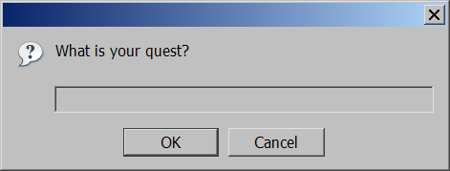
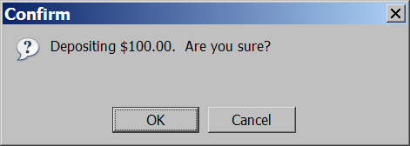
Popup boxes
alert("message"); // message
confirm("message"); // returns true or false
prompt("message"); // returns user input string JS

Slide 16
Type Conversions String Conversion
String conversion happens when we need the string form of a value.
For example, console.log(value) does it to show the value.
We can also call the String(value) function to convert a value to a string.
String conversion is mostly obvious.
A false becomes "false", null becomes "null", etc.

Slide 17
Numeric Conversion
Numeric conversion happens in mathematical functions and expressions automatically.
For example, when division / is applied to non-numbers:
alert( "6" / "2" ); // 3, strings are converted to numbers.
We can use the Number(value) function to explicitly convert a value to a number:
If the string is not a valid number, the result of such a conversion is NaN

Slide 18
Boolean Conversion
Boolean conversion is the simplest one.
It happens in logical operations but can also be performed explicitly with a call to Boolean(value).
The conversion rule:
Values that are intuitively “empty”, like 0, an empty string, null, undefined, and NaN, become false.
Other values become true.

Slide 19
Functions
Functions are the main “building blocks” of the program. They allow the code to be called many times without repetition.
A JavaScript function is executed when "something" invokes it (calls it).
Quite often we need to perform a similar action in many places of the script.
For example, we need to show a nice-looking message when a visitor logs in, logs out and maybe somewhere else.
A Function is much the same as a Procedure or a Subroutine, in other programming languages.

Slide 20
JavaScript Function Syntax
A JavaScript function is defined with the function keyword, followed by a name, followed by parentheses ().
function name(parameter1, parameter2, parameter3) { // code to be executed }
Function parameters are listed inside the parentheses () in the function definition.
Function arguments are the values received by the function when it is invoked.

Slide 21
Local and Outer variables
Local variable: A variable declared inside a function is only visible inside that function.
Outer variable: A variable declared outside a function.
The function has full access to the outer variable. It can modify it as well.
The outer variable is only used if there’s no local one.
If a same-named variable is declared inside the function then it shadows the outer one.

Slide 22
Global variables
Variables declared outside of any function are called global.
Global variables are visible from any function (unless shadowed by locals).
It’s a good practice to minimize the use of global variables.

Slide 23
Default parameters
If a function is called, but an argument is not provided, then the corresponding value becomes undefined.
In JavaScript, a default parameter is evaluated every time the function is called without the respective parameter.
Sometimes it makes sense to assign default values for parameters not in the function declaration, but at a later stage.
We can check if the parameter is passed during the function execution, by comparing it with undefined.

Slide 24
Returning a value
A function can return a value back into the calling code as the result.
There may be many occurrences of return in a single function.
A function with an empty return or without it returns undefined.
1. function doNothing() { /* empty */ }
alert( doNothing() === undefined ); // true
2. function doNothing() {
return;
}
alert( doNothing() === undefined ); // true

Slide 25
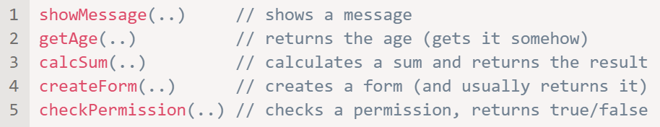
Naming a function
Functions are actions. So their name is usually a verb.
It should be brief, as accurate as possible and describe what the function does, so that someone reading the code gets an indication of what the function does.

Slide 26
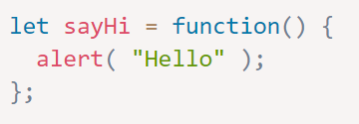
Function Expression
It allows us to create a new function in the middle of any expression.
For example:
Here we can see a variable sayHi getting a value, the new function, created as function() { alert("Hello"); }.
As the function creation happens in the context of the assignment expression (to the right side of =), this is a Function Expression.

Slide 27
Function is a value
In JavaScript, a function is a value, so we can deal with it as a value.
So we can work with it like with other kinds of values.
We can copy a function to another variable:

Slide 28
Callback functions
A callback is a function passed as an argument to another function.
When you pass a function as an argument, remember not to use parenthesis.
Callbacks make sure that a function is not going to run before a task is completed but will run right after the task has completed.

Slide 29
Function Expression vs Function Declaration
Syntax
Function Declaration: a function, declared as a separate statement.
Function Expression: a function, created inside an expression or inside another syntax construct.
Creation
A Function Expression is created when the execution reaches it and is usable only from that moment.
A Function Declaration can be called earlier than it is defined.

Slide 30
Arrow function
Arrow functions were introduced in ES6.
Arrow functions allow us to write shorter function syntax:
Better than Function Expressions.
It’s called “arrow functions”, because it looks like this:
let func = (arg1, arg2, ..., argN) => expression;
This creates a function func that accepts arguments arg1..argN, then evaluates the expression on the right side with their use and returns its result.

Slide 31
Arrow function
Example
let sum = (a, b) => a + b;
/* This arrow function is a shorter form of:
let sum = function(a, b) {
return a + b;
}; */
alert( sum(1, 2) );

Slide 32
Arrow function
If we have only one argument, then parentheses around parameters can be omitted, making that even shorter.
Example
let double = n => n * 2;
alert( double(3) ); // 6
Sometimes we need a more complex function, with multiple expressions and statements. In that case, we can enclose them in curly braces.
The major difference is that curly braces require a return within them to return a value.

Slide 33
Arrow function
Arrow functions are special: they don’t have their own ‘this’.
If we reference ‘this’ from such a function, it’s taken from the outer “normal” function.
In regular functions the ‘this’ keyword represented the object that called the function.
When we use the arrow function inside the object, it inherits the ‘this’ value from the enclosing lexical scope

Slide 34
Immediately-invoked Function Expression
An Immediately-invoked Function Expression is a way to execute functions immediately, as soon as they are created.
Syntax: (function() {
/* */
})()
IIFEs can be defined with arrow functions as well:
(() => {
/* */
})()

Slide 35
When to Use an IIFE?
The most common use cases for IIFEs are:
Avoids polluting the global scope or conflict with other's JavaScript code which have objects/functions/variables with same name.
Creating private variables and functions
Asynchronous functions in loops

Slide 36
References
[1] https://javascript.info
[2] https://www.w3schools.com/js
[3] https://www.tutorialsteacher.com/javascript

Slide 37
Thank You

