Slide 1
HACKTHON PROJECT LEVEL-2
- Bharatesha n s

Slide 2
PROBLEM STATEMENT:
An MNC company conducting an interview hiring more than 10k candidate .
Based on each candidate’s performance they divided into three category
Consider
May consider
Not consider
Now build a model which gives accuracy based on the hiring status .

Slide 3
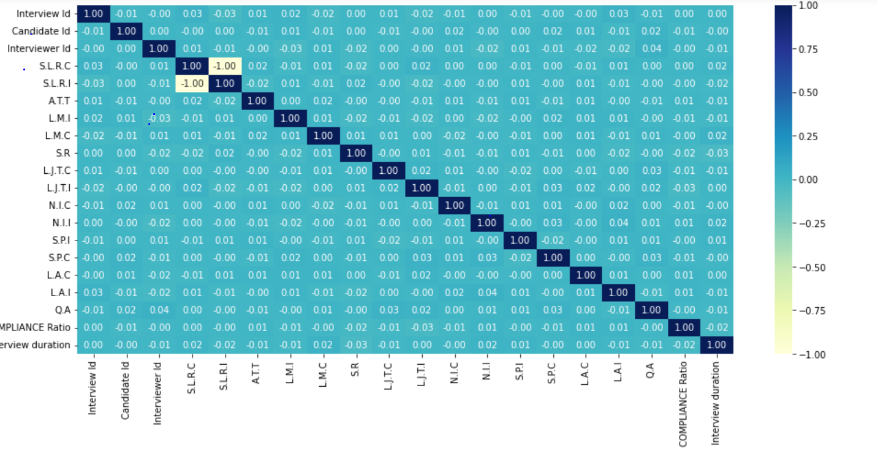
solution approaches
1.Checking the Correlation by plotting heap map.
Removing the Highly negatively Correlated Columns.

Slide 4
2. HANDLING MISSIG VALUES
Some categorical features had missing values .
To resolve this problem of missing values treat with MODE
3.ENCODING FOR CATEGORICAL FEATURES
Label encoding for “ target ” variable
The features that had nominal data is converted into binary
features by doing “ One-Hot Encoding ”.

Slide 5
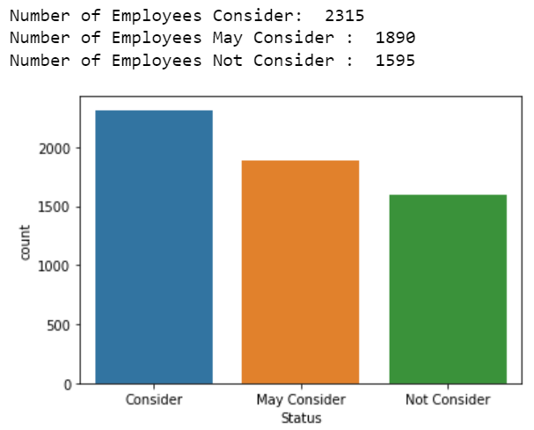
4.Checking whether target data is balanced or not
Here some how target data is balanced, if in case the data is imbalanced we need to do oversampling.

Slide 6
5. Handling outliers
“ Box-plotting ” is done to check whether outliers are present or not.
If found remove the outliers.
6. FEATURE SCALING
Standard Scaler is used for to convert the values having high variance into the range between [ 0 -1 ].

Slide 7
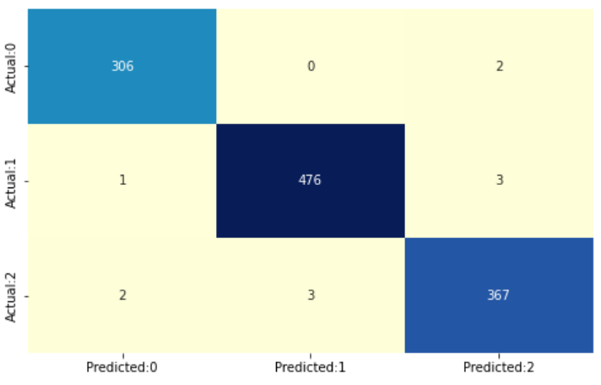
7.Buliding model
For this classification problem I used “ Logistic Regression” method to build the model .
Then “ Confusion matrix ” is used to know how the model has performed.

Slide 8
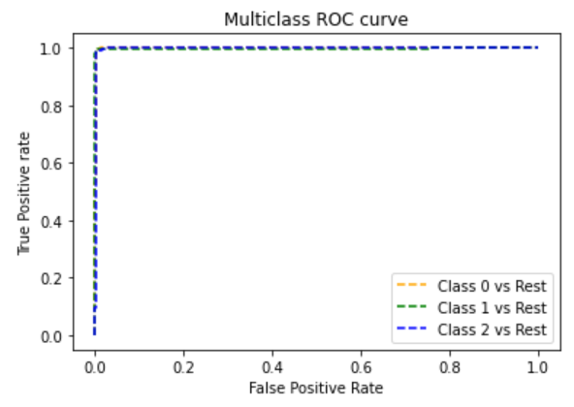
The a “ ROC – Curve ” is plotted to show graphically the probability of the outcome.
Finally the accuracy of the model can be known using
“ Classification report ”.

Slide 9
Thank you

