Slide 1
DEVOPS & CLOUD ENGINEER · 2025
CalmRoot
Production-Grade Mental Health Platform on AWS EKS
"Ground Yourself. Grow Together."
Bharath · DevOps & Cloud Engineer
🌐 LIVE AT WELLNEST-PROJECT.ONLINE
☸️ KUBERNETES (EKS) DEPLOYED
🤖 AI-POWERED BY AMAZON BEDROCK

Slide 2
What is CalmRoot?
The Platform
The Scale
A HIPAA-aligned mental health platform connecting users with verified therapists. Built with a React Bento Grid UI featuring dark/light mode.
4 Microservices
6 DynamoDB Tables
2 S3 Buckets
50+ Verified Therapists (capacity)
HIPAA-aligned security
Zero-downtime deployments
AI Wellness Companion "Sage" (Amazon Bedrock — Nova Lite)
Mood tracking & analytics with AI risk scoring
Therapist booking system (50+ verified therapists)
PHQ-9, GAD-7 & PSS assessments
Emergency contact alert system
Stress Buster game
REACT
NODE.JS
AWS EKS
TERRAFORM
ARGOCD
DYNAMODB
BEDROCK
CLOUDFRONT
ENVOY GATEWAY

Slide 3
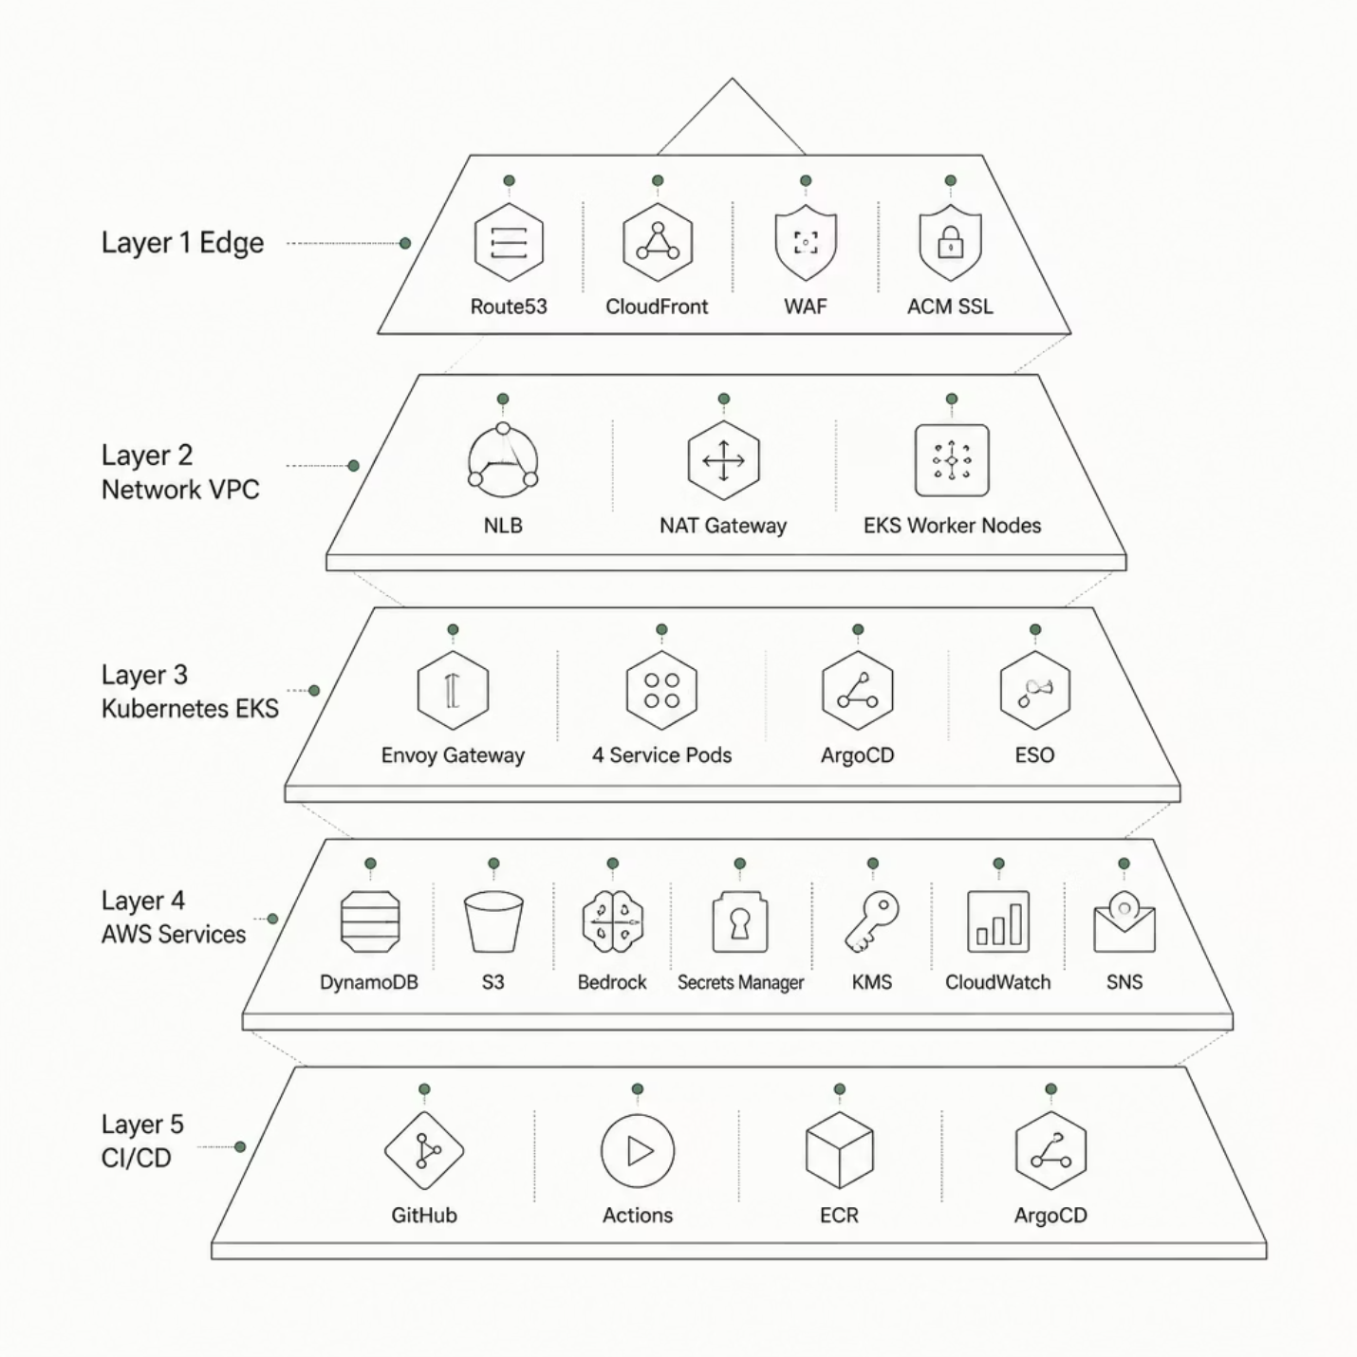

Cloud Architecture Overview
Five-Layer Design
Edge: Route53 → CloudFront → WAF → ACM SSL
Network: VPC with public NLB + NAT Gateway; private EKS worker nodes (2× t3.medium)
Kubernetes: Envoy Gateway → 4 Service Pods; ArgoCD, ESO, Metrics Server, LB Controller
AWS Services: DynamoDB, S3, Bedrock, Secrets Manager, SES, KMS, CloudWatch, SNS, ECR
CI/CD: GitHub → Actions → ECR → ArgoCD → EKS
All traffic encrypted with TLS 1.2+ · Zero secrets in code via External Secrets Operator · GitOps-driven deployments via ArgoCD · IRSA for pod-level AWS permissions

Slide 4

Infrastructure as Code with Terraform
What Terraform Manages
Modular Structure
VPC (10.0.0.0/16) + 4 Subnets + 8 VPC Endpoints
EKS Cluster + Node Groups
4 ECR Repositories · 6 DynamoDB Tables · 3 S3 Buckets
CloudFront Distribution + AWS WAF v2 (OWASP rules)
Route53 Hosted Zone + ACM SSL Certificate
KMS Encryption Key + Secrets Manager
6 IRSA IAM Roles + CloudWatch Alarms + SNS
terraform/
├── modules/
│ ├── vpc/
│ ├── eks/
│ ├── security/
│ ├── ecr/
│ ├── dynamodb/
│ ├── s3/
│ ├── secrets/
│ ├── waf/
│ ├── acm/
│ ├── route53/
│ ├── cloudfront/
│ └── monitoring/
126 resources provisioned across 12 modules
State: S3 backend + DynamoDB locking
Single terraform apply provisions the entire production infrastructure

Slide 5
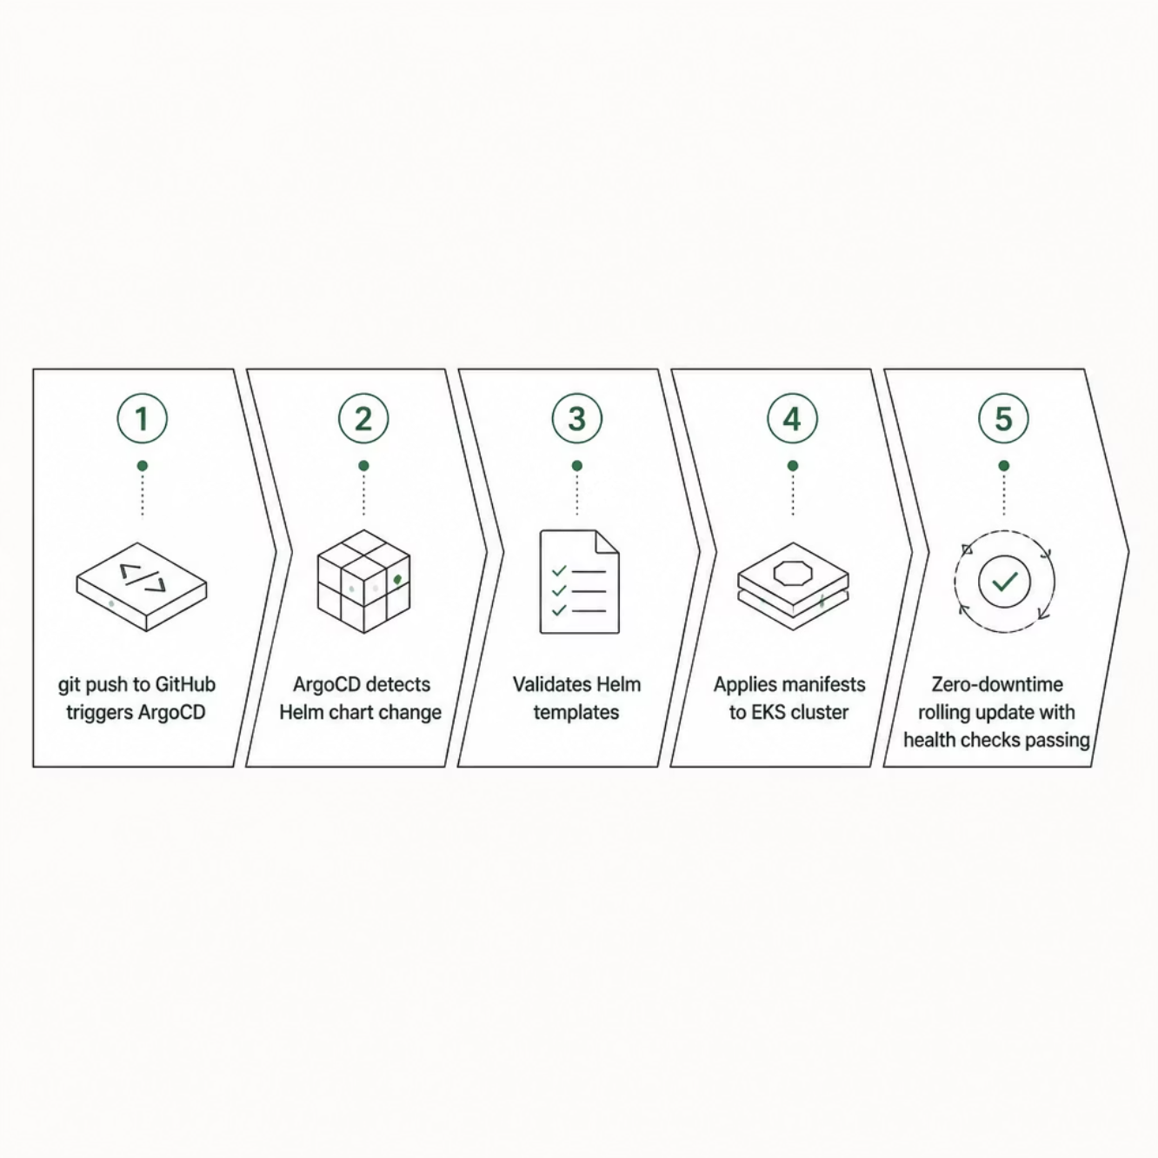

Kubernetes Architecture & GitOps with ArgoCD
GitOps Flow
EKS Namespaces
calmroot-prod: Frontend (nginx + React SPA), Auth Service (:3001), Assessment Service (:3002), Therapist Service (:3003), HPA auto-scaling
envoy-gateway-system: Envoy Gateway Controller + Proxy (L7 routing, CORS, rate limiting)
kube-system: AWS LB Controller, CoreDNS, Metrics Server
argocd: ArgoCD Server + Controller
external-secrets: External Secrets Operator
Challenge solved: Fixed HPA vs ArgoCD replica conflict using ignoreDifferences configuration in the ArgoCD Application spec

Slide 6
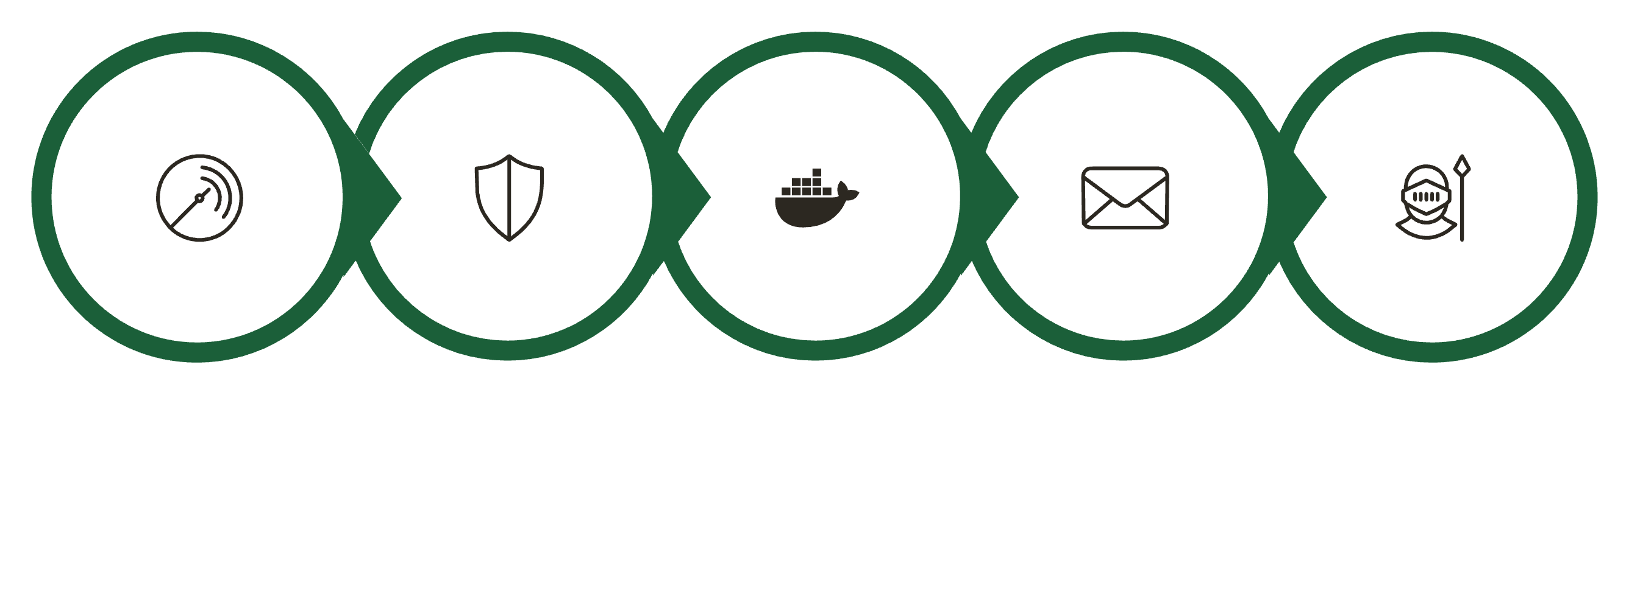
CI/CD Pipeline — GitHub Actions + ArgoCD
Code Quality
Security Scan
Build & Push
Approval Gate
GitOps Update
Each service triggers on git push to main or manual workflow_dispatch. Four independent pipelines: ci-cd-frontend.yml, ci-cd-auth.yml, ci-cd-assessment.yml, and ci-cd-therapist.yml.
Quality & Security Gates
Build & Deploy
SonarCloud: Code smells, bugs, coverage — pipeline fails if quality gate not met
Snyk: Dependency vulnerability scan — high severity = pipeline fails, report generated
Docker buildx (linux/amd64) builds optimized images, pushes to Amazon ECR with git-sha + latest tags
Approval gate via GitHub Environments protection on main branch — email sent to team
GitOps update: helm/values.yaml updated with new image tag, git pull --rebase fixes race condition, ArgoCD auto-detects and deploys

Slide 7
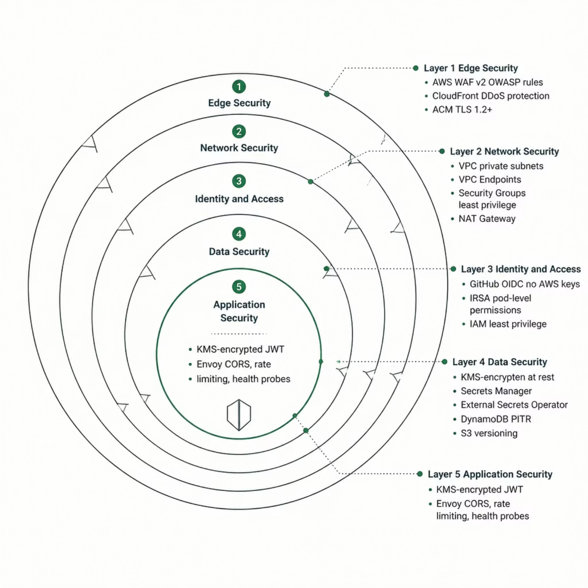

Security — Defense in Depth
Five Security Layers
Edge: AWS WAF v2 (OWASP Top 10, IP reputation, rate limiting 2000 req/5min), CloudFront DDoS protection, ACM TLS 1.2+
Network: VPC private subnets, 8 VPC Endpoints (traffic never leaves AWS), least-privilege Security Groups, NAT Gateway outbound-only
Identity: GitHub OIDC (no AWS keys in CI/CD), IRSA pod-level permissions, least-privilege IAM per service role
Data: KMS encryption at rest, Secrets Manager + ESO runtime injection, DynamoDB PITR, S3 versioning
Application: KMS-encrypted JWT tokens, Envoy Gateway CORS policies, per-route rate limiting, liveness + readiness probes
Zero secrets hardcoded anywhere in the codebase — all injected at runtime via External Secrets Operator

Slide 8

AI-Powered Wellness Intelligence
AI Chatbot "Sage"
Risk Detection System
Powered by Amazon Bedrock — primary model Nova Lite, fallback Titan Text Express.
Sentiment scoring (−1 to +1) on every mood log
Risk levels: LOW / MEDIUM / HIGH
3+ consecutive HIGH-risk days → auto-email to emergency contact via SES
48-hour cooldown prevents alert spam
Therapist notification triggered
Context-aware responses referencing mood history
Crisis detection → iCall hotline referral
Therapist recommendations
Chat history in DynamoDB (rolling 50 msgs)
HIPAA-aligned — all data stays in AWS
Assessments: PHQ-9 (depression: 0–27), GAD-7 (anxiety: 0–21), PSS (stress)
AI analyzes every mood log and assessment in real-time to proactively protect users

Slide 9

Key Technical Challenges Solved
ArgoCD vs HPA Replica Conflict
NLB Stuck in Pending State
Global Rate Limiting Caused 500 Errors
Added ignoreDifferences for spec.replicas in ArgoCD Application spec
Fixed IRSA policy for LB Controller — added elasticloadbalancing:DescribeTags and wildcard resource permissions
Switched to local rate limiting directly in Envoy proxy — no external Redis required
DynamoDB GSI Access Denied
Terraform Circular Dependency
GitOps Race Condition
Added explicit IAM permissions for index/* resources alongside table permissions
Split Route53 ↔ ACM ↔ CloudFront into passes using try() and depends_on
Added git pull --rebase retry loop across all 4 CI/CD workflows pushing to shared values.yaml
EBS CSI Addon Timeout
Removed from Terraform, installed separately post-cluster creation
Every problem solved = deeper AWS & Kubernetes expertise

Slide 10
Results & Complete Tech Stack
What Was Achieved
Key Numbers
Live at wellnest-project.online
Zero-downtime deployments (ArgoCD + rolling updates)
End-to-end HTTPS with custom domain
AI chatbot responding in real-time
Full user registration → therapy booking flow
Mood tracking with AI risk analysis
Emergency alert system active
CloudWatch monitoring operational
126 Terraform resources · 12 modules
5 GitHub Actions pipelines
6 Kubernetes namespaces · 4 microservices
6 DynamoDB tables · 2 AI models (Bedrock)
1 production domain
REACT 18 · VITE · TAILWIND CSS
NODE.JS · EXPRESS.JS
DYNAMODB · S3
AMAZON BEDROCK (NOVA LITE + TITAN)
DOCKER · ECR
EKS 1.31 · HELM · ARGOCD
ENVOY GATEWAY
TERRAFORM (126 RESOURCES)
GITHUB ACTIONS (5 PIPELINES)
WAF · KMS · IRSA · ESO · OIDC
ROUTE53 · CLOUDFRONT · ACM
CLOUDWATCH · SNS · SONARCLOUD · SNYK
AWS SES
"Built end-to-end: From local Docker Compose to production EKS in a single project sprint"

