Slide 1
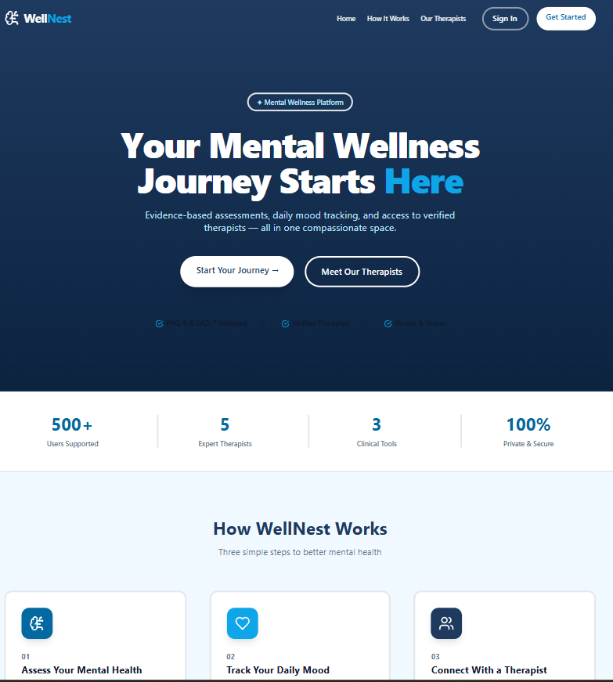
DEVOPS PROJECT
WellNest
A Cloud-Native Mental Health Platform — built on microservices, containerized with Docker, orchestrated on Kubernetes, and secured end-to-end with DevSecOps practices.
DEVOPS
DEVSECOPS
KUBERNETES
CI/CD
GITOPS

Slide 2
What is WellNest?
WellNest is a mental health platform built as 3 backend microservices + 1 frontend, containerized with Docker, and orchestrated on Kubernetes across isolated dev and prod environments.
Auth Service
Assessment Service
User registration & login
JWT tokens
bcrypt password hashing
MongoDB for user data
Mental health assessments
PHQ-9 & GAD-7 questionnaires
Score calculation & history
MongoDB storage
Therapist Service
Frontend
Therapist profiles & search
Appointment booking
Availability management
MongoDB storage
React 18 + TypeScript + Vite
Tailwind CSS + shadcn/ui
JWT in localStorage, protected routes
Served via Nginx

Slide 3
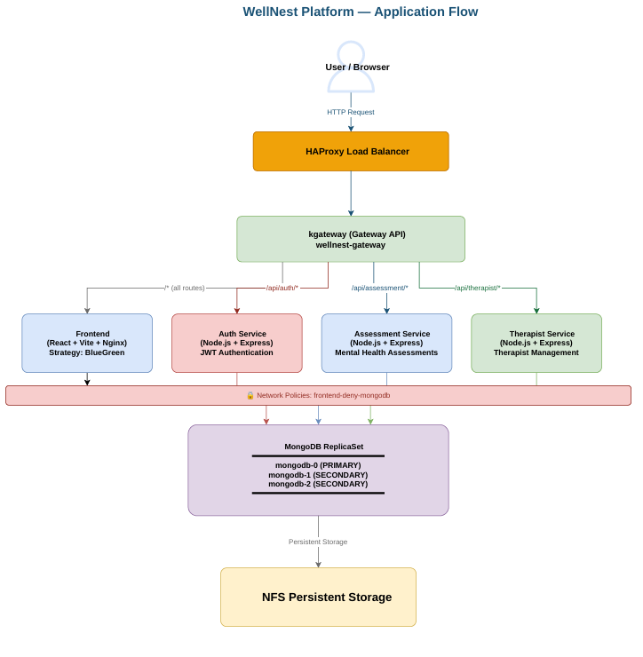
Application-Flow Diagram:

Slide 4

Containerization with Docker
Backend Services — Node.js Alpine
Frontend — Multi-Stage Build
01
1
Base Image
node:20-alpine — minimal footprint via Alpine Linux
Stage 1 — Builder
node:20-alpine · npm install · npm run build (Vite) → produces /app/dist
02
Install & Copy
npm install --omit=dev · COPY src/
2
03
Stage 2 — Runtime
Non-Root Security
nginx:alpine · copy dist/ · copy nginx.conf
adduser -S wellnest · chown -R · USER wellnest
3
04
Serve
Runtime Env Injection
EXPOSE 3001/3002/3003 · CMD: node src/index.js
Nginx serves static build. API URLs configured via env variables at build time.
Image Tagging Strategy: Dev: Short SHA (3a4b5c6) · Prod: Semantic Version (v1.0.1) · All images pushed to Docker Hub

Slide 5






Kubernetes — Resources & Architecture
Deployments
StatefulSets
auth · assessment · therapist · frontend(Rollouts)
MongoDB 7 — 3 replicas with persistent storage
PVCs
NetworkPolicy
NFS StorageClass · 2Gi (dev) / 5Gi (prod) per MongoDB instance
Deny Frontend to the MongoDB
Gateway (kgateway)
Namespaces
/api/auth → 3001 · /api/assessment → 3002 · /api/therapist → 3003 · / → frontend:80
wellnest-dev · wellnest-prod
Dev Environment
Prod Environment
wellnest-dev namespace · develop branch · values-dev.yaml · HPA min:1 max:3
wellnest-prod namespace · main branch · values-prod.yaml · HPA min:2 max:5

Slide 6
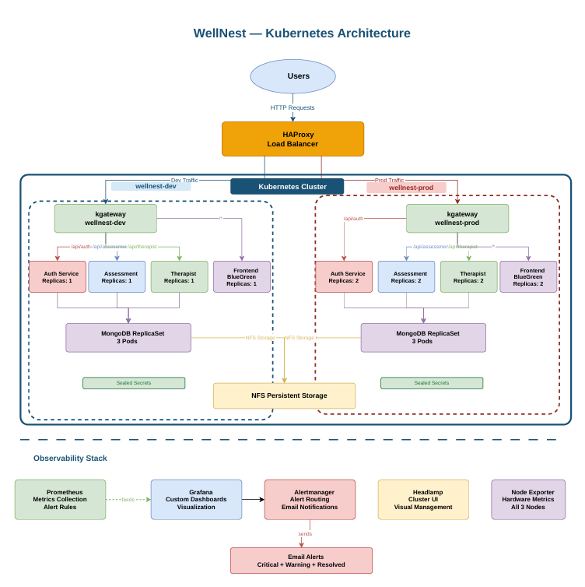
Kubernetes Architecture — Traffic Flow
Traffic enters via HAProxy, is routed through kgateway using path-based rules, distributed across namespace-isolated microservices, and persisted to replicated MongoDB instances backed by NFS storage.

Slide 7


CI/CD — GitHub Actions, GitOps & DevSecOps
Dev Branch — Continuous Deployment
Main / Prod Branch — Continuous Delivery
SAST
SCA
SAST
SCA
SonarQube static analysis with quality gate enforcement
Snyk dependency scan — blocks known vulnerable packages
SonarQube static analysis with quality gate enforcement
Snyk dependency scan — blocks known vulnerable packages
Container Scan
GitOps Update
Container Scan
Approval Gate and
Push to manifest repo
Trivy image scan — CRITICAL + HIGH severity findings block the pipeline
Bot updates
values-dev.yaml and ArgoCD autosyncs.
Trivy image scan — CRITICAL + HIGH severity findings block the pipeline
Approve after error-check -> bot updates values-prod.yaml -> ArgoCD auto-syncs
Merge → build {SHA} → push Docker Hub → ArgoCD auto-syncs ✅
Merge → create GitHub Release tag (v1.0.1) → build image with semantic version → push Docker Hub → ArgoCD auto-syncs ✅
01
02
03
Approval Gate
Build & Tag
GitOps Update
GitHub Environment: production — manual approval required before any deployment proceeds
Semantic versioning (v1.0.1) — Docker build + push to Docker Hub
CD bot updates values-prod.yaml → ArgoCD detects drift and syncs cluster

Slide 8

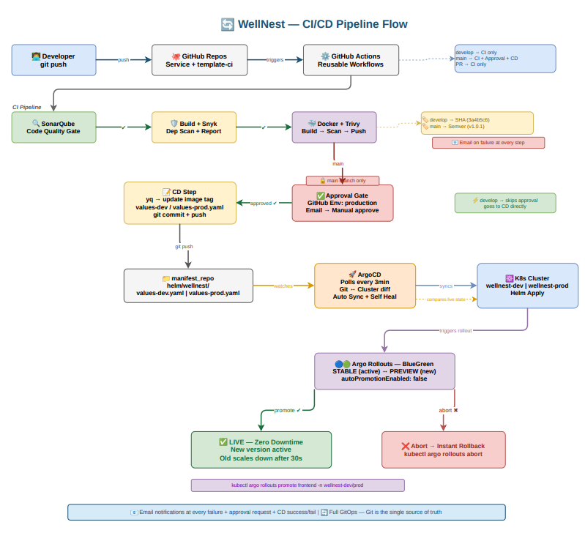
CI/CD End-to-End Flow
wellnest-ci — A reusable GitHub Actions workflow library shared by all service pipelines, ensuring consistent security gates and build steps across every microservice.

Slide 9
Pipeline Execution & Release Workflow
Dev Pipeline — Develop Branch
Prod Pipeline — Release Workflow
Trigger
PR to Main
PR to develop branch opens pipeline
Same full security gate runs — no image built on merge
Security Gate
GitHub Release
SonarQube SAST · Snyk SCA · Trivy container scan
Developer creates release tag (e.g. v2.0.0) to trigger prod pipeline
Merge & Build
Approval Gate
Reviewer approves → image built as dev-{SHA} and pushed
Manual approval via GitHub Environment: production
GitOps Sync
Deploy to Prod
ArgoCD detects values-dev.yaml update → auto-deploys to dev
Image tagged v2.0.0 pushed → ArgoCD syncs wellnest-prod

Slide 10




Key Takeaways & Architecture Summary
Cloud-Native by Design
Production-Grade Kubernetes
4 containerized services, multi-stage Docker builds, non-root execution, minimal Alpine base images.
Namespace isolation, HPA autoscaling, StatefulSet MongoDB, NFS persistence, Gateway API routing.
Shift-Left Security
True GitOps Delivery
SAST, SCA, and container scanning on every PR. CRITICAL/HIGH findings block the pipeline before merge.
ArgoCD drives all deployments from Helm values. No manual kubectl apply — cluster state is always declarative.
WellNest demonstrates a complete DevSecOps lifecycle — from code commit to production deployment — with security, observability, and infrastructure-as-code built in at every layer.

Slide 11
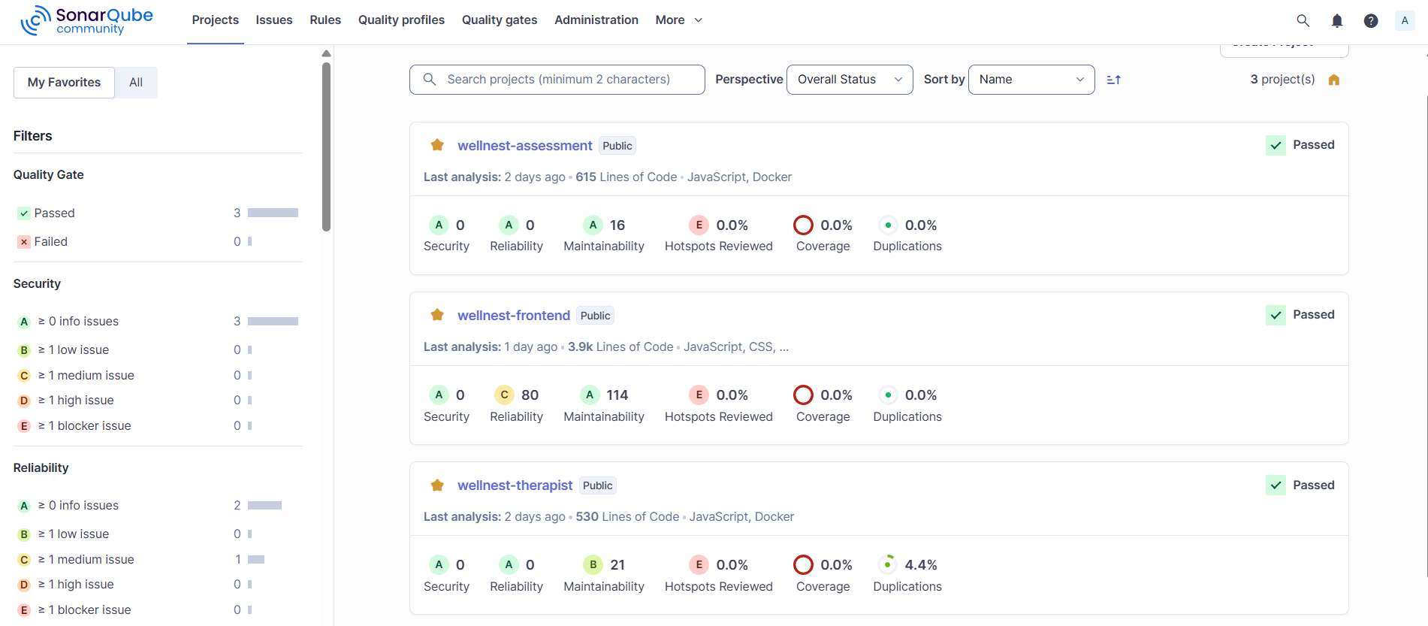
SonarQube Analysis Dashboard

Slide 12
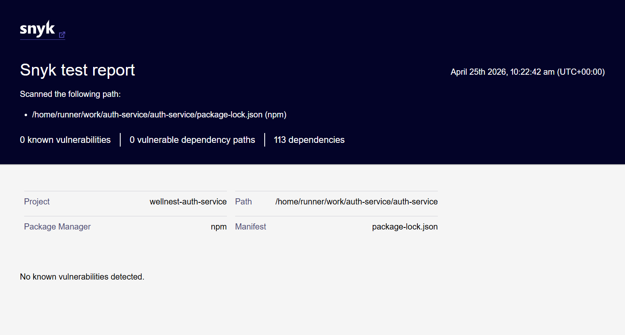
Synk Report

Slide 13
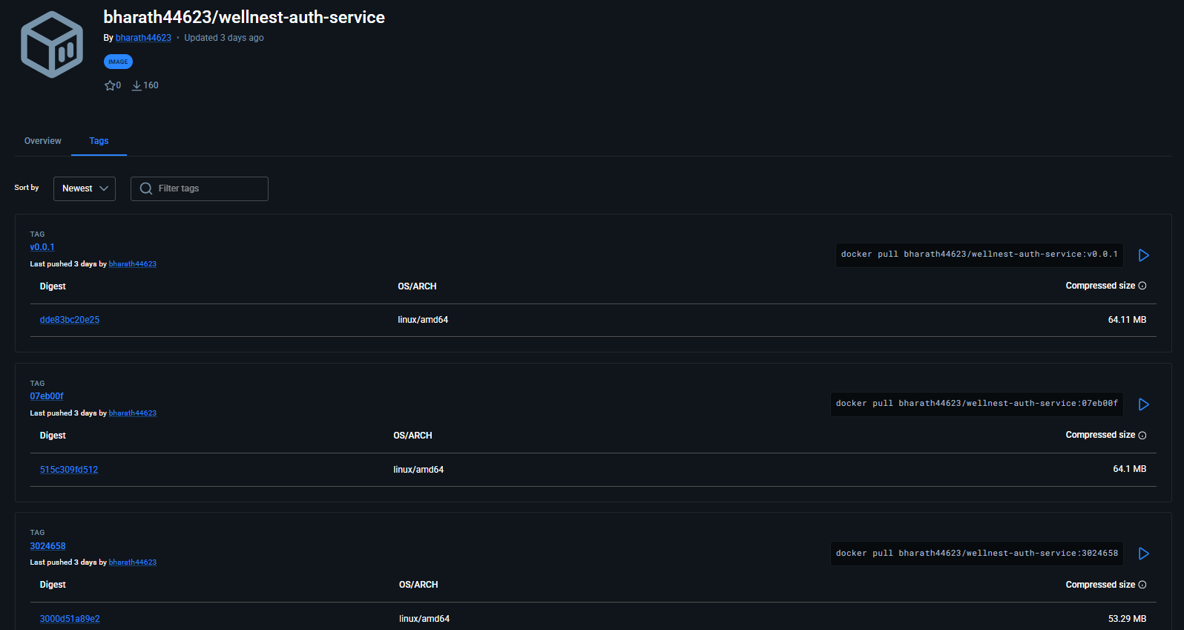
Docker Hub Repository Tags
bharath44623/wellnest-auth-service

Slide 14

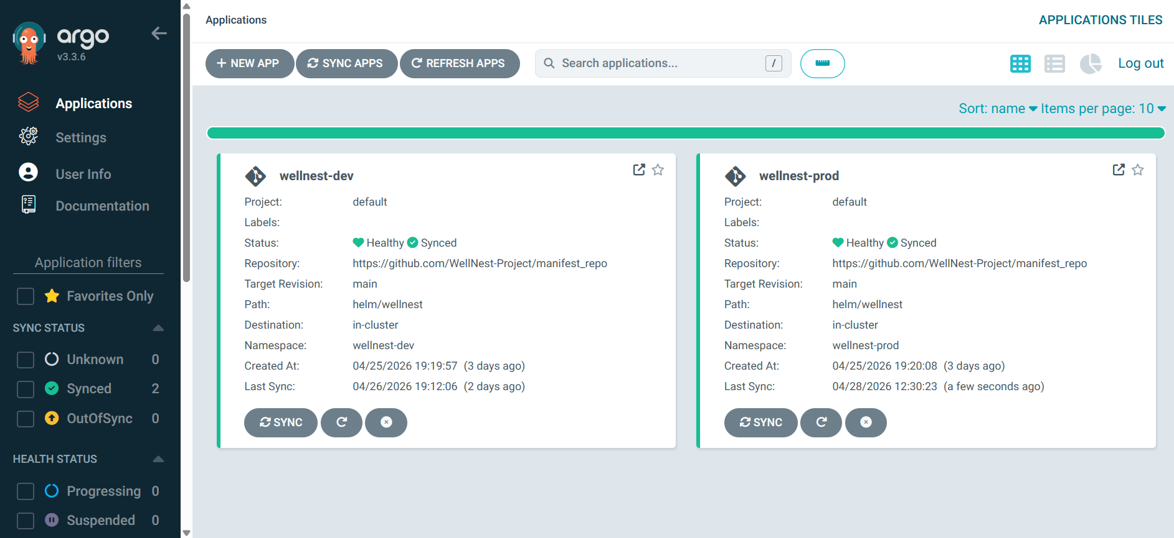
GitOps with ArgoCD
ArgoCD manages deployments using the app-of-apps pattern. selfHeal + prune enabled — cluster state always matches Git. develop branch → DEV cluster. main branch → PROD cluster.

Slide 15

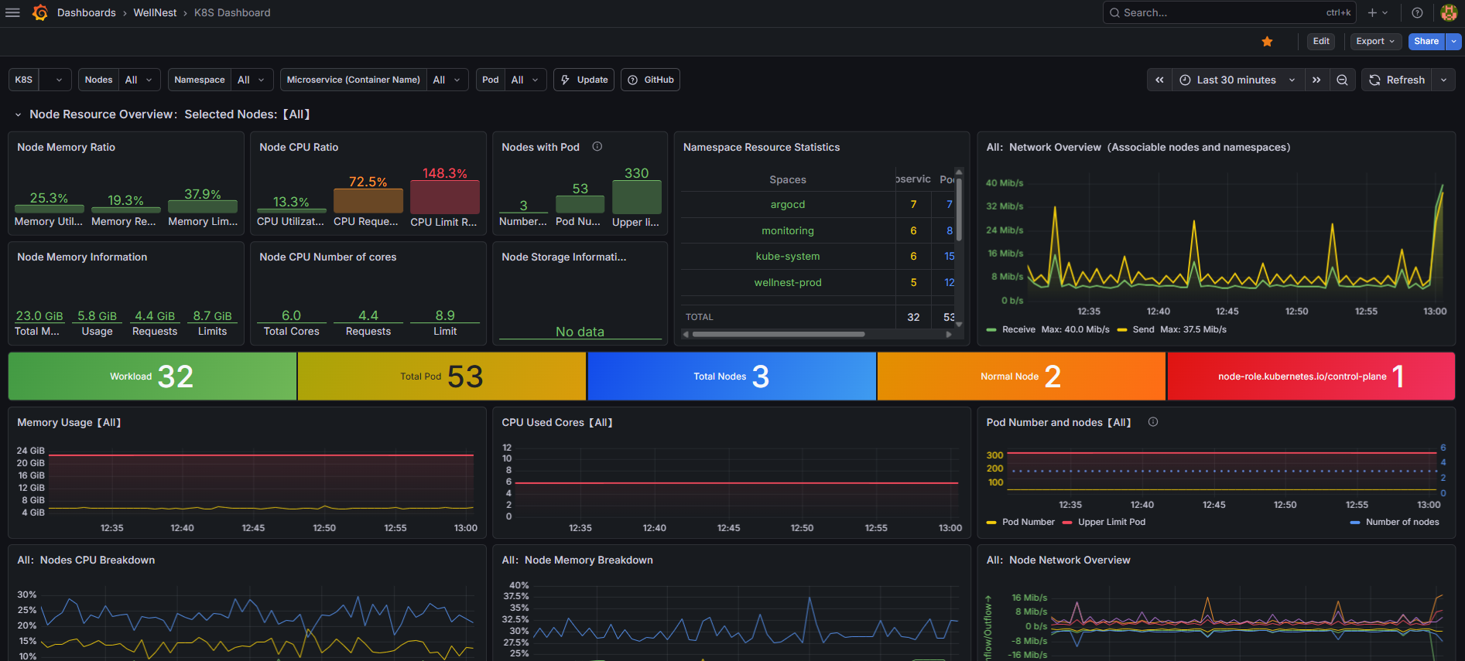
Monitoring — Prometheus & Grafana
Prometheus + Grafana deployed on both dev and prod clusters. Exposed via HAProxy on NodePorts 32000 (Grafana) and 32001 (Prometheus). Custom WellNest dashboards track service health, pod metrics, MongoDB status, and HPA scaling.

Slide 16
Thank You
GitHub Repository
Live URLs
• WellNest-Project — Organization
(https://github.com/WellNest-Project)
• Production App (http://wellnest-project.online/)
• Development App (http://wellnest-project.online:8081)
• ArgoCD UI (http://wellnest-project.online:8080)
• Grafana (http://wellnest-project.online:3200)
• Prometheus (http://wellnest-project.online:9090)

