Slide 1
STUDENT PLACEMENT PREDICTION

Slide 2
Problem Statement
📌 Why this project?
Many students struggle to understand their chances of getting placed.
Companies seek data-driven insights for recruitment.
Predicting student placements can help:
Students → Improve skills for better chances.
Institutions → Identify weak areas in student training.
📌 Objective
Build a machine learning model to predict whether a student will get placed or not.
Deploy the model as a Flask web application for user interaction.

Slide 3
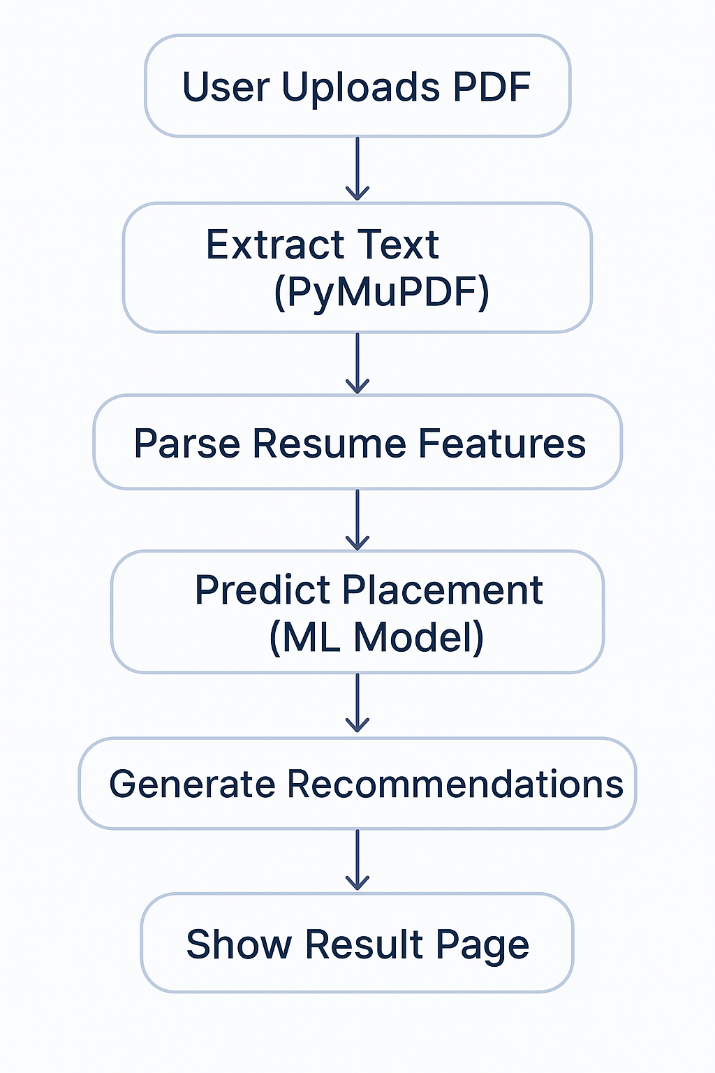
Project Workflow
Text is extracted from the uploaded PDF using PyMuPDF.
- Key features such as CGPA, internships, projects, and skills are parsed.
- A trained ML model predicts whether the student is likely to be placed.
- Personalized recommendations are provided to improve chances of success.
- The results are displayed in a clean, user-friendly interface.

Slide 4
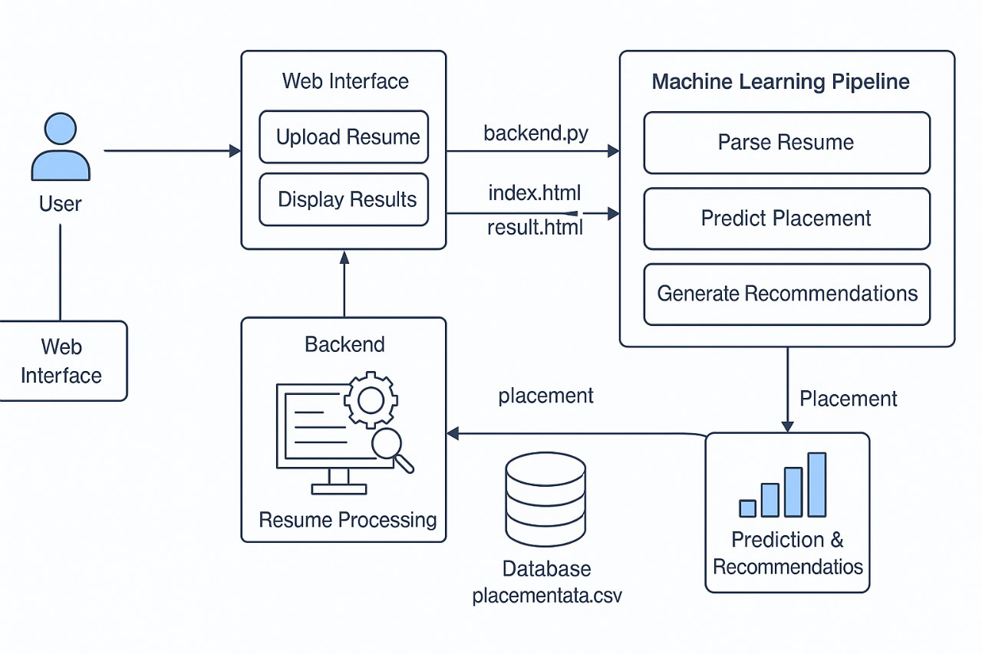
Architechture Diagram

Slide 5
Technologies Used
Backend: Flask (Python Web Framework)
PDF Parsing: PyMuPDF (fitz)
ML Model: Random Forest Classifier
Preprocessing: Pandas, LabelEncoder, StandardScaler
Frontend: HTML, CSS
Deployment: Localhost (Flask Development Server)

Slide 6
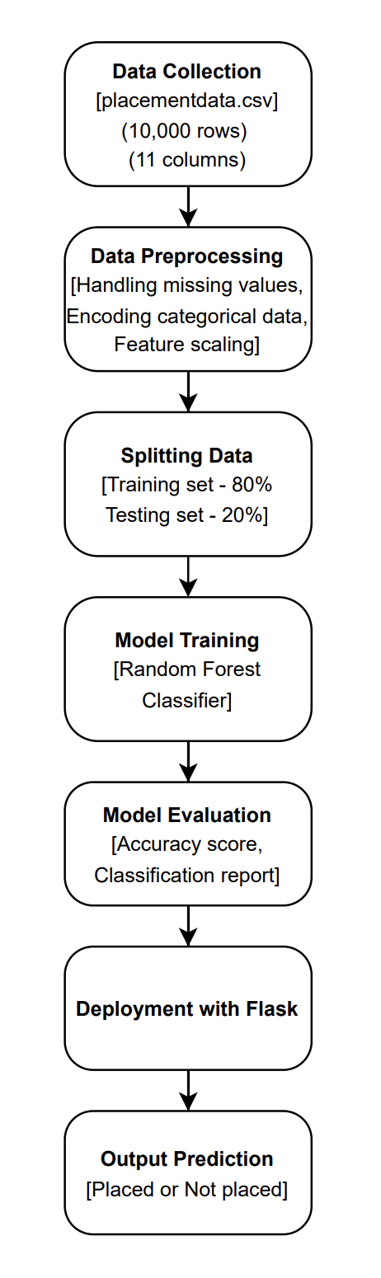

Slide 7
Dataset Description
📌 Source: placementdata.csv 📌 Number of records: 10,000 📌 Number of features (columns): 11 📌 Target Variable: PlacementStatus 📌 Feature Types:
Numerical: CGPA, Aptitude Score, SSC/HSC Marks
Categorical: Placement Training, Extracurricular Activities

Slide 8
Features & Target Variable
📌 Input Features Extracted from Resume (X) - CGPA, Internships, Projects, Certifications, AptitudeTestScore, SoftSkillsRating, ExtracurricularActivities, PlacementTraining, SSC_Marks, and HSC_Marks.
📌 Target Variable (y)
PlacementStatus:
1 → Placed
0 → Not Placed

Slide 9
Data Preprocessing
✔ Handling Missing Values
Used SimpleImputer(strategy="most_frequent") to replace missing values with most frequent values in each column.
✔ Encoding Categorical Data
Used LabelEncoder() to convert text values to numeric format.
Example: "Yes" → 1, "No" → 0.
✔ Feature Scaling
Used StandardScaler() to normalize numerical features.
Ensures all features have a similar range for better model performance.

Slide 10
Machine Learning Model Used
Model: Random Forest Classifier
✔ Why Random Forest?
Works well for classification problems.
Handles both numerical and categorical data efficiently.
Prevents overfitting using multiple decision trees.
📌 Model Parameters Used
n_estimators: 100 – Number of trees in the Random Forest model.
random_state: 42 – Ensures reproducibility of results.
📌 Training the Model
Used model.fit(X_train, y_train) to train the model on the dataset.

Slide 11
Data Splitting for Training & Testing
Training Set: 80% – Used to train the model.
Testing Set: 20% – Used to evaluate the model's performance.
📌 Code Used for Splitting
- X_train, X_test, y_train, y_test = train_test_split(X, y, test_size=0.2, random_state=42)

Slide 12
Model Evaluation Metrics
📌 Metrics Used
✔ Accuracy Score - Measures the overall correct predictions made by the model.
✔ Classification Report - Includes Precision, Recall, and F1-score for evaluation.

Slide 13
Recommendation Engine
Provides tips based on low-performing areas:
- Improve CGPA - Add Internships/Projects - Attend Workshops - Improve Aptitude/Soft Skills - Participate in Placement Training - Highlight Extracurriculars

Slide 14
THANK YOU

