Slide 1


SonarQube

Slide 2
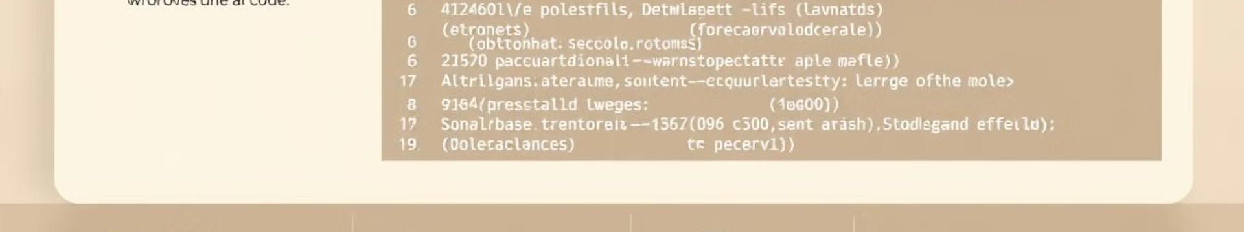
What is SonarQube?
SonarQube is an open-source platform designed for continuous inspection of code quality. It helps developers and teams improve code quality, security, and maintainability.
Continuous Inspection
Code Quality & Security
Code Maintainability
SonarQube continuously analyzes code as it's being developed, providing immediate feedback to developers.
It identifies code quality issues, security vulnerabilities, and technical debt, enabling proactive remediation.
It improves code readability, understandability, and ease of maintenance, fostering long-term sustainability.

Slide 3
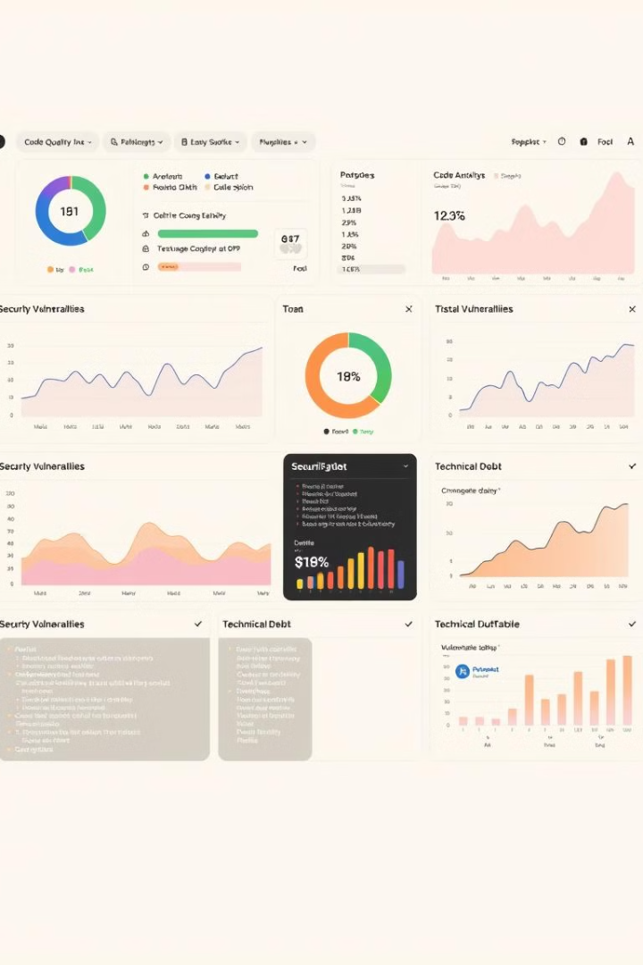
Key Features
SonarQube offers a comprehensive set of features to support the entire development lifecycle.
1
Code Quality Analysis
2
Security Vulnerability Detection
Analyzes code for various metrics like complexity, code coverage, and duplication.
Identifies potential security vulnerabilities and provides actionable recommendations.
3
Technical Debt Management
4
Customizable Dashboards & Reporting
Helps track and prioritize code improvements to reduce technical debt and maintain code health.
Provides customizable dashboards and reports to visualize code quality and security trends.

Slide 4
Code Quality Analysis
SonarQube analyzes code for various metrics related to quality, ensuring maintainable and reliable code.
Code Complexity
Code Coverage
Code Duplication
Measures the complexity of code, identifying potentially hard-to-understand or maintain sections.
Tracks the percentage of code covered by unit tests, highlighting areas needing further testing.
Detects and reports duplicated code sections, promoting code reuse and reducing redundancy.

Slide 5




Code Scanning and Reporting
SonarQube automatically scans code and generates detailed reports highlighting issues and providing actionable insights.
Code Scanning
SonarQube analyzes the codebase, identifying issues and generating reports.
Reporting
SonarQube presents reports in various formats, including dashboards, charts, and tables.
Issue Tracking
SonarQube allows developers to track and prioritize issues for resolution.

Slide 6
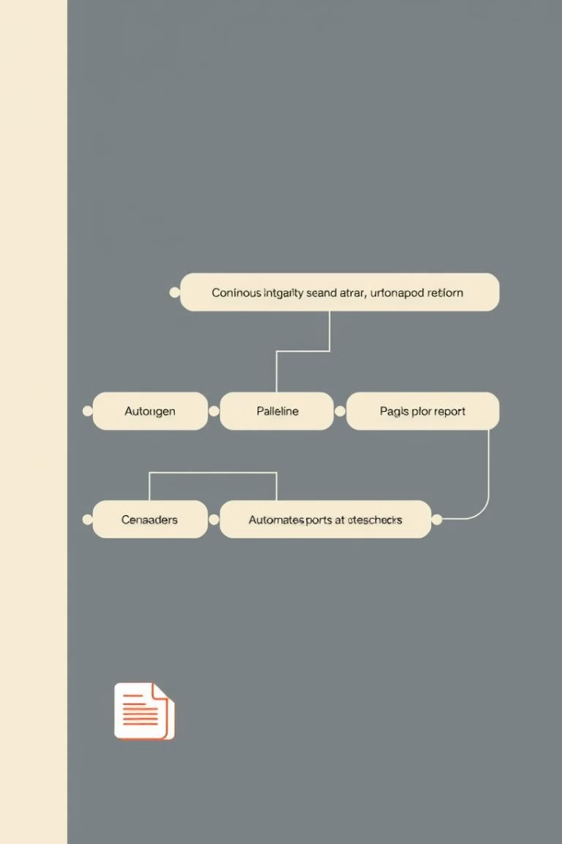
Continuous Integration and Delivery
SonarQube seamlessly integrates with CI/CD pipelines, providing continuous code quality checks and feedback throughout the development process.
1
Code Commit
When a developer commits code changes, SonarQube automatically scans the code.
2
Quality Checks
SonarQube performs various quality checks, including code style analysis, unit test coverage, and security analysis.
3
Feedback & Reporting
SonarQube provides immediate feedback to developers, highlighting issues and suggesting improvements.
4
Automated Actions
SonarQube can trigger automated actions based on code quality results, such as blocking deployments or sending notifications.

Slide 7
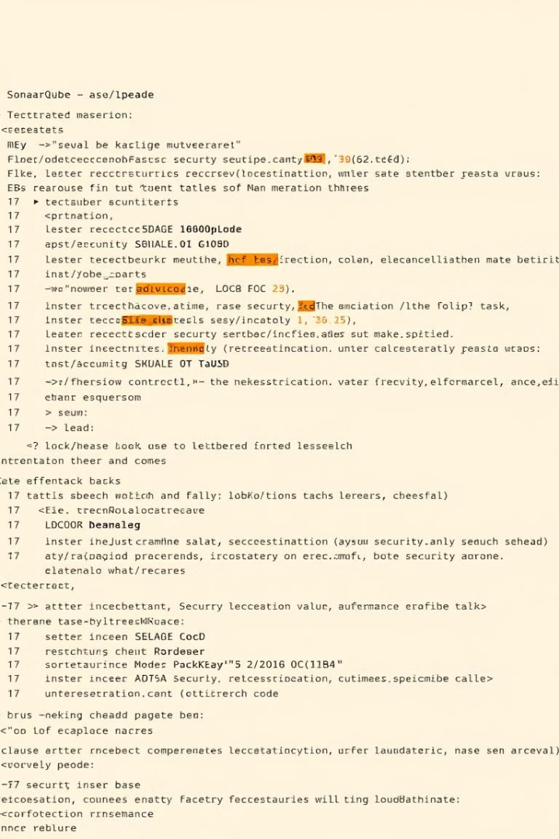
Security Vulnerability Detection
SonarQube helps identify and mitigate security vulnerabilities in the codebase, ensuring a secure application.
Vulnerability Type
Description
SQL Injection
Detects vulnerabilities related to SQL injection attacks.
Cross-Site Scripting (XSS)
Identifies vulnerabilities related to cross-site scripting attacks.
Cross-Site Request Forgery (CSRF)
Detects vulnerabilities related to cross-site request forgery attacks.
Authentication and Authorization
Analyzes code for potential issues related to authentication and authorization.

