Slide 1
Mandarin Tone Coach
Adaptive Pitch Feedback for L2 Mandarin Tone Learning
Milestone 1
Video Link
Bharath Jagadish (bjagadish3@gatech.edu)
CS6460 Educational Technology
Georgia Tech
Milestone 1

Slide 2
Problem & Motivation
The Challenge
The Gap
Mandarin has 4 tones — the same syllable means completely different things depending on pitch shape.
mā (妈) = mother · má (麻) = hemp
mǎ (马) = horse · mà (骂) = to scold
English doesn’t use pitch to change word meaning, so tones are often heard and produced incorrectly.
Existing tools fall short:
Duolingo / HelloChinese
Audio-only feedback, no pitch visualization
Research CAPT systems
Not publicly available; designed for lab use
Praat / Commercial tools
Require phonetics training to interpret output

Slide 3
System Architecture
🎙
📊
🤖
📈
💬
Record
Extract F0
Classify
Visualize
Feedback
Browser mic
audio-recorder-streamlit
Parselmouth / Praat
Silence trimming
SVM (RBF kernel)
27 acoustic features
Pitch overlay chart
Learner vs Reference
Plain-language cues
Tone-pair specific
Training Data
Michigan State University’s Tone Perfect corpus: 9,838 monosyllabic MP3s · 6 native speakers ·
4 tones · 410 syllables
Canonical contours: Chao (1968) tone letter system · 4 reference shapes saved as .npz

Slide 4
Key Design Decisions & Tradeoffs
Training Corpus Selection
Chose: Tone Perfect (monosyllabic, isolated words) — 9,838 files, 6 speakers Why: Classifier must work on learner's single-word recordings. Isolated syllable recordings match the inference context exactly.
⚠ Tradeoff: Only 9,838 training samples — larger corpora exist but use continuous speech which introduces sentence-level F0 artifacts.
SVM vs deep learning
Chose: SVM with RBF kernel Why: 9,838 training samples is too small for reliable deep learning. SVM achieves 91.95% with far less data and is interpretable.
⚠ Tradeoff: A CNN trained on larger data would likely outperform, but risks overfitting with this corpus size.
Canonical vs corpus-derived reference contours
Chose: Chao (1968) canonical tone templates Why: Sentence-level continuous speech F0 has natural declination that corrupts tone shape. Canonical templates from Chao (1968) are theoretically grounded and match the four tone descriptions used in every Mandarin textbook.
⚠ Tradeoff: Canonical templates are theoretically grounded but may not match individual native speaker variation.

Slide 5
Classifier Results — SVM, Speaker-Independent Evaluation
Per-Tone F1 Score
Setup
91.95%
T1 flat
98%
Model: SVM, RBF kernel C=10, gamma=scale Features: 27 per utterance F0 contour · delta · slope std · min/max · duration f0_min_pos Train: 4 speakers 6,557 samples Test: 2 speakers 3,280 samples
T2 rising
87%
Test accuracy
2 unseen speakers
T3 dipping
85%
T4 falling
97%
MLP tested: 90.52%
SVM outperformed MLP
on this dataset size.
Main confusion: T2 ↔ T3 (16% error rate) Both involve pitch movement — T2 rises, T3 dips then rises. Adding f0_min_pos feature improved T3 recognition in live testing.
Evaluation uses speaker-independent split: Female Voice 3 + Male Voice 3 held out from all training.

Slide 6
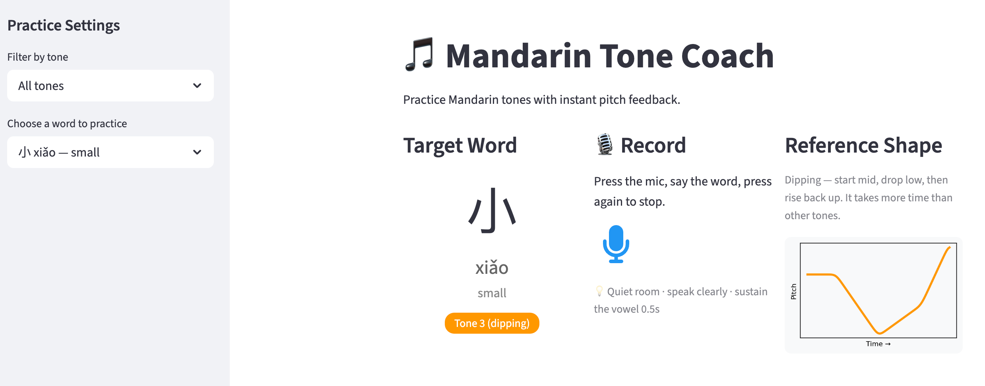
Working Prototype — Streamlit App
✅ 40 practice words across T1–T4
✅ Real-time silence trimming

Slide 7
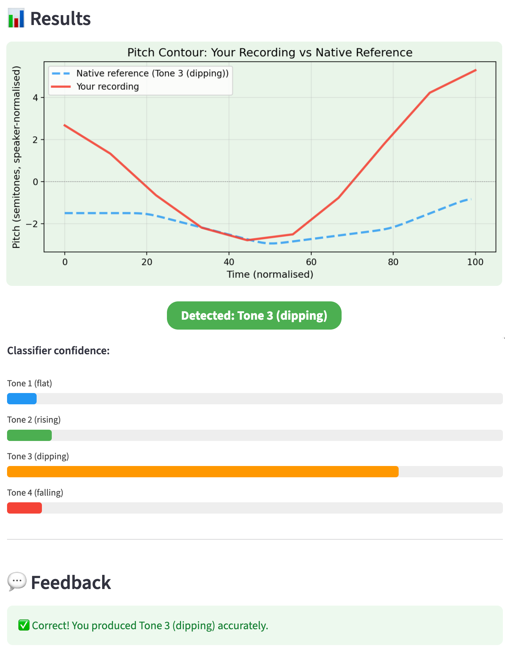
Working Prototype — Streamlit App
✅ Pitch contour overlay chart
✅ Plain-language corrective feedback

Slide 8
Feedback Questions — For Mentor & Classmates
Classifier feedback design
01
The app currently shows the detected tone and a text explanation of what went wrong. Should it also show a numerical confidence score (e.g. '73% T3, 21% T2')? Or does that add cognitive load without pedagogical value?
Word list scope
02
The current list has 40 words (10 per tone). For beginner learners, is it more effective to practice fewer words repeatedly (e.g. 5 per tone) or to have broader vocabulary coverage?
T2/T3 confusion handling
03
16% of T2 recordings are misclassified as T3 and vice versa — a known acoustic overlap. Should the app warn the user that 'T2 and T3 are easily confused by the classifier' to calibrate expectations, or does that undermine trust in the tool?

Slide 9
What's Next — Weeks 11–16
Week 11 · Feedback & UI Polish
Week 12 · Evaluation Design
Plain-language error cues for all T1–T4 pairs
Pre/post tone perception test (20 clips)
Disyllabic word list + tone sandhi
TAM usability survey
UI refinements from Milestone 1 feedback
Consent materials & participant recruitment
Week 13 · User Study
Wks 14–16 · Analysis & Paper
6–10 participants, 1 session each
Statistical analysis of pre/post gains
Pre-test → practice → post-test
Draft full paper
Milestone 2 video submission
Final submission

