Slide 1
Mandarin Tone Coach
Adaptive Pitch Feedback for L2 Mandarin Tone Learning
Milestone 2
Video Link
Bharath Jagadish (bjagadish3@gatech.edu)
CS6460 Educational Technology
Georgia Tech

Slide 2
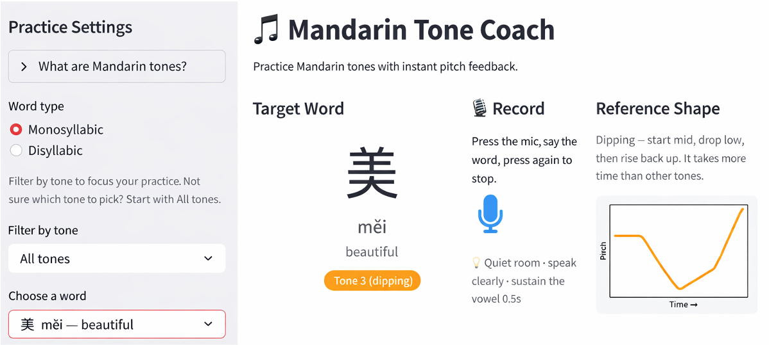
Milestone 1 Recap — What We Built
The System
Streamlit web app — real-time Mandarin tone practice
Pipeline: Record → Extract F0 → Classify → Visualize → Feedback
SVM Classifier
• 91.95% speaker-independent accuracy (Tone Perfect corpus, 9,838 MP3s)
• 27 acoustic features: F0 contour, first-order deltas, f0_min_pos
• Main T2↔T3 confusion (16%); rule-based override applied
Practice Modes
• Monosyllabic: 40 words (10 per tone T1–T4)
• Disyllabic: 20 two-syllable words with tone sandhi support
• Pitch contour overlay: learner (red) vs canonical reference (blue)
• Plain-language corrective feedback for all tone-pair combinations

Slide 3
Study Design
Study Protocol
Instruments
Perception test & Tech. Acceptance Model (TAM) survey
Online, asynchronous, self-paced (~15 min)
No prior Mandarin experience required
1. Pre-test (Form A)
12 audio clips · select the tone heard · no feedback given
2. Practice with the App
Mandarin Tone Coach: monosyllabic & disyllabic words
Real-time pitch contour + plain-language corrective feedback
3. Post-test (Form B)
12 new clips · different speakers
4. TAM Usability Survey
8 Likert items (1–5) + 1 open-ended feedback question
Perception Test
• 12 items per form (3 per tone T1–T4)
• Items randomized per participant (seeded by participant ID)
• Scored: proportion correct (0–12 per participant)
• Responses stored in Google Sheets via gspread
Speaker Design
• Form A — Female Voice 1 & Male Voice 1
• Form B — Female Voice 2 & Male Voice 2 (new, unseen speakers)
TAM Survey (Technology Acceptance Model)
• 8 Likert items, 5-point scale (1 = strongly disagree → 5 = strongly agree)
• Constructs: perceived usefulness, ease of use, reuse intent
• 1 open-ended question for qualitative feedback
Participant IDs
• Auto-generated 8-char hex ID shown at end of Form A
• Participants enter their ID to link Form A → Form B

Slide 4
Participant Demographics
Prior Mandarin Experience
Native Language
13
Never studied before: 11 / 16 (69%)
More than 2 years: 3 / 16 (19%)
Less than 6 months: 2 / 16 (13%)
69% of respondents had no prior Mandarin exposure — confirming the target population of complete novices.
English (all variants) 7 / 16 (44%)
Mandarin / Chinese 3 / 16 (19%)
Kannada / Tulu 2 / 16 (13%)
Hindi 1 / 16 (6%)
Farsi 1 / 16 (6%)
Malayalam 1 / 16 (6%)
Swahili 1 / 16 (6%)
Native/heritage Mandarin speakers (n=3) flagged — different performance profile from novices.
Paired participants
16
TAM respondents

Slide 5
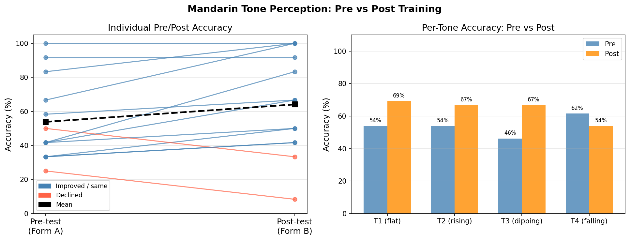
Pre/Post Perception Test Results
+10.3 pp
Mean accuracy gain
53.8% → 64.1%
Statistical Tests
Wilcoxon signed-rank test
W = 13.5, p = 0.087 (two-sided)
Paired t-test (reference)
t = −2.17, p = 0.051
n = 13 paired participants
3 items per tone per participant
Interpretation
Strong positive trend; p just above 0.05 threshold — marginal with n=13 (est. power ~35%)

Slide 6
Per-Tone Accuracy
T1 flat
T2 rising
T3 dipping
T4 falling
Pre-test
53.8%
Post-test
69.2%
+15.4 pp ↑
Pre-test
53.8%
Post-test
66.7%
+12.8 pp ↑
Pre-test
46.2%
Post-test
66.7%
+20.5 pp ↑
Pre-test
61.5%
Post-test
53.8%
−7.7 pp ↓
Key observations: T3 (dipping) showed the largest gain (+20.5 pp) — likely benefiting from the pitch contour visualization. T4 declined (−7.7 pp) — possibly harder Form B stimuli or high variance with only 3 items per tone. Caution: n=13, 3 items/tone = limited statistical power.

Slide 7
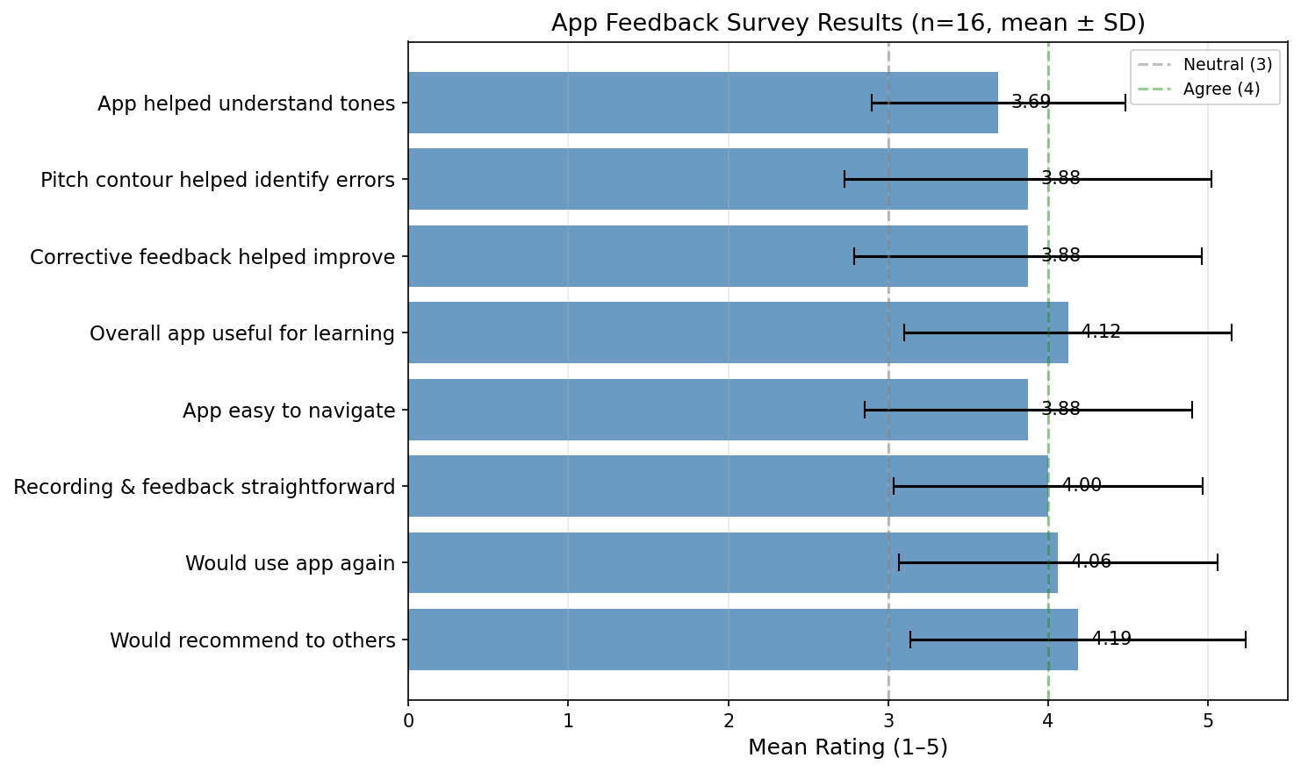
App Feedback
3.96 / 5.0
Overall mean (8 items)
4.19
Would recommend to others (highest)
4.12
Overall app useful for learning
4.06
Would use app again
4.00
Recording & feedback straightforward
3.69
Helped understand tones (lowest)
⚠ Respondent 13 (native Mandarin speaker who couldn’t navigate the app) gave all 1s — excluding this outlier raises the overall mean to 4.09.

Slide 8
Key Findings & Limitations
What Worked
Participant Feedback
Limitations
• Positive pre→post trend (+10.3 pp) across all non-native participants
• T3 (dipping) largest gain (+20.5 pp) — pitch contour most helpful
• TAM overall usefulness & reuse intent both 4.12 / 5
• Pitch contour overlay praised in open-ended feedback
• Disyllabic mode broadened practice scope successfully
• T2 vs T3 perceptually hard to distinguish — confirmed by test data
• No target audio before recording — users wanted to hear word first
• “Too noisy / too quiet” error not specific enough to act on
• More words requested; 40-word list feels limited
• App navigation confusing for one participant on first load
• n = 13 paired — underpowered pilot (est. power ~35%)
• Asynchronous: no control over practice time or noise environment
• T4 decline (−7.7 pp) likely Form B difficulty, not regression
• 3 native speakers in sample — different performance profile
• SVM misclassifies some correct native-speaker productions
“The app is well planned and designed in a way that makes it very easy for the user to learn Mandarin.” — Participant 9

Slide 9
What’s Next — Weeks 14–16
Week 14 · Deep Analysis
Weeks 14–15 · Paper Writing
Week 16 · Final Submission
✓ Per-participant learning curve analysis
✓ Subgroup: novices vs prior Mandarin learners
✓ Perception test confusion matrix (which tones mixed up)
✓ Correlate TAM scores with learning gains
✓ Introduction & literature review (CAPT, Noticing Hypothesis, TAM)
✓ Methods: system design + study protocol
✓ Results: quantitative pre/post + qualitative survey themes
✓ Discussion: implications, limitations, future work
✓ Complete paper (course format)
✓ Final video walkthrough of the system
✓ Open-source release on GitHub
✓ Optional: add target-word audio examples to the app

