Slide 1




PREPARED BY
K.BHARATH -- 2451-17-733-335
K.NITHISH -- 2451-17-733-329
B.SAI SHIVA REDDY -- 2451-17-733-179
Computer Science and engineering
1

Slide 2

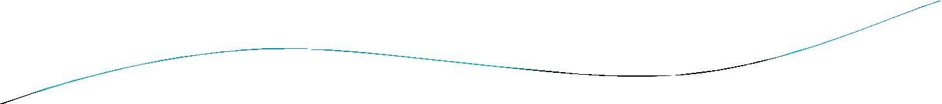
CONTENT
INTRODUCTION
WHAT IS SOLAR TRACKER
NEED OF SOLAR TRACKER
INTERNAL BIOCK DIAGREM
HARDWARE COPONENTS OF SOLAR TRACKER
ADVANTAGES
DISADVANTAGES
CONCLUTION
REFERENCE
2

Slide 3

INTRODUCTION
Renewable energy solutions are becoming popular.
Maximizing output from solar system increases efficiency.
Presently solar panels are of fixed type which lower the efficiency.
Solar tracking system has 35% higher generating power than fixed.
Solar tracking system based on PLC can adjust automatically orientation of panel
3

Slide 4

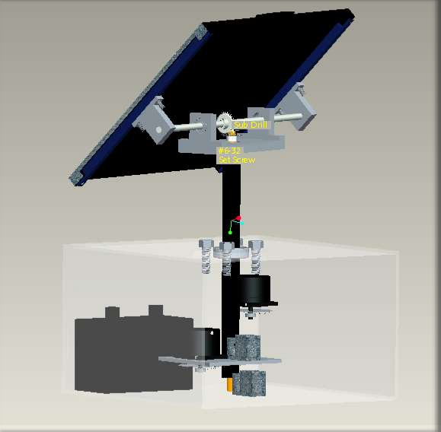
WHAT IS SOLAR TRACKER?
A Solar tracker is a device for orienting a solar
used
photovoltaic panel or lens towards the sun by using the solar or light sensors connected with the machine ( ex: stepper motor, servo motor, gas filled piston ).
Fig:1
4

Slide 5

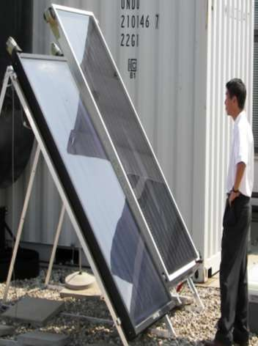
NEED OF SOLAR TRACKER
Increase Solar Panel Output
Max.efficency of the panel
Maximize Power per unit Area
Able to grab the energy through out the day
Fig:2
5

Slide 6

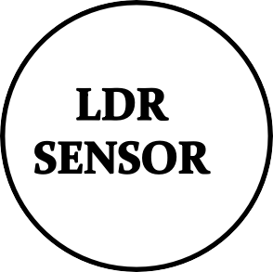









BLOCK DIAGRAM
Fig:10

Slide 7

HARDWARE COMPONENTS
SOLAR PANEL
LDR SENSORS
STEPPER MOTOR
RELAY
PLC

Slide 8

ADVANTAGES
Simple
Low cost
Eco-Friendly
We can monitor directly using PC
Tracking accuracy is more
Reduce the usage of power from power grid

Slide 9

DISADVANTAGES
Solar electricity is not available at night and is less available in cloudy weather conditions. Therefore, a storage or complimentary power system is required.
Limited power density.
Solar cells produce DC which must be converted to AC when used in currently existing distribution grids

Slide 10



