Slide 1
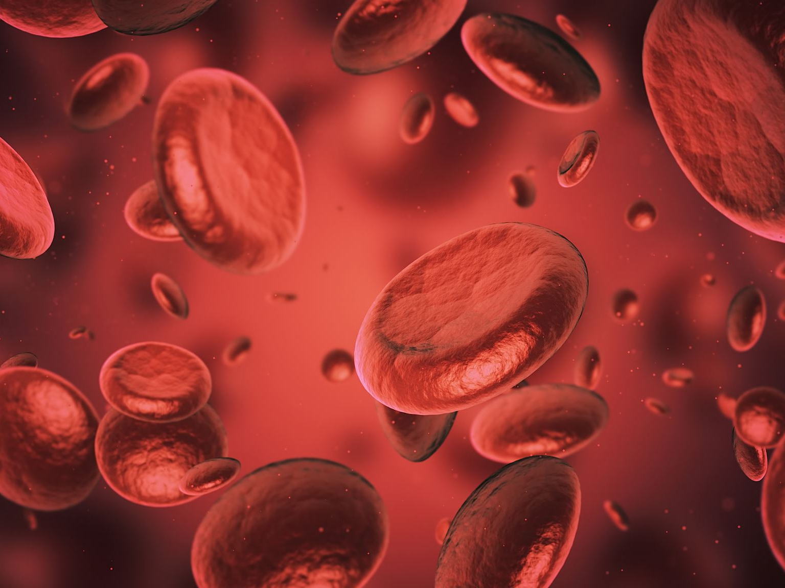
Blood Relations
– Aptitude & Reasoning
Bharath Kumar K

Slide 2
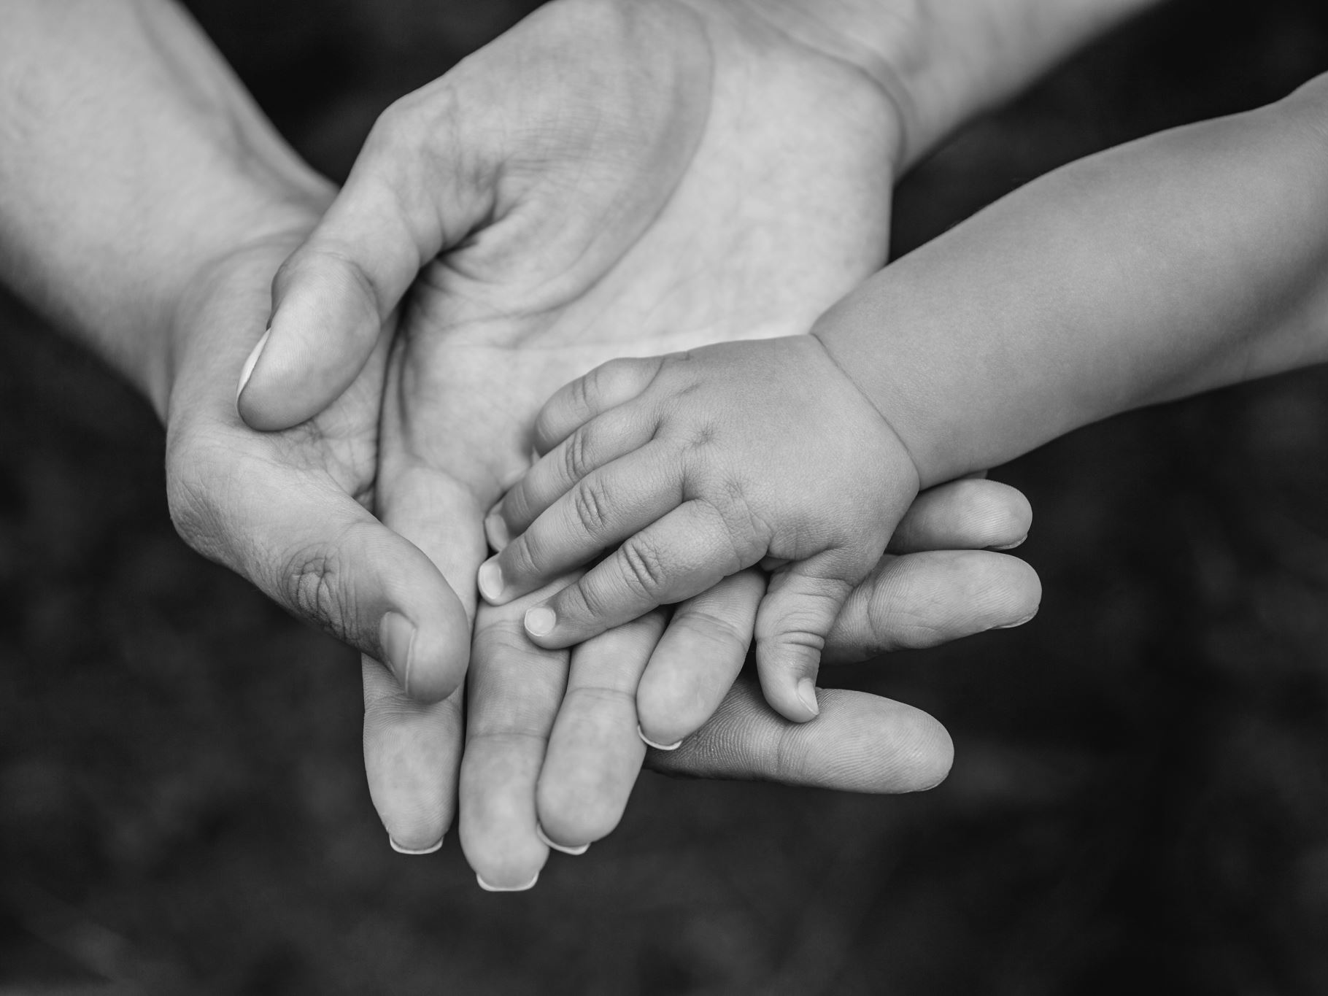
Introduction
The questions which are asked in this section depend upon Relation.
You should have a sound knowledge of the blood relation in order to solve the questions.
1. Relations of Paternal side:
Father's father → Grandfather
Father's mother → Grandmother
Father's brother → Uncle
Father's sister → Aunt
Children of uncle → Cousin
Wife of uncle → Aunt
Children of aunt → Cousin
Husband of aunt → Uncle

Slide 3
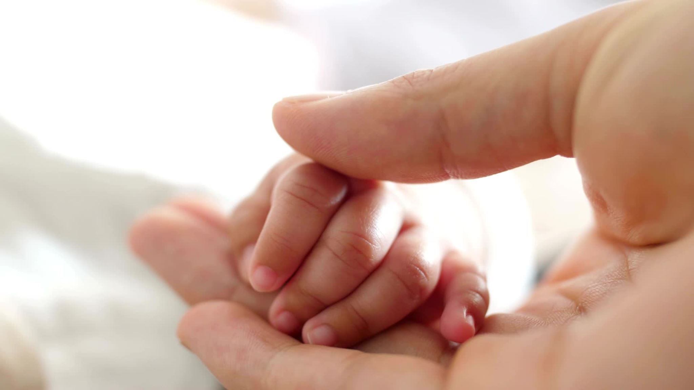
2. Relations of Maternal side:
Mother's father → Maternal grandfather
Mother's mother → Maternal grandmother
Mother's brother Maternal uncle
Mother's sister → Aunt
Children of maternal uncle → Cousin
Wife of maternal uncle → Maternal aunt

Slide 4
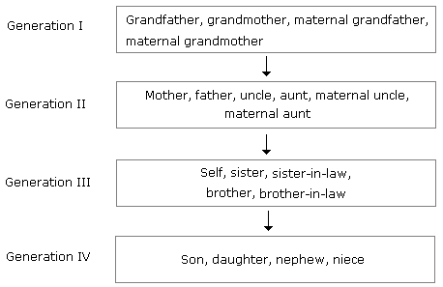
Relations from one generation to next:

Slide 5
Different types of questions with explanation:
Type 1:
If A + B means A is the mother of B; A x B means A is the father of B; A $ B means A is the brother of B and A @ B means A is the sister of B then which of the following means P is the son of Q?
(A) Q + R @ P @ N (B) Q + R * P @ N
(C) Q x R $ P @ N (D) Q x R $ P $ N
Solution: (D)
Q x R = Q is the father of R [-Q, ±R]
R $ P = R is the brother of P [+ R, ±P]
P $ N = P is the brother of N [+ P, ±N]
Therefore P is the son of Q.

Slide 6

Different types of questions with explanation:
Type 2:
A has 3 children. B is the brother of C and C is the sister of D, E who is the wife of A is the mother of D. There is only one daughter of the husband of E. what is the relation between D and B?
Solution: With the chart
Therefore, D is a boy because there is only one daughter of E.
Hence, B is the brother of D.

Slide 7
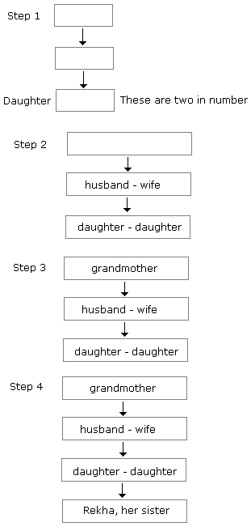
Different types of questions with explanation:
Type 3:
Pointing to a photograph, Rekha says to Lalli, "The girl in the photo is the second daughter of the wife of only son of the grandmother of my younger sister." How this girl of photograph is related to Rekha?
Solution:
First Method - By Generating Charts:

Slide 8

Different types of questions with explanation:
Second method:
Grandmother of younger sister of Rekha → Grandmother of Rekha
Wife of only son of grandmother → Mother of Rekha
Younger daughter of the mother → Younger sister.
Note: While solving the question (+) can be used for male and (-) can be used for female.

Slide 9

Question 1
Pointing to a photograph of a boy Suresh said,
"He is the son of the only son of my mother." How is Suresh related to that boy?
Brother
Uncle
Cousin
Father

Slide 10
Answer: Father
Explanation:
The boy in the photograph is the son of Suresh. Hence, Suresh is the father.

Slide 11
Question 2
If A + B means A is the mother of B; A - B means A is the brother of B; A % B means A is the father of B and A x B means A is the sister of B, which of the following shows that P is the maternal uncle of Q?
Q - N + M x P
P + S x N - Q
P - M + N x Q
Q - S % P

Slide 12
Answer: P - M + N x Q
Explanation:
P - M → P is the brother of M
M + N → M is the mother of N
N x Q → N is the sister of Q
Therefore, P is the maternal uncle of Q.

Slide 13
Question 3
If A is the brother of B; B is the sister of C; and C is the father of D, how D is related to A?
Brother
Sister
Nephew
Cannot be determined

Slide 14
Answer: Cannot be determined
Explanation:
If D is Male → Nephew
If D is Female → Niece
As the sex of D is not known, the relation cannot be determined.

Slide 15
Question 4
If A + B means A is the brother of B; A - B means A is the sister of B and A x B means A is the father of B.
Which of the following means that C is the son of M?
M - N x C + F
F - C + N x M
N + M - F x C
M x N - C + F

Slide 16
Answer: M x N - C + F
Explanation:
M x N → M is the father of N
N - C → N is the sister of C
C + F → C is the brother of F
Hence, C is the son of M.

Slide 17
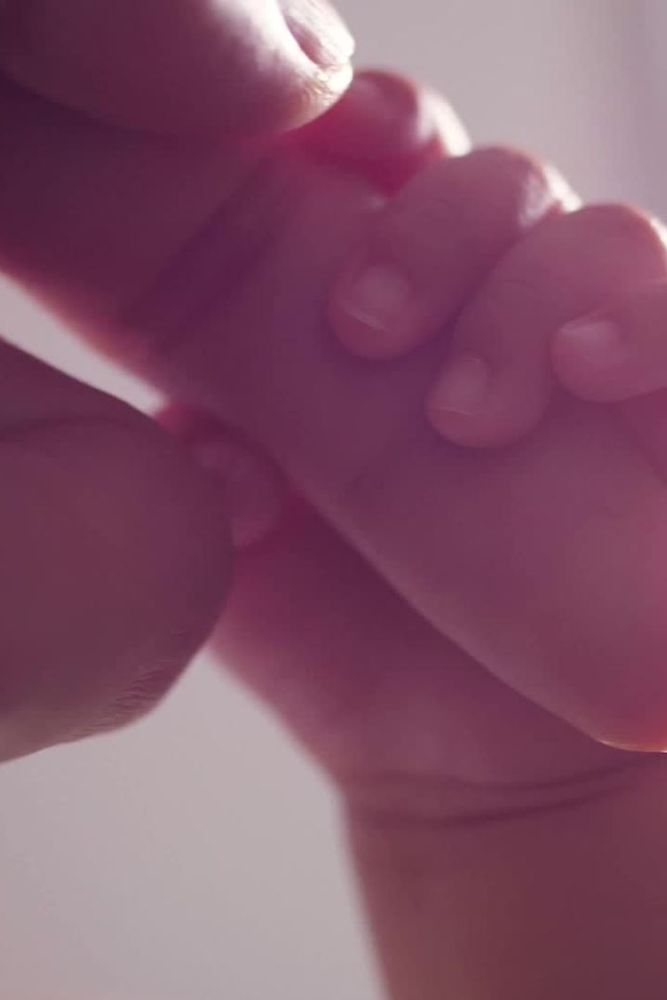
Question 5
Introducing a boy, a girl said,
"He is the son of the daughter of the father of my uncle."
How is the boy related to the girl?
Brother
Nephew
Uncle
Son-in-law

Slide 18
Answer: Nephew
Explanation:
Father of uncle → Grandfather
Daughter of grandfather → Aunt
Son of aunt → Nephew

Slide 19
Question 6
Pointing to a photograph Lata says,
"He is the son of the only son of my grandfather."
How is the man in the photograph related to Lata?
Brother
Uncle
Cousin
Data is inadequate

Slide 20
Answer: Brother
Explanation:
Only son of grandfather → Lata’s father
Son of father → Brother

Slide 21
Question 7
If A + B means A is the brother of B; A x B means A is the son of B; and A % B means B is the daughter of A then which of the following means M is the maternal uncle of N?
M + O x N
M % O x N + P
M + O % N
None of these

Slide 22
Answer: Option D
Explanation:
Because the sex of O is not known.

Slide 23
Question 8
If D is the brother of B, how B is related to C? To answer this question which of the statements is/are necessary?
1. The son of D is the grandson of C.
2. B is the sister of D.
Only 1
Only 2
Either 1 or 2
1 and 2 both are required

Slide 24
Answer: Option D
Explanation:
Given: D is the brother of B.
From statement 1, we can detect that D is son of C (son of D is the grandson of C).
From statement 2, we can detect that B is 'Female' (sister of D).
Therefore, B is daughter of C.

Slide 25
Question 9
If A + B means A is the father of B; A - B means A is the brother B; A % B means A is the wife of B and A x B means A is the mother of B, which of the following shows that M is the maternal grandmother of T?
M x N % S + T
M x N - S % T
M x S - N % T
M x N x S % T

Slide 26
Answer: Option A
Explanation:
M x N → M is the mother of N
N % S → N is the wife of S
and S + T → is the father of T.
Hence, M is the maternal grandmother of T.

Slide 27

Question 10
Deepak said to Nitin, "That boy playing with the football is the younger of the two brothers of the daughter of my father's wife." How is the boy playing football related to Deepak?
Son
Brother
Cousin
Brother-in-law

Slide 28

Answer: Option B
Explanation:
Father's wife → mother. Hence, the daughter of the mother means sister and sister's younger brother means brother. Therefore, the boy is the brother of Deepak.

Slide 29
Question 11
If A + B means A is the sister of B; A x B means A is the wife of B, A % B means A is the father of B and A - B means A is the brother of B. Which of the following means T is the daughter of P?
P x Q % R + S - T
P x Q % R - T + S
P x Q % R + T - S
P x Q % R + S + T

Slide 30
Answer: Option B
Explanation:
P x Q → P is the wife of Q
Q % R → Q is the father of R
R - T → R is the brother of T
T + S → T is the sister of S.
Therefore, T is the daughter of P.

Slide 31
Question 12
Pointing to a woman, Abhijit said, "Her granddaughter is the only daughter of my brother." How is the woman related to Abhijit?
Sister
Grandmother
Mother-in-law
Mother

Slide 32
Answer: Option D
Explanation:
Daughter of Abhijit's brother → niece of Abhijit. Thus the granddaughter of the woman is Abhijit's niece.
Hence, the woman is the mother of Abhijit.

Slide 33

Directions to Solve
Each of these questions is based on the following information:
A + B means A is the mother of B.
A - B means A is the sister of B.
A * B means A is the father of B.
A β B means A is the brother of B.

Slide 34

Which of the following means that N is the maternal uncle of M?
N β P - L + E - M
N - Y + A β M
M - Y * P - N
N β C + F * M

Slide 35

Answer: Option A
Explanation:
N β P → N is the brother of P
P - L → P is the sister of L
L + E → L is the mother of E
E - M → E is the sister of M.
Hence, L is the mother of M, P is the maternal aunt of M and N is the maternal uncle of M.

Slide 36
In a family, there are six members A, B, C, D, E and F.
A and B are a married couple, A being the male member.
D is the only son of C, who is the brother of A.
E is the sister of D. B is the daughter-in-law of F, whose husband has died.
How is E related to C ?
A) Sister | B)Daughter
C) Cousin | D) Mother

Slide 37
Answer: B) Daughter
Explanation:
A is a male and married to B. So, A is the husband and B is the wife. C is the brother of A. D is the son of C. E. who is the sister of D will be the daughter of C. B is the daughter-in-law of F whose husband has died means F is the mother of A.
Clearly. E is the daughter of C.

Slide 38
(i) In a family of six persons A, B, C, D, E and F, there are two married couples.
(ii) D is grandmother of A and mother of B.
(iii) C is wife of B and mother of F.
(iv) F is the grand daughter of E.
Who among the following is one of the couples ?
A) CD | B) DE
C) EB | D) none of these

Slide 39
Answer: D) none of these
Explanation:
C is wife of B. So, one couple is BC. Now, D in grandmother of A, B is the son of D and his wife C is the mother of F. SO, D is also the grandmother of F But F is the granddaughter of E.
So, E is the grandfather of F and the husband of D. Thus, DF is another couple

Slide 40
If ‘A#B’ means A is father of B, ‘A*B’ means A is brother of B, ‘A@B’ means A is mother of B then which of the following is correct about G@T#P?
a) G is mother of P
b) P is father of T
c) T is son of G
d) P is brother of T

Slide 41
Explanation:
Here, according to the question, G@T means G is mother of T and T#P means T is father of P. So, it is clear that T is son of G.
Hence the answer is T is son of G.
Answer: c

Slide 42
Rahul is brother of Nilesh. Diva is daughter of Nilesh. Parul who is daughter of Rahul is married to Kapil. Ankita is sister of Nilesh. What is the relation between Ankita and Parul?
a) Sister
b) Aunt
c) Mother
d) Mother-in-law

Slide 43
Answer: b
Explanation:
Here, it is given that Rahul and Nilesh are brothers and Parul is Daughter of Rahul. Ankita is sister of Nilesh i.e. Ankita is sister of Rahul. So, it is clear that Ankita is aunt of Parul.
Hence the answer is Aunt.

Slide 44
A, B, C, D, E, F and G are members of a family consisting of four adults and three children, two of whom, F and G are boys. A and D are brothers and A is an engineer. E is a doctor married to one of the brothers and has two children. B is married to D and G is their child. Who is C?
a) G’s father
b) F’s father
c) E’s daughter
d) A’s son

Slide 45
Answer: c
Explanation:
Here, it is given that C, F and G are children and F and G are boys i.e. C is a girl. Since, B married to D and G is their child, therefore, E married to A and C and F are their children.
Hence the answer is E’s daughter.

Slide 46
Kalyan is brother of Salman. Dhriti is sister of Atharv and daughter of Suchitra. Saloni is wife of Kalyan and is sister of Suchitra. If Syed is son of Salman, how is Saloni related to Syed?
a) Daughter
b) Mother
c) Niece
d) Aunt

Slide 47
Answer: d
Explanation:
Here, it is given that Kalyan is brother of Salman. Saloni is wife of Kalyan and Syed is son of Salman. So, Saloni is his aunt.
Hence the answer is Aunt.

Slide 48
Bhaskar is son of Chellam and is brother of Deepan. Milind is son of Deepan and Zoya is sister of Milind’s grandfather’s son. If Raji is sister of Milind then how is Zoya related to Raji ?
a) Daughter
b) Mother
c) Niece
d) Aunt

Slide 49
Answer: d
Explanation:
Here, it is given that Zoya is sister of Milind’s grandfather’s (i.e. Chellam’s) son i.e. Zoya is sister of Bhaskar and Deepan and Raji is sister of Mlind. So, Zoya is Raji’s aunt.
Hence the answer is Aunt.

Slide 50
MP and JK are brothers, AB is son of MP and brother of XY. JK is father of UV and is son of CD, if ST is wife of MP and UV is brother of PQ then, how is UV related to ST?
a) Father
b) Son
c) Nephew
d) Grandson

Slide 51
Answer: c
Explanation:
Here, it is given that CD is father/mother of JK and JK and MP are brothers so, CD is father/mother of both JK and ST. Also, AB is son of MP and ST and UV is son of JK so, ST is his aunt.
Hence the answer is Nephew.

Slide 52
Q is the brother of R;
P is the sister of Q;
T is the brother of S;
S is the daughter of R.
Who are the cousins of Q ?
A) R and P | B) P and T
C) Q and T | D) S and T

Slide 53
Answer: D) S and T
Explanation:
T is the brother of S, who is the daughter of R. So, T and S are the children of R.
Now. Q is the brother of R. So, T and S are the cousins of Q.

Slide 54
THANK YOU

