Slide 1
Technical Presentation-2 Group 1
By:
Bharath Kumar N Aritra Sinha Roy
Sahil Cahudhary Siddhesh Kedkar
Titli Ghosh Aditya Kumar
Aakash Kulthia

Slide 2
What,Why & How to use Python

Slide 3
What is Python
High-Level Language Python abstracts away complex details, letting you focus on solving problems.
General-Purpose Used in web development, data science, machine learning, automation, AI, and more.
Interpreted Language Python code runs line-by-line, making it easier to debug and test.
Readable & Clean Syntax Designed to be easy to read and write—great for beginners and professionals.
Extensive Library Support Thousands of libraries available for everything from math to machine learning.
Cross-Platform Works on Windows, macOS, Linux—write once, run anywhere.

Slide 4
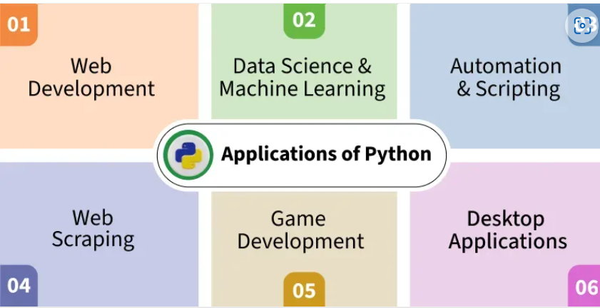
Why Python
Requires fewer lines of code compared to other programming languages like Java.
Provides Libraries / Frameworks like Django, Flask and many more for Web Development, and Pandas, Tensorflow, Scikit-learn and many more for, AI/ML, Data Science and Data Analysis
Cross-platform, works on Windows, Mac and Linux without major changes.
Used by top tech companies like Google, Netflix and NASA.
Many Python coding job opportunities in Software Development, Data Science and AI/ML.

Slide 5
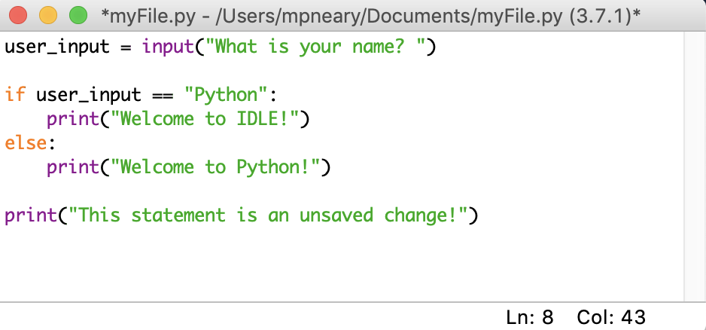
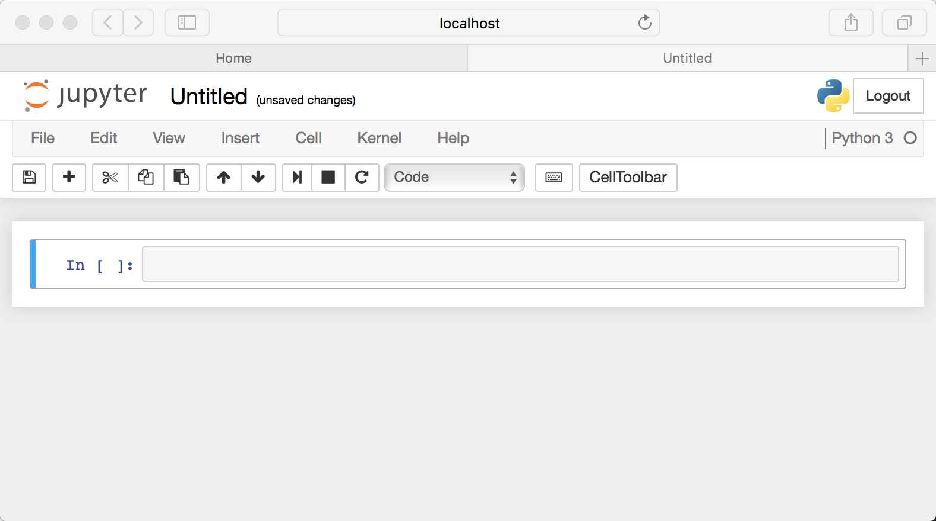
How to use Python
Install Python
➤ Download from python.org
➤ Add to system PATH
Choose an Editor
➤ IDLE, VS Code, PyCharm, Jupyter Notebook
Write & Run Code
print("Hello, World!")
➤ Save as .py file
➤ Run via terminal: python filename.py
Use Libraries
➤ Install with pip install library_name
➤ Example: pip install numpy
Practice & Explore
➤ Try online platforms: W3Schools, Real Python, LeetCode

Slide 6
Basics of Python Indentation

Slide 7
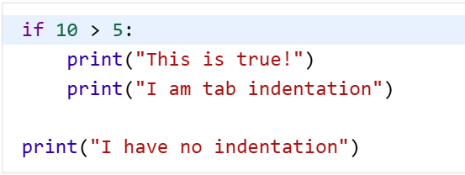

Indentation in python
In Python, indentation is used to define blocks of code. It tells the Python interpreter that a group of statements belongs to a specific block. All statements with the same level of indentation are considered part of the same block. Indentation is achieved using whitespace (spaces or tabs) at the beginning of each line.
Example Output:

Slide 8
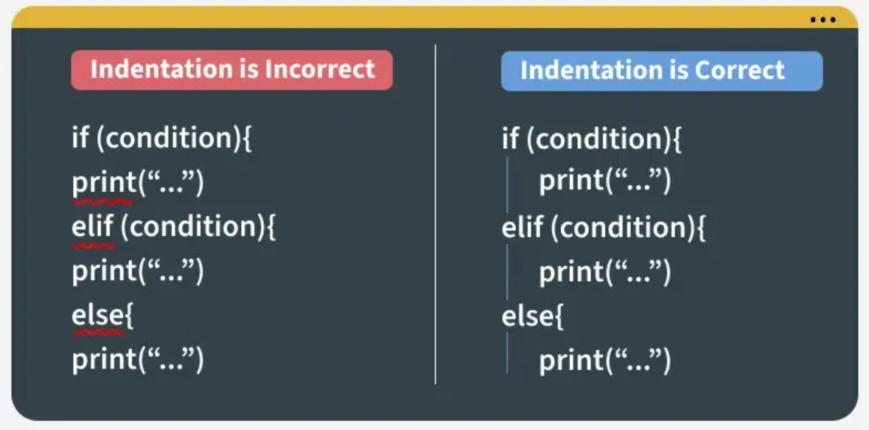
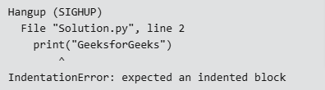
Indentation Error
🔹 Indentation Error occurs when Python code is not properly aligned using spaces or tabs.
🔹 Python uses indentation to define blocks of code—missing or inconsistent indentation breaks execution.

Slide 9
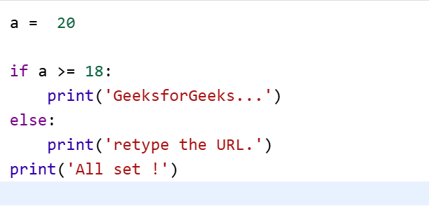
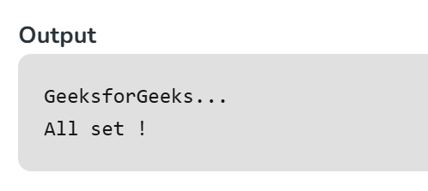
Indentation in conditional statement
The lines print(‘GeeksforGeeks…’) and print(‘retype the URL.’) are two separate code blocks. The two blocks of code in our example if-statement are both indented four spaces. The final print(‘All set!’) is not indented, so it does not belong to the else block.

Slide 10
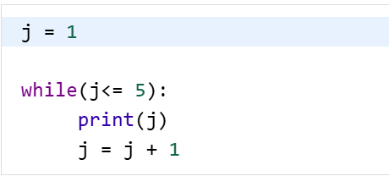
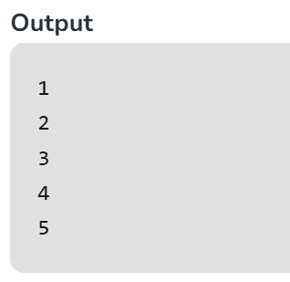
Indentation in looping
To indicate a block of code in Python, we must indent each line of the block by the same whitespace. The two lines of code in the while loop are both indented four spaces. It is required for indicating what block of code a statement belongs to.

Slide 11
Basics of Python Comment

Slide 12
Python Comments
Comments in Python are the lines in the code that are ignored by the interpreter during the execution of the program.
Comments enhance the readability of the code.
Comment can be used to identify functionality or structure the code-base.
Comment can help understanding unusual or tricky scenarios handled by the code to prevent accidental removal or changes.
Comments can be used to prevent executing any specific part of your code, while making changes or testing.

Slide 13
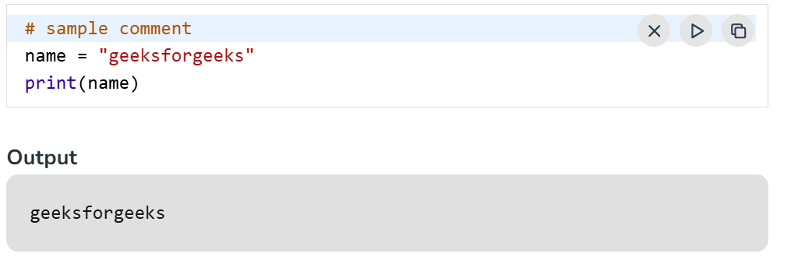
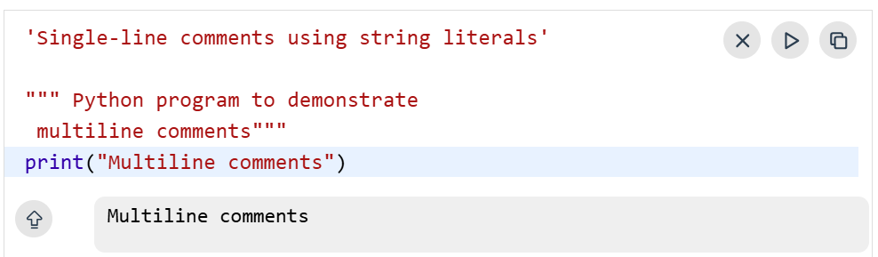
Types of comments
Single line comments
In Python, single line comments starts with hashtag symbol #.
Multi line comments
Multiline comments using multiple hashtags (#)
We can multiple hashtags (#) to write multiline comments in Python.
Each and every line will be considered as a single-line comment.
Using String Literals as Comment
Python ignores the string literals that are not assigned to a variable.
So, we can use these string literals as Python Comments.

Slide 14
Best Practice to Write Comments
These are some of the tips you can follow, to make your comments effective are:
Comments should be short and precise.
Use comments only when necessary, don't clutter your code with comments.
Avoid writing generic or basic comments.
Write comments that are self explanatory.

Slide 15
Basics of Python-String values

Slide 16
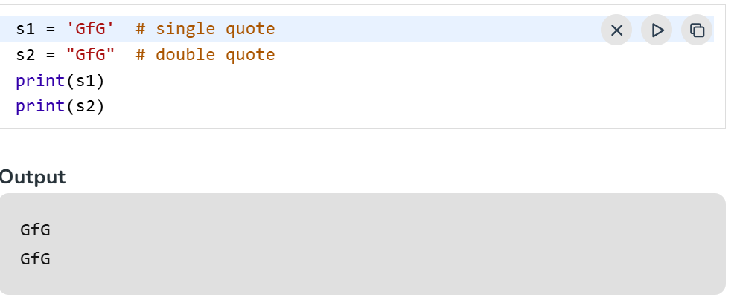
Python String
In Python, a string is a sequence of characters enclosed in quotes. It can include letters, numbers, symbols or spaces. Since Python has no separate character type, even a single character is treated as a string with length one. Strings are widely used for text handling and manipulation.
A string is a sequence of characters enclosed in quotes.
Can use single ('), double ("), or triple quotes (''' or """).

Slide 17
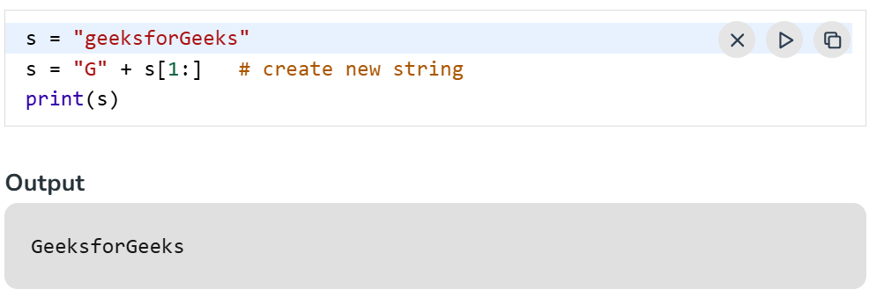
String Immutability
Strings are immutable, which means that they cannot be changed after they are created. If we need to manipulate strings then we can use methods like concatenation, slicing or formatting to create new strings based on original.
Example: In this example we are changing first character by building a new string.

Slide 18
Operations of Strings
Operation | Syntax / Example | Description
Concatenation | "Hello" + "World" | Combines two strings
Repetition | "Hi" * 3 | Repeats the string multiple times
Indexing | text[0] | Accesses character at a specific position
Slicing | text[1:4] | Extracts substring from index 1 to 3
Length | len(text) | Returns number of characters in the string
Uppercase | text.upper() | Converts all characters to uppercase
Lowercase | text.lower() | Converts all characters to lowercase
Strip | text.strip() | Removes leading and trailing whitespace
Replace | text.replace("a", "b") | Replaces substring with another
Split | text.split() | Splits string into a list of words
Join | " ".join(list_of_words) | Joins list elements into a single string
Find | text.find("word") | Returns index of first occurrence
Count | text.count("a") | Counts occurrences of a substring
Startswith | text.startswith("Hello") | Checks if string starts with given substring
Endswith | text.endswith("World") | Checks if string ends with given substring
Isdigit | text.isdigit() | Checks if string contains only digits
Isalpha | text.isalpha() | Checks if string contains only letters

Slide 19
Introduction to data structure

Slide 20
Python Data Structures
Data Structures are a way of organizing data so that it can be accessed more efficiently depending upon the situation. Data Structures are fundamentals of any programming language around which a program is built. Python helps to learn the fundamental of these data structures in a simpler way as compared to other programming languages.
Built-in: | Collection module: | Others
List Tuple Set Dictionary | deque Counter OrderedDict defaultdict namedtuple | Queue LifoQueue PriorityQueue heap (min-heap) array

Slide 21
Data structure - List

Slide 22
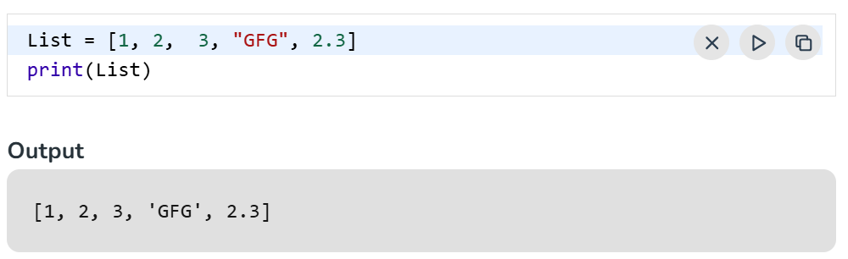
Lists
Python Lists are just like the arrays, declared in other languages which is an ordered collection of data. It is very flexible as the items in a list do not need to be of the same type.

Slide 23
Operations of List
Operation | Syntax / Method | Description
Create a list | my_list = [1, 2, 3] | Initializes a list
Access element | my_list[0] | Gets the first element
Modify element | my_list[1] = 10 | Changes the second element
Append element | my_list.append(4) | Adds to the end of the list
Insert element | my_list.insert(1, 99) | Inserts at a specific index
Remove by value | my_list.remove(99) | Removes first occurrence of value
Remove by index | my_list.pop(1) | Removes and returns element at index
Length of list | len(my_list) | Returns number of elements
Sort list | my_list.sort() | Sorts the list in ascending order
Reverse list | my_list.reverse() | Reverses the list
Slice list | my_list[1:3] | Gets a sublist from index 1 to 2
Check existence | 4 in my_list | Returns True if 4 is in the list
Loop through list | for x in my_list: | Iterates over each element
List comprehension | [x*2 for x in my_list] | Creates a new list with modified elements
Clear list | my_list.clear() | Removes all elements
Copy list | copy_list = my_list.copy() | Creates a shallow copy

Slide 24
Data structure - Tuple

Slide 25
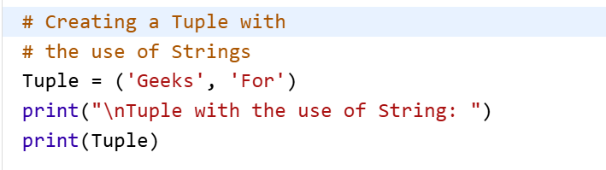
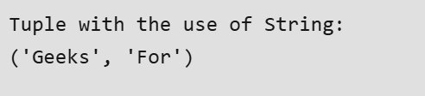
Tuple
Tuple is a collection of Python objects much like a list but Tuples are immutable in nature i.e. the elements in the tuple cannot be added or removed once created. Just like a List, a Tuple can also contain elements of various types.

Slide 26
Operations in Tuple
Operation | Syntax / Method | Description
Create a tuple | my_tuple = (1, 2, 3) | Initializes a tuple
Access element | my_tuple[0] | Gets the first element
Slice tuple | my_tuple[1:3] | Gets a sub-tuple from index 1 to 2
Length of tuple | len(my_tuple) | Returns number of elements
Loop through tuple | for x in my_tuple: | Iterates over each element
Check existence | 2 in my_tuple | Returns True if 2 is in the tuple
Count occurrences | my_tuple.count(2) | Counts how many times 2 appears
Find index | my_tuple.index(2) | Returns the index of first occurrence of 2
Nested tuples | nested = ((1, 2), (3, 4)) | Tuples can contain other tuples
Tuple unpacking | a, b, c = my_tuple | Assigns tuple elements to variables
Immutable nature | my_tuple[0] = 10 ❌ | Tuples cannot be modified after creation

Slide 27
Other libraries
Data Structure | Module | Purpose / Use Case
deque | collections | Double-ended queue for fast appends/pops from both ends. Ideal for stacks and queues.
Counter | collections | Counts frequency of elements in an iterable. Great for statistics and histograms.
OrderedDict | collections | Dictionary that remembers insertion order (before Python 3.7).
defaultdict | collections | Dictionary with default values for missing keys. Avoids KeyError.
namedtuple | collections | Tuple with named fields. Improves readability and access by name.
array | array | Efficient storage of basic data types (like C arrays). Better than lists for numbers.
heapq | heapq | Implements a min-heap. Useful for priority queues and efficient sorting.
Queue | queue | Thread-safe FIFO queue. Used in multi-threaded applications.
LifoQueue | queue | Thread-safe stack (Last-In-First-Out).
PriorityQueue | queue | Thread-safe queue where elements are retrieved by priority.

Slide 28
Input/Output – Read Files and access method

Slide 29
File Handling
File handling refers to the process of performing operations on a file, such as creating, opening, reading, writing and closing it through a programming interface. It involves managing the data flow between the program and the file system on the storage device, ensuring that data is handled safely and efficiently.
Why do we need File Handling
To store data permanently, even after the program ends.
To access external files like .txt, .csv, .json, etc.
To process large files efficiently without using much memory.
To automate tasks like reading configs or saving outputs.
To handle input/output in real-world applications and tools

Slide 30
Operations in File
Operation | Syntax / Method | Purpose / Description
Open a file | open('filename.txt', 'mode') | Opens a file in specified mode ('r', 'w', 'a', etc.). 'r' is default.
Close a file | file.close() | Closes the file and releases system resources.
Check file properties | file.name, file.mode, file.closed | Returns file name, mode, and whether it's closed.
Read entire file | file.read() | Reads the entire content of the file.
Write to file | file.write("text") | Writes text to the file (overwrites in 'w' mode).
Use with statement | with open(...) as file: | Automatically handles file closing.
Handle exceptions | try: ... finally: file.close() | Ensures file is closed even if an error occurs.
Read line-by-line | file.readline() / file.readlines() | Reads one line or all lines into a list.
Append to file | open('filename.txt', 'a') | Opens file in append mode to add content without overwriting.
Check if file exists | os.path.exists('filename.txt') | Checks if a file exists before opening (requires import os).
Delete a file | os.remove('filename.txt') | Deletes a file (requires import os).

Slide 31
Modes in file Handling
Mode | Description
‘r’ | Read-only. Raises I/O error if file doesn't exist.
‘r+’ | Read and write. Raises I/O error if the file does not exist.
‘w’ | Write-only. Overwrites file if it exists, else creates a new one.
‘w+’ | Read and write. Overwrites file or creates new one.
‘a’ | Append-only. Adds data to end. Creates file if it doesn't exist.
‘a+’ | Read and append. Pointer at end. Creates file if it doesn't exist.
‘rb’ | Read in binary mode. File must exist.
‘rb+’ | Read and write in binary mode. File must exist.
‘wb’ | Write in binary. Overwrites or creates new.
‘wb+’ | Read and write in binary. Overwrites or creates new.
‘ab’ | Append in binary. Creates file if not exist.
‘ab+’ | Read and append in binary. Creates file if it does not exist.

Slide 32
except FileNotFoundError:
print("❌ File not found.")
# Step 3: Check file properties
file = open("example.txt", "r")
print("\n🔍 File Properties:")
print("Filename:", file.name)
print("Mode:", file.mode)
print("Is Closed?", file.closed)
file.close()
print("Is Closed after closing?", file.closed)
# Step 1: Write to a file
with open("example.txt", "w") as file:
file.write("Hello, Bharath!\n")
file.write("This is a file handling example in Python.\n")
print("✅ File written successfully.")
# Step 2: Read from the file
try:
with open("example.txt", "r") as file:
content = file.read()
print("\n📄 File Content:")
print(content)

Slide 33
Classes in Python-Class and OOPS concept

Slide 34
Class in python
What is a Class?
A class is a blueprint for creating objects.
It defines attributes (data) and methods (functions) that describe the behavior of the object.
Why Use Classes?
Organize code using Object-Oriented Programming (OOP).
Reusability and modularity.
Encapsulation of data and behavior.
Basic Syntax:
class MyClass:
def __init__(self, name):
self.name = name
def greet(self):
print(f"Hello, {self.name}!")

Slide 35
What is Object Oriented Programming
A programming paradigm based on the concept of "objects"
Objects contain data (attributes) and functions (methods)
Promotes modularity, reusability, and scalability
Key Concepts:
Class: Blueprint for creating objects
Object: Instance of a class

Slide 36
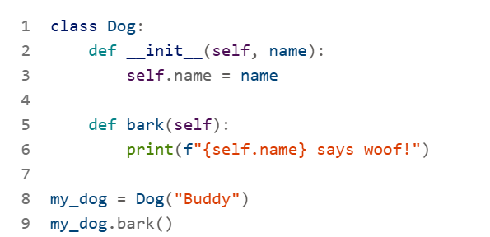
Sample Example

Slide 37
Core Principles of OOP
Principle | Description
Encapsulation | Hides internal state; access via methods
Abstraction | Shows only essential features
Inheritance | Child class inherits from parent class
Polymorphism | Same method behaves differently in different classes

Slide 38
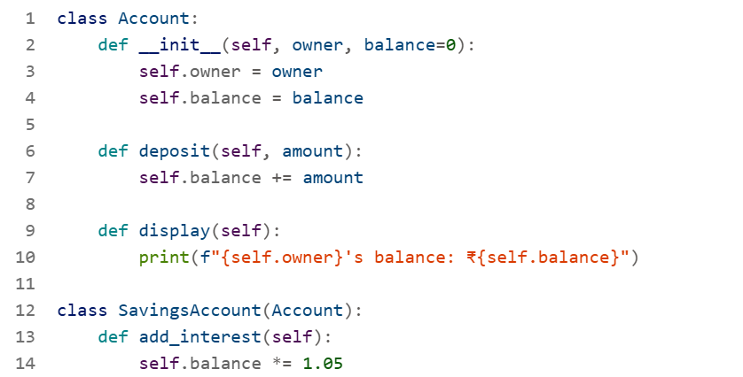
OOP in Action

Slide 39
Why Use OOP in Python?
✅ Code Reusability: Use existing code via inheritance
✅ Modularity: Break down complex systems into manageable parts
✅ Maintainability: Easier to update and debug
✅ Scalability: Ideal for large applications

Slide 40
How to create classes in python

Slide 41
Working with Objects
Creating an Object:
obj = MyClass("Bharath")
obj.greet() # Output: Hello, Bharath!
Key Concepts:
__init__: Constructor method, runs when object is created.
self: Refers to the current instance of the class.
Methods: Functions defined inside a class.

Slide 42
Example template
class ClassName:
def __init__(self, attribute1, attribute2):
self.attribute1 = attribute1
self.attribute2 = attribute2
def method1(self):
# Code for method1
pass
def method2(self, parameter):
# Code for method2
return parameter
# Creating an instance of the class
object_name = ClassName(value1, value2)
# Calling methods on the object
object_name.method1()
result = object_name.method2(argument)

Slide 43
Introduction to AWS

Slide 44

What is AWS?
AWS is a cloud computing platform by Amazon.
Offers on-demand services like:
Compute power (e.g., EC2)
Storage (e.g., S3)
Databases (e.g., RDS)
Networking, AI/ML, DevOps tools, and more
Used by startups, enterprises, and governments globally

Slide 45
Core Services
Category | Service | Purpose
Compute | EC2, Lambda | Run applications & code
Storage | S3, EBS | Store files and data
Database | RDS, DynamoDB | Manage structured data
Networking | VPC, Route 53 | Secure and route traffic
DevOps | CloudFormation, CodeDeploy | Automate deployments

Slide 46
Why Use AWS?
✅ Scalability: Scale up/down based on demand
✅ Cost-Effective: Pay-as-you-go pricing
✅ Global Reach: Data centers in multiple regions
✅ Security: Built-in compliance and encryption
✅ Innovation: Access to AI, ML, IoT, and more

Slide 47
Core AWS Services: IAM, EC2, S3, VPC

Slide 48
IAM (Identity and Access Management)
What is IAM?
A service to securely manage access to AWS services and resources.
Allows you to create users, groups, and roles with specific permissions.
Key Features:
Fine-grained access control using policies
Supports MFA (Multi-Factor Authentication)
Enables role-based access for services and applications
Use Case:
Grant developers access to S3 but restrict EC2 access.

Slide 49
EC2 Instances (Elastic cloud compute)
What is EC2?
A web service that provides resizable compute capacity in the cloud.
You can launch virtual servers (instances) on-demand.
Key Features:
Choose instance types based on CPU, memory, and storage
Supports auto-scaling and load balancing
Integrates with EBS for persistent storage
Use Case:
Host a web application or backend server.

Slide 50
Amazon S3 (Simple Storage Service)
What is S3?
A scalable object storage service for storing and retrieving any amount of data.
Key Features:
Stores files as objects in buckets
Highly durable and available
Supports versioning, encryption, and lifecycle policies
Use Case:
Store images, backups, logs, or static website files.

Slide 51
Amazon VPC (Virtual Private Cloud)
What is VPC?
A logically isolated network in AWS where you can launch resources.
Key Features:
Define subnets, route tables, internet gateways
Control inbound/outbound traffic using security groups and NACLs
Enables hybrid cloud setups via VPN or Direct Connect
Use Case:
Host a secure web application with public and private subnets.

