Slide 1
MP3 Tag Reader and Editor
Project Name: MP3 Tag Reader and Editor
Using Advanced C
ID3v2.3 Tag Parser and Modifier
Modes: View & Edit
Developed by: Bharath Kumar Gundralla

Slide 2
About the Project
We have developed a command-line tool that reads and edits ID3v2.3 tags in .mp3 files using Advanced C .
These tags store metadata such as song title, artist, album, year, etc.
Our tool allows viewing and modifying these tags using command-line arguments.
The project is written entirely in Advanced C.

Slide 3
What is ID3v2.3?
ID3v2.3 is a metadata standard for MP3 files.
It stores information at the beginning of the file in a structured format.
The 10-byte header includes signature, version, revision, flags, and tag size.
Each tag (title, artist, etc.) is stored in individual frames.
Understanding this structure helps us modify MP3 tags efficiently.

Slide 4
View Mode
Command: ./a.out -v <file.mp3>
Functionality:
Opens the .mp3 file
Reads ID3v2.3 header and frames
Displays tag content like Title, Artist, Album, Year, Genre, Comment
Skips unknown or unsupported frames

Slide 5
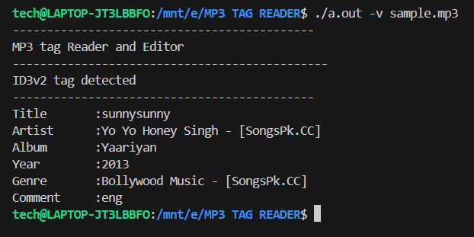
Original song details

Slide 6
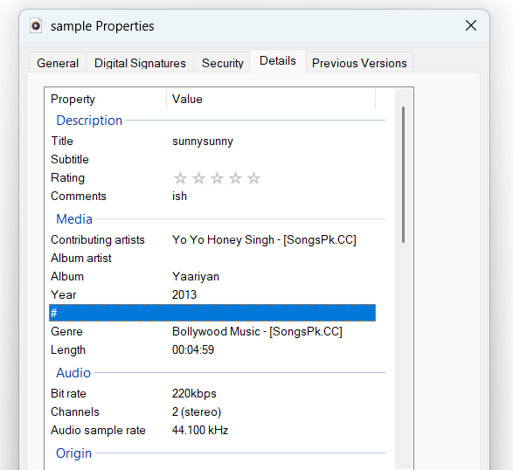
Song details

Slide 7
Edit Mode
Command: ./a.out -e <file.mp3> <option> <new_value>
Options:
-t Title
-a Artist
-A Album
-y Year
-g Genre
-c Comment
Replaces the selected tag with the new value, keeping other tags intact.

Slide 8
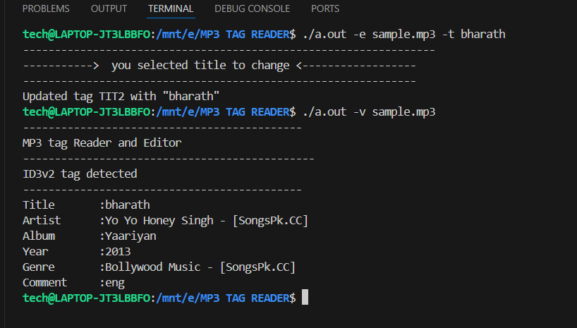
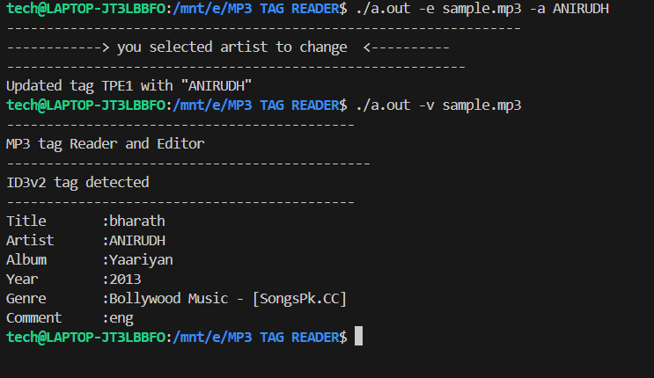
Here we editing the title and artist

Slide 9
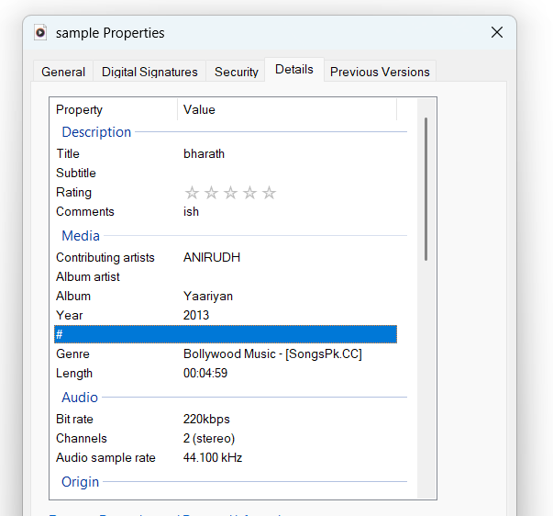

Slide 10
Help Mode
Command: ./a.out -h
Displays usage instructions:
View mode: ./a.out -v <file name>
Edit mode: ./a.out -e <file name> <option> <new tag>
Tag options: -t, -a, -A, -y, -g, -c
Handles invalid tags and wrong inputs gracefully.

Slide 11
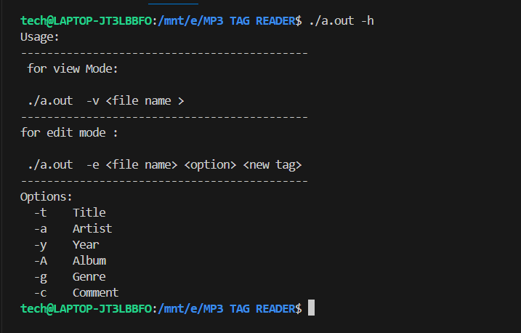
Help part

Slide 12
Code Concepts Used
Advanced C Programming
File I/O operations: fopen, fread, fwrite
Binary parsing and hex handling
Command-line arguments
Structures and byte-level manipulation
Endianness and sync-safe integers
Error checking and buffer safety

Slide 13
Thank you
Thank you for your time!
I'm open to any questions or suggestions.
Your feedback will help me improve and grow.
📂 GitHub: https://github.com/Bharath-kumar-Gundralla/mp3-tag-reader
🔗 LinkedIn: https://www.linkedin.com/in/bharath-kumar-gundralla-1692a1317
— Bharath Kumar Gundralla

