Slide 1


Review-I
QoS-Aware Seamless Vertical Handoff in Heterogeneous Wireless Networks using SDN and MIPv6
AY 2025-26
Capstone Project – Introduction (PROJ2999)
GITAM (Deemed-to-be) University
Department of Electrical Electronics and Communication Engineering
Project Team:
Bharath Narasimha Sai[BU22EECE0100184]
Gannoju Om Prakash Chary[BU22EECE0100304]
Abhishek Hiremath[BU22EECE0100448]
Project Mentor:
Dr. Kamalanathan C
Project In-charge:
Dr. Subhashish Tiwari
www.gitam.edu

Slide 2
Objective and Goals
Objective
Design and implement an intelligent handoff system for heterogeneous wireless networks that ensures seamless connectivity and maintains high Quality of Service (QoS), leveraging Software Defined Networking (SDN) and Mobile IPv6 (MIPv6) for dynamic and efficient mobility management.
Goals
Develop a centralized SDN controller capable of managing real-time vertical handoffs between cellular and Wi-Fi technologies in heterogeneous wireless environments.
Formulate a multi-parameter handoff decision algorithm considering factors like signal strength, cell load, user velocity, and expected dwell time to optimize QoS.
Integrate MIPv6 to handle address continuity, enabling uninterrupted service during mobile node transitions between different networks.
Simulate and validate the improved handoff framework using realistic mobility scenarios and network models, measuring handover delay, packet loss, and throughput.
Compare and benchmark the proposed approach against legacy and existing mobility management methods within wireless networks.

Slide 3
Problem Statements
Seamless Handoff Challenge Traditional handoff mechanisms in heterogeneous wireless networks cause service disruptions, high latency, and packet loss, leading to degraded QoS.
Lack of Centralized Control Legacy handoff techniques operate in a distributed manner without centralized intelligence, making optimal real-time decisions inefficient.
Multi-Parameter Decision Limitation Most vertical handoff algorithms depend mainly on signal strength while ignoring key factors like cell load, velocity, and dwell time, resulting in poor network choices.
Address Continuity Issues During vertical handoffs, IP address changes break ongoing sessions, causing interruptions and reducing user experience.
Performance Bottlenecks in Mobility Management Conventional methods like Mobile IP suffer from high delays and packet loss, making them unsuitable for modern QoS requirements.
Need for Comparative Benchmarking Current research lacks SDN–MIPv6 integrated frameworks that are benchmarked against legacy methods under realistic mobility conditions.

Slide 4
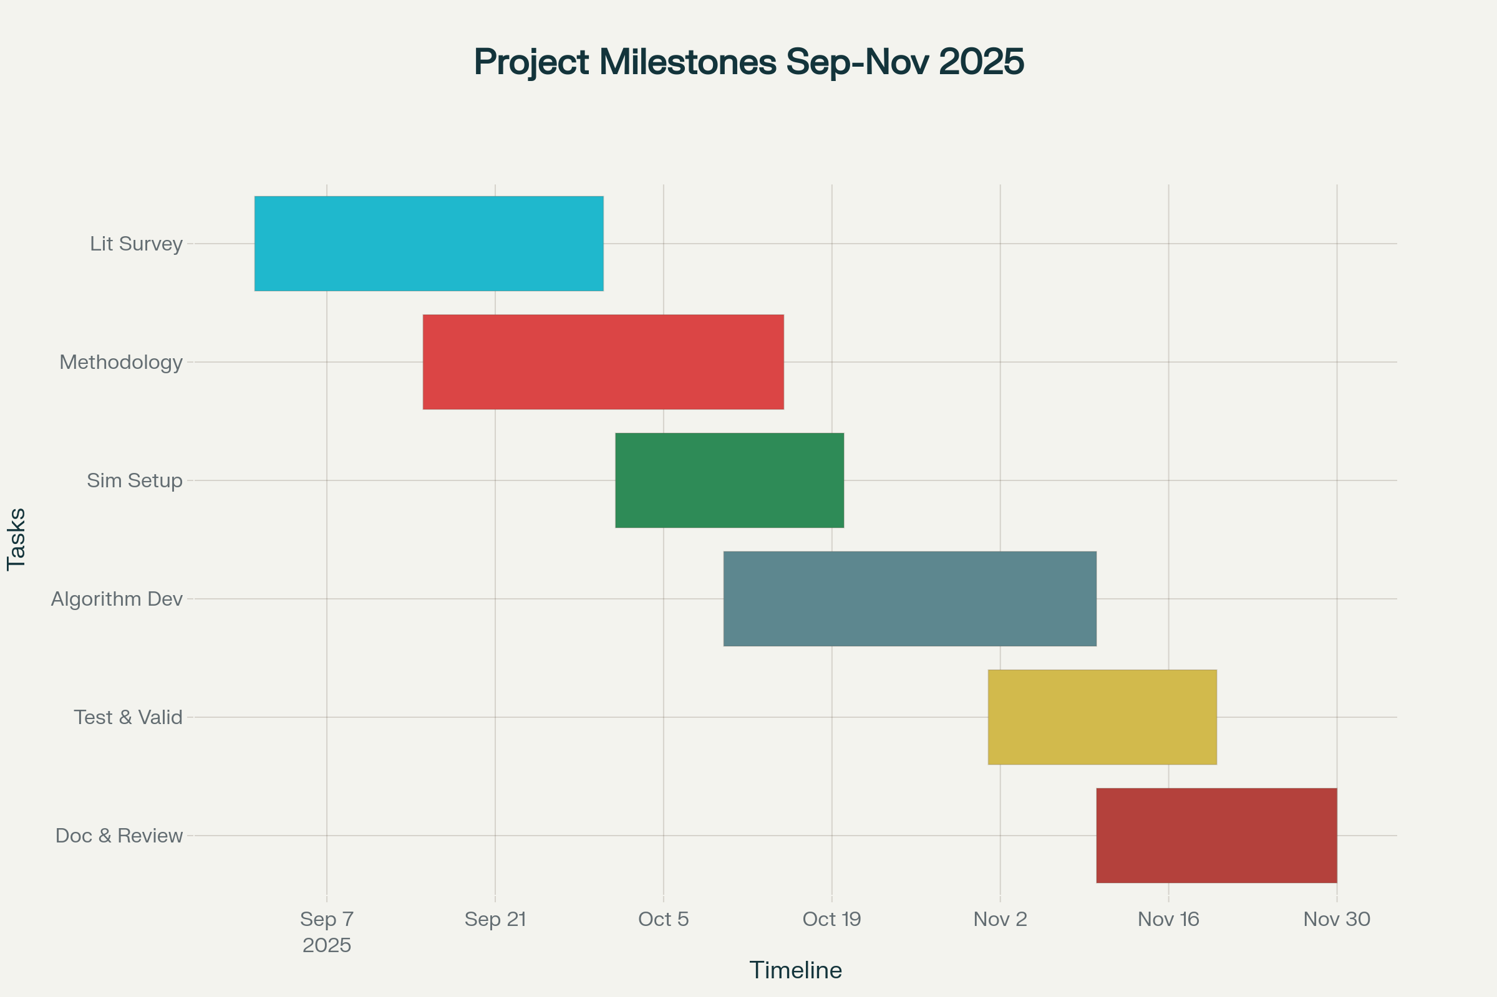
Project Plan

Slide 5
Literature Survey
Title and Author | Problem Statement | Methodology | Result
Dynamic Mobility and Handover Management in SDN-Based 5G HetNets Khan et al., 2024 | Frequent and unnecessary handovers in dense heterogeneous networks degrade QoS and increase signaling overhead. | Multi-parameter best cell selection using SDN controller. Algorithm based on RSS, load, dwell time, direction. Simulated in 5G HetNet scenario. | 39% reduction in handovers; improved throughput and lower delay. SDN enables efficient, dynamic mobility.
QoS-Aware and Fault-Tolerant Handovers in SDN-Based 5G Networks Recent Supporting Paper | Vertical handoffs can cause packet loss, latency spikes, and service disruption, especially in real-time apps. | SDN-based centralized control with QoS criteria. Fault-tolerant handover logic tested in wireless emulation environments. | Enhanced QoS during handoff. Fault-tolerance reduces service interruption. Improved performance for multimedia apps.

Slide 6
Machine Learning for Handover Decision in 6G Networks Recent Publication (2025) | Classical handover methods fail to predict user movement and network load, impacting handoff quality. | ML algorithms trained with user mobility and network data. Edge computing assists handover prediction and selection. | Higher handoff accuracy and lower delay. Dynamic adjustment to network conditions, useful for future 6G scenarios.
SDN-Based Distributed Mobility Management for 5G Networks Eurecom White Paper | Traditional mobility management lacks scalability and quick adaptability for multiple user types and diverse apps. | SDN and DMM integration, centralized flow management, simulation in cloud-based testbed. | Reduced signaling load, rapid handoff response, scalable to large networks. Successful dynamic handoff management.

Slide 7
QOS Aware Vertical Handover Process in Heterogeneous Wireless Networks Santhi and Prabha, 2023 | Vertical handoffs must meet QoS constraints such as delay, jitter, bandwidth, security, and cost. | Combined multiple analytic network process (M-ANP) and TOPSIS for network selection satisfying QoS constraints. | Enhanced QoS-aware network selection for vertical handoffs, validated through simulation.
Enhancing QoS Through SDN in Wireless Networks Ait Oulahyane, 2023 | Addressing unreliable access points and dynamic access control to maintain QoS in wireless networks. | Proposed SDN-based secure model for dynamic access control and QoS management. Tested using SDN controllers and real scenarios. | Improved connection reliability and QoS enforcement in wireless networks through SDN-enabled control.

Slide 8
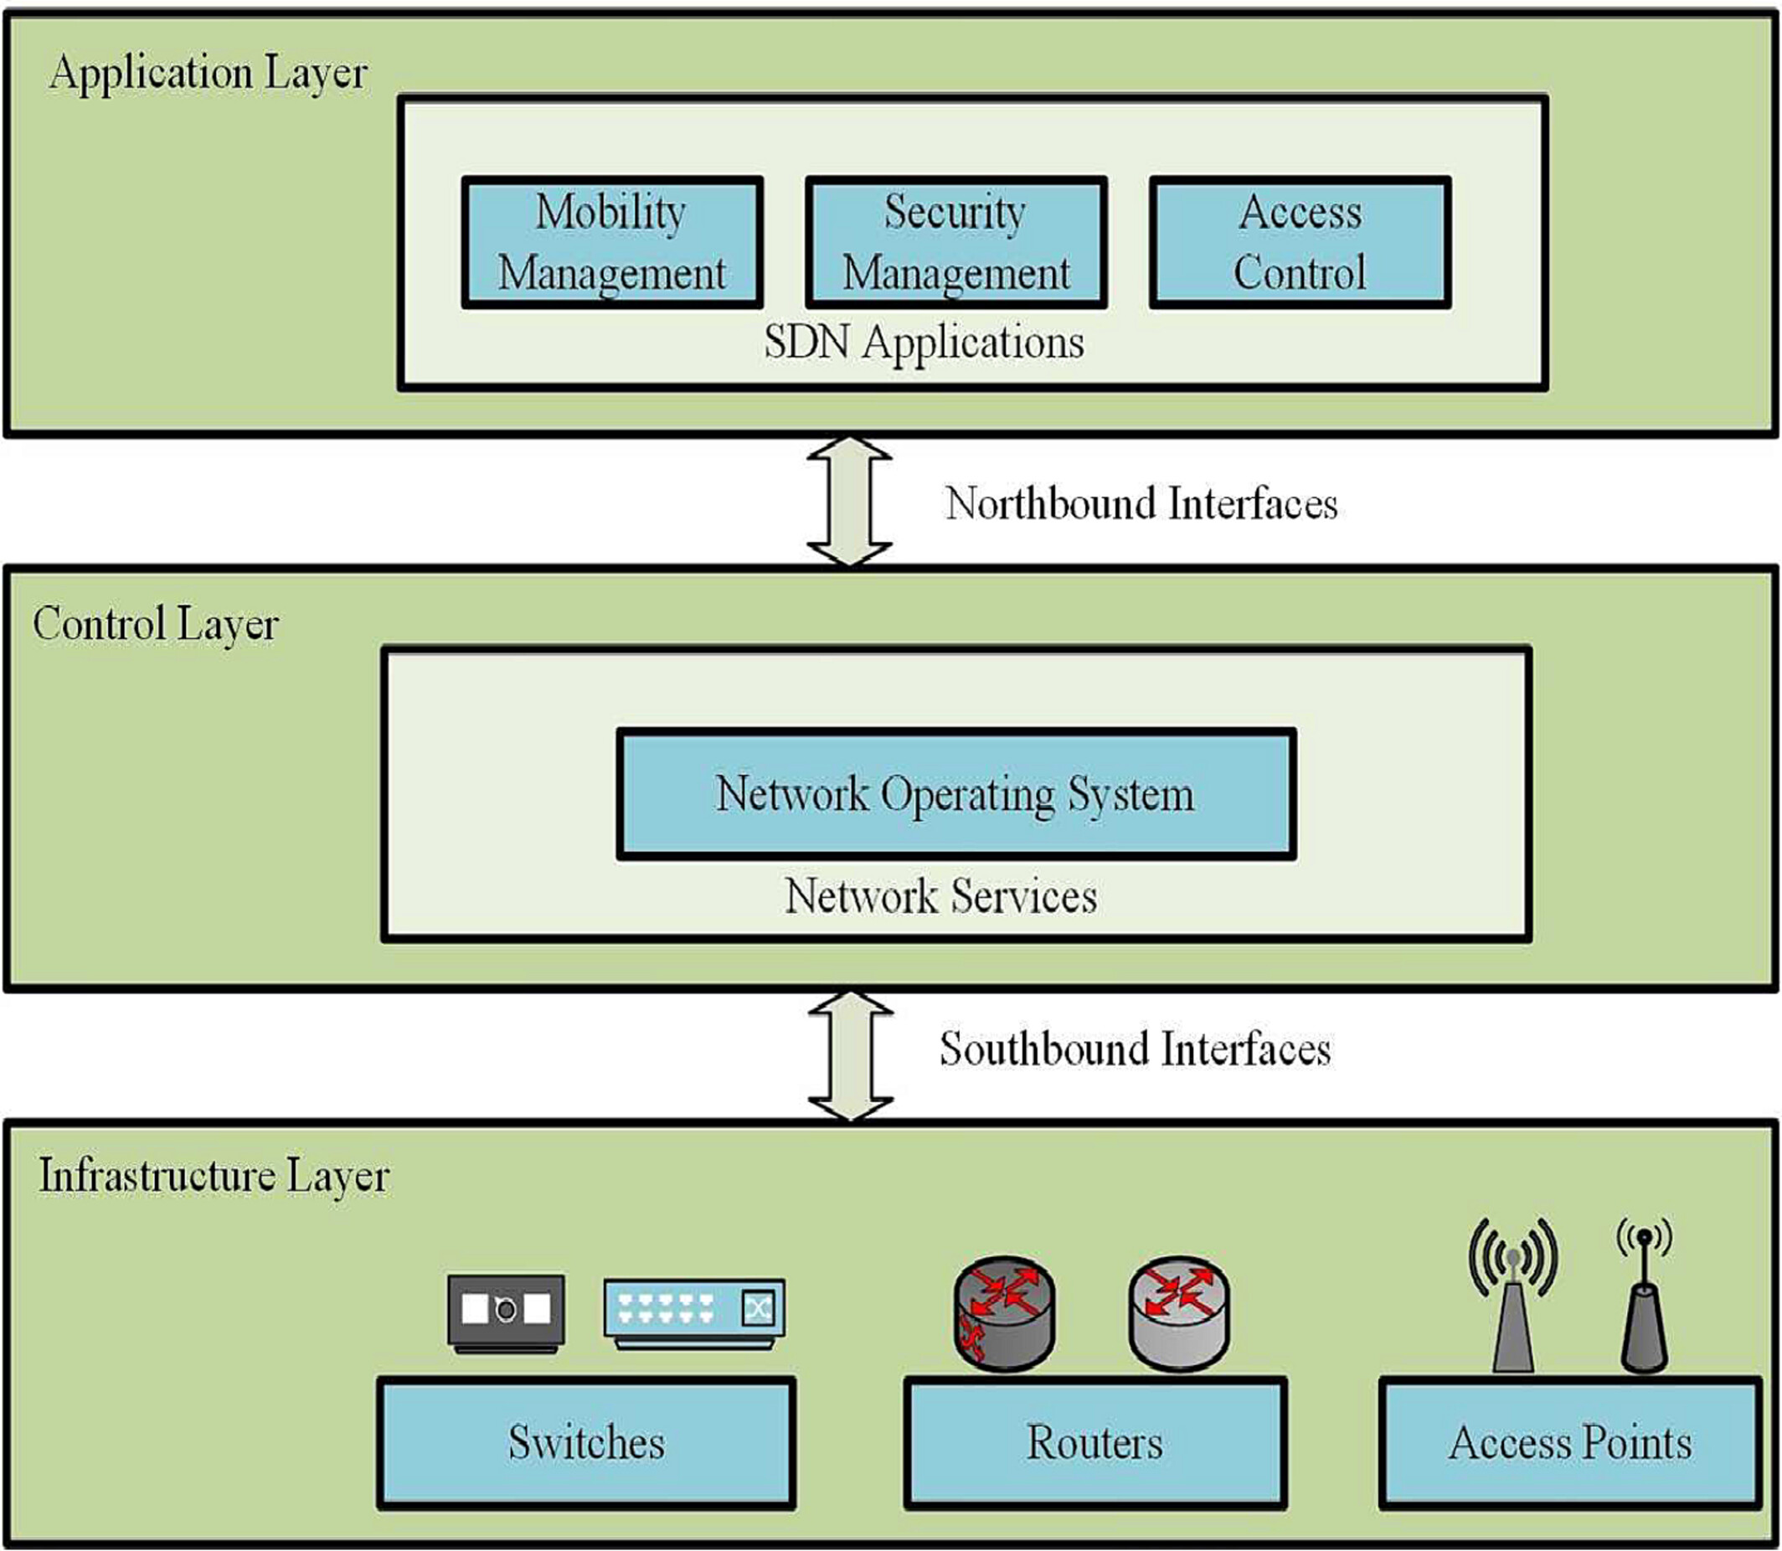
Architecture
Block Diagram:

Slide 9
Novelty (what’s new in our work?)
Integration of SDN and MIPv6 for Vertical Handoff: Unlike traditional handoff mechanisms, your work combines Software Defined Networking for centralized, programmable control with the Mobile IPv6 protocol’s robust session continuity features. This integration enhances seamlessness during vertical handoffs across diverse wireless technologies.
Multi-criteria, QoS-Aware Handoff Decision Algorithm: Your project leverages multiple real-time network and user parameters such as received signal strength, cell load, user velocity, and dwell time in a unified handoff decision process optimized for QoS. This holistic approach reduces unnecessary handovers and maximizes throughput and latency guarantees beyond simpler RSS or speed-only methods.
Dynamic Resource and Mobility Management via SDN: Your work exploits SDN’s global network view for intelligent traffic engineering and load balancing during handoffs, dynamically adapting to network conditions and user mobility patterns, thus reducing signaling overhead and improving network capacity.
Foundation for Future AI-driven Mobility Enhancements: Your framework’s architecture supports integration of machine learning and AI techniques for predictive handoff decisions, paving the way for novel mobility optimizations in next-generation (6G and beyond) wireless systems.

Slide 10
Software’s required
Mininet-WiFi or Mininet
To simulate SDN networks with wireless access points and mobile nodes for testing handoff and controller behavior.
OpenFlow Controller Software
Controllers like POX, ONOS, or Ryu to implement SDN control logic and handover algorithms.
NS-3 or OMNeT++
Network simulators to model heterogeneous wireless environments, mobility patterns, and evaluate QoS performance metrics.
Mobile IPv6 (MIPv6) Stack/Simulator
To implement and test mobile IP address management and session continuity during handoff.
Programming Languages and IDEs
Python, C/C++ for controller and simulator development.
IDEs like Visual Studio Code, PyCharm, or Eclipse.
Network Monitoring Tools
Wireshark for packet capture and analysis during handoff test scenarios.
Data Analysis and Visualization
MATLAB, Excel, or Python libraries (Matplotlib, Pandas) for analyzing simulation results and creating graphs.
Version Control System
Git or GitHub for source code management and collaboration.

Slide 11
Conclusion & Future Work
Methodology:
Conduct detailed literature survey of SDN, MIPv6, and vertical handoff techniques.
Develop QoS-aware multi-criteria handoff decision algorithm (RSS, load, velocity, dwell time).
Design SDN controller architecture for centralized mobility control.
Integrate MIPv6 for seamless IP session continuity.
Simulate heterogeneous wireless environments (Wi-Fi, LTE, 5G) using Mininet-WiFi and NS-3.
Evaluate performance through handoff latency, packet loss, throughput, and load balancing.
Summary:
Proposed framework enables dynamic, QoS-driven seamless vertical handoff in multi-RAT networks.
SDN provides centralized, adaptable network control; MIPv6 ensures IP continuity.
Expected benefits: reduced latency, minimized packet loss, improved network utilization.
Future Work:
Implement machine learning models for predictive handoff decisions.
Expand support towards 6G, network slicing, and edge computing paradigms.
Validate through real-world prototyping and extensive simulations.

Slide 12
THANK YOU
Have a Great Day !

