Slide 1







BATCH-1:
HEALTH
COACH
PRESENTED BY:
- HANEESH-22R21A6693
-Shruthi-22R21A6675
-Raghava-22R21A6687
-Sriya-22R21A6679

Slide 2
Problem Statement -To Provide Fitness and Diet Guides.
Customer Survey
Solution And design -An online platform for people to get the proper guidance.
TABLE OF CONTENTS

Slide 3


Problem Statement
"The Fitness Barrier: Breaking Down Financial Obstacles”.
With the rise of awareness about healthcare and fitness, people are becoming more consious about their wellbeing.
As a result, there is an increasing demand for guidance and support to achieve fitness goals efficiently.
Many people do no have proper guidance when it comes to fitness.

Slide 4

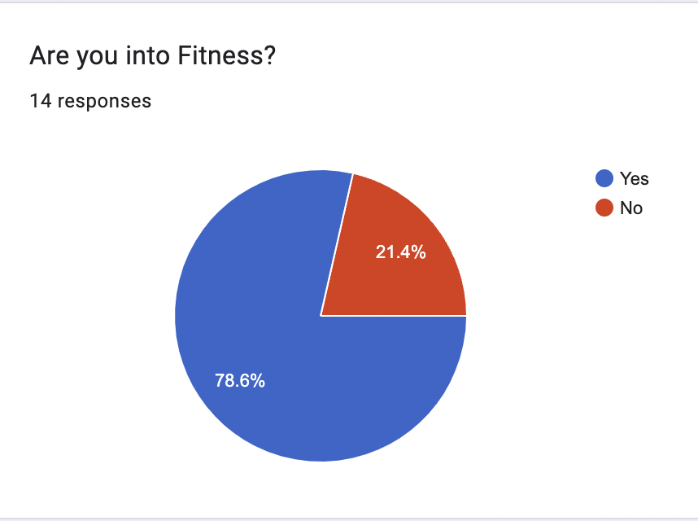
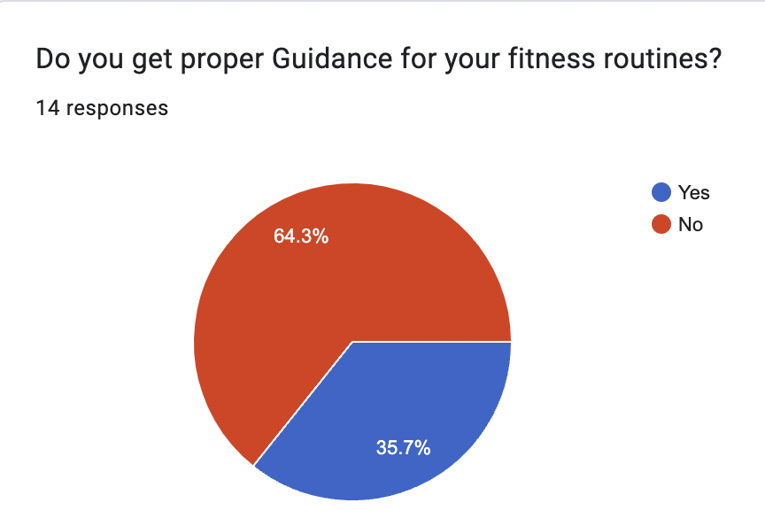
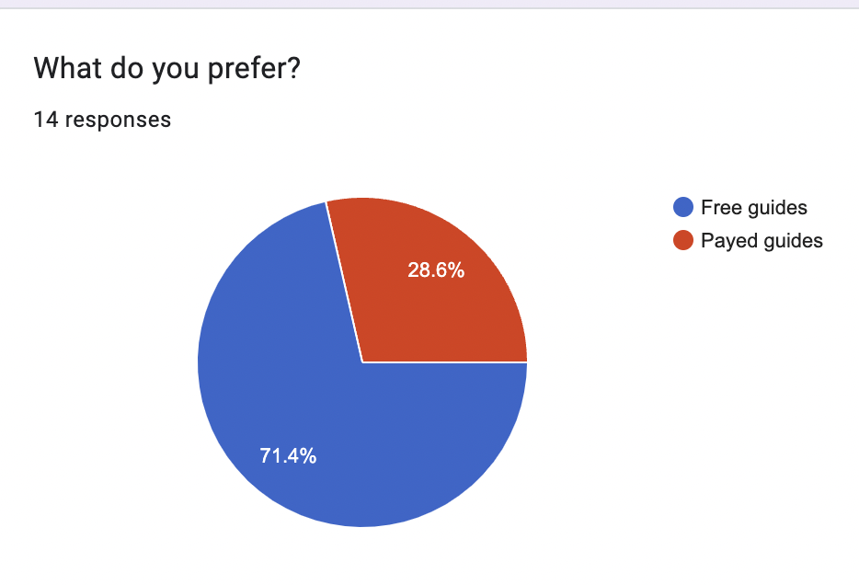
Customer Survey:
Results of the survey from the public is as follows:-

Slide 5
PROBLEM-
There is no proper guidance for people who just started getting into fitness.
SOLUTION-
To provide Proper fitness guides and diet routines at free of cost through and online platform.

Slide 6
Existing Solutions
Solution 1- Muscle and Strength -Mainly Male oriented workouts. -No proper tracking system. Solution 2- "HealthifyMe" -Not entirely free.

Slide 7
Product Overview:
An online Platform Which provides Fitness and Diet routines.
Also Has a login system which enables personalized profiles.
Has a Fitness tracking system for a systematic workout routines.
Has a wide variety of Guides and routines.

Slide 8
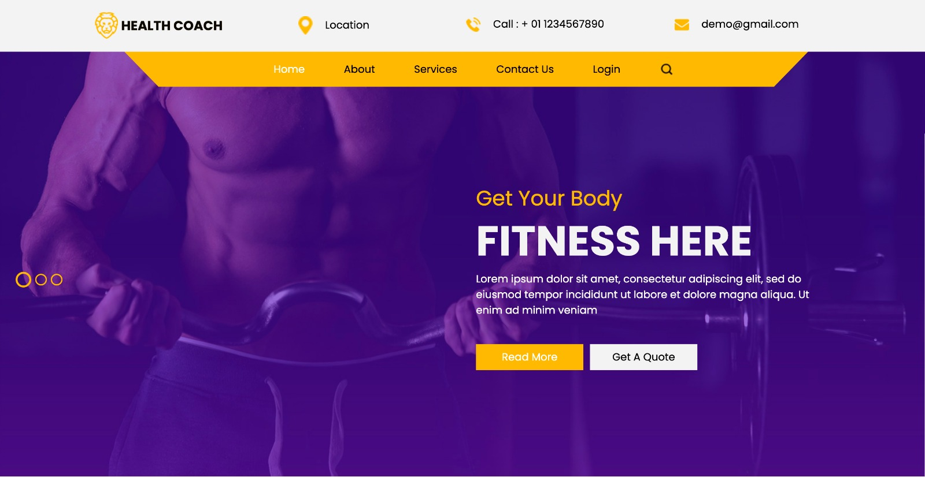

PROTOTYPE:

Slide 9
Strengths
Opportunities
Potential for growing online fitness market
Ability to integrate with potential brand partnerships
Opportunity for providing a personalized fitness routines at a membership subscription .
Simple and easy to use
Provides information at free of cost
Does not require the involvement of a third party
O
S
T
W
Weaknesses
Threats
Lack Of Direct Interaction
Limited To Use By People Who Have Personalized Trainers
Limited personalization
Competition from existing & new players on market
Rapidly changing market trends
consumer preferences that may require continuous adaptation.
Ensuring the platform maintains its credibility amidst a crowded marketplace.

Slide 10
VALUE PROPOSITION (PRODUCT)
Gain creators
monetization via google ads
Products and services
provides free fitness and diet routines
Pain relievers
stores all guides at a single place so it’s efficient

Slide 11
VALUE PROPOSITION (CUSTOMERS)
Gains
gets complete fitness guidelines
Customer jobs
Fulfilling the job of providing accessible and effective fitness guidance and support for individuals to achieve their goals.
Pains
Overcome cost barriers, access expert guidance, and find convenience in achieving fitness goals.

Slide 12
FUTURE SCOPE:
A FREE WEBSITE
A FREE ANDROID APP
PERSONALISED GUIDES FOR A MEMBERSHIP

Slide 13
Thank you

