Slide 1


Batch - 1: Local Travelling Website
01
2023
Pitch deck
Presented by
A.SRINIVAS-22R21A6666
A.NIKITHA REDDY-22R21A6668
A.VARSHA REDDY-22R21A6669
B.PARTHIV REDDY-22R21A6671
Pitch deck

Slide 2
Table of contents
01
02
03
Problem Statement
Customer Survey
Solution and Design
02
20XX
The lack of a reliable platform for local travelers to find up-to-date information on destinations, accomodations,and activites to showcase their services , results in challenges in trip planning and revenue generation
Developing a web which suggests the user the places to visit and spend time and money approvingly without compromising in the taste according to their taste
Pitch deck

Slide 3
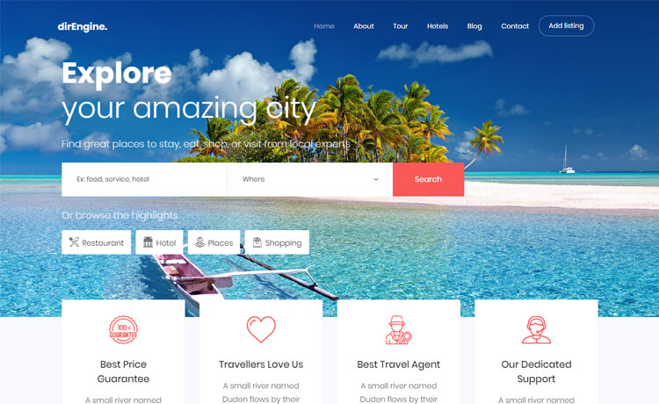
Problem Statement
03
One of the most difficult problem that we face is,when we are at some place and we feel difficult in finding new places like local visiting places which can not found in google maps,may be because of underrated or might be any other reason.
Many of the people find difficulty in finding a good restaurants/hotels according to their interest and budget.
Sometimes we feel uncomfortable to ask about the prices and sometimes we adjust ourselves to eat awful food by spending a lot of money unknowingly.
So we felt like creating solution for this problem will be a good idea
20XX
Pitch deck

Slide 4

Customer Survey
04
20XX
This website can be accesed by everyone the only criteria is they should have account in the website.If they don’t have account the website says them to create one and then they can access the features of the website happily without any problem.
This website is linked to the google maps and we find the restaurants and hotels present in the map and we would like to add a new feature where restaurant /hotels /places can add be added by owners to make people know about their places.
Pitch deck

Slide 5
Problem and solution
05
20XX
Problem
Solution
The lack of reliable platform for local travellers to find up to date information on destinations and local business to showcase their services
Developing a web which suggests the user the places to visit and spend time and money approvingly without compromising in the taste according to their taste
Pitch deck

Slide 6
Exisisting Solutions
06
20xx
Solution 1
Solution 2
TripAdvisor : TripAdvisor is a popular travel website that provides a platform for travellers to browse and book hotels , flights and activites.
Airbnb : Airbnb is a platform that allows travellers to book unique accomodations,such as apartments , houses and villas from local hosts.
Pitch Deck

Slide 7
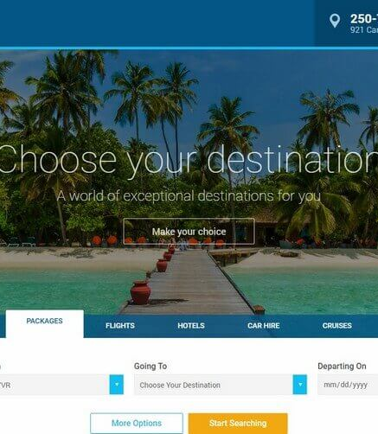
Product Overview
07
20xx
In this digital world most of the problems are solved via internet and gadgets
so in similar way we thought of developing a web which suggests the user the places to visit and spend time and money approvingly without compromising in the taste according to their taste
In our website there are 3 stages:
1 . Login page : where the user need to login in order to access our website
2 . Home page : where the user needs to enter his location and the location upto where he go in his journey like destination
3 . On submitting our location and destination location our website suggests them the hotels/restaurants and some more intresting place present in between those two places including prices and distance and rating etc…
Pitch Deck

Slide 8
SWOT Analysis
08
20XX
In depth knowledge of local culture and attraction
Support for local business and economics
Increased demand for domestic travel
Collaboration with local communities.
Strengths
Opportunities
Weakness
Threats
Lack of expertise
Competition from mainstream travel platform
Economical instability
Pitch deck

Slide 9
Value proposition (Product)
Gain creators
This website is completely digitial there no budget for constructing this website.
Products and services
Our app suggests people to find local places
Pain relievers
Our website can offer personalized recommendations to theirs users based on their travel prefrences,budget and interests.

Slide 10
Value proposition (Customers)
Gains
Customers can easily explore the local places through our website.
Customer jobs
Customers should have account in website.And they can access the features of the website happily without any problem.
Pains
There are many tourist apps and websites present in online but the thing is , there is no website or app which suggests people locally.

Slide 11
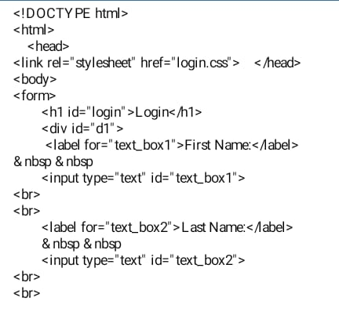
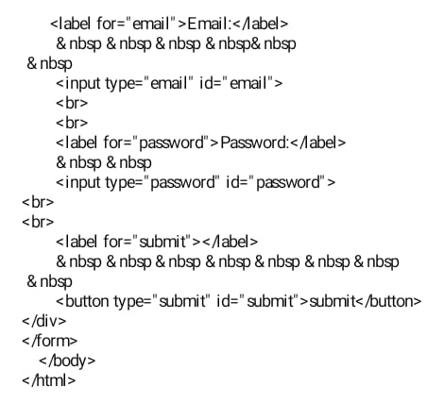
Design Blueprint
Pitch deck
20XX
09

Slide 12
Thank You!
20xx
Presented by
A.SRINIVAS-22R21A6666
A.NIKITHA REDDY-22R21A6668
A.VARSHA REDDY-22R216669
B.PARTHIV REDDY-22R21A6671
Pitch Deck

