Slide 1




FRAUD DETECTION
BY
AKSHAYA ( 22R21A6682)
ANISH (22R21A6689)
THANMAYEE(22R21A6690)
ABHINAY(22R21A6691)

Slide 2



TABLE OF CONTENTS :
01
PROBLEM STATEMENT
Fighting Financial crime with Machine learning
02
CUSTOMER SURVEY
03
SOLUTION AND DESIGN

Slide 3
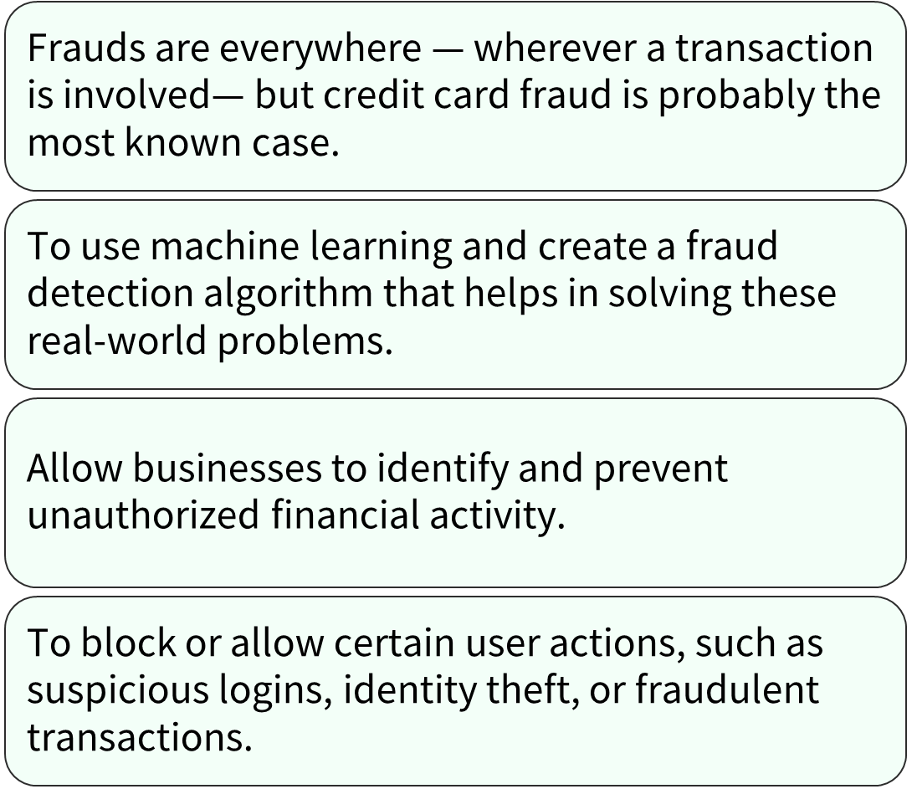
PROBLEM STATEMENT:

Slide 4

CUSTOMER SURVEY
Very few transactions are actually fraudulent (less than 1%). The data set is highly skewed, consisting of 492 frauds in a total of 284,807 observations. This resulted in only 0.172% fraud cases. This skewed set is justified by the low number of fraudulent transactions

Slide 5
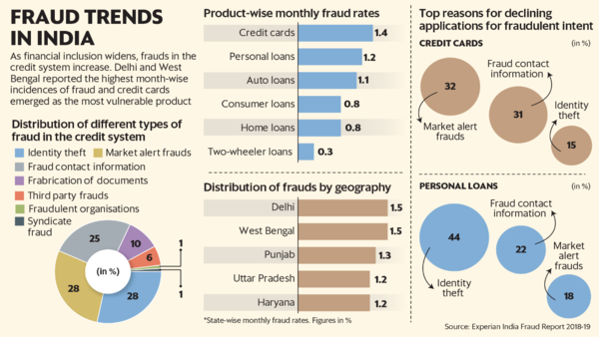


Slide 6
PROBLEM
SOLUTION
Fraud detection has been one of the major challenges for most organizations particularly those in banking, finance, retail, and e-commerce.
More often than not, for any fraud detected, the organization ends up paying for the losses.
Taking the help from machine learning and developing an algorithm.

Slide 7


1. Changing fraud patterns over time_ This one is the toughest to address since the fraudsters are always in the lookout to find new and innovative ways to get around the systems to commit the act.
MAJOR CHALLENGES WE WILL FACE
2. Class Imbalance — Practically only a small percentage of customers have fraudulent intentions. Consequently, there’s an imbalance in the classification of fraud detection models
3. Model Interpretations — This limitation is associated with the concept of explainability since models typically give a score indicating whether a transaction is likely to be fraudulent or not — without explaining why.

Slide 8
HOW TO TACKLE THEM
1. Ensemble Modeling — To tackle the ever-evolving fraudulent patterns, Ensemble modeling leverages multiple models for a single task such as fraud detection. Ensembling with classic machine learning, deep learning, and linear models can capture various fraud patterns to maximize outputs.
2. Human-in-the-loop — This technique addresses the classification imbalance issue as well as shortens the time taken for feature detection. It involves humans assisting the models by providing information to identify new patterns, features, and dimensions of fraud.
3. Explainability — The concept of explainable AI can provide reasons for the approval or decline of transactions as fraudulent, solving the model interpretation challenge.

Slide 9

EXISTING SOLUTION
SEON
SEON analyzes hundreds of data points in real-time to verify the transaction. Including email, phone number, IP, credit card, device fingerprint, digital footprint, behavior analysis, and more.
Artificial Intelligence, Data mining, Fuzzy logic, Machine learning, Sequence Alignment, Genetic Programming

Slide 10

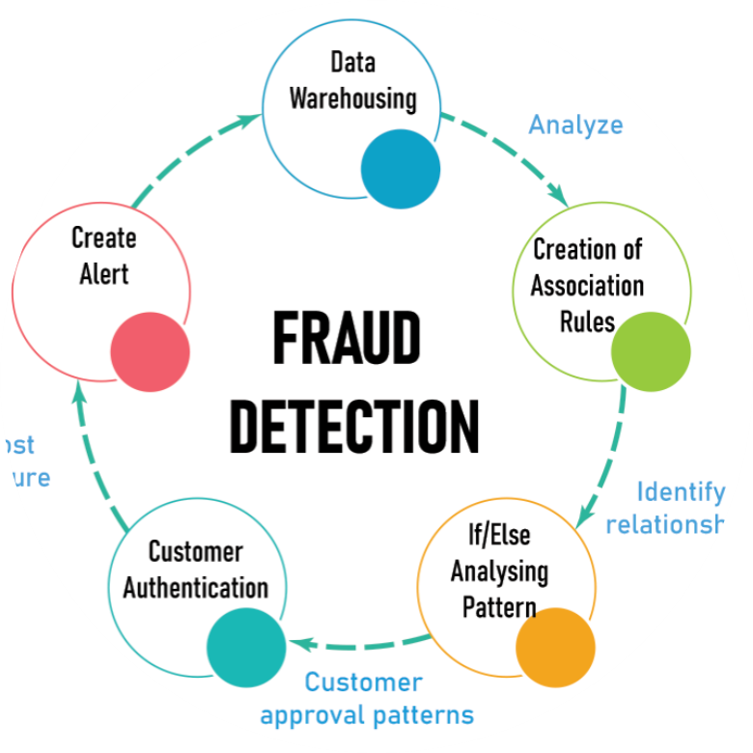

PRODUCT OVERVIEW.
Stolen/fake credit card fraud: A fake card is generated based on a user’s card information that scammers manage to gain access to. There are numerous ways that scammers use to do this, with card skimming being the most common. Credit card skimming is a technique where the scammer attaches a small device to the transaction machine that cannot be easily noticed.
Machine learning is a powerful force for improving both the accuracy and efficiency of fraud detection.
It will Create and update rules for detection and alert handling: Machine learning can examine masses of data to help establish rules and keep them up to date. Even something as simple as a decision tree can add some benefits (certainly in the segmentation approach) to more accurate rules

Slide 11
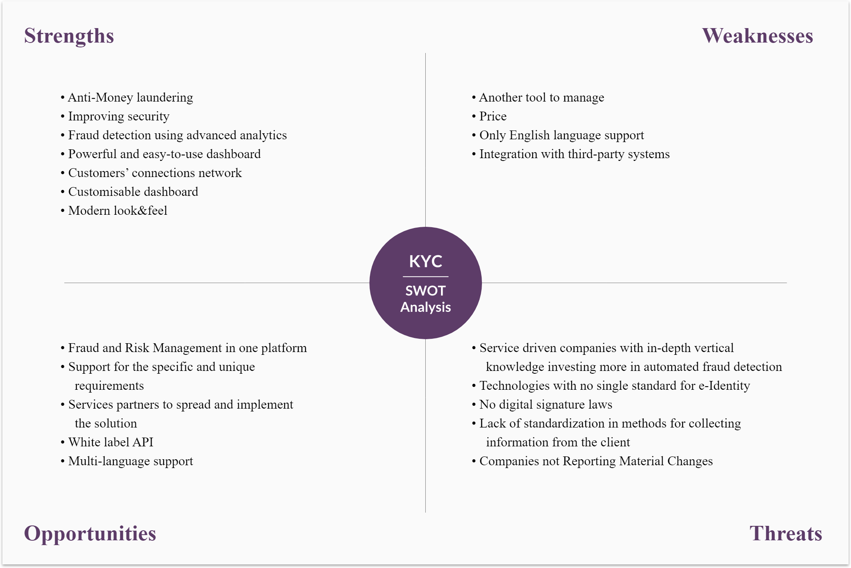

Slide 12
GAINS
A fraud risk assessment is a process to help you better understand your entity's fraud exposure, the associated risks and the strength of your existing controls. A good fraud risk assessment helps you specifically identify how potential fraudsters might attempt to find a way around existing controls.
PAINS
Allow businesses to identify and prevent unauthorized financial activity.

Slide 13
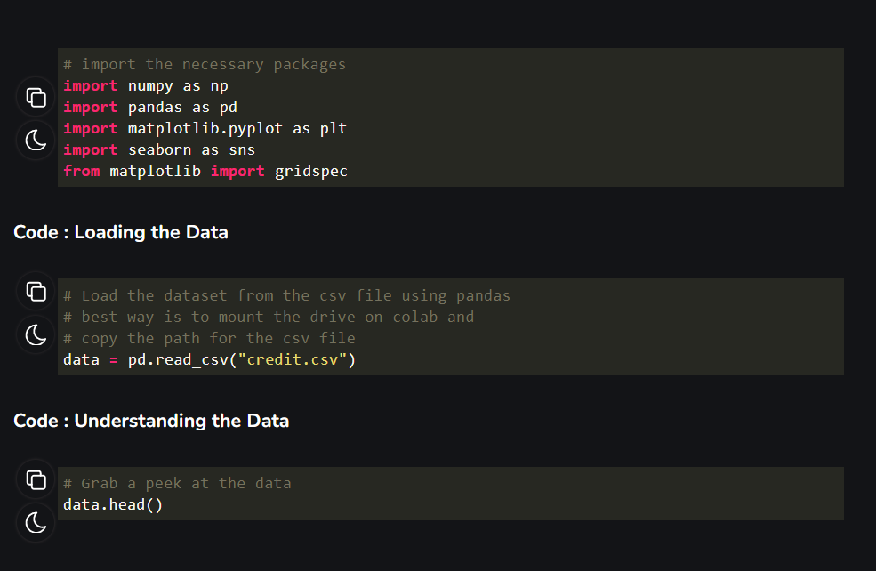
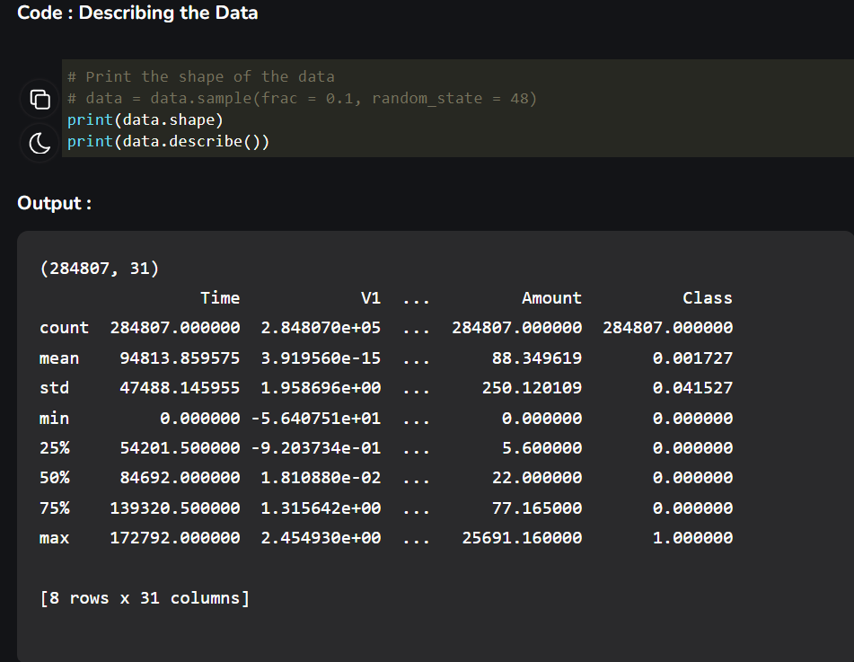
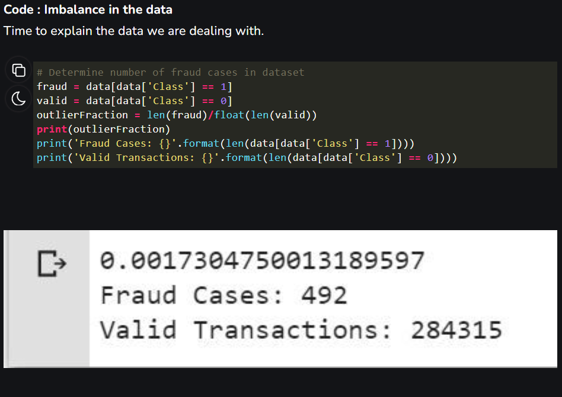

Slide 14
THANK YOU

