Slide 1
STOP DRUG TRAFFICKING TEAM:MIRACLE WORKERS
TEAM MEMBERS:
ARAVIND.S
BHARATH.S
DHANALAKSHMI.R
DEVDHARSNI.MA
DEVISRI.Y
ABHINAYA.M
POOJA.M

Slide 2


Slide 3


Slide 4


Slide 5


Slide 6
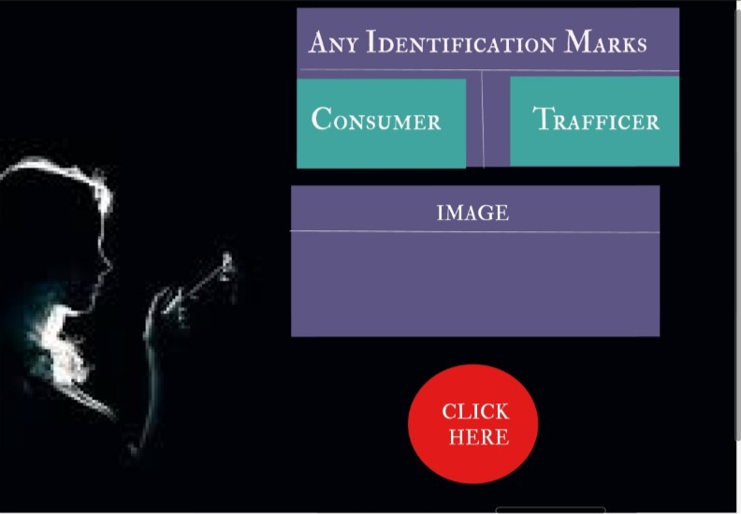

Slide 7
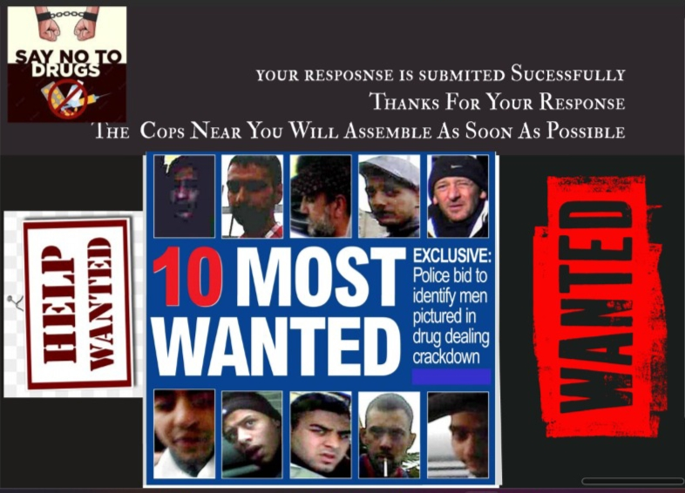

Slide 8

https://www.figma.com/proto/l1cvTdcYFhc0D8xRQ3EFCc/Project?node-id=8%3A43&scaling=scale-down&page-id=0%3A1

Slide 9
https://www.figma.com/proto/l1cvTdcYFhc0D8xRQ3EFCc/Project?node-id=8%3A56&scaling=scale-down&page-id=0%3A1

