Slide 1
Doctor's Clinical Assistant
(RAG Chatbot)
Submitted By: Bharath V N

Slide 2
Task Statement
The system must act as a "second brain" for physicians by providing a conversational interface over private patient databases. The architecture relies on Retrieval-Augmented Generation, where the model first "retrieves" specific sections from a patient’s historical records (like past visits, SQL-based appointment logs, and medication lists) and then "generates" a summary. Unlike a general AI, this chatbot is "grounded" in actual medical evidence, significantly reducing the risk of clinical hallucinations. For a doctor, this means they can ask, "Show me a trend of this patient's HbA1c over the last 3 years," and the system will pull the relevant lab results to create a statistical table or summary instantly.

Slide 3
Objectives
To eliminate clinical hallucinations by ensuring the assistant retrieves 100% of its data directly from verified SQL patient records.
To enable physicians to query complex historical clinical data (labs, meds, appointments) using intuitive natural language.
To automatically aggregate and visualize long-term patient trends (e.g., HbA1c or Blood Pressure history) from 2021–2025 instantly.
To reduce physician cognitive load through premium UI aesthetics and "at-a-glance" synthesis of active vs. discontinued treatments.
To provide responses grounded strictly in medical evidence—citing exact values, measurement dates, and standard reference ranges for every answer.

Slide 4
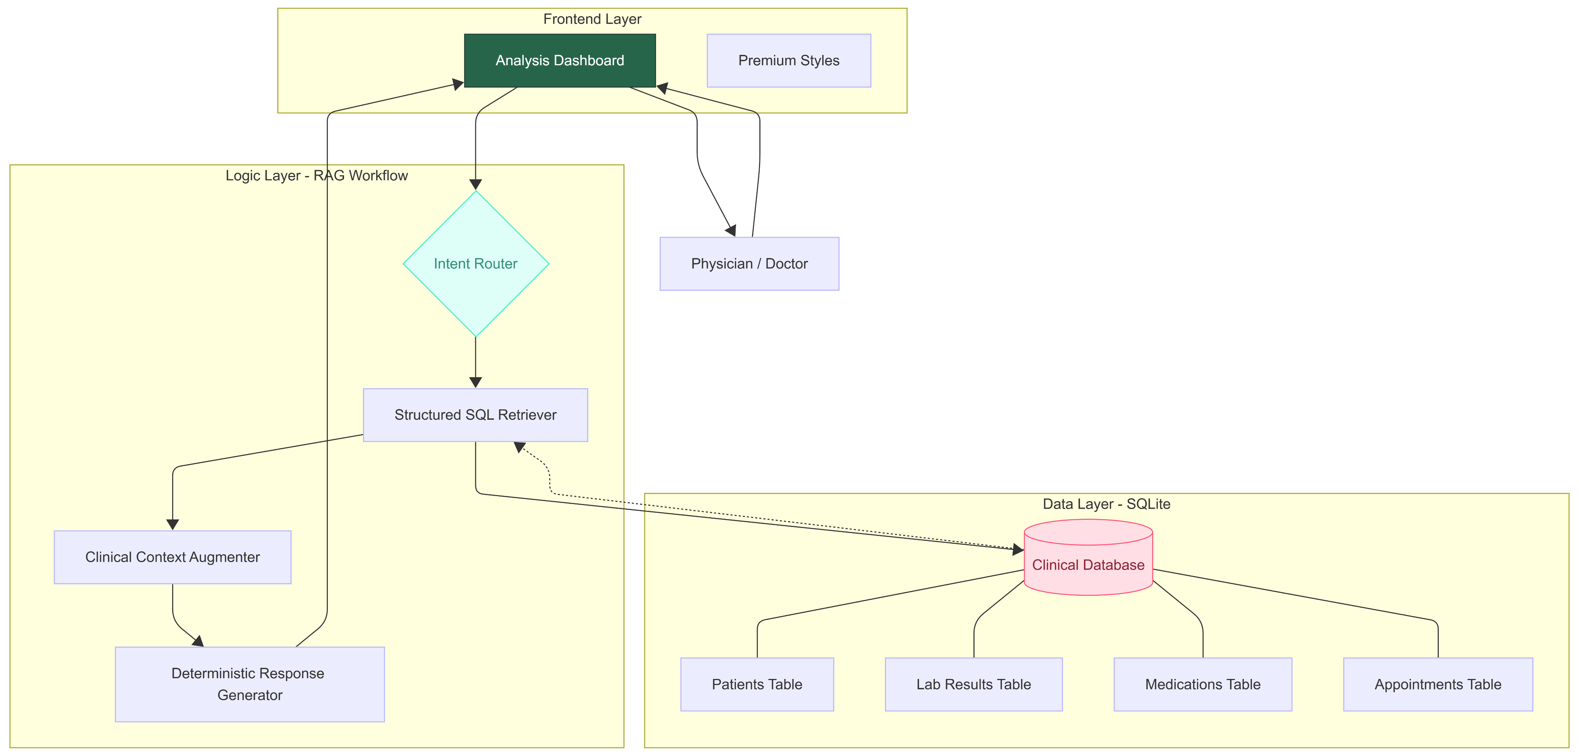
Architecture

Slide 5
Solution
The core innovation of the Doctor’s Clinical Assistant is the use of Deterministic Retrieval-Augmented Generation (RAG). Unlike standard AI that predicts the next word, this system follows a strict three-step "Evidence-First" workflow:
Verifiable Retrieval: The system identifies the doctor's intent and executes precise SQL queries to pull raw data directly from the patient record.
Clinical Augmentation: It "augments" that data by applying temporal filters (e.g., "last 3 years") and comparing values against standard clinical reference ranges in real-time.
Hallucination-Free Generation: It constrains the output to deterministic formats (tables or structured lists) that are 100% grounded in the retrieved evidence—ensuring that the assistant never "guesses" a medical value.

Slide 6
Key Features for Physicians
Medication Guard: Real-time tracking of Active vs. Discontinued treatments.
Statistical Trending: Auto-generation of trend tables for any lab component.
Smart Appointments: NL-search for today, tomorrow, and historical visits.
AI Interpretation: Automatic classification of lab values (Normal vs. High/Low) based on standard ref ranges.
Efficiency-First: "Enter-to-Analyse" workflow for rapid querying.
Technical Stack
Interface: Streamlit (Python-based Web Framework).
Styling: Vanilla CSS with Glass morphism & Google Fonts (Inter/Outfit).
Logic: Python (Pandas for data processing, Re for NLP intent routing).
Database: SQLite (SQL for precise clinical record retrieval).
Architecture: 100% Grounded RAG (Retrieval-Augmented Generation).

Slide 7
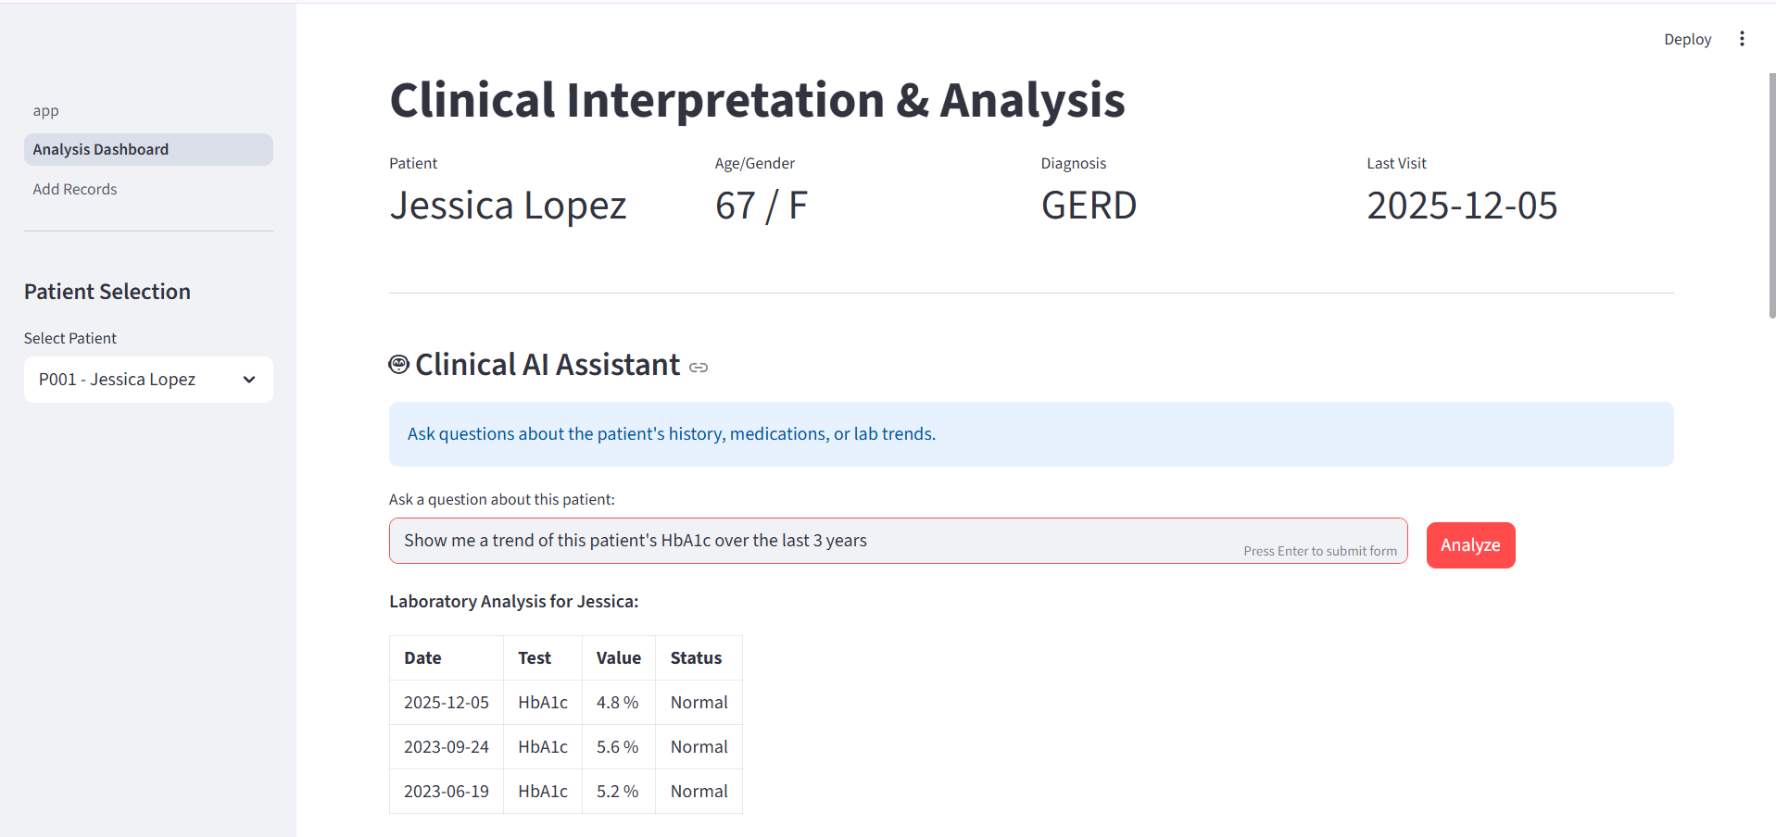
Result
Fig 1: Clinical AI Assistant

Slide 8
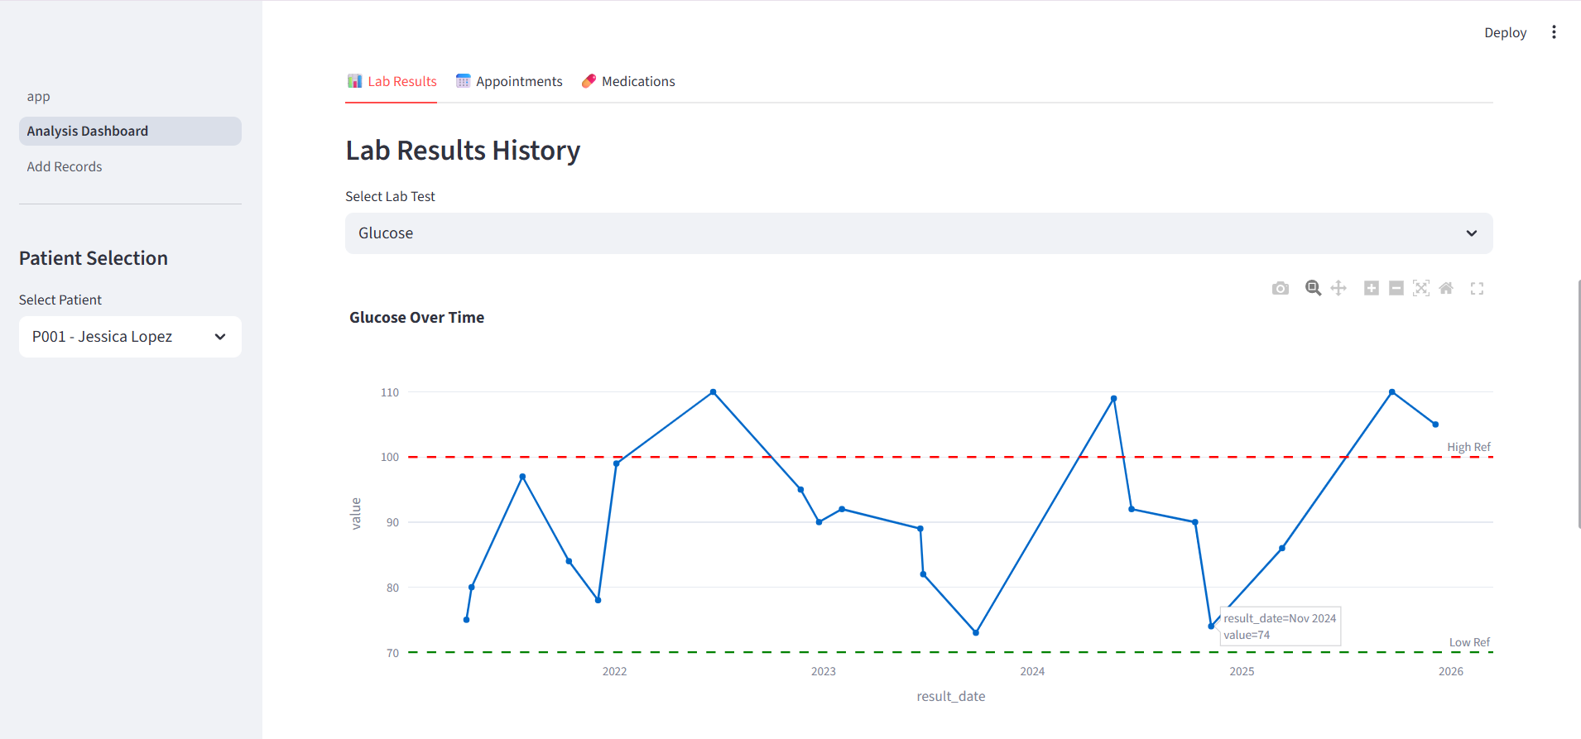
Fig 2: Lab results history & trends

Slide 9
Conclusion
100% Grounded Accuracy: Successfully eliminated clinical hallucinations by using a deterministic RAG architecture that anchors every response in the patient's verified SQL records.
Operational Efficiency: Reduced physician "data-mining" time by aggregating multi-year longitudinal data (2021–2025) into instant, actionable summaries and trend tables.
Actionable Insights: Enhanced diagnosis support by automatically flagging lab results against standard reference ranges and tracking medication status (Active vs. Discontinued).
Modern Clinical UX: Deployed a premium, glassmorphic interface that minimizes cognitive load and provides a focused interpretation environment for healthcare professionals.

