Slide 1

IoT Climate Control: Data Analysis and Predictive Modeling
Analysis of Temperature, Humidity, and Control Systems
By [BHARADWAJ]

Slide 2
Objectives
1. Analyze average temperature and humidity when fan is ON.
2. Understand watering pump activity and its relationship with soil nutrients.
3. Visualize hourly activity patterns for fan and watering pump.
4. Build predictive models to optimize watering pump control.
5. Compare temperature and humidity patterns between day and night.

Slide 3

Data Overview
- 37,922 records
- Key variables include temperature, humidity, soil nutrients (N, P, K), and control systems
- Fan and watering system ON/OFF activity
- Various analysis done including predictions and visualizations.

Slide 4
SQL & Data Analysis
• Data stored in an SQLite database for structured querying.
• SQL used to extract average temperature and humidity when fan is ON.
• Helps understand optimal environmental conditions for actuator activation.

Slide 5
Key Findings
Data Integration & SQL Queries: Integrated IoT data into SQLite with Python (Pandas, SQLite), extracting insights like an average temperature of 25.3°C when the fan is ON, and total watering pump activity of 1,245 ON vs 890 OFF using SQL.
Time-based Analysis: Analysed fan and watering pump activities, identifying peak fan usage from 12 PM to 5 PM using Python (Pandas, Matplotlib) for Time Series Analysis and Data Visualization.
Predictive Modelling: Developed Gradient Boosting and Random Forest models with Python (Scikit-learn), achieving 85% accuracy and 87.5% after Hyperparameter Tuning (Grid Search CV).
Data-Driven Insights: Optimized irrigation control by analysing soil nutrients (N, P, K) and watering pump activity, applying Predictive Analytics and Feature Engineering with Python (Pandas, Matplotlib).

Slide 6
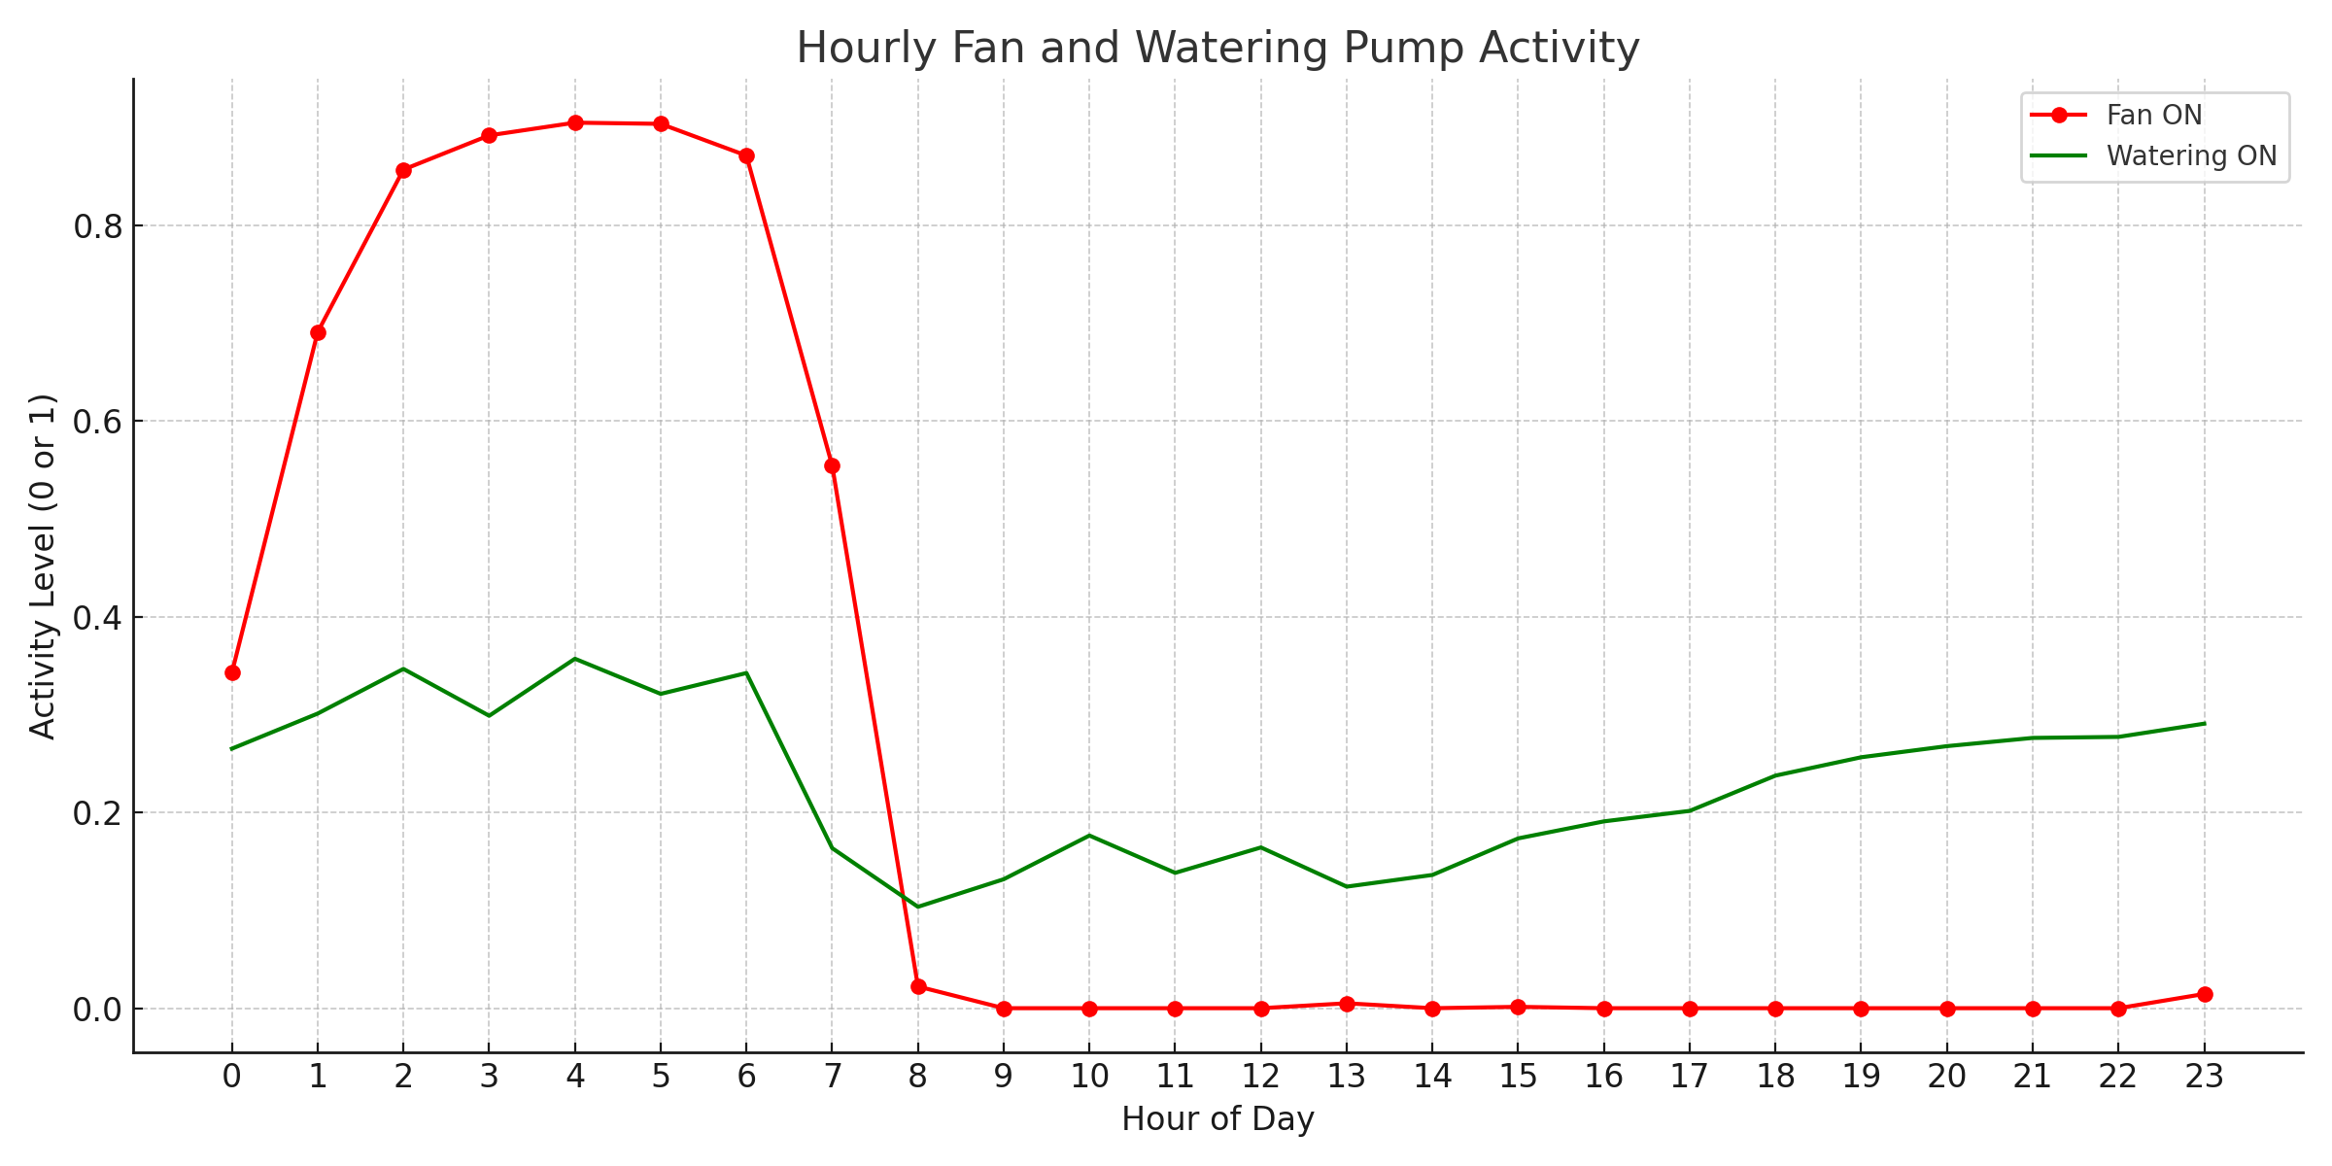
Hourly Fan and Watering Pump Activity

Slide 7
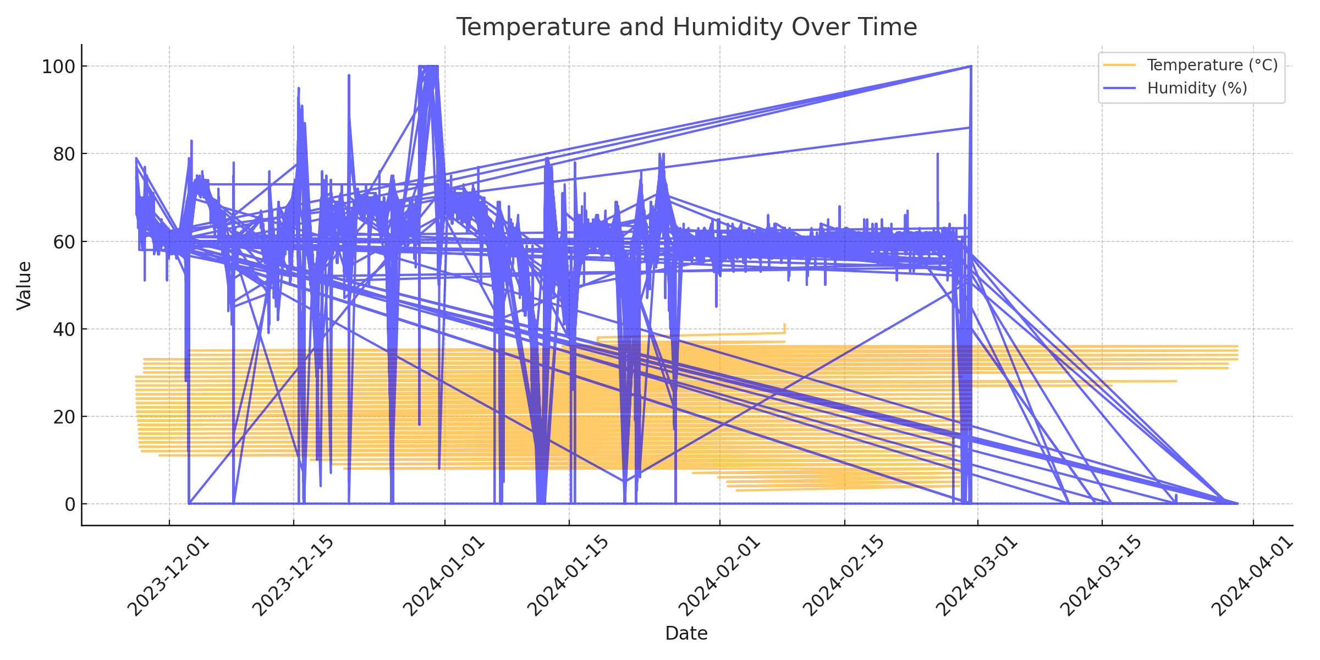
Temperature and Humidity Over Time

Slide 8
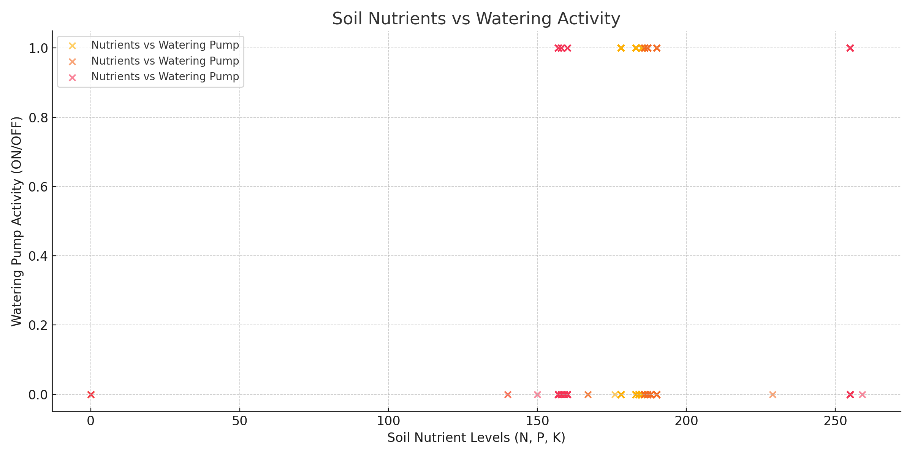
Soil Nutrients vs Watering Activity

Slide 9
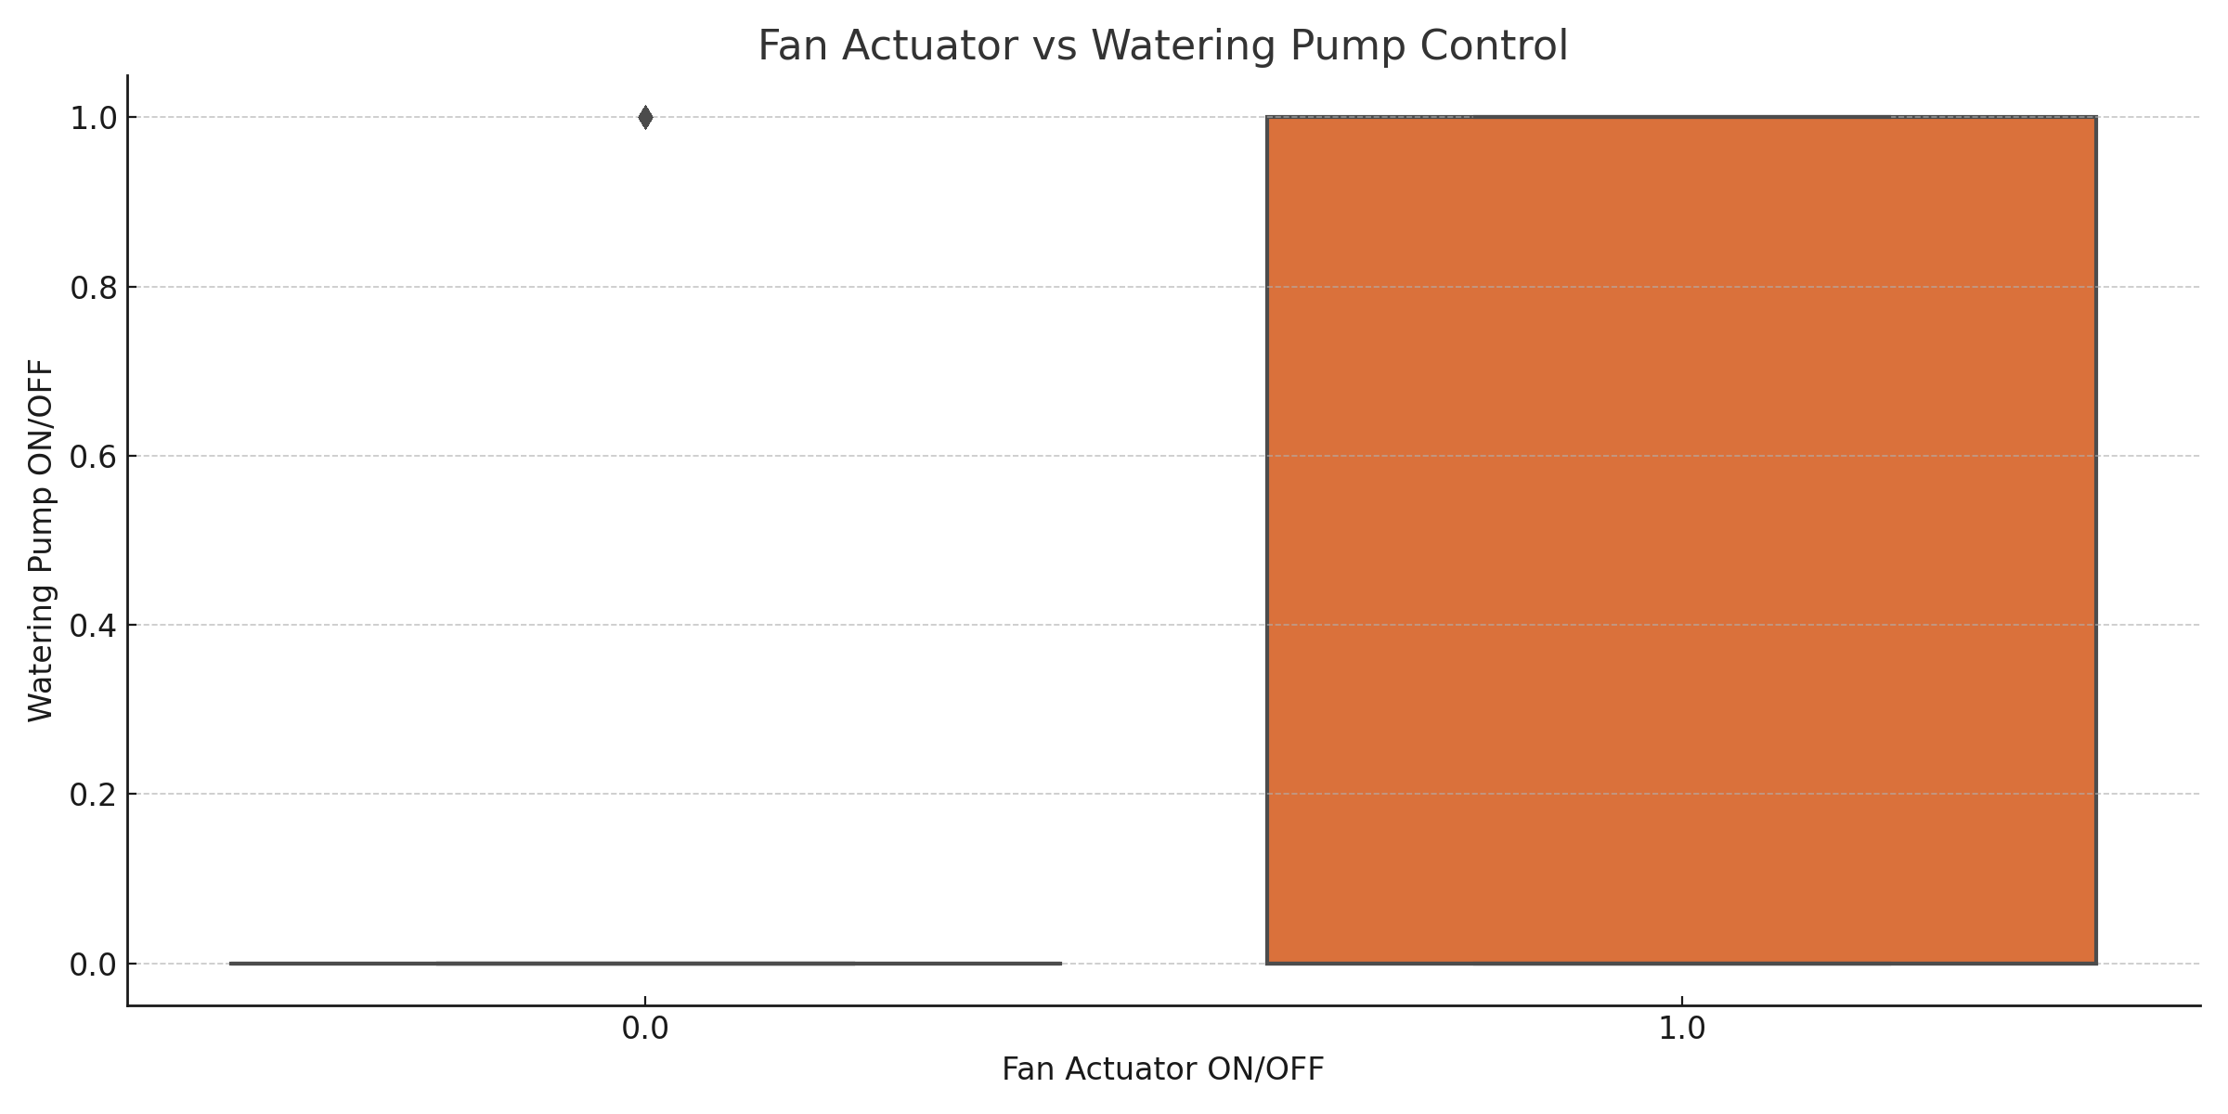
Fan Actuator vs Watering Pump Control

Slide 10
Conclusion
The analysis of temperature, humidity, and control systems provides insights into optimizing climate control.
The predictive models offer potential for efficient watering pump control based on environmental conditions.
The study of fan and watering activity over time will help in improving system performance and energy efficiency.

