Slide 1
Secure Data Hiding in Image Using Steganography
CAPSTONE PROJECT
Presented By: Bharath Reddy
Student Name : Bharath Reddy
College Name & Department : Parul university/ Computer Science

Slide 2
OUTLINE
Problem Statement
Technology used
Wow factor
End users
Result
Conclusion
Git-hub Link
Future scope

Slide 3
Problem Statement
Traditional message transmission methods are vulnerable to interception. This project aims to securely hide text messages inside images using steganography techniques, making it difficult for unauthorized parties to detect and access hidden data.

Slide 4
Technology used
Programming Language: Python
Libraries:
OpenCV - Image processing
NumPy - Numeric operations

Slide 5
Wow factors
✔️ Uses steganography for secure data hiding. ✔️ Simple and efficient message encryption inside images. ✔️ Secure access using passcode authentication. ✔️ Supports lossless image storage (PNG format) to prevent data corruption.

Slide 6
End users
👤 Who can use this project?
Individuals who want private communication.
Cybersecurity professionals for secure data transmission.
Organizations requiring covert data storage.

Slide 7
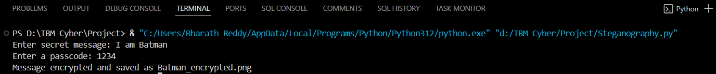
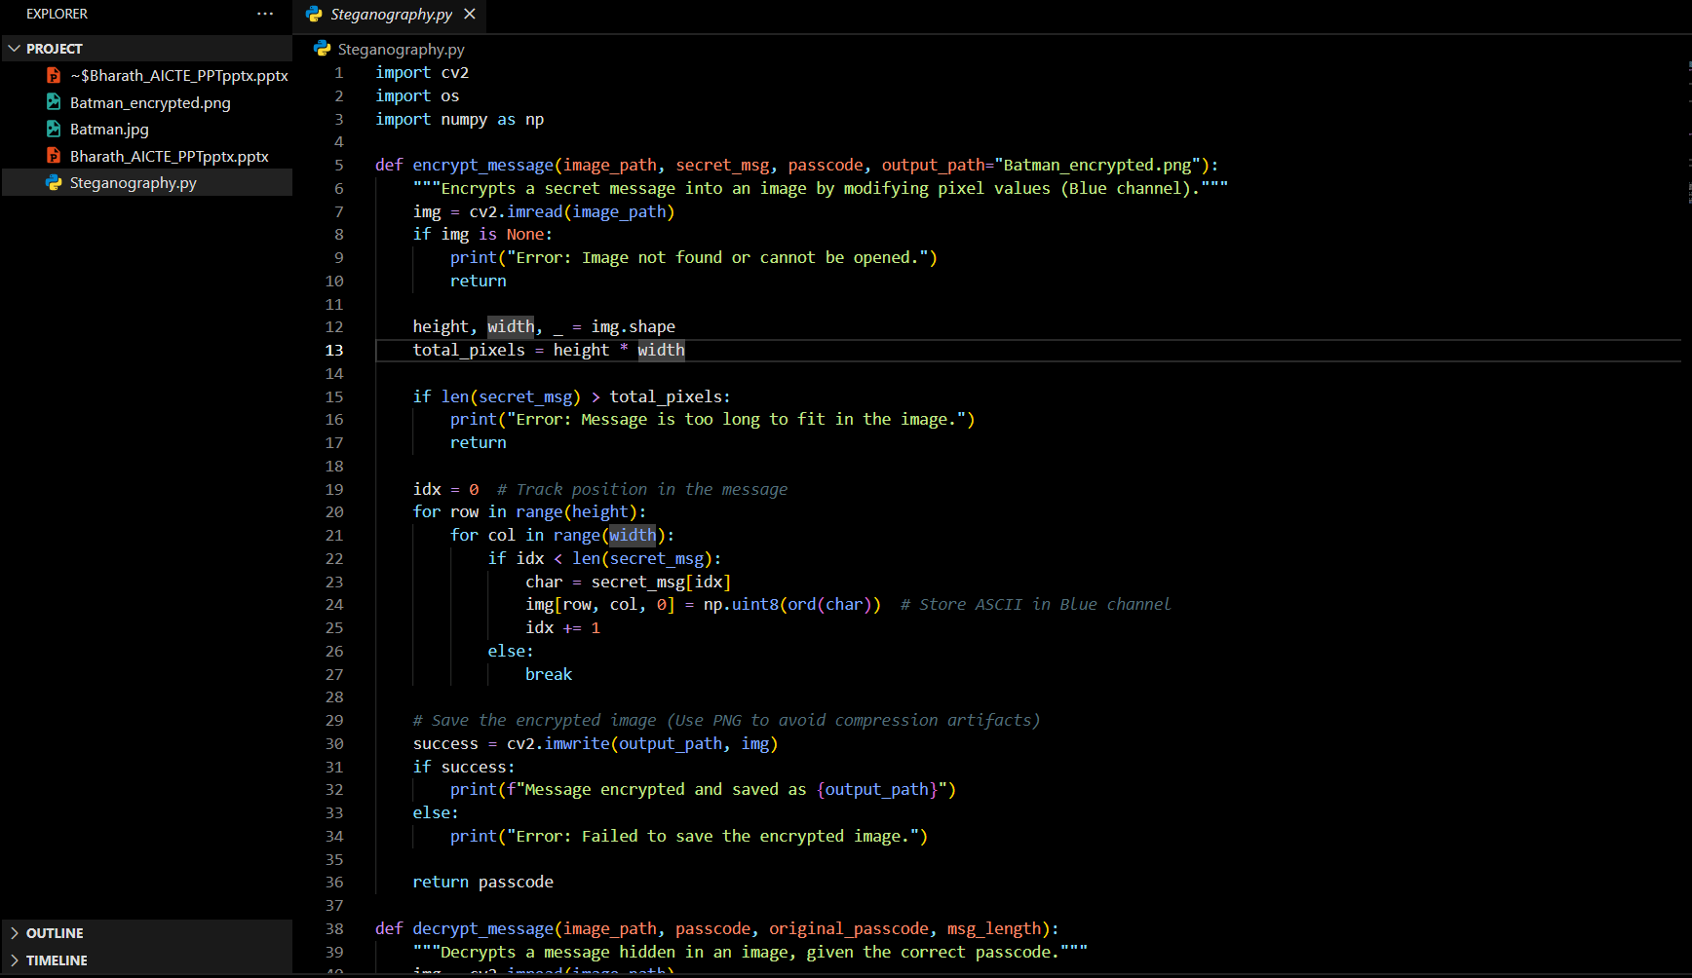

Results

Slide 8
Conclusion
This project successfully demonstrates a simple steganography technique for hiding messages inside images. It ensures secure message transmission while maintaining image quality. The passcode-based access adds an extra layer of security, preventing unauthorized retrieval of hidden data.

Slide 9
GitHub Link
Repository: https://github.com/Bharath0666/ACITE-PROJECT-Steganography

Slide 10
Future scope(optional)

Slide 11
THANK YOU

