Slide 1
ACUURACY METRICS

Slide 2
Confusion Matrix
A confusion matrix is a table that is often used to describe the performance of a classification model (or "classifier") on a set of test data for which the true values are known.
It is used to compare the predicted and actual values.
A good model is one which has high TP and TN rates, while low FP and FN rates.

Slide 3
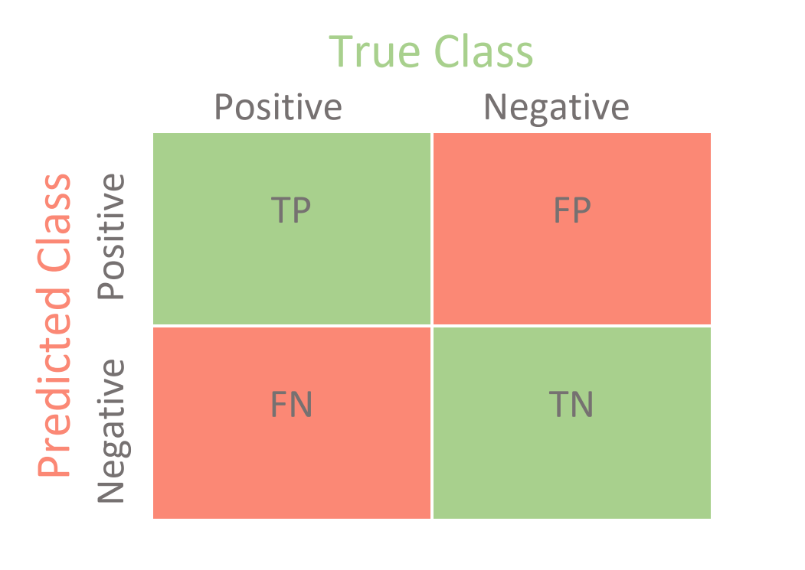
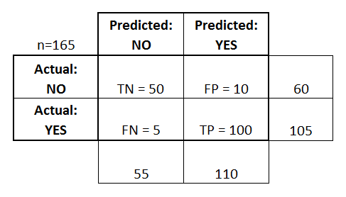

Slide 4
There are two possible predicted classes: "yes" and "no". If we were predicting the presence of a disease, for example, "yes" would mean they have the disease, and "no" would mean they don't have the disease.
The classifier made a total of 165 predictions (e.g., 165 patients were being tested for the presence of that disease).
Out of those 165 cases, the classifier predicted "yes" 110 times, and "no" 55 times.
In reality, 105 patients in the sample have the disease, and 60 patients do not.

Slide 5
True positives (TP): These are cases in which we predicted yes (they have the disease), and they do have the disease.
True negatives (TN): We predicted no, and they don't have the disease.
False positives (FP): We predicted yes, but they don't actually have the disease. (Also known as a "Type I error.")
False negatives (FN): We predicted no, but they actually do have the disease. (Also known as a "Type II error.")

Slide 6
Type I Error | Type II Error
Actual Negative but predicted as Positive Known as False positive in confusion matrix EG- We predicted yes, but they don't actually have the disease. | Actual Positive but predicted as Negative Known as false negative in confusion matrix EG- We predicted no, but they actually do have the disease.

Slide 7
Precision
It is also called as Positive Predictive Value (PPV)
When it predicts yes, how often is it correct?
Precision= TP/predicted yes

Slide 8
Recall
It is also called as Sensitivity, Hit Rate, True Positive Rate
Recall = TP/Actual Yes

Slide 9
Accuracy
Accuracy is defined as the percentage of correct predictions for the test data. It can be calculated easily by dividing the number of correct predictions by the number of total predictions.
Accuracy= (TP+TN)/TOTAL

Slide 10
F1 Score
The F₁ score is the harmonic mean of the precision and recall.
The highest possible value of an F-score is 1.0, indicating perfect precision and recall, and the lowest possible value is 0.
It is difficult to compare two models with low precision and high recall or vice versa. So to make them comparable, we use F-Score.

