Slide 1
JAVA
EVERY TOPIC
PPT – EXISTING IMAGES
WRITE AND PRACTICE THE THINGS WHICH YOU DON’T REMEMBER
  TOPICS- PRACTICAL EXAMPLES ( UTTARA NOTES , PPT , LABS, GFG, COLLECTION HIERARCHY )
    JVM ARCHITECTURE , JDK ARCHITECTURE
    ENCAPSULATION , ABSTRACTION
    OOP – CLASS DESIGN
    CONSTRUCTORS AND STATICS
    INHERITANCE , INTERNALS OF INHERITANCE
    POLYMORPHISM – ALL VARIETIES
    INITIALIZERS
    FINAL , ABSTRACT
    INTERFACES
    EXCEPTION HANDLING
    BASICS – DATATYPES , MEMBERS OF A CLASS , ACCESS SPECIFIERS , TYPE CASTING , OPERATORS , CONTROL STATEMENTS , STP.
    ARRAYS , STRINGS

Slide 2
JVM ARCHITECTURE
Source file - .java
CLASS LOADER SUB SYSTEM
LOADING LINKING INITIALIZATION
1)Bootstrap(RT.JAR – api classes)
2)Extension – ext folder , lib , jdk , jre
3)Application – envt variable class path classes
1)Verify (generated by proper compiler)
2)Prepare – static data with default values
3)Resolve – all symbolic references are replaced with original mem location
Initialization (original values for static variables)
(CLASS LOADING COMPLETED SUCCESSFULLY)
compiler
.class file (bytecode)
METHOD AREA HEAP STACK (THREAD SAFE) PC REGISTERS NATIVE METHOD STACK
Static - class level data
Not thread safe – data can be accessed by any thread
Instance (object) data
Not thread safe – data can be accessed by any thread
For every thread separate runtime stack will be created (stack frame - local variable array , frame data - symbols , operand stack – intermediate action)
Which next instruction should be called ? – for every thread a separate pc register will be created
For every thread a separate stack will be created
Memory areas present inside JVM

Slide 3
EXECUTION ENGINE (EXECUTES . CLASS FILE) - CENTRAL COMPONENT OF JVM
Interpreter – read and execute the code line by line
JIT compiler
Intermediate code generator – produces intermediate code
Code optimizer – remove the comments
Target code generator – generates – machine code / native code
Profiler – identifies REAPEATEDLY REPEATED METHOD (HOTSPOT)
Garbage collector , security manager
JNI
NATIVE LIBRARY METHODS
OS CALLS
INSTEAD OF INTERPRETTING THE METHOD EVERYTIME – INTERPRET ONCE AND GET THE MACHINE CODE

Slide 4
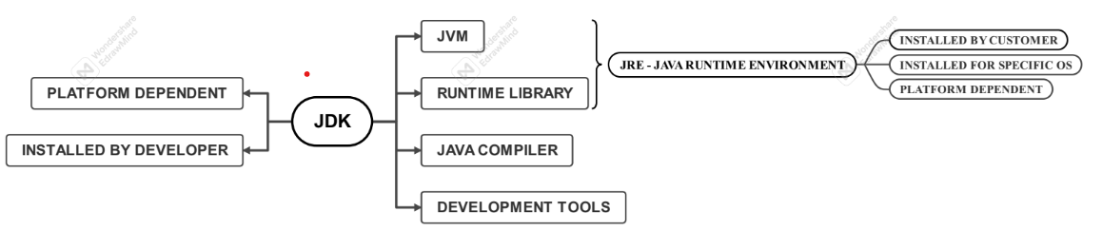
JDK ARCHITECTURE

Slide 5
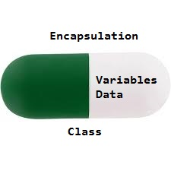
ENCAPSULATION
    Ability to put together attributes and behaviours inside of named design
    Principle of combining data (variable) and methods in a class
    Ex:- getters and setters – it protects the internal state of the object , by providing better control and flexibility in how a variable is accessed and modified.(by restricting the direct access – setting variables as private).
    It is a mechanism to bind together code and data it manipulates – the variable or the data is hidden from another class , can be accessed only through member function , of it’s own class.
      Data hiding – user do not see the implementation class , only pass the values to getters and setters
      Increased flexibility – read only (getters only), write only (setters only)
      Add validations according to requirements

Slide 6
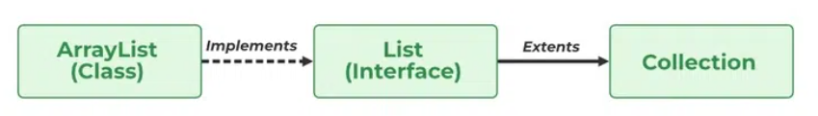
ABSTRACTION
Abstraction – hiding implementation (class implementing the interface) and exposing the features (interfaces) – SHOWING ONLY THE ESSENTIAL DETAILS.
Abstract classes and interfaces (100% abstraction) are the examples
We will show only the features – we do not show the implementation / logic behind how it is implemented , what are we calling internally , how data is processed ….etc.
A abstract method must always be redefined in the subclass, thus making overriding compulsory or making the subclass itself abstract.
Object creation is not possible in abstract class , but constructors are present.
Only essential details are provided to the user
Example – collection hierarchy
  All the collection interface methods are implemented in the classes
  Add , add all , remove , remove all , get, contains , contains all ….etc
  List interface methods – add (index, element) , size , clear , remove(index, element) , set(index)…etc
  This is also example of inheritance in the interfaces

Slide 7
OOP – CLASS DESIGN-PRACTICAL EXAMPLE
There are giraffes , every giraffe has a height and can sing.
Public class giraffe
{
  Int height;
  Public void sing()
  {
    System.out.println(“giraffe is singing”);
  }
}

Slide 8
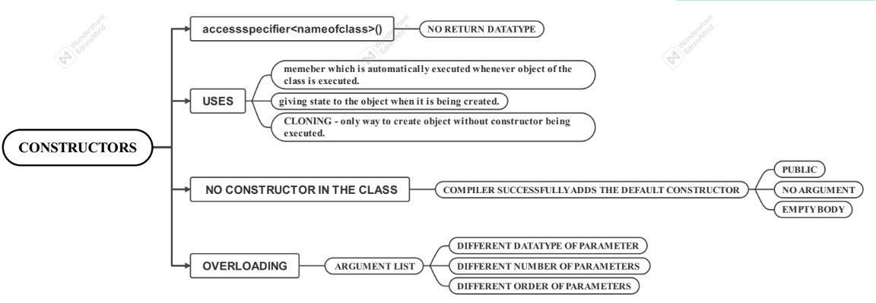
CONSTRUCTORS – notes , ppt , labs , example
Whenever “new” keyword is used – constructor is called.
Collection hierarchy –
  Array list contains these constructors
    ArrayList()
    ArrayList (int capacity)
    ArrayList (collection c)

Slide 9
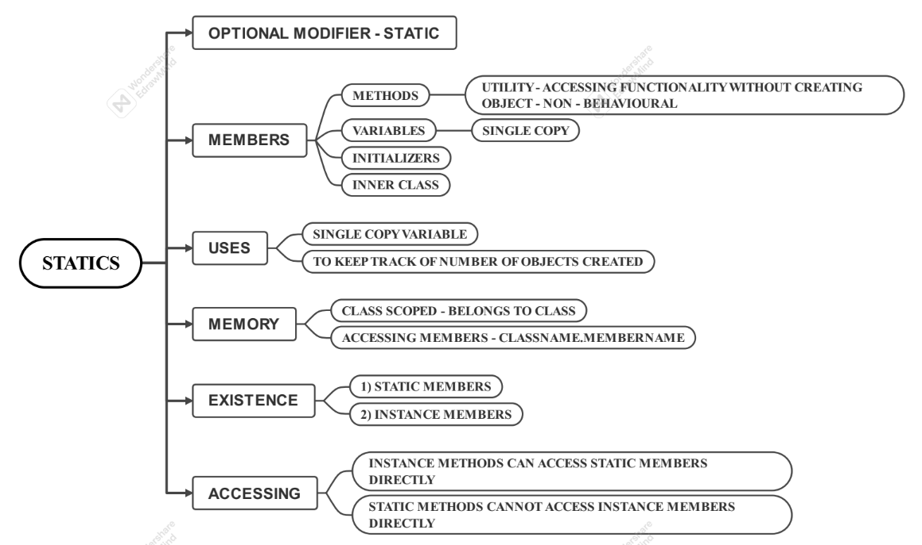
STATICS – ppt , notes , labs , example
Only getters are given – since the values should not be modified
They are usually present outside a method but inside a class
They are usually non – behavioural utility methods
Comes to existence before instance members
Can be called using class name , instance references
Instance variables – object
Static variables – class class object
Local variables – stack frame
Executed when class is loaded only one time
Main method

Slide 10
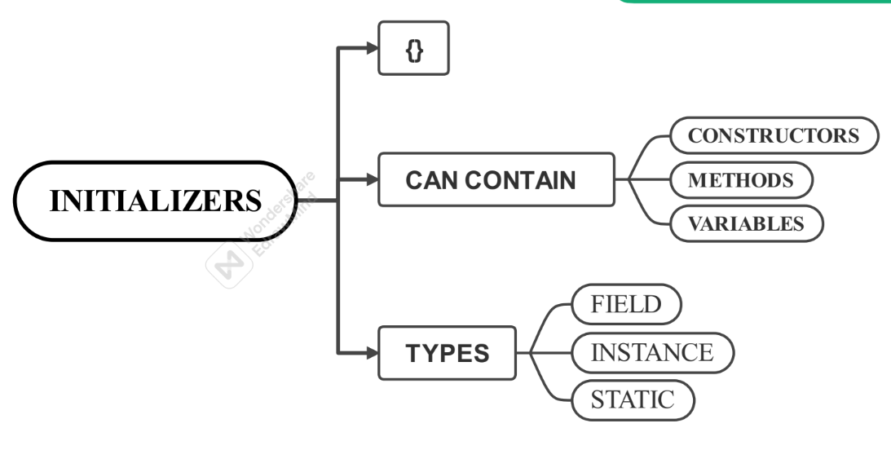
INITIALIZERS- ppt, notes , labs ,example
Fields initializers are only for static and instance initializers.
For local variables – it is assignment operators

Slide 11
CONSTRUCTORS , STATICS , INITIALIZERS
Practical example – IMPORTANT CODE SNIPPETS FROM LABS

Slide 12
INHERITANCE
Ppt , Notes , Labs , Practical Examples (Code Snippets).
Compiler Bases It’s Decision Based On Reference
Jvm Bases It’s Decision Based On Datatype Of Object
Parent Classes Are Loaded First , After That Child Classes Are Loaded
Dog D (Compiler , Points to method header , compile time) = New Dog(); (runtime , JVM , points to method body) , (method call to , method body linking happens during runtime - DMD).
Diamond Problem – In Case Of Multiple Inheritance If Both Parent Classes Will Have Same Method Header – Then Child Class Will Get Confused Regarding Which Method Should Be Over-ridden.
Method over-riding – changing the implementation of the parent’s class method.
Inheritance should be used only when the request stipulates IS-A relationship
If child reference points to parents object and call for sub-type(child) specific functionality – compiler will compile the code since it bases it’s decision based on datatype of reference , but runtime error occurs since parent do not have that functionality.
Now , if parent references child object and try to call sub-type specific functionality , compiler time error occurs because of type incompatibility to call the behaviour.
Behaviour will be picked up based on the object – if it is child object , child’s implementation (over-ridden method) will be picked up (Lishkov substitution principle) , if it is parent’s object then parent’s implementation will be picked up.
Inheritance + Dynamic method dispatch + Method over-riding + Lishkov substitution.
No matter which method is called , which body is picked is only dependent on type of object.

Slide 13
INTERNALS OF INHERITANCE

Slide 14
POLYMORPHISM – ALL VARIETIES
Device
Name
doSomething()
TV
doSomething – watchMovie
switchChannel()
Printer
doSomething - print
Microwave
doSomething - cook
Electrician
testDevice (Device D) – d.doSomething
D instance of TV
TV t = (TV)d;
t.switchChannel();

Slide 15
WHEN EVER WE WRITE POLYMORPHIC CODE , IF WE WANT TO ACCESS SUB-TYPE SPECIFIC SPECIFIC FUNCTIONALITY – WE DOWNCAST.

Slide 16
REVISE - NOTES , MIND MAPS , UTTARA LABS FOR IMPLEMENTATION
EVALUATE WHERE ALL THESE ARE PRACTICALLY IMPLEMENTED IN COLLECTIONS
Collections –
Properties
Underlying datastructure
Methods
constructures
Oops in collections – code snippet , particular line
Questions ?
  Which classes of the collections ? – queue ? Navigable set ?...etc.

Slide 20
    INTERFACES

Slide 26
FINAL , ABSTRACT
    Tomorrow

Slide 27
EXCEPTION HANDLING

Slide 30
OOPS IN COLLECTIONS
EVERY COLLECTION CLASS

