Slide 1
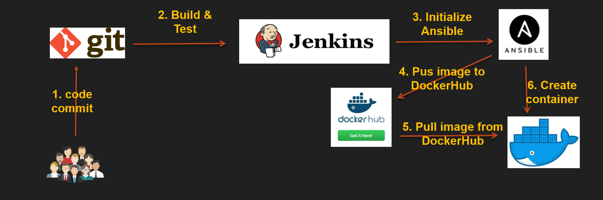
Complete CI-CD Process with Docker Swarm

Slide 2
STEP-1)
1)Lauched 5-AWS Instances with required configurations.
1-Instance(Install git & maven)
2-Instance(Jenkins)
3-other-Instances:
make-1-Instance(ANSIBLE MASTER & DOCKER SWARM MANAGER)

Slide 3
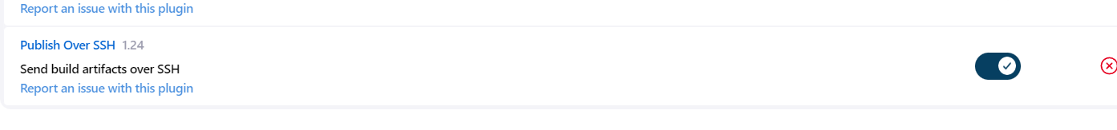
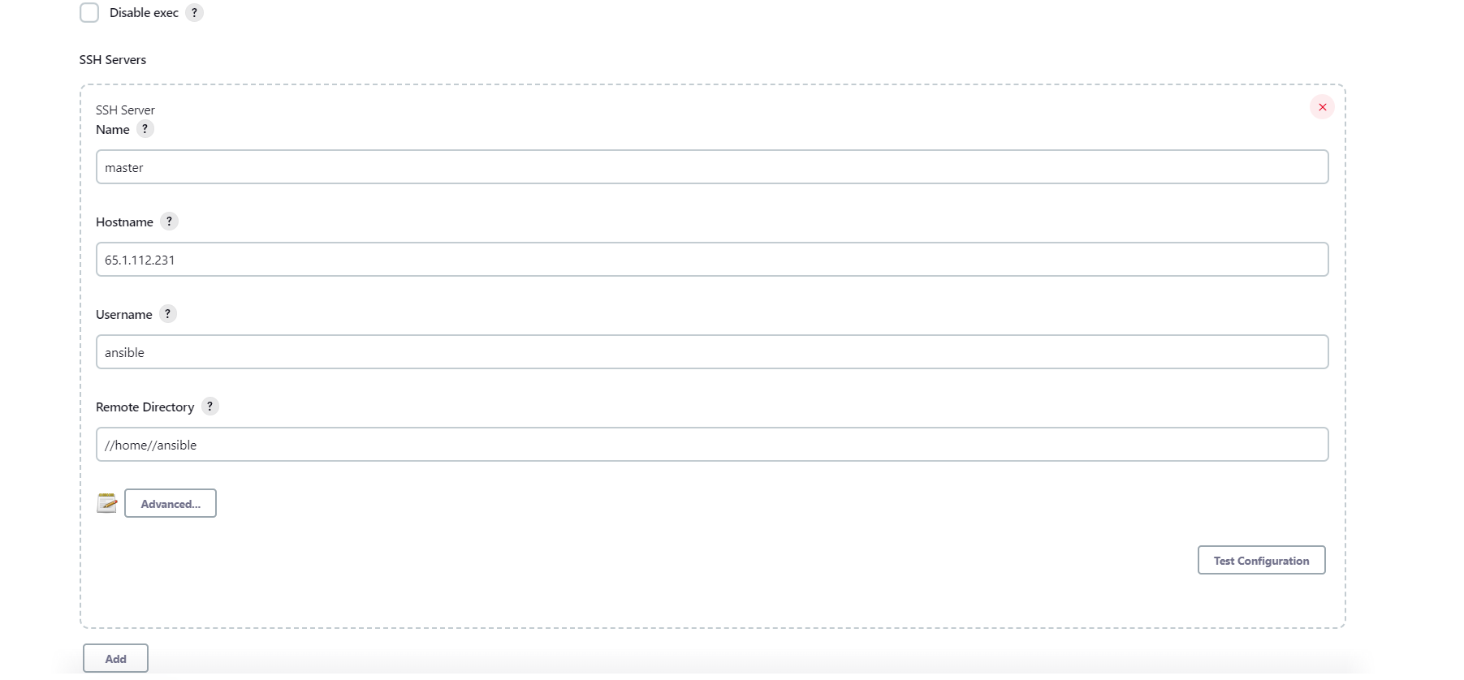
STEP-2)
1-In Jenkins goto managejenkins
install plugin called(publish over ssh)
2-Next goto configure-system
configure ssh-server

Slide 4
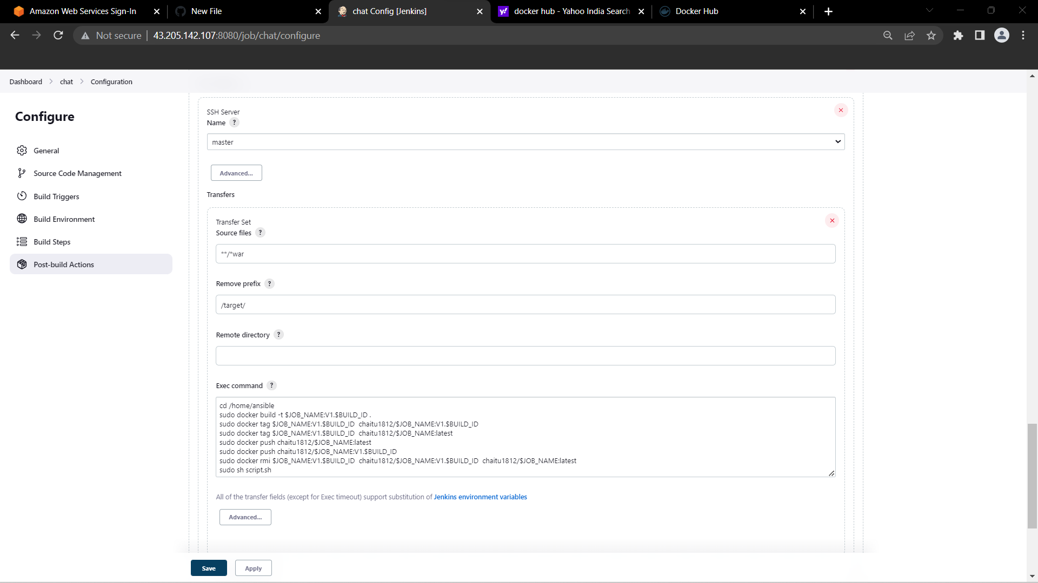
3-create a free stye job(name=chat)
1-git(https://github.com/chaithanya1812/Chat-Interface.git)
2-build triger (enable POLL-SCM)
3-Build Environment(delete work-space before build start)
4-Buldsteps(Invoke top-level Maven targets) goals(clean package)
5-Post-build Actions(Send build artifacts over SSH)

Slide 5
1-In post-build-actions((Send build artifacts over SSH)
UNDER EXEC COMMAND SECTION
----------------------------------------------------------------------
cd /home/ansible
sudo docker build -t $JOB_NAME:V1.$BUILD_ID .
sudo docker tag $JOB_NAME:V1.$BUILD_ID chaitu1812/$JOB_NAME:V1.$BUILD_ID
sudo docker tag $JOB_NAME:V1.$BUILD_ID chaitu1812/$JOB_NAME:latest
sudo docker push chaitu1812/$JOB_NAME:V1.$BUILD_ID
sudo docker push chaitu1812/$JOB_NAME:latest
sudo docker rmi $JOB_NAME:V1.$BUILD_ID chaitu1812/$JOB_NAME:V1.$BUILD_ID chaitu1812/$JOB_NAME:latest
sudo sh script.sh
-------------------------------------------------------------------------------
Place this script in docker manger sever
vi script.sh
#!/usr/bin env bash
sudo docker service create --name c1 -p 8081:8080 chaitu1812/chat:latest

Slide 6
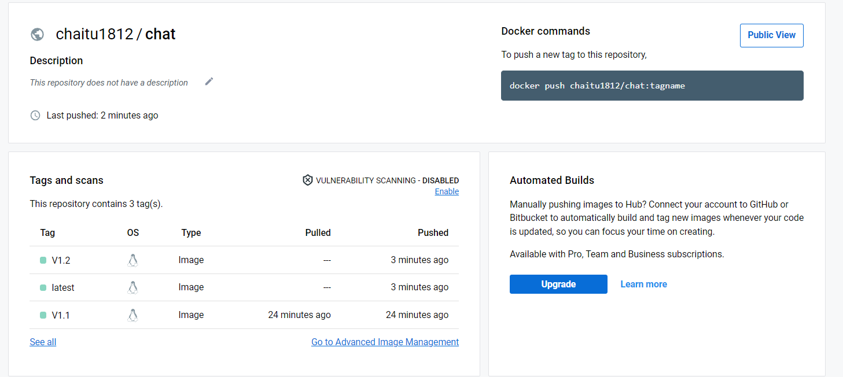
Docker Hub

Slide 7
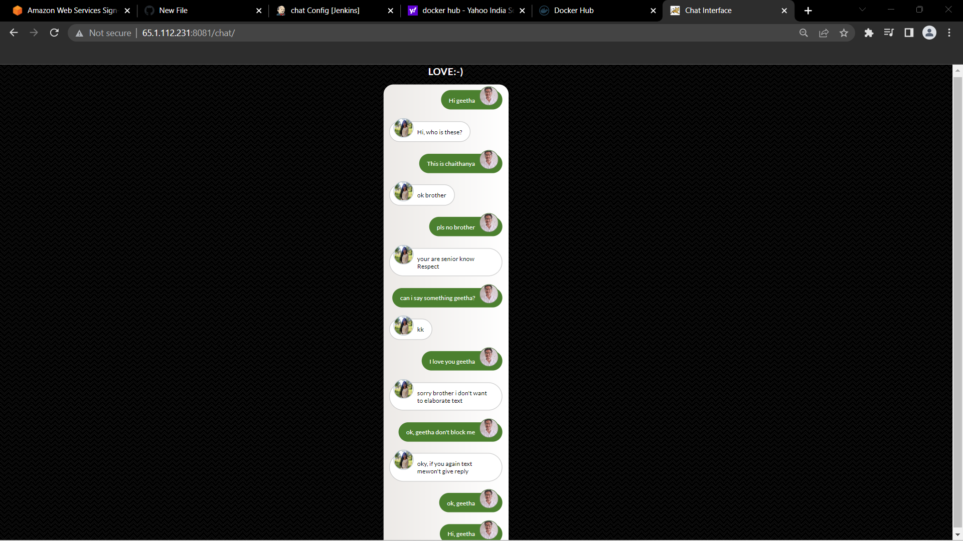
project-output

