Slide 1
Cursor movement on object motion
Digital signal processing
Mini-project
ESD18I009 K Bharath
EVD18I015 J Sarath Chandra
ESD18I013 Sri Harsha
ESD18I018 Krishna Kishore

Slide 2
Project Description
Problem Statement:
To track the movement of the objects.
This project can be broadly divided into three parts:
Frame Acquisition
Image processing
Cursor Movement
Signal Processing Applications: Image processing

Slide 3
Motivation
In some applications of today’s world human computer interaction need to without any devices/human touch are needed, so that it would make their tasks more efficient. In today’s world of pandemic touch less devices in public places are needed like remote less TV, Air conditioner. These kind of applications may require tracking a moving object like hand or a stick(like stick used in ps4) .Our aim is to control the cursor of your computer, not using any input devices like mouse, trackpad, or stylus, but by tracking movement of an object

Slide 4
A Brief Description
Frame acquisition:
Frames from webcam are captured, sensitivity of the mouse is directly proportional to the resolution of the camera.

Slide 5
Image processing:
It has mainly the following parts:
1.Extracting Color
2.Filtering of images
3.Conversion to binary
4.Removing pixel values < 300

Slide 6
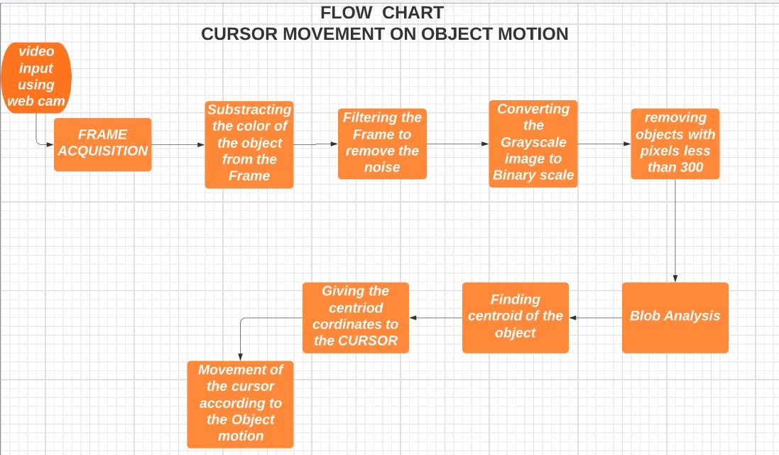

Slide 7
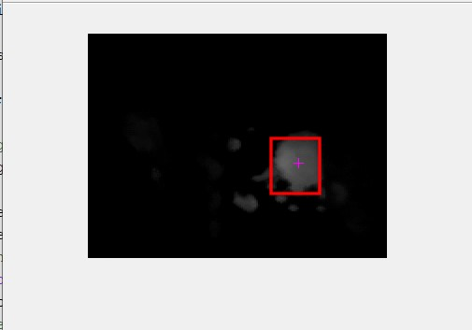
Extracting Color:
Here we dealing with certain coloured object and for tracking that object we should first extract that colour from the image and then by using diff_im1=imsubtract(data(:,:,1),rgb2gray(data));
We can extract the the component from the image.

Slide 8
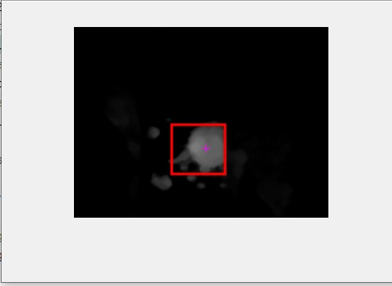
Filtering of images:
Filtering clears all sorts background noise caused due to various factors such as instability of the camera or system problems while recording the video. Median filter is used in this case it is help full to reduce noise as well as to preserve edges in the grey scale image.

Slide 9
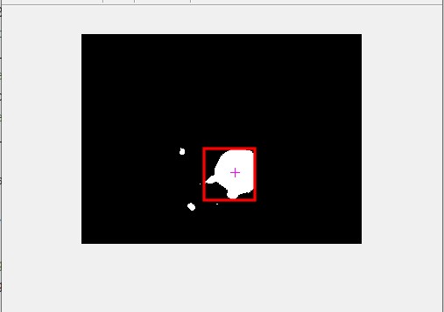
Conversion to binary: Grey scale is converted into binary. Binary has only two luminance
1. White if the intensity is greater than the specified intensity.
2. Black, if the intensity is less than specified intensity.

Slide 10
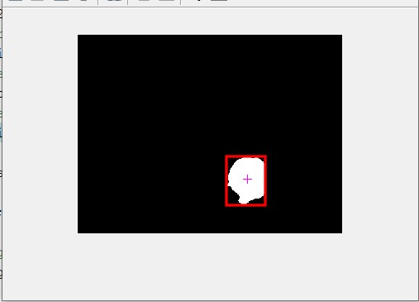
Removing pixel values < 300:
If in the image there are any other small objects of same colour them we sould remove them.

Slide 11
Blob analysis:
Finding centroid and boundaries of the object.
Cursor Movement:
Based on the movement of object it’s continuously changing centroid coordinates will be given to the cursor,according to which the cursor moves.

Slide 12
References
1.https://www.ijcaonline.org/research/volume128/number11/ghodichor-2015-ijca-906665.pdf
2.Erdem, M. E., Erdem, I. A., Atalay, V., Cetin, A. E. (2003). ”Computer vision based unistroke keyboard system and mouse for the handicapped” 2003 International Conference on Multimedia and Expo. ICME ’03. Proceedings .
3.­Chu­Feng Lien, “Portable Vision ­Based HCI – A Real­time Hand Mouse System on Handheld Devices”, National Taiwan University, Computer Science and Information Engineering Department

Slide 13
Thank you

