Slide 1


K.RAMAKRISHNAN COLLEGE OF TECHNOLOGY
(AUTONOMOUS), TRICHY.
E-COMMERCE PLATFORM
PRESENTED
BHARATH B
2303811710421017
SUPERVISOR
Mr. M. Saravanan, M.E.,
AP/CSE.

Slide 2
PRESENTATION OVERVIEW
Objective
Project Introduction
Problem Statement
Methodologies (Programming concepts relevant to problem statement)
Architecture of the proposed system
List of Modules
Merits
Results and Discussion
Queries

Slide 3
OBJECTIVE
The objective of this project is to create a user-friendly e-commerce application with a seamless GUI, allowing users to browse products, manage a virtual cart, and checkout. It demonstrates core programming concepts like OOP, exception handling, and event-driven design while integrating features such as product management, cart operations, and discount calculations, providing insights into real-world Java application development.

Slide 4
PROJECT INTRODUCTION
This Java-based e-commerce platform features a Swing GUI for browsing products, managing a dynamic cart, and seamless checkout. It demonstrates OOP principles, event handling, and exception management while integrating key e-commerce functionalities like product management, discounts, and payment simulation, bridging theory with practical application.

Slide 5
PROBLEM STATEMENT
Previously, users could only purchase a single product per transaction, limiting the convenience and flexibility of online shopping. This project addresses the problem by enabling users to select and purchase multiple products in a single order. By implementing a shopping cart system, it allows users to add, view, and manage multiple items before proceeding to checkout, enhancing the overall user experience and simulating real-world e-commerce functionality.

Slide 6
METHODOLOGIES
Object-Oriented Design: Use classes and encapsulation for modular and scalable code.
Data Management: Handle products and cart items using Java Collections.
Event-Driven Programming: Implement GUI with Swing and event listeners for user interactions.
Business Logic: Develop functionalities like cart operations, total calculation, and discount handling.
Exception Handling: Manage errors using custom and standard exceptions.
User Interface Design: Create an intuitive and interactive GUI for seamless navigation.

Slide 7
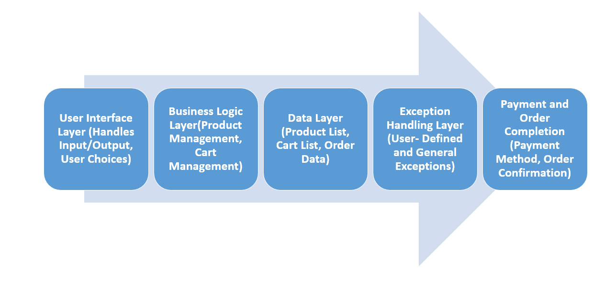
ARCHITECTURE OF THE PROPOSED SYSTEM

Slide 8
LIST OF MODULES
Data Model Module: Defines the structure for products and cart items.
Business Logic Module: Handles core functionalities like product management, cart operations, and discount calculations.
UI Elements Module: Provides an interactive Swing-based graphical user interface.
Interaction Module: Manages user actions like adding items to the cart and proceeding to checkout.
Exception Handling Module: Ensures smooth operation by handling errors and invalid inputs.

Slide 9
MERITS
User-Friendly Interface: Simplifies online shopping with an intuitive GUI.
Enhanced Functionality: Supports multiple product selection and real-time cart updates.
Practical Learning: Demonstrates OOP, event handling, and exception management effectively.
Real-World Simulation: Mimics actual e-commerce processes, providing a hands-on experience.
Extensibility: Modular design allows easy addition of features or enhancements.

Slide 10
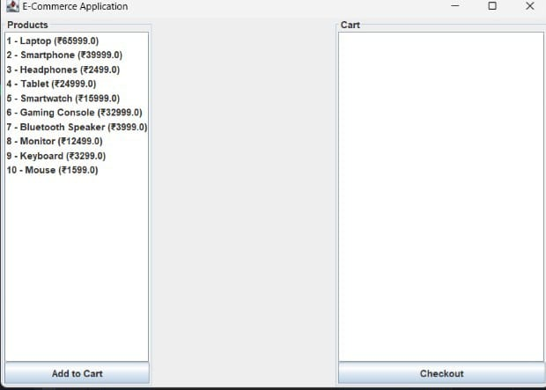
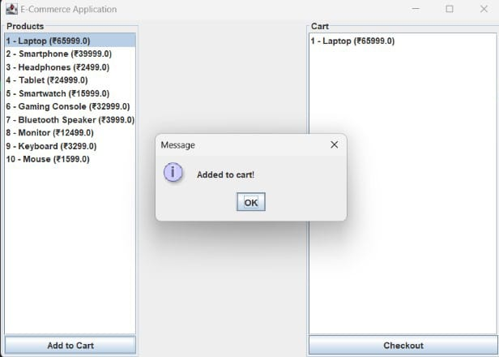
RESULTS AND DISCUSSION

Slide 11
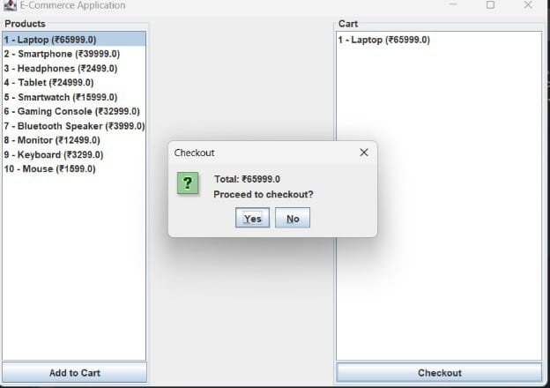
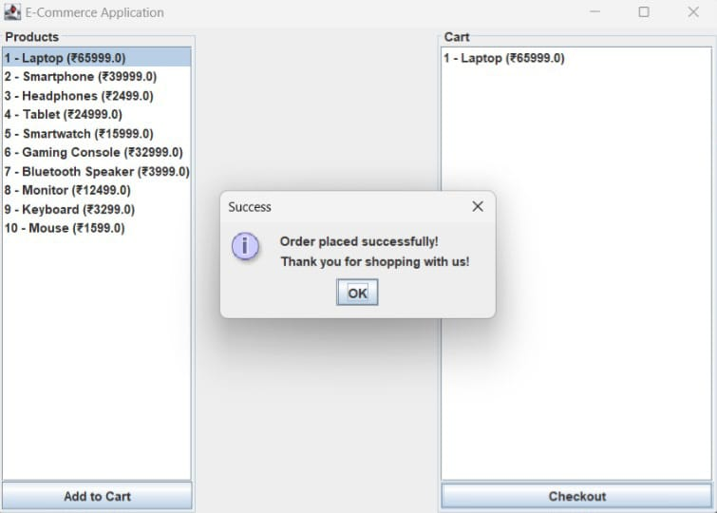

Slide 12
QUERIES ?

