Slide 1


Amazon Sales Analytics Hub
INTRODUCTION
Welcome to the Amazon Sales Analytics Hub presentation. This project focuses on analyzing and visualizing sales data across various product categories on Amazon. We aim to provide insights into customer engagement, pricing strategies, and product performance.
Key Features :
Generate and view detailed statistics for the data.
Compare the performance of various product categories.
Perform correlation analyses to understand relationships between different metrics.
Conduct custom analyses tailored to specific business needs.
Download reports and export visualizations for further use.

Slide 2
PROBLEM DESCRIPTION
Retailers on Amazon encounter difficulties in:
Grasping customer preferences
Optimizing pricing strategies
Assessing product performance across categories
Existing methods often lack comprehensive, real-time insights.
Need for an interactive, user-friendly platform to analyze and visualize sales data.

Slide 3
SOLUTION NARRATIVE
The Amazon Sales Analytics Hub addresses these challenges by :
The Amazon Sales Analytics Hub addresses these challenges by:
Features include:
Comparing product category performance
Examining pricing and discount patterns
Analyzing rating distributions
Correlating ratings with discounts
Technologies used:
Python with Pandas for data analysis
Matplotlib and Plotly for visualization
Streamlit for interactive development

Slide 4
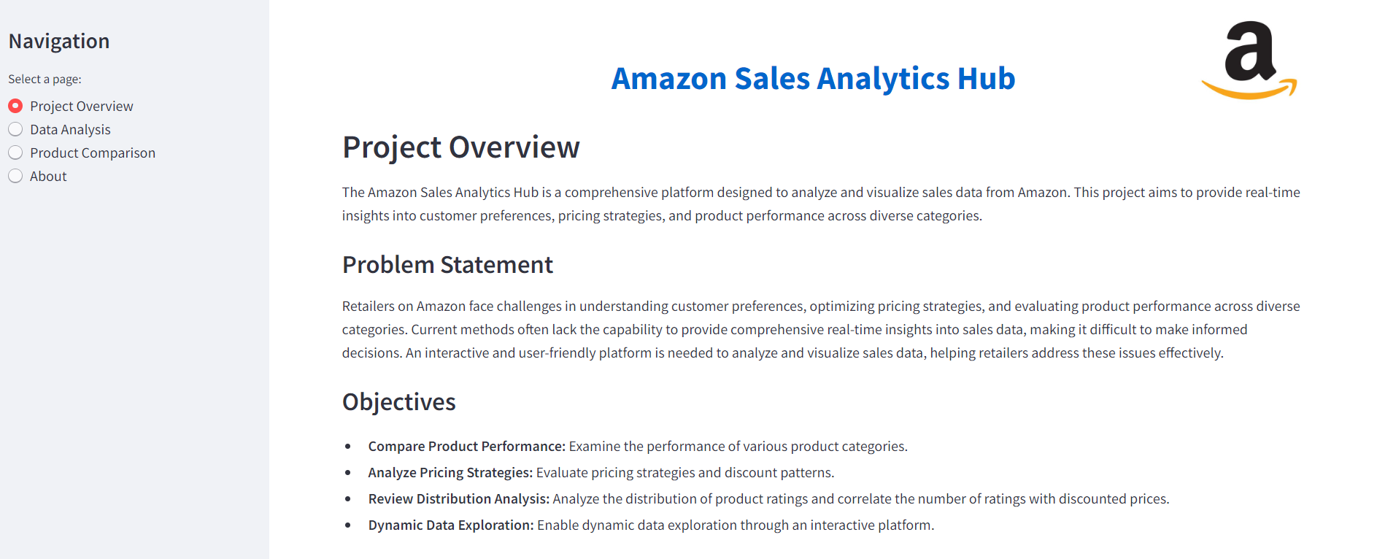
Application DEMO
URL - Amazon Sales Analytics

Slide 5
CONCLUSION
Addresses challenges in customer preferences, pricing strategies, and product performance.
Provides real-time insights using advanced data analysis and visualization.
Key findings:
High engagement and diverse prices in cameras.
Significant discounts in football products.
Varied feedback in cycling.
Enables informed decision-making and improved sales strategies.
Highlights the value of a user-friendly, interactive platform for sales data analysis.
Key Challenges Addressed

Slide 6
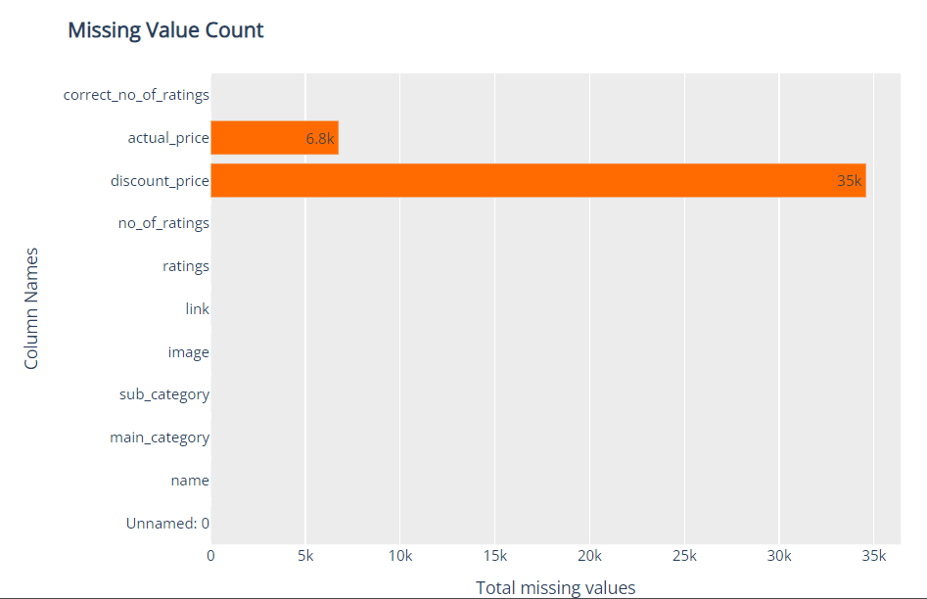
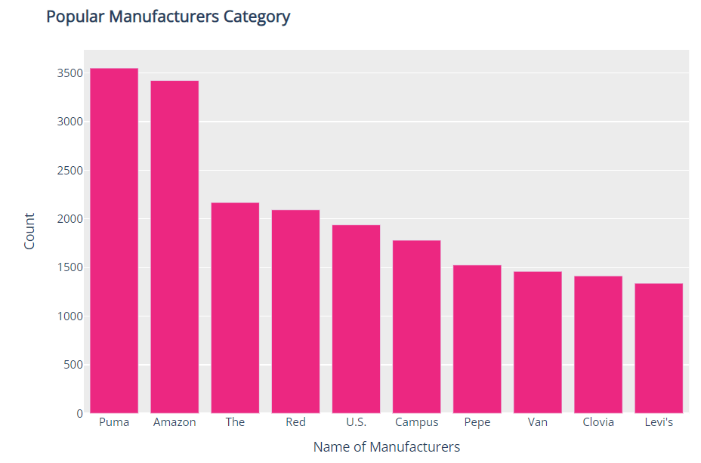
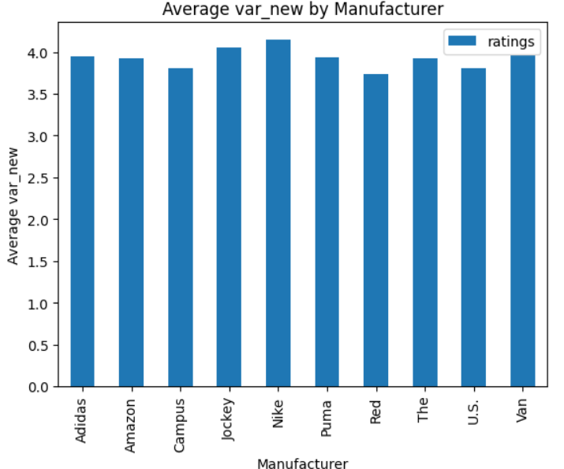
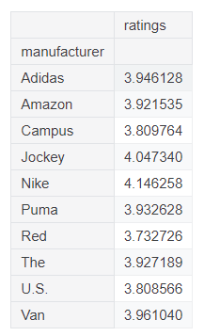
REFERENCES
sonialikhan Analysis
joaodantas13 Analysis
Other References :
hishaamarmghan analysis on amazon-products-sales-2023
mudaykiranreddy analysis on badminton data

Slide 7
Thank you
Developed as part of the BANA 8083 - 006 MS Capstone at the University of Cincinnati
Special thanks to the MS BANA program and project mentors.
Developed By
Bharath Marturu Masters in Business Analytics
marturbh@mail.uc.edu
LinkedIn
Primary Reader
Dr. Yan Yui
Secondary Reader
Professor Delmer "Bill" Nicholson

