Slide 1
Make a “U” Turn : Extravagance to Resourceful
WiT Hacathon
Team – Turbo Dynamic
IBM India Pvt. Ltd

Slide 2
What Triggered the Idea!!
Realizing the importance of green practices at home or at workplace or in the society in general, can help reduce waste, conserve resources, improve air, soil and water quality, and protect ecosystems and biodiversity.
Despite being aware of the destruction, it is causing to the ecosystem, we continue indulging in production of irreversible & harmful waste products and engaging in detrimental practices.
The designed application will update the users on how we are contributing to this destruction by producing volume of harmful waste products. This application will also recommend solutions & ways to mitigate and overcome the situation.
privileged.

Slide 3
Solution Outline
Solution
To start with, we immensely contribute to the “CO2 emission percentage”, and # years of reserve oil left is scaring. As an alternative, we can opt for using Biogas to save our environment. However, the challenge of producing Biogas is due to unavailability of adequate raw materials. The application will provide means of selling the wasted products like food, papers, crop residue as raw material for Biogas.
There is also the issue on the amount of food being wasted, % of people hungry, % of people below poverty line. Instead of throwing the food into the bin, if there would be any means and resources to feed the hungry it will make our world a better place to live in. The application will provide means of donating the surplus food for fellow humans.
To add on, indiscriminate usage of chemical pesticides and fertilizers have a devastating effect on our entire ecosystem. They directly impact the helpful insects/pests, soil quality, water usage. The application will recommend the crop to be harvested based on the soil type, temperature, rainfall, etc. Based on the recommendation, it will also exhibit the harmful and beneficial pest for the crop.
The application provides some additional benefits to the users. Emission from fueled vehicles is a key contributor for poor air quality. Car pooling, is one of the options available to reduce vehicle emissions. The app will courage car pooling by providing “bio coins” to users(which they can redeem later for purchase), once they provide valid invoice for car pooling/sharing.
Benefit
Generate awareness to convert waste products to cheap, eco friendly energy, philanthropic approach to society by redistributing surplus food to the under privileged. Minimize the environmental degradation.

Slide 4



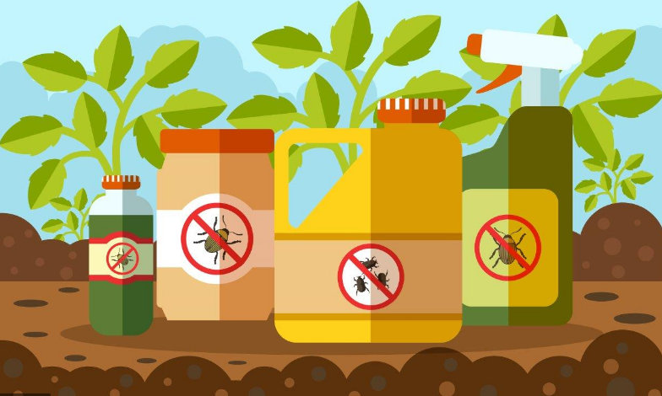
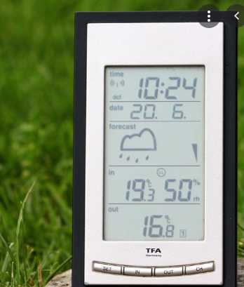
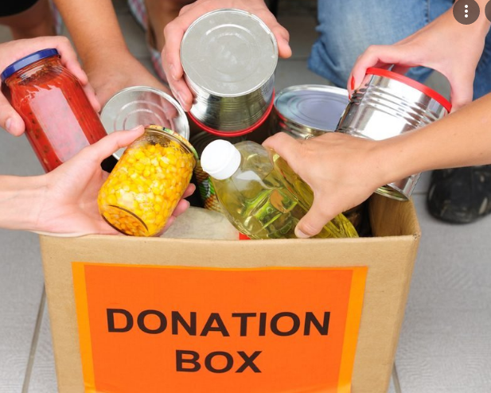


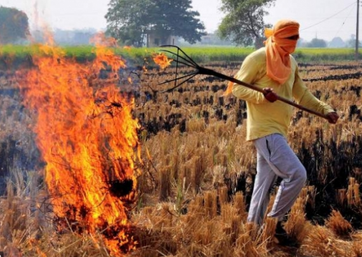
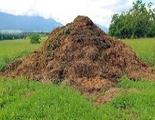
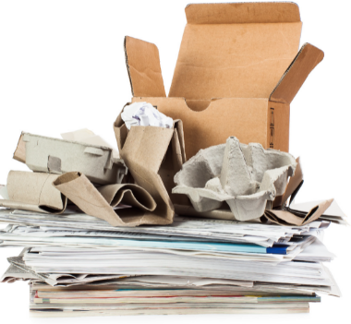
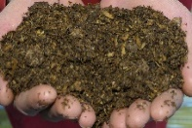

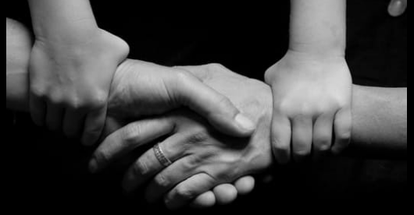

How “GREENHOUSE” will help from Extravagance to be Resourceful
Register/Login
Reduce CO2 emission
No wastage / burning, convert to Biogas
Crop to harvest / good & bad pest for the crop
Do I get any extra information?
No food wastage
Farmers seeking work
Convert Extravagance & Wastages
Become Resourceful
GREENHOUSE
Marketplace
Purchase
Sell
Useful Sections
Forum
Weather Forecast
Account
Bio Coin
Car Pool Receipt
Recommendations
Pest Identification
crop Suggestions
Helping Hand
Farming Opportunities
Donate

Slide 5




Technologies Used
K
IBM Kubernetes
User
React JS
Django
Crop Suggestion – Watson Studio, ML service
Pest Identification – IBM COS
Frontend
Backend
Request Type
Weather Forecast – IBM Weather API
Invoice Verification – IBM MAX-OCR
Marketplace, Helping Hand, Forum, Account
Database
PostgreSQL
PostgreSQL
NGINX

Slide 6
Thank You

