Slide 1

DISASTER MANAGEMENT

Slide 2

ABSTRACT
In this project, tracking the location of disaster victims becomes effortless, enabling swift and efficient rescue operations.
Victims can easily be located and rescued promptly. Additionally, victims gain the capability to track the real-time location of agency vehicles, ensuring transparency and reassurance about incoming assistance.
In the event of a disaster occurring nearby, individuals can promptly inform nearby agencies, facilitating a quicker response.
Furthermore, the system sends notifications to volunteers, enhancing overall communication and coordination in times of crisis.

Slide 3
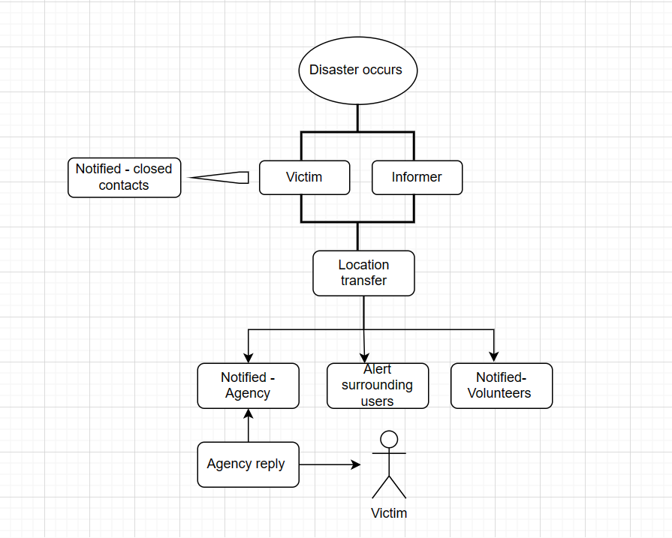
BLOCK DIAGRAM

Slide 4
SERVICES
In the event of a disaster, ...
Determining the specific geographic area impacted by a disaster from the user.
The user’s location will be forwarded to the closest agency that is a logical match to the user's location to ensure suitability and feasibility.
Victims can track the location of agency vehicle which is allotted for rescue through our application.
Volunteers nearby will be alerted via SMS and can provide assistance to the victims.
Alert the victim's immediate contacts through SMS

Slide 5
Users can find possible nearby rescue agencies along with necessary details in Track the location option.
Additional users can report a nearby disaster.

Slide 6
BENEFITS
MANAGING THE DISASTERS
TIME MANAGEMENT
INFORMING
VOLUNTEERING
AFFORDABILITY
EFFECTIVE RESPONSE
REDUCE THE LOSS OF LIFE AND PROPERTY

Slide 7
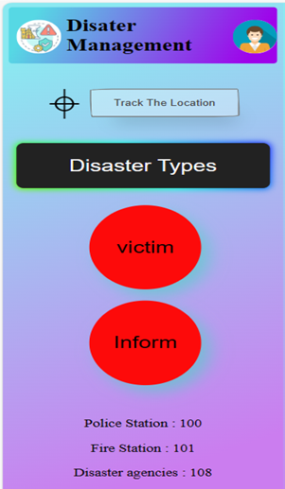
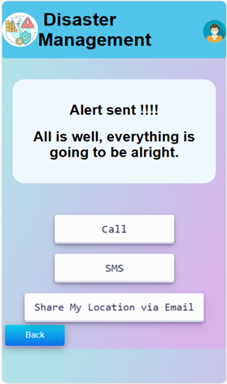
USER INTERFACE

Slide 8

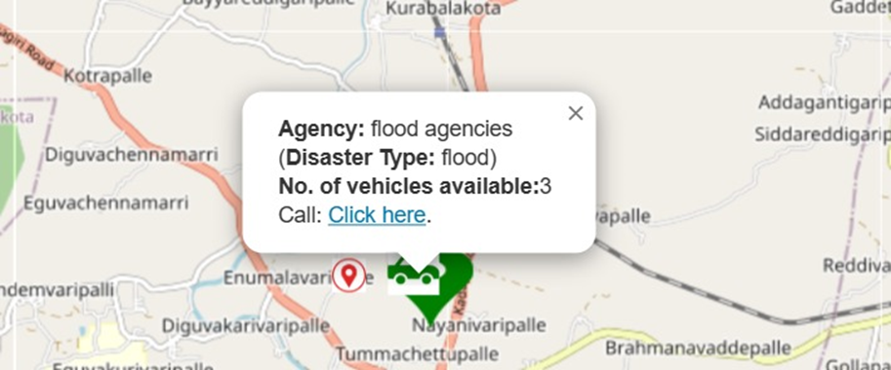


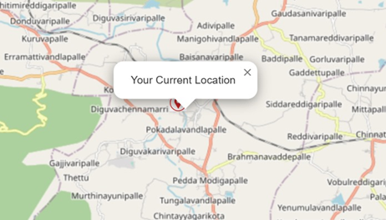
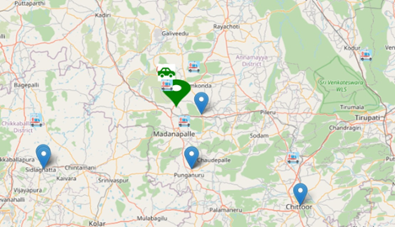

Slide 9

CONCLUSION
In conclusion, the integration of location tracking in this project not only streamlines the process of locating and rescuing disaster victims swiftly but also empowers victims with real-time visibility into the approaching aid.
The ability to track agency vehicles enhances transparency, instilling confidence in victims awaiting assistance. The proactive communication feature, where individuals can promptly inform nearby agencies, contributes to a faster and more coordinated response during disasters.
Moreover, the inclusion of notifications for volunteers enhances overall communication, creating a robust system that fosters efficiency and collaboration in times of crisis. Overall, the project stands as a testament to the transformative power of technology in optimizing disaster response and ultimately improving outcomes for those affected.

Slide 10

Thank you
Presenter names
Janga Anusha
Y Bharath
M Lakshmi devi
G Harsha Vardhan sai
N Dasaratha Reddy
N Anil Kumar

