Slide 1

MULTI-SOURCE AI FOR
HYPERLOCAL RAINFALL NOWCASTING
Bharath B (23UCS025) · Ariyan M (23UCS015) · Hemnnath G (23UCS066)
IV Year CSE A section
Guide: Mrs. N. Danapaquiame, Professor & HOD, CSE
Sri Manakula Vinayagar Engineering College
Notes:
This is our first review presentation. We move from the domain discussed in the 0th review to the actual proposed system, architecture, modules, literature survey, objectives and technology stack.

Slide 2
Abstract
The proposed project develops a hyperlocal rainfall nowcasting platform for Puducherry and the surrounding Tamil Nadu region, targeting rainfall conditions 0–3 hours ahead. The system addresses the short-term gap between live observations and conventional numerical weather forecasts.
At the observation layer, IMD Automatic Weather Stations and Personal Weather Stations provide temperature, humidity, pressure, wind and rainfall-related measurements. Personal-station observations are collected through supported APIs and aligned into a common time-series representation.
The machine-learning layer performs data cleaning, feature engineering and short-horizon prediction. Baseline models such as Random Forest and XGBoost will be compared with temporal and spatiotemporal models including LSTM and a planned CNN/GNN-LSTM hybrid.
In parallel, ECMWF numerical weather prediction products are processed from GRIB2 using cfgrib/xarray, converted into geospatial raster layers and displayed alongside station observations. This provides broader atmospheric context beyond the local 0–3 hour ML prediction.
The final full-stack application combines FastAPI services, SQLAlchemy storage and a Next.js/React dashboard. Users can inspect live stations, trends, predictions and interactive rainfall maps through one unified platform.
Notes:
Our system combines three complementary sources of information: live local observations, machine-learning nowcasts and broader NWP forecasts. The goal is not to replace NWP, but to provide a unified hyperlocal view for the immediate 0–3 hour decision window.

Slide 3
Problem Statement
01
Fragmented observations
02
0–3 hour prediction gap
AWS and personal weather stations exist in separate networks, making it difficult to obtain one consistent regional view.
Observation platforms show what is happening now, while many forecast products emphasize longer horizons or broader spatial scales.
03
Heterogeneous data quality
04
No unified decision interface
Sources differ in timestamps, sampling frequency, accuracy, missing values and station metadata.
Users need live stations, short-term prediction and NWP context together rather than switching between separate tools.
Notes:
The central problem is not simply predicting rain. It is integrating fragmented local observations and producing useful short-horizon information while keeping broader NWP guidance available for context.

Slide 4
Existing Systems & Limitations
System
What it offers
Limitation
IMD Mausam
Official weather observations, forecasts, warnings and services
General-purpose; hyperlocal 0–3h ML fusion is not its primary focus
Windy
Interactive global weather maps using multiple forecast models
Model-centric; local station fusion and custom regional nowcast workflow are limited
RainViewer
Radar-based precipitation visualization and short-term movement
Coverage depends on radar availability; does not provide our planned multi-source station + ML pipeline
Ambient Weather Network
Personal weather-station observations and community network
Observation-focused; does not itself provide the proposed 0–3h ML nowcasting workflow
Notes:
These systems provide valuable weather information, but they emphasize different layers: official services, NWP visualization, radar, regional analysis or personal observations. Our proposed contribution is the integration of these information types around a specific 0–3 hour hyperlocal nowcasting workflow.

Slide 5
Proposed System Overview
LAYER 1 · OBSERVATION
LAYER 2 · ML NOWCAST
LAYER 3 · NWP VISUALIZATION
IMD AWS + PWS
Weather Underground / Ambient Weather
RF / XGBoost baseline
LSTM → CNN/GNN-LSTM
ECMWF GRIB2
cfgrib/xarray → GeoTIFF
Live station data
Quality control · alignment
0–3h rainfall
Prediction + confidence
Broader forecast context
Interactive map
DASHBOARD
Live station cards · 30s auto-refresh · TrendChart · search/filter · nowcast display · NWP layers · blog · authentication
Notes:
The proposed system has three layers. The first captures observations, the second learns short-term rainfall behavior, and the third provides NWP context. All three are delivered through one dashboard so the user can compare present conditions with immediate prediction and broader forecast guidance.

Slide 6
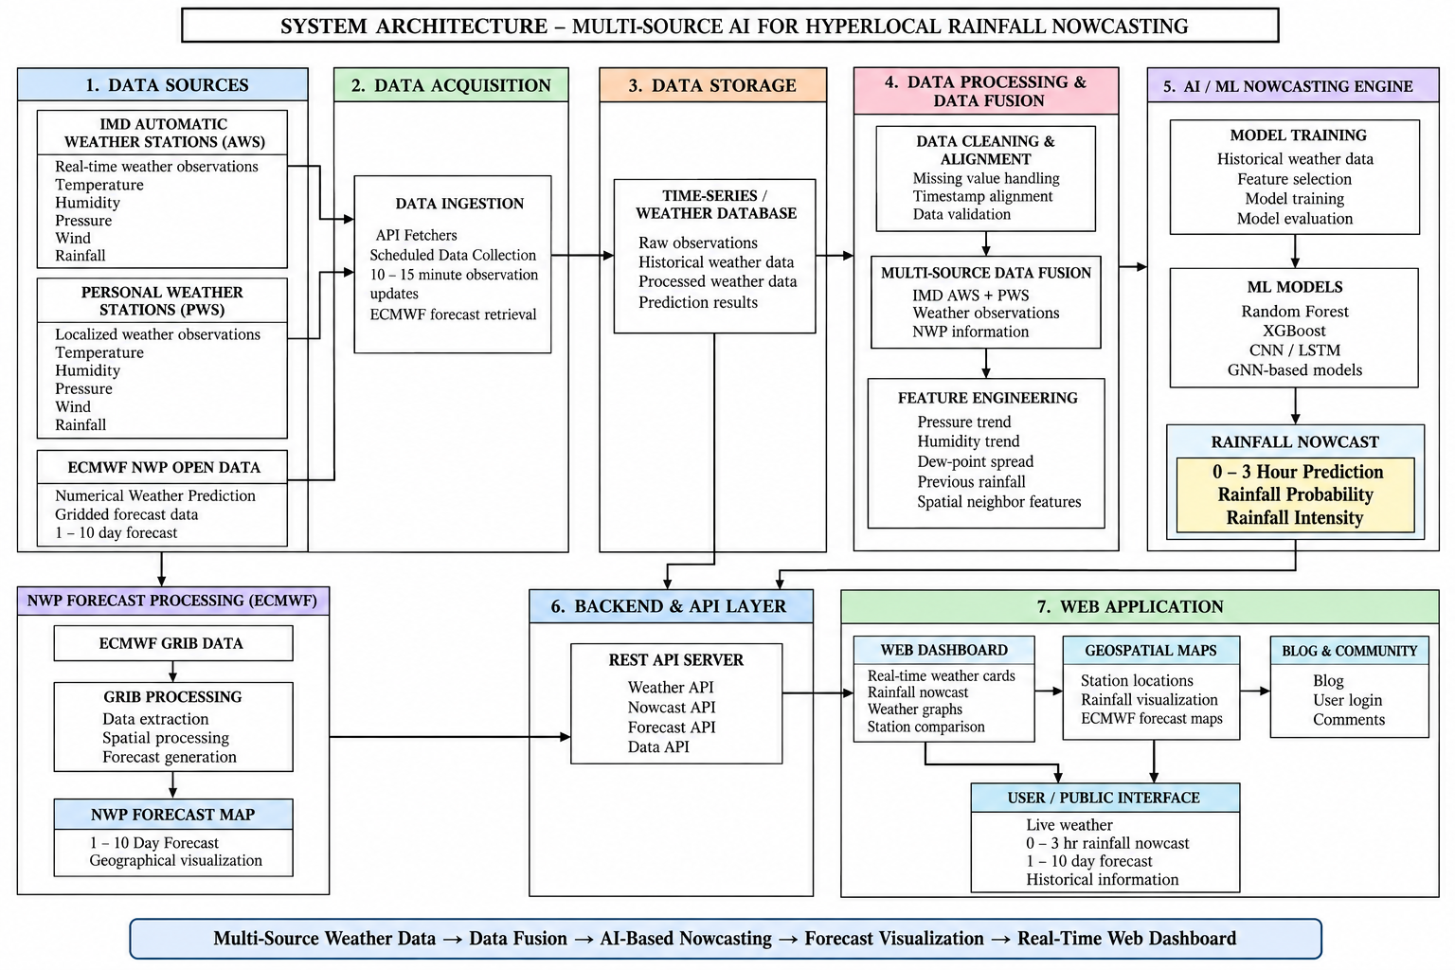
System Architecture
Parallel NWP branch joins the web map while the ML branch serves the 0–3h prediction.
Notes:
The main pipeline moves from data sources through ingestion, storage, processing and APIs into the web application. ECMWF follows a parallel geospatial branch: GRIB2 is decoded with cfgrib/xarray, converted to GeoTIFF and rendered as Leaflet layers.

Slide 7
Module 1: Data Acquisition & Storage
• APScheduler triggers the ingestion workflow at a 60-second interval.
• Three adapter concepts normalize station-provider responses into one internal schema.
• Current Phase 1 includes six live PWS stations in Puducherry/Auroville through Weather Underground API.
• Deduplication prevents repeated readings from producing duplicate database records.
• A 48-hour backfill mechanism supports recovery after service interruption or deployment restart.
• SQLAlchemy async ORM supports the development SQLite database and production PostgreSQL path.
DATABASE TABLES
Station
metadata + coordinates
WeatherReading
timestamped observations
NowcastPrediction
future rainfall predictions
BlogPost
content / publishing
Notes:
Module 1 establishes reliable data collection. The scheduler, provider adapters, deduplication and backfill logic are important because the machine-learning stage is only as reliable as the time series entering it.

Slide 8
Module 2: Data Processing & Feature Engineering
pressure_drop_rate
humidity_delta
Rate of pressure change over time; can capture rapidly evolving atmospheric conditions.
Short-term humidity change used as a signal of evolving moisture conditions.
dew_point_spread
spatial neighbor features
Difference between temperature and dew point, representing near-surface moisture state.
Nearby-station rainfall / weather context helps represent spatial structure around a target station.
Raw readings → cleaning → timestamp alignment → missing-value handling → engineered features → model-ready sequences
Notes:
Feature engineering converts raw weather readings into signals that a model can learn from. We start with pressure change, humidity change, dew-point spread and spatial neighbor information, then create time-aligned sequences for model training.

Slide 9
Module 3: AI/ML Nowcasting Engine (Phase 2)
BASELINE
TEMPORAL
SPATIOTEMPORAL
OUTPUT
Random Forest
XGBoost
LSTM
CNN / GNN-LSTM
0–3h rainfall
• Training data: historical, time-aligned station observations with rainfall targets.
• Split chronologically into training, validation and test periods to reduce temporal leakage.
• Compare models using rainfall-appropriate metrics such as MAE/RMSE and event metrics such as precision, recall and F1 where thresholds are defined.
• Final model consumes recent multi-station sequences and produces rainfall estimates across the next 0–3 hours.
Phase 2 objective: select the model based on validation performance and operational usefulness.
Notes:
The ML engine will progress from interpretable tree-based baselines to temporal and spatiotemporal neural models. The comparison is important because a more complex model should only be selected if it provides meaningful improvement on unseen time periods.

Slide 10
Module 4: NWP Visualization (Phase 2)
ECMWF
GRIB2
cfgrib + xarray
rasterio
GeoTIFF
Leaflet
Open forecast data
Gridded fields
Decode / subset
Raster conversion
Web-ready layer
Interactive map
• Read forecast variables and geographic bounds relevant to Puducherry and Tamil Nadu.
• Convert model fields into raster layers that can be overlaid with station markers.
• Support multi-model / multi-run comparison or blending where compatible forecast fields are available.
• Display NWP as broader atmospheric context alongside the hyperlocal 0–3h ML nowcast.
Notes:
The NWP module does not replace the ML nowcast. It adds a spatially continuous forecast layer from ECMWF, allowing users to see the broader atmospheric pattern while the ML model focuses on the immediate local horizon.

Slide 11
Module 5: Web Application & Dashboard
NEXT.JS DASHBOARD
USER EXPERIENCE
Homepage
• Live station cards with latest observations.
• 30-second auto-refresh for near-real-time monitoring.
• Trend charts for historical temperature, humidity, pressure and rainfall-related signals.
• Responsive search and station filtering.
• Planned OAuth login using NextAuth.js + Firebase Auth.
• Planned blog CMS and commenting system.
Station Dashboard
TrendChart
Search / Filter
Forecast Scaffold
Blog Scaffold
Frontend: React + TypeScript + TailwindCSS + Recharts + Leaflet
Notes:
The dashboard is the delivery layer of the project. Phase 1 already establishes the homepage, live station dashboard, trend chart, search and filtering, while forecast, authentication and blog features are planned for the next phase.

Slide 12
Literature Survey – Part 1
Title
Authors
Year
Methodology
Key Result
Gap Identified
Convolutional LSTM Network
Shi et al.
2015
ConvLSTM
Showed convolutional recurrent modeling for precipitation nowcasting.
Need stronger long-range motion / multi-source context.
Deep Learning for Precipitation Nowcasting
Shi et al.
2017
TrajGRU / deep recurrent
Improved nonlinear motion representation over standard recurrent approaches.
Radar-centric; local station + NWP fusion remains open.
Deep Learning Based Precipitation Nowcasting using BiLSTM + 1D CNN
Selected recent literature
2021–24
BiLSTM + CNN
Combines temporal sequence learning with local feature extraction.
Limited spatial graph structure and heterogeneous station fusion.
LSTMAtU-Net for precipitation nowcasting
Selected recent literature
2023–24
LSTM + attention U-Net
Attention helps focus on important spatial-temporal features.
Often dependent on dense radar / image inputs.
ConvLSTM with wind-field information
Selected recent literature
2020–24
ConvLSTM + wind features
Wind context improves representation of precipitation movement.
Requires richer spatial observations than sparse PWS alone.
Notes:
Part 1 focuses on deep learning approaches for precipitation nowcasting. A common trend is the move from purely temporal models toward architectures that represent spatial motion and atmospheric structure.

Slide 13
Literature Survey – Part 2
Title
Authors
Year
Methodology
Key Result
Gap Identified
Two-stream ConvLSTM
Recent precipitation-nowcasting studies
2022–24
Two-stream ConvLSTM
Separates complementary spatial / temporal representations.
Data-intensive and commonly radar-based.
Spatiotemporal GNN for rainfall
Recent GNN literature
2022–25
Graph neural network
Models stations as nodes and spatial relations as edges.
Requires careful graph construction for sparse, heterogeneous stations.
ST-GRF
Recent spatiotemporal graph research
2023–25
Spatiotemporal graph + recurrent features
Captures spatial dependency and temporal evolution.
Operational deployment and regional data fusion remain challenging.
GIPMN: NWP + GNN precipitation model
Recent hybrid NWP-GNN research
2024–25
NWP + GNN
Combines physical forecast context with learned spatial relations.
Model complexity and data alignment are significant.
RF/XGBoost comparison for rainfall
Applied ML weather studies
2019–25
Tree ensembles
Strong baselines on engineered tabular weather features.
Does not fully capture sequential spatial evolution.
Notes:
Part 2 motivates our planned architecture. Tree models provide strong baselines, while GNN and hybrid NWP-learning approaches offer ways to represent spatial relationships. Our project evaluates these ideas within a practical multi-station regional pipeline.

Slide 14
Scope & Objectives
SCOPE
OBJECTIVES
• Puducherry and selected nearby Tamil Nadu locations.
• 0–3 hour rainfall nowcasting as the primary prediction horizon.
• Multi-source station observations with data quality handling.
• ML model comparison from RF/XGBoost to temporal and spatiotemporal models.
• ECMWF NWP visualization as complementary context.
• Public-facing full-stack dashboard with maps and station analytics.
• Build a reliable automated weather-data ingestion pipeline.
• Create a clean time-aligned multi-station dataset.
• Engineer physically meaningful temporal and spatial features.
• Train and compare ML nowcasting models.
• Process ECMWF forecast grids into interactive map layers.
• Deliver an integrated platform for monitoring, prediction and visualization.
Notes:
The scope is intentionally regional and focused on the immediate 0–3 hour horizon. The objectives move from reliable data engineering through modeling and geospatial delivery, so that the final system is an end-to-end engineering project rather than only a model.

Slide 15
Technology Stack
Component
Technology
Frontend
Next.js 16 · React 19 · TypeScript · TailwindCSS v4 · Recharts · Leaflet
Backend
FastAPI · Uvicorn · APScheduler · Pydantic · HTTPX
Database
SQLAlchemy Async ORM · SQLite (development) · PostgreSQL (production)
ML / Data
Python · Pandas · NumPy · scikit-learn · XGBoost · PyTorch
NWP / Geo
xarray · cfgrib · rasterio · Matplotlib · Cartopy · GeoTIFF
Authentication
NextAuth.js · Firebase Auth · Google/Facebook OAuth
Deployment
Docker · Vercel · Azure · GitHub Actions
Notes:
The stack separates the system into clear responsibilities. Next.js provides the interface, FastAPI exposes services, SQLAlchemy handles persistence, Python libraries support ML and NWP processing, and Docker plus cloud deployment tools support productionization.

Slide 16
Conclusion & Future Work
CURRENT PHASE 1 STATUS
FUTURE WORK · PHASE 2
• FastAPI backend operational with scheduled ingestion.
• Six live PWS stations integrated for Puducherry/Auroville.
• Core API endpoints implemented.
• SQLAlchemy async database schema established.
• Next.js dashboard with auto-refresh, charts and station search/filter.
• Initial feature engineering pipeline established.
• Train and evaluate RF, XGBoost, LSTM and CNN/GNN-LSTM models.
• Expand and validate multi-station training data.
• Add ECMWF GRIB2 → GeoTIFF processing.
• Build interactive NWP + station overlay maps.
• Implement authentication and blog CMS.
• Containerize and deploy the complete production pipeline.
Notes:
Phase 1 establishes the engineering foundation: live data ingestion, storage, APIs and dashboard. Phase 2 concentrates on the scientific contribution—model training and evaluation—while also completing NWP visualization and the production web experience.

Slide 17
References
[1] Shi, X., Chen, Z., Wang, H., Yeung, D.-Y., Wong, W.-K., & Woo, W.-c. (2015). Convolutional LSTM Network: A Machine Learning Approach for Precipitation Nowcasting.
[2] Shi, X., Gao, Z., Lausen, L., et al. (2017). Deep Learning for Precipitation Nowcasting: A Benchmark and a New Model. NeurIPS.
[3] Ravuri, S., Lenc, K., Willson, M., et al. (2021). Skilful precipitation nowcasting using deep generative models of radar. Nature, 597, 672–677.
[4] Bowler, N. E., Pierce, C. E., & Seed, A. W. (2006). STEPS: A probabilistic precipitation forecasting scheme which merges an extrapolation nowcast with downscaled NWP. QJRMS, 132, 2127–2155.
[5] ECMWF. Open Data: Real-time IFS and AIFS forecast products and documentation.
[6] Weather Underground. Personal Weather Station API / network documentation.
[7] Ambient Weather. Ambient Weather Network and API documentation.
[8] Leaflet.js Documentation. Interactive maps and geospatial layers.
[9] FastAPI Documentation. Modern Python API framework.
[10] xarray, cfgrib and rasterio documentation for multidimensional and raster meteorological data processing.
Notes:
These references provide the foundation for both the scientific and engineering parts of the project. The literature will be expanded and cited in the final report as the Phase 2 model experiments are completed.

