Slide 1

MULTI-SOURCE AI FOR HYPERLOCAL RAINFALL NOWCASTING
ACTUAL IMPLEMENTATION · CODE ARCHITECTURE · LIVE DATA · DASHBOARD
Bharath B (23UCS025) · Ariyan M (23UCS015) · Hemnnath G (23UCS066)
IV Year CSE
Guide: Mrs. N. Danapaquiame, Professor & HOD, CSE
Sri Manakula Vinayagar Engineering College
Notes:
This review focuses on what has actually been implemented in Phase 1. We will demonstrate the backend ingestion system, database, feature engineering and live dashboard, followed by the planned ML and NWP modules.

Slide 2
Abstract
The project implements a hyperlocal rainfall intelligence platform for Puducherry and Tamil Nadu, targeting a future 0–3 hour nowcasting layer. Phase 1 establishes the data and application foundation required for reliable model development.
Live weather observations are collected through modular adapters. The current implementation integrates six real Personal Weather Stations in Puducherry/Auroville and supports Open-Meteo live/backfill ingestion, while the IMD adapter is prepared as a stub.
An asynchronous FastAPI backend, APScheduler and SQLAlchemy manage scheduled ingestion, deduplication, 48-hour startup backfill and persistent storage in SQLite. REST endpoints expose overview, station and reading data to the frontend.
The ML pipeline already contains domain-driven feature engineering for dew-point spread, pressure-drop rate and humidity change. These features form the input foundation for the planned RF/XGBoost, LSTM and CNN/GNN-LSTM nowcasting experiments.
A Next.js dashboard provides 30-second auto-refresh, live station cards, 24-hour Recharts trends, search and source filtering. Phase 2 will add the trained nowcasting engine, ECMWF NWP raster maps, authentication and community features.
Notes:
Phase 1 is primarily an engineering foundation. We have moved from a conceptual design to a running backend, real station ingestion, persistent data, engineered features and a live web dashboard.

Slide 3
Problem Statement
01
Fragmented weather observations
02
Immediate 0–3h prediction gap
Official and personal stations are distributed across different sources and APIs.
Users can observe current weather or access broader forecasts, but the project targets a unified hyperlocal nowcast window.
03
Heterogeneous time-series data
04
Separated user experience
Different timestamps, sampling intervals, missing values and sensor characteristics must be normalized before ML.
Live observations, model predictions and NWP maps are often consumed through different interfaces.
Notes:
The engineering challenge is integration: reliable collection, normalization and storage must come before useful prediction. The final platform is intended to bring observation, prediction and geospatial forecast context together.

Slide 4
Existing Systems & Limitations
System
What it offers
Limitation
IMD Mausam
Official observations, forecasts and warnings
General public service; not our custom station-fusion ML workflow
Windy
Interactive multi-model weather maps
Model-centric; project focuses on regional station fusion and 0–3h ML
RainViewer
Radar precipitation visualization
Depends on radar coverage; different from our station-based pipeline
ChennaiRains.com
Regional rainfall analysis and forecast discussion
Provides regional context; our implementation is an end-to-end reproducible data pipeline
Ambient Weather Network
PWS observations and network visualization
Observation-focused; no project-specific ML nowcast engine
Notes:
We are not claiming these systems are inadequate. They solve different parts of the weather-information problem. Our engineering contribution is a unified workflow tailored to a regional hyperlocal nowcasting use case.

Slide 5
Proposed System
1 · OBSERVATION
2 · INTELLIGENCE
3 · NWP CONTEXT
IMD AWS + 6 PWS
Open-Meteo + provider adapters
Feature engineering
RF/XGBoost → LSTM → CNN/GNN-LSTM
ECMWF GRIB2
cfgrib/xarray → GeoTIFF
60s scheduler · backfill · dedup
0–3h rainfall nowcast
Interactive regional maps
WEB DASHBOARD
Live station cards · 30s refresh · TrendChart · search/filter · future nowcast · future NWP layers
Notes:
The proposed system is layered so each concern is testable independently. Phase 1 has implemented the observation and web foundation, while the ML and NWP intelligence layers are the main Phase 2 development targets.

Slide 6
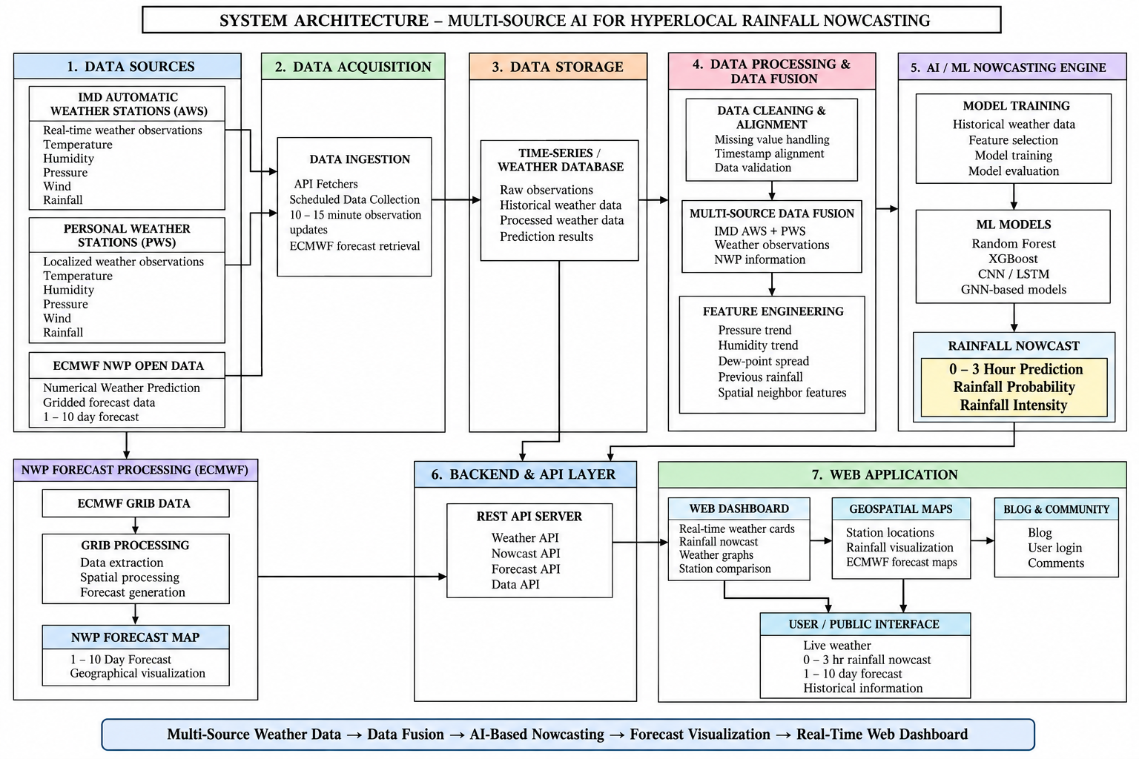
System Architecture
Notes:
This architecture reflects the actual Phase 1 implementation. The backend runs scheduled adapters, persists data through SQLAlchemy and exposes REST APIs. The Next.js frontend consumes those APIs. ML and ECMWF branches are shown as planned extensions.

Slide 7
Implementation: Module 1 – Data Acquisition & Storage
• FastAPI application runs at localhost:8000; Swagger documentation is available at /docs.
• AsyncIOScheduler triggers ingestion every 30 seconds.
• Adapters: OpenMeteoAdapter (live + 48h backfill), AmbientWeatherAdapter (6 real PWS), IMDAdapter (stub).
• 48-hour historical backfill executes on every backend startup.
• _reading_exists() checks station + timestamp before every insert.
• SQLite weather.db currently contains approximately 368 KB of real data.
API ENDPOINTS
Endpoint
Purpose
/api/overview
Aggregate dashboard stats
/api/stations
Station list + metadata
/api/stations/{id}/readings
Readings up to 7 days
/api/readings/latest
Latest readings
DATABASE SCHEMA
Station
WeatherReading
NowcastPrediction
BlogPost
Notes:
This is the most complete backend module. The scheduler runs every 60 seconds, adapters normalize provider data, startup backfill protects continuity, and database constraints plus an explicit existence check prevent duplicate readings. The two screenshots should demonstrate the live API rather than mock data.

Slide 8
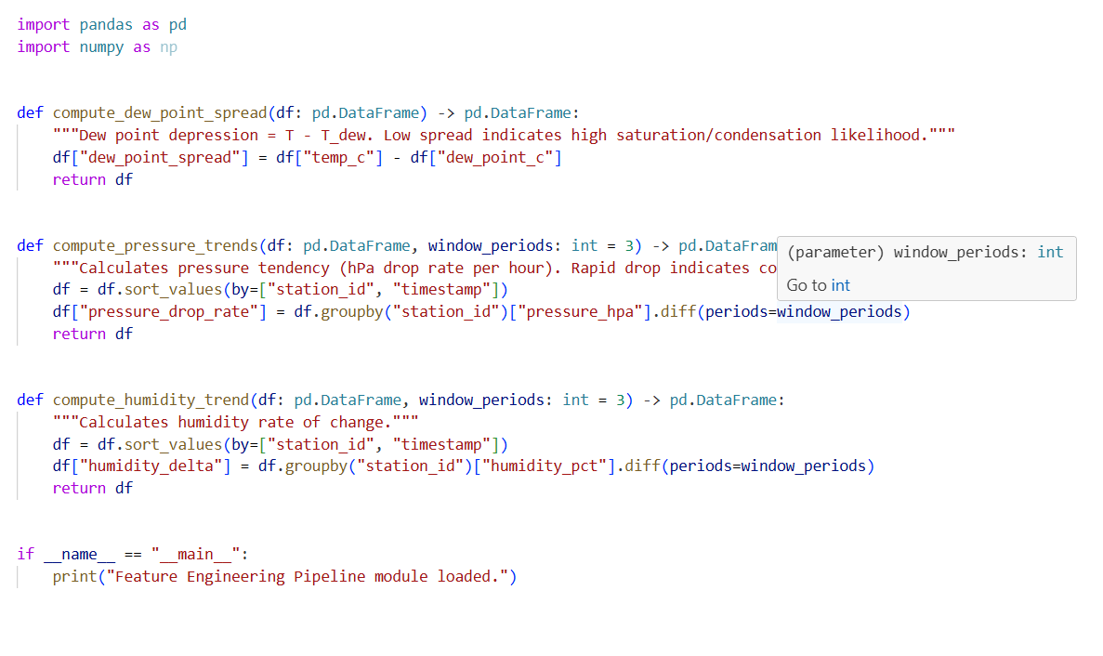
Implementation: Module 2 – Feature Engineering
IMPLEMENTED FEATURES
CODE / PIPELINE
dew_point_spread
temp_c − dew_point_c
[CODE: ml-pipeline/src/feature_engineering.py]
compute_dew_point_spread()
compute_pressure_trends()
compute_humidity_trend()
Pipeline: raw readings → station grouping → temporal differences → model-ready features
Near-surface moisture / saturation signal
pressure_drop_rate
groupby(station_id).diff(3)
Short-term pressure tendency
humidity_delta
groupby(station_id).diff(3)
Short-term moisture evolution
spatial neighbors
nearby station features
Represents local spatial context
Notes:
The feature engineering module is already implemented. The three primary engineered signals capture moisture state and atmospheric tendency, while spatial neighbor features are intended to represent local variation. These are designed as model inputs, not as standalone rainfall rules.

Slide 9
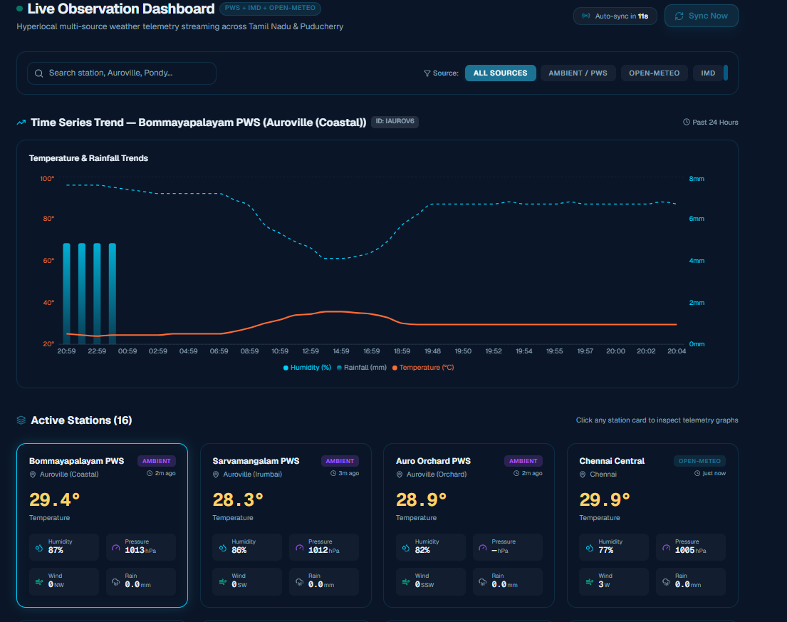
Implementation: Frontend Dashboard
COMPONENT TREE
AUTO-REFRESH LOGIC
scheduler.add_job(
run_ingestion,
trigger=IntervalTrigger(seconds=settings.INGESTION_INTERVAL_SECONDS),
id="weather_ingestion",
name="Weather Data Ingestion",
replace_existing=True,
)
scheduler.start()
logger.info(f" High-frequency ingestion scheduled every {settings.INGESTION_INTERVAL_SECONDS} seconds")
scheduler.shutdown(wait=False)
logger.info("🛑 Scheduler stopped. Backend shutting down.")
HeroWeather
StationCard × N
TrendChart (Recharts)
SCREENSHOT PLACEHOLDERS
Search + Source Filter
30s Countdown Refresh
[SCREENSHOT: Dashboard with live StationCards]
[SCREENSHOT: 24hr TrendChart]
[SCREENSHOT: Homepage with 3-layer section]
Notes:
The frontend is also operational. HeroWeather displays aggregate statistics, StationCard shows the latest weather values, and TrendChart provides a 24-hour view. The dashboard automatically refreshes every 30 seconds and supports search and source filtering.

Slide 10
Module 3: AI/ML Nowcasting Engine – Phase 2
Baseline
Temporal
Target
Random Forest
XGBoost
LSTM
CNN/GNN-LSTM
• Training sequence: historical station readings + engineered features → chronological train/validation/test split.
• Compare RF/XGBoost tabular baselines before increasing model complexity.
• LSTM learns temporal dependencies; CNN/GNN-LSTM is intended to capture spatial station relationships plus temporal evolution.
• Output target: rainfall prediction for future intervals within the 0–3 hour horizon.
• Evaluation will include MAE/RMSE plus event-based precision/recall/F1 where thresholds are defined.
Notes:
The ML engine is Phase 2, not a completed Phase 1 module. We will establish RF and XGBoost baselines first, then test temporal and spatiotemporal neural architectures. This staged approach lets us quantify whether complexity produces meaningful improvement.

Slide 11
Module 4: NWP Processing & Interactive Map – Phase 2
ECMWF
GRIB2
cfgrib + xarray
rasterio
GeoTIFF
Leaflet
Forecast fields
Download / parse
Subset / transform
Rasterize
Map layer
Interactive map
• Process regional ECMWF grids relevant to Puducherry/Tamil Nadu.
• Convert forecast variables into web-renderable raster layers.
• Overlay PWS station locations and values on the map.
• Explore compatible multi-model / multi-run blending as a future enhancement.
• Present NWP as broader-scale context beside the 0–3h ML nowcast.
Notes:
The NWP module will turn gridded ECMWF forecast data into interactive geospatial layers. The key engineering step is converting GRIB2 fields into a raster representation that can be efficiently displayed together with station observations.

Slide 12
Module 5: Blog, Auth & Community – Phase 2
Authentication
Blog CMS
Community
NextAuth.js + Firebase Auth
Google/Facebook OAuth
BlogPost table
create/edit/publish workflow
Comments, moderation
future user feedback loop
• Authentication will protect user-specific features and administration.
• Blog content can communicate rainfall events, analysis and project updates.
• Commenting creates a community layer, with moderation planned before public release.
• Future possibility: use verified user feedback as an additional qualitative signal, without treating comments as sensor measurements.
Notes:
These features are planned for Phase 2. The database already includes a BlogPost table, while authentication and community interaction are still to be implemented and secured before deployment.

Slide 13
Progress Tracker
Workstream
Current state
Status
Data acquisition
60s scheduler, adapters, 6 PWS, backfill
COMPLETED
Database
SQLite schema + deduplication + REST reads
COMPLETED
Feature engineering
3 core features + pipeline file
COMPLETED
Frontend dashboard
Cards, charts, filters, 30s refresh
COMPLETED
ML baselines
RF / XGBoost training + evaluation
PLANNED
Deep learning
LSTM / CNN/GNN-LSTM
PLANNED
ECMWF NWP
GRIB2 → GeoTIFF → Leaflet
PLANNED
Auth / Blog / Community
OAuth + CMS + comments
PLANNED
Production deployment
Docker + cloud CI/CD
PLANNED
Notes:
This slide separates implemented work from planned work. For the review, the completed modules are the evidence of Phase 1 progress, while the remaining items define the Phase 2 execution roadmap.

Slide 14
Literature Survey – Part 1
Paper
Authors
Year
Method
Key Result
Gap for Project
ConvLSTM Network
Shi et al.
2015
ConvLSTM
Spatial convolutions inside recurrent units for precipitation nowcasting.
Our sparse station setting requires different spatial representation.
Deep Learning for Precipitation Nowcasting
Shi et al.
2017
TrajGRU / recurrent
Learned nonlinear motion improves precipitation sequence prediction.
Primarily radar-image based.
Skilful Precipitation Nowcasting
Ravuri et al.
2021
Deep generative model
Strong radar-based short-range precipitation nowcasting.
Data and compute requirements differ from PWS fusion.
BiLSTM + CNN rainfall studies
Recent studies
2021–24
CNN + BiLSTM
Combines local feature extraction with temporal dependencies.
Often lacks heterogeneous station + NWP integration.
LSTMAtU-Net / attention nowcasting
Recent studies
2023–24
LSTM + attention U-Net
Attention focuses model capacity on important spatial-temporal features.
Typically requires dense gridded/radar inputs.
Notes:
The first literature group establishes the evolution from ConvLSTM to modern deep nowcasting. The important gap for our project is not simply model novelty; it is adapting spatiotemporal ideas to heterogeneous local station data.

Slide 15
Literature Survey – Part 2
Paper
Authors
Year
Method
Key Result
Gap for Project
Two-stream ConvLSTM
Recent studies
2022–24
Two-stream recurrent
Separates complementary temporal/spatial representations.
High data dependency.
Spatiotemporal GNN rainfall
Recent GNN studies
2022–25
Graph neural network
Represents stations as nodes and spatial relations as edges.
Graph design required for sparse PWS.
ST-GRF
Recent research
2023
Spatiotemporal graph
Models spatial and temporal dependencies jointly.
Operational regional integration remains open.
GIPMN / NWP + GNN
Recent hybrid studies
2024–25
NWP + GNN
Combines physics-based forecast context with learned spatial relations.
Alignment and computational complexity.
RF/XGBoost rainfall comparison
Applied weather ML
2019–25
Tree ensembles
Strong baselines on engineered tabular weather data.
Limited sequential spatial learning.
Notes:
The second group motivates our model progression. Tree models are practical baselines, while GNNs can represent relationships among stations. Hybrid NWP-learning approaches motivate keeping ECMWF as a parallel contextual source.

Slide 16
Scope & Objectives
PHASE 1 SCOPE
PROJECT OBJECTIVES
• Puducherry + nearby Tamil Nadu region.
• Six live PWS stations currently integrated.
• 30-second ingestion and 48-hour startup backfill.
• Persistent weather time series in SQLite.
• Domain-based feature engineering.
• Live monitoring dashboard with 30-second refresh.
• Create a reliable multi-source weather ingestion pipeline.
• Prepare clean time-aligned data for ML.
• Develop and compare 0–3h rainfall nowcasting models.
• Add ECMWF NWP visualization as broader context.
• Deliver a unified interactive regional dashboard.
• Evaluate the system on realistic unseen time periods.
Notes:
The Phase 1 scope is already demonstrable. The broader project objectives continue into Phase 2, especially model training, NWP processing and evaluation.

Slide 17
Technology Stack
Component
Technology
Frontend
Next.js 16 · React 19 · TypeScript · TailwindCSS v4 · Recharts · Leaflet
Backend
FastAPI · Uvicorn · APScheduler AsyncIOScheduler · Pydantic · HTTPX
Database
SQLAlchemy Async ORM · SQLite development · PostgreSQL production
ML
Python · Pandas · NumPy · scikit-learn · XGBoost · PyTorch
NWP / Geo
xarray · cfgrib · rasterio · Matplotlib · Cartopy · GeoTIFF
Auth
NextAuth.js · Firebase Auth
Deployment
Docker · Vercel · Azure · GitHub Actions
Notes:
The technology stack is intentionally modular. Python handles data and ML, FastAPI exposes services, SQLAlchemy manages persistence, Next.js provides the user interface, and the geospatial stack will process ECMWF data in Phase 2.

Slide 18
Conclusion & Future Work
PHASE 1 ACHIEVEMENTS
PHASE 2 PRIORITIES
• Running FastAPI backend with Swagger documentation.
• Automated 60-second multi-source ingestion.
• Six real PWS stations integrated.
• 48-hour backfill + deduplication implemented.
• SQLite database with real weather data.
• Feature engineering module implemented.
• Live dashboard with charts, filters and auto-refresh.
• Train RF/XGBoost baselines.
• Develop LSTM and CNN/GNN-LSTM experiments.
• Validate 0–3h prediction performance.
• Implement ECMWF GRIB2 → GeoTIFF pipeline.
• Build interactive NWP + station map.
• Add authentication, blog and community features.
• Deploy production system with monitoring.
Notes:
Phase 1 has converted the original concept into a working data and visualization platform. Phase 2 will add the core predictive intelligence and geospatial NWP layer, followed by authentication, community features and production deployment.

Slide 19
References
[1] Shi, X., Chen, Z., Wang, H., Yeung, D.-Y., Wong, W.-K., & Woo, W.-c. (2015). Convolutional LSTM Network: A Machine Learning Approach for Precipitation Nowcasting.
[2] Shi, X., Gao, Z., Lausen, L., et al. (2017). Deep Learning for Precipitation Nowcasting: A Benchmark and a New Model. NeurIPS.
[3] Ravuri, S., Lenc, K., Willson, M., et al. (2021). Skilful precipitation nowcasting using deep generative models of radar. Nature, 597, 672–677.
[4] Bowler, N. E., Pierce, C. E., & Seed, A. W. (2006). STEPS: Probabilistic precipitation forecasting combining extrapolation nowcast with downscaled NWP. QJRMS.
[5] ECMWF. Open Data: Real-time IFS and AIFS forecast products and documentation.
[6] Weather Underground. Personal Weather Station network / API documentation.
[7] Ambient Weather. Ambient Weather Network / API documentation.
[8] Leaflet.js Documentation. Interactive maps and geographic layers.
[9] FastAPI Documentation. Python API framework and OpenAPI/Swagger integration.
[10] xarray, cfgrib and rasterio documentation for multidimensional meteorological and raster data processing.
Notes:
These references cover the scientific foundation of precipitation nowcasting and the operational/software components used in the project. The final report will expand the literature review and include exact URLs, DOIs and access dates where applicable.

