Slide 1

Bharath chittibomma
PROJECT

Slide 2
HIDING A TEXT INSIDE AN IMAGE USING STEGANOGRAPHY
In an age where information security is paramount, techniques like steganography play a crucial role in safeguarding
sensitive data. Steganography is the art and science of concealing information within other non-suspicious data, such
as images, audio files, or even text, without arousing suspicion. Unlike cryptography, which focuses on encrypting data
to make it unreadable, steganography aims to hide the existence of the message itself.
In this project, we explore the application of steganography specifically in the realm of digital images. The primary
goal is to embed textual information covertly within an image file, making it imperceptible to the human eye and
difficult to detect without the appropriate tools. This process involves encoding the text into the pixels of the image in
such a way that the image appears unchanged to casual inspection but can be decoded to retrieve the hidden message.

Slide 3
Agenda for Steganography Project: Hiding Text Inside an Image
Project overview
Software and tools selection
Who are the end users of this project?
Your solution and its value proposition
How did you customize the project and make it your own
Modelling
Results
links

Slide 4
Project overview
Steganography is the art and science of concealing information within other non-secret data (such as images, audio files, or text) to avoid detection. This project aims to explore various techniques and applications of steganography, emphasizing practical implementation and theoretical understanding.
Key objectives:
Understanding Steganography Fundamentals
Implementing Steganographic Techniques
Developing a Steganographic Tool
Security and Detection
Applications and Ethical Considerations
Deliverables:
A detailed report documenting the project's objectives, methodologies, and findings.
Source code of the steganographic tool developed during the project.
Demonstration videos or screenshots showcasing the tool's functionality.
Conclusion:
This project on steganography aims to provide a comprehensive exploration of both the
theoretical foundations and
practical implementations of hiding data within digital media.

Slide 5


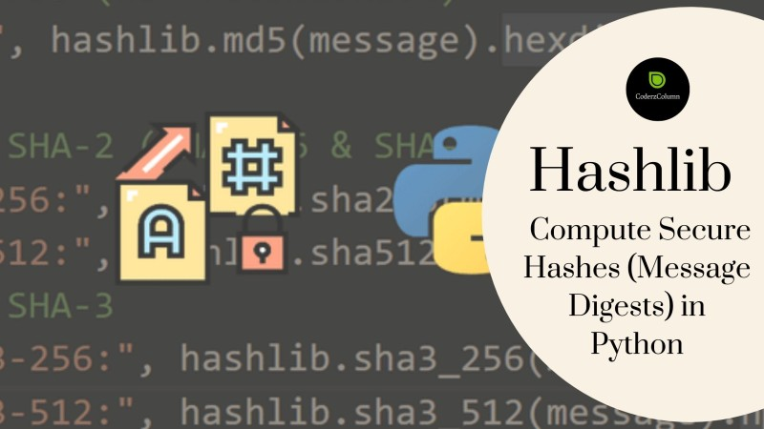
Software and tools selection
Choose programming languages and libraries (Python, OpenCV, HashLib) suitable for implementation.
Install necessary software and tools for development and testing.

Slide 6
Who are the end users of this project?
General Users: Everyday individuals who use steganography tools to hide sensitive information
within digital media (like images, audio files, or videos) for privacy or security reasons.
Law Enforcement and Intelligence Agencies: These entities may use steganography detection
tools to uncover hidden messages or data during investigations.
Military Personnel: Military applications may involve embedding secret messages in images or
other media for secure communication.
Security Experts: Cybersecurity professionals might utilize steganography tools to test network
defenses or to secure data transmission.

Slide 7
Your solution and its value proposition
Steganography Techniques: Implementation of various steganographic techniques such as LSB (Least Significant Bit) embedding in images, hiding text in audio files through frequency manipulation, or embedding data in the whitespace of text files.
Encryption: Often, steganography is combined with encryption to ensure that the hidden information remains secure even if discovered.
Detection and Analysis Tools: Development of tools to detect steganographic content within media files, which can involve statistical analysis, anomaly detection, or visual inspection techniques.
VALUE PROPOSITION
Flexibility and Versatility: Can be applied across various digital media types (images, audio,
video, text), offering flexibility in how information is concealed and transmitted.
Forensic Applications: Tools for detecting steganographic content can aid forensic investigations,
providing insights into hidden communication or digital manipulation.
Research and Development: Supports ongoing research into new techniques and advancements
in steganography, contributing to the field of information security and cryptography.

Slide 8
How did you customize the project and make it your own
Algorithm selection and modification:
The choice of steganographic algorithm was carefully considered based on its suitability for embedding data within various media types.
USER INTERFACE DESIGN:
The user interface (UI) was customized to ensure ease of use and intuitive interaction.
INTEGRATION OF ADDITIONAL FEATURES:
Additional functionalities were integrated to extend the utility of the application beyond basic steganographic operations.
TESTING AND VALIDATION PROCEDURES:
Rigorous testing procedures were customized to validate the accuracy and reliability of the steganographic techniques employed.
DOCUMENTATION AND REPORTING:
Detailed documentation was customized to provide comprehensive insights into the project’s development process.

Slide 9
MODELLING
Data Model: This involves defining how data will be represented and manipulated within the steganography
system. It includes decisions on data formats (text, binary, etc.), encoding schemes, and how data will be structured
for embedding and extraction.
Embedding Model: This specifies the technique or algorithm used to embed hidden data into a cover media
(such as an image or audio file). Modeling here involves determining how to modify the carrier file to embed the
hidden information while minimizing perceptible changes and maintaining cover media integrity.
Extraction Model: This defines the method for extracting hidden data from the carrier media. Modeling the extraction
process ensures that the embedded information can be accurately retrieved, even after potential alterations to the carrier file.

Slide 10

results
Normal image
Download any sample image from google
or any other websites.
ENCRYPTED IMAGE
After hiding the text in the image the image will be became as
Above image is normal image.
We can choose the image on which we want to do the encryption
We can see there is no difference in both the normal and encrypted images

Slide 11
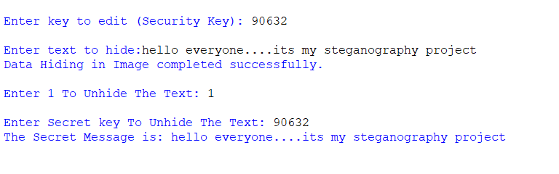
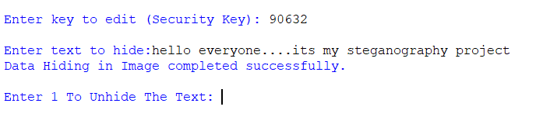
We can protect our text inside the image by keeping an secure password.
By entering the password we can get the text hided inside the pic
In above image we can see the secret message
(hello everyone….its my steganography project) that had to be hided inside the image.
And also a password to protect our text.
By entering the password we can
get the text hided inside the image

Slide 12
PROJECT LINKS

