Slide 1



WATERFALL MODEL

Slide 2
What is Waterfall Model
Waterfall approach was first SDLC Model to be used widely in Software Engineering to ensure success of the project. It is also referred to as a linear-sequential life cycle model.
In this Waterfall model, typically, the outcome of one phase acts as the input for the next phase sequentially.
It was introduced in 1970 by Winston Royce.

Slide 3
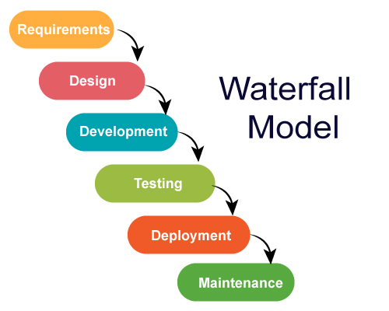
Different Phases of Waterfall Model

Slide 4
When To Go For Waterfall Model
This model is used only when the requirements are very well known, clear and fixed.
The project is short.
The tools and techniques used is stable.

Slide 5
Advantages of Waterfall Model
Simple and Easy To Understand and Use.
Before the next phase of development, each phase must be completed.
Suited for smaller projects.
This model is less costly compared to others

Slide 6
Disadvantages Of Waterfall Model
Changes in Requirement are not Allowed
Back Tracking is Not Possible
There is less Frequent Interaction Between Customers And Company

Slide 7
Conclusion:
In the waterfall model, it is very important to take the sign off of the deliverables of each phase. As of today most of the projects are moving with Agile and Prototype models, Waterfall model still holds good for smaller projects. If requirements are straightforward and testable, Waterfall model will yield the best results.

Slide 8
Thank you..!

