Slide 1
HYPERCUBE ALGORITHMS : ODD–EVEN MERGE ALGORITHM
NAME: BHARATH GOWDA B
USN: 1BI19CS038
SECTION: 4TH A

Slide 2
Introduction to the Algorithm
Odd-Even Mergesort:
The odd-even mergesort algorithm was developed by K.E. Batcher. It is based on a merge algorithm that merges two sorted halves of a sequence to a completely sorted sequence.
In contrast to mergesort, this algorithm is not data-dependent, i.e. the same comparisons are performed regardless of the actual data. Therefore, odd-even mergesort can be implemented as a sorting network

Slide 3
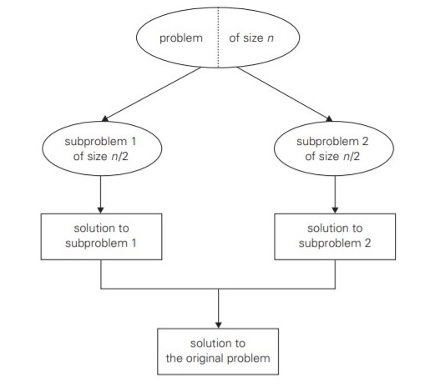
Designing Technique
Odd-EvenMergesort is one of the application of Divide and Conquer Technique. Where the problem is divided into sub problems and find their respective solution. Later combine these solutions to get solution of main problem.

Slide 4
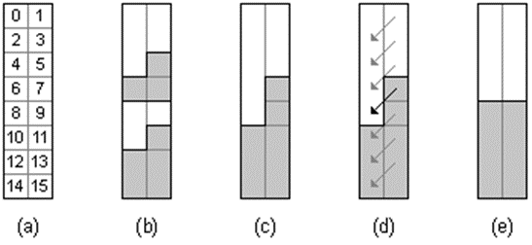
PROOF
The correctness of the merge algorithm is proved using induction and the 0-1-principle.
If n = 2¹ the sequence is sorted by the comparison [0 : 1]. So let n = 2^{k}, k > 1 and assume the algorithm is correct for all smaller k (induction hypothesis).
Consider the 0-1-sequence a = a₀, ..., a_{n-1} to be arranged in rows of an array with two columns. The corresponding mapping of the index positions is shown in Figure (a), here for n = 16.
Then Figure (b) shows a possible situation with a 0-1-sequence.
Each of its two sorted halves starts with some 0's (white) and ends with some 1's (gray).
In the left column the even subsequence is found, i.e. all a_{i} with i even, namely a₀, a₂, a₄ etc.; in the right column the odd subsequence is found, i.e. all a_{i} with i odd, namely a₁, a₃, a₅ etc. Just like the original sequence the even as well as the odd subsequence consists of two sorted halves.
By induction hypothesis, the left and the right column are sorted by recursive application of odd-even merge(n/2) in step 1 of the algorithm. The right column can have at most two more 1's than the left column (Figure (c)).
After performing the comparisons of step 2 of the algorithm (Figure (d)), in each case the array is sorted (Figure (e)

Slide 5
Algorithm
Algorithm: Odd-Even Merge(n)
Input: | Sequence a₀, ..., a_{n-1} of length n>1 whose two halves a₀, ..., a_{n/2-1} and a_{n/2}, ..., a_{n-1} are sorted (n a power of 2)
Output: | the sorted sequence
Method: | if n>2 then apply odd-even merge(n/2) recursively to the even subsequence a₀, a₂, ..., a_{n-2} and to the odd subsequence a₁, a₃, , ..., a_{n-1} comparison [i : i+1] for all i {1, 3, 5, 7, ..., n-3} else comparison [0 : 1]

Slide 6
Algorithm
Algorithm : Odd-Even Mergesort(n)
Input: | sequence a₀, ..., a_{n-1} (n a power of 2)
Output: | the sorted sequence
Method: | if n>1 then apply odd-even mergesort(n/2) recursively to the two halves a₀, ..., a_{n/2-1} and a_{n/2}, ..., a_{n-1} of the sequence odd-even merge(n)

Slide 7
Implementation
An implementation of odd-even mergesort in Java is given in the following. The algorithm is encapsulated in a class OddEvenMergeSorter. Its method sort passes the array to be sorted to array a and calls function oddEvenMergeSort.
Function oddEvenMergeSort recursively sorts the two halves of the array. Then it merges the two halves with oddEvenMerge.
Function oddEvenMerge picks every 2r-th element starting from position lo and lo+r, respectively, thus forming the even and the odd subsequence. According to the recursion depth r is 1, 2, 4, 8, ....
With the statements
Sorter s=new OddEvenMergeSorter();
s.sort(b);
an object of type OddEvenMergeSorter is created and its method sort is called in order to sort array a. The length n of the array must be a power of 2.

Slide 8
JAVA PROGRAM
import java.util.Arrays;
import java.util.Scanner;
interface Sorter
{
void sort(int[] a);
}
public class OddEvenMergesort {
static int[] a ;
public static void main(String[] args)
{
Scanner input = new Scanner(System.in);

Slide 9
System.out.print("Enter Max array size in powers of 2 (i.e 2, 4, 8, 16...) : ");
int n = input.nextInt();
a = new int[n];
System.out.println("Enter the array elements : ");
for(int i=0 ; i <n ;i++)
{
a[i] = input.nextInt();
}
Sorter s = new OddEvenMergeSorter();
s.sort(a);
System.out.println("Sorted Array :");
for(int i = 0;i<n;i++)
System.out.print(a[i]+ " ");
input.close();
}
}

Slide 10
class OddEvenMergeSorter implements Sorter
{
private int[] a;
public void sort(int[] a)
{
this.a=a;
oddEvenMergeSort(0, a.length);
}
/* sorts a piece of length n of the array starting at position low */
private void oddEvenMergeSort(int low, int n)
{
if (n>1)
{
int m=n/2;
oddEvenMergeSort(low, m);
oddEvenMergeSort(low+m, m);
oddEvenMerge(low, n, 1);
}
}

Slide 11
/* * low is the starting position and ‘n’ is the length of the piece to be merged, ‘r’ is the distance of
the elements to be compared */
private void oddEvenMerge(int low, int n, int r)
{
int m=r*2;
if (m<n)
{
oddEvenMerge(low, n, m); // even subsequence
oddEvenMerge(low+r, n, m); // odd subsequence
for (int i=low+r; i+r<low+n; i+=m)
compare(i, i+r);
}
else
compare(low, low+r);
}

Slide 12
private void compare(int i, int j)
{
if (a[i]>a[j])
exchange(i, j);
}
private void exchange(int i, int j)
{
int t=a[i];
a[i]=a[j];
a[j]=t;
}
} //End of OddEvenMergesorter class

Slide 13
Time Analysis
Let T(n) be the number of comparisons performed by odd-even merge(n).
Then we have for n>2
T(n) = 2·T(n/2) + n/2-1.
With T(2) = 1 we have
T(n) = n/2 · (log(n)-1) + 1 element
.’. T(n) € O(n·log(n)).

Slide 14
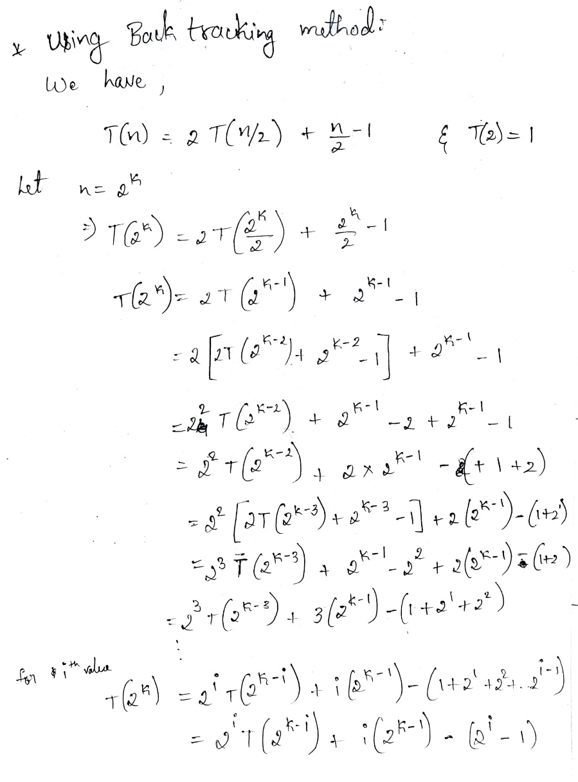
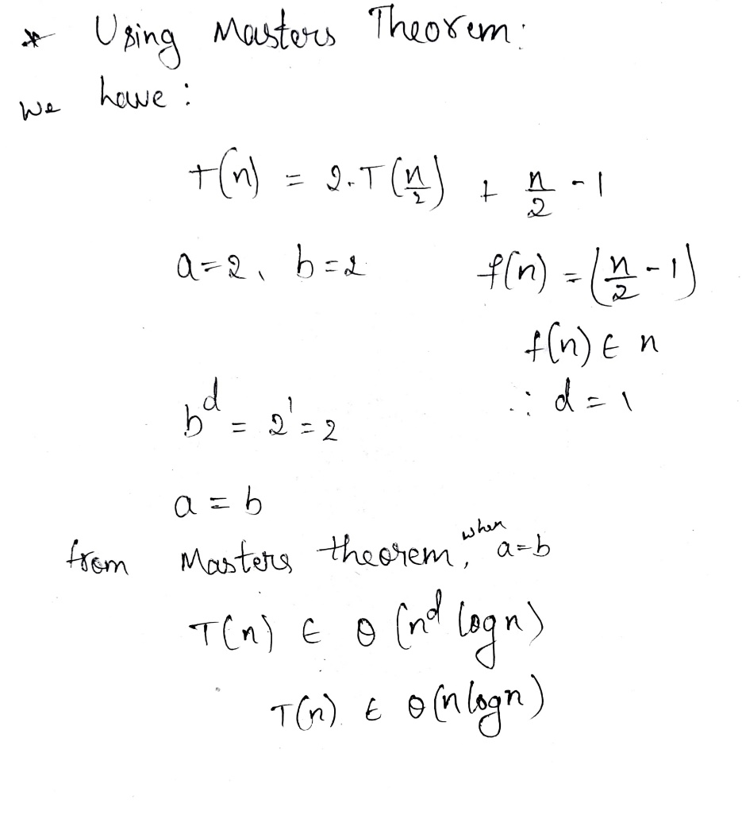
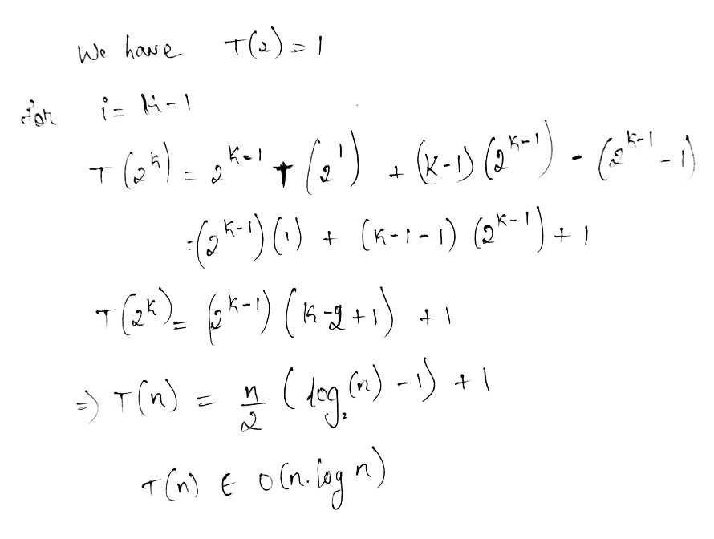

Slide 15
Applications
•The single-processor algorithm like bubblesort are generally simple but not very efficient.
•Batcher algorithm is a related but more efficient sort and merge algorithm.
•It uses perfect-shuffle operations and compare-exchange operations.
•It is usually more efficient on parallel processors with long range connections.
•Overcall this algorithm is fast than their counterparts proposed so far.

Slide 16
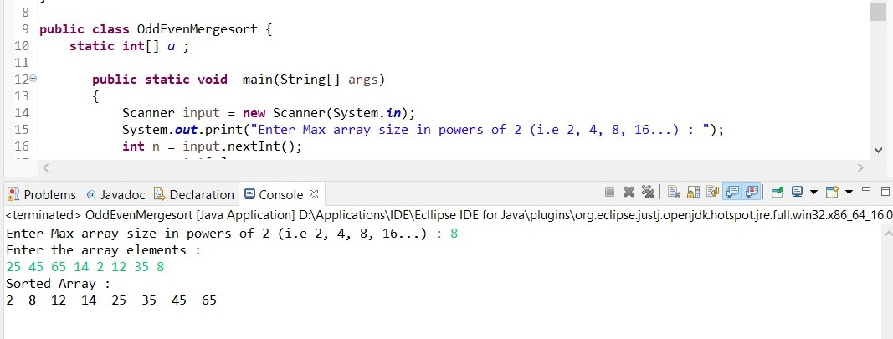
Output

