Slide 1
BANGALORE INSTITUTE OF TECHNOLOGY
K.R Road, V.V Pura,Bengaluru-04
DEPARTMENT OF COMPUTER SCIENCE & ENGINEERING
“SGPA CALCULATOR”
Presented by
Bharath Gowda B
1BI19CS038
Under the Guidance of Archana A Associate professor CSE

Slide 2
Agenda
Introduction
Problem Statement
Formulas
Source Code
Results
Conclusion
References
1/20

Slide 3
Introduction
Universities across the world use unique scoring systems to evaluate the academic performance of students in a specific period. While countries like India commonly use the percentage system, educational institutes in the USA widely use the Grade Point Average (GPA) and Semester Grade Point Average (SGPA).
One of the multiple methods that are there to calculate your performance in schools and colleges is SGPA.
Credit Points
These are basically the measurements of your study load. It is used by universities to assess your progress and completion of the course matters. Individual subjects are assigned credits based on the institutional hours they comprise of. Colleges and universities require you to finish a particular number of credits to be considered for the final examination.
2/20

Slide 4
Introduction
Grade Point
Grades are used to represent how well you have absorbed the information in class and whether you are able to reproduce that information upon being tested. You are typically awarded grade points for each subject that you study as a part of your course, which goes on to be used in deriving your Grade Point Average at the end of each term.
6/20

Slide 5
Problem statement
To develop an application that calculates and returns SGPA (Semester Grade Point Average). This application will be interactive, menu based implemented in shell script.
3/20

Slide 6
Formulas
Marks to Grade Points
Level | Out Standing | Excellent | Very Good | Good | Above Average | Average | Fail
Letter Grade | S | A | B | C | D | E | F
Grade Points | 10 | 9 | 8 | 7 | 6 | 5 | 00
Percentage of Marks Scored in a Course | ≥90 | <90 ≥80 | <80 ≥70 | <70 ≥60 | <60 ≥45 | <45 ≥40 | <40
 | (90-100) | (80-89) | (70-79) | (60-69) | (45-59) | (40-45) | (0-39)

Slide 7

Formulas
SGPA Formula
$SGPA= \frac{Σ\left[Course Credits X Grade Points\right] for all the Courses in that Semester}{Σ\left[Course Credits\right] for all the Courses in that Semester}$

Slide 8
Example for Computation of SGPA
Course | Credit | Marks Obtained | Grade Letter | Grade point | Credit Point (Credit x Grade)
Course 1 | 3 | 90 | S | 10 | 30
Course 2 | 4 | 85 | A | 9 | 36
Course 3 | 3 | 70 | B | 8 | 24
Course 4 | 3 | 86 | A | 9 | 27
Course 5 | 3 | 78 | B | 8 | 24
Course 6 | 3 | 75 | B | 8 | 24
Course 7 | 2 | 45 | D | 6 | 12
Course 8 | 2 | 78 | B | 8 | 16
Course 9 | 1 | 80 | A | 9 | 9
 | 24 |  |  |  | 202
Thus, SGPA = 202/24 = 8.41

Slide 9
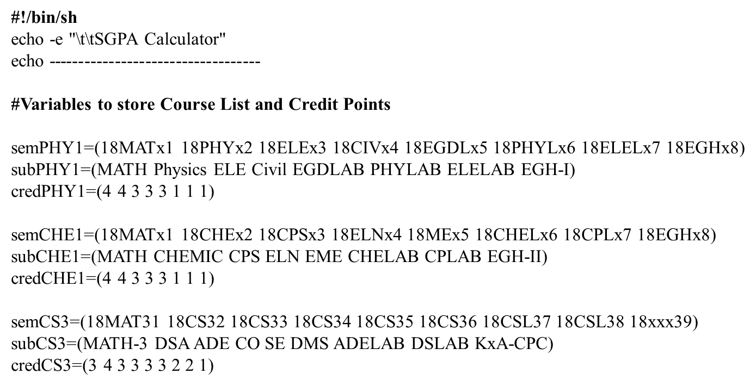
Source Code

Slide 10
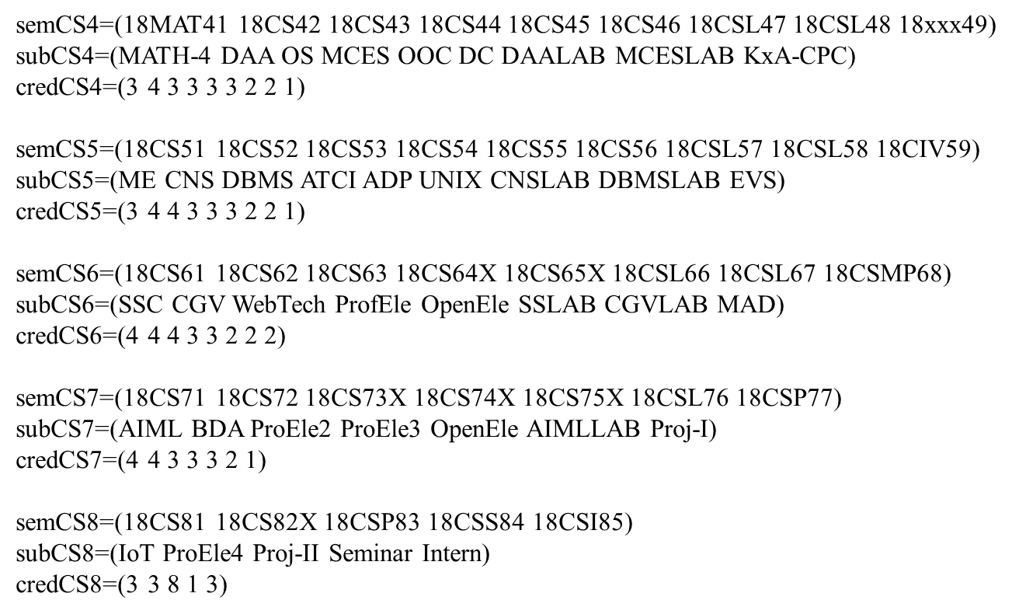
Source Code

Slide 11
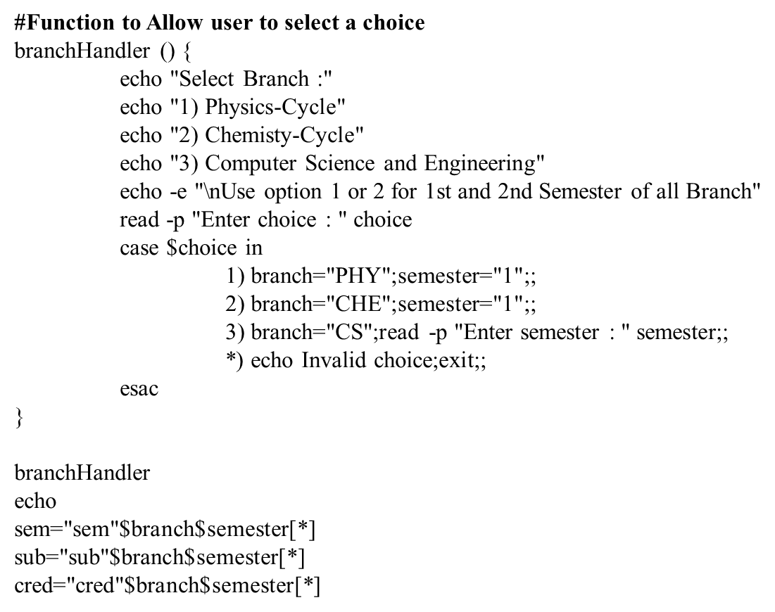
Source Code

Slide 12
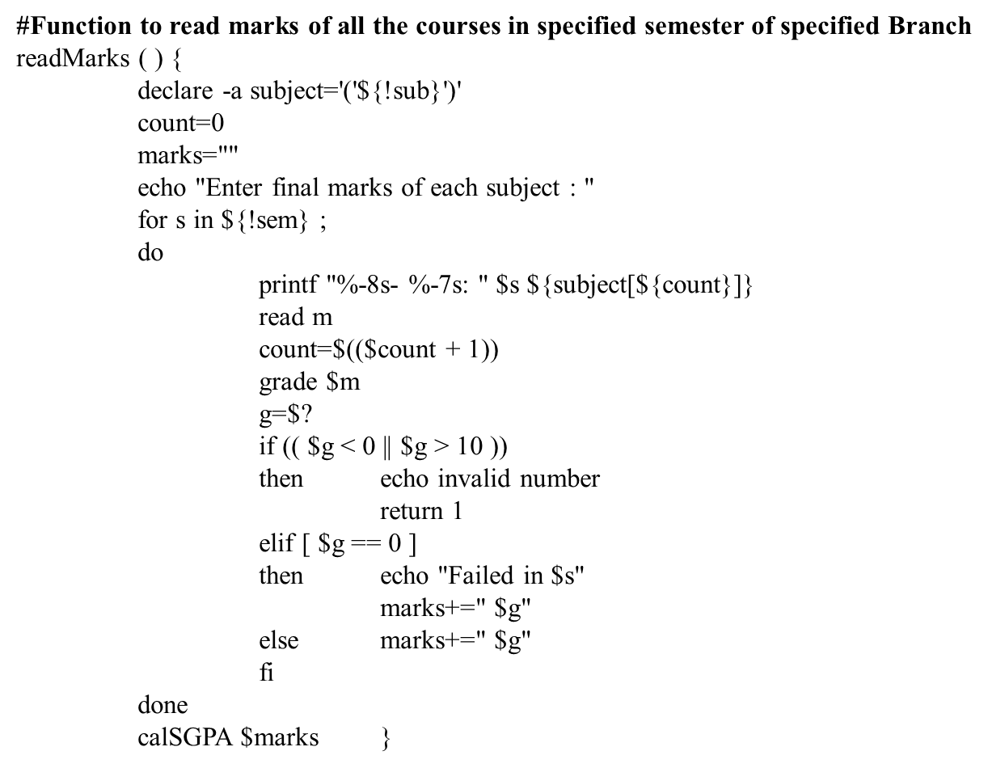
Source Code

Slide 13
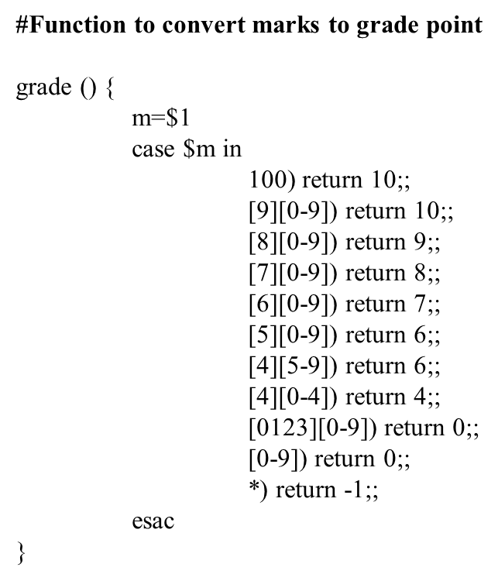
Source Code

Slide 14
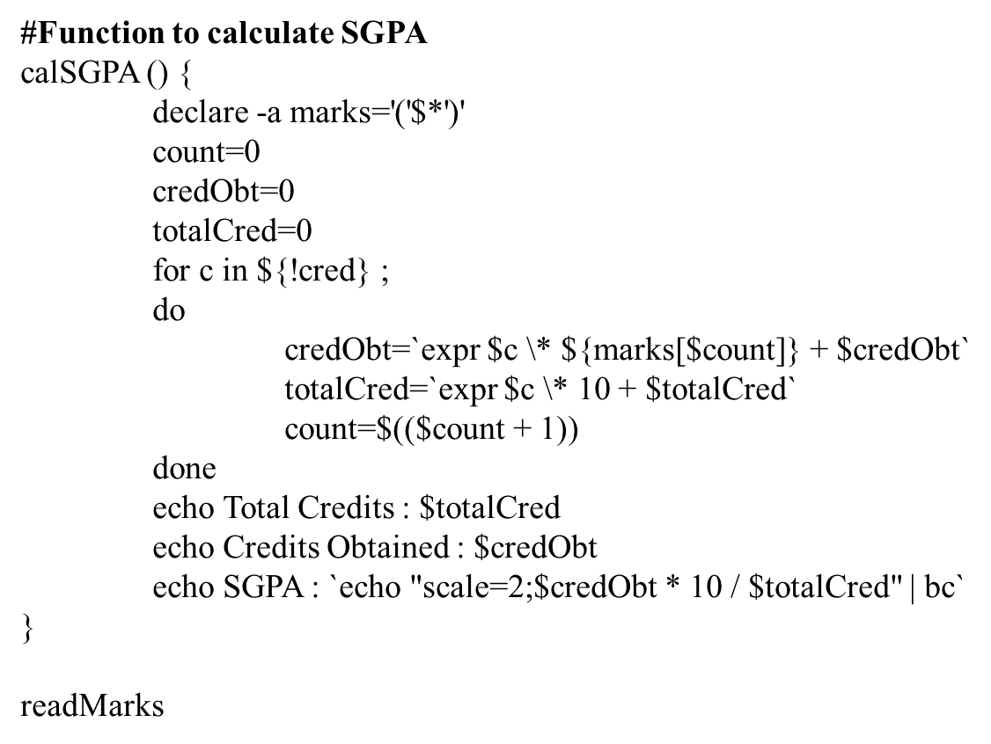
Source Code

Slide 15
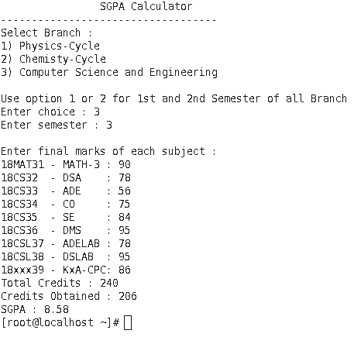
Results
15/20

Slide 16
Conclusion
Conclusion This project taught me a lot about programming. I learned how to set a goal for what I wanted my program to look like and do and I went and did it. I found that trial and error in programming is basically the only way to finalize a project to be sure it works 100% correctly. This project was challenging and fun for me and I felt I learned a lot for my first programming class. This project taught me a lot about programming. I learned how to set a goal for what I wanted my program to look like and do and I went and did it. I found that trial and error in programming is basically the only way to finalize a project to be sure it works 100% correctly. This project was challenging and fun for me and I felt I learned a lot for my first programming class.
21

Slide 17
References
https://stackoverflow.com/questions/33041363/what-does-read-p-do-in-a-linux-shell
https://www.geeksforgeeks.org/introduction-linux-shell-shell-scripting/
https://vtu.ac.in/wp-content/uploads/2019/12/becbcs2018-19.pdf
https://www.geeksforgeeks.org/calculate-the-cgpa-and-cgpa-of-marks-obtained-by-a-student-in-n-subjects
21

Slide 18
Thank You
1818

