Slide 1
Artificial intelligence: methods & applications Predict stock prices with LSTM
Sherzod Muminov smumin2@uic.edu
Nihal Pratap Ghanathe nghana2@uic.edu
Bharath Koneti bkonet2@uic.edu
May 3, 2018

Slide 2
Summary
Stock Market
S&P 500 stocks
Initial Public offering (IPO) of a private company
Exchange of Stocks
Forecasting using LSTM and GRU
Watson API based interactive response and scale.

Slide 3
Survey
Predicting Stock Prices Using LSTM Murtaza Roondiwala, Harshal Patel, Shraddha Varma. International Journal of Science and Research.
An Article on Time Series Prediction with LSTM Recurrent Neural Network in Python with Keras on machinelearningmastery.com
Predict stock prices with LSTM - Pablo Castilla on Kaggle.com

Slide 4
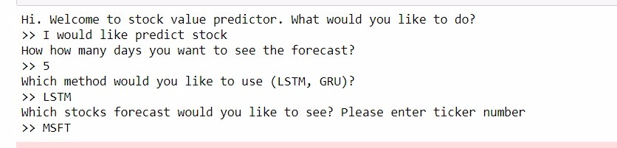
Proposed Solution
LSTM and GRU based models for Stock Prediction
Watson Integration and extensibility to support real-time interaction

Slide 5
Data
Closing prices data on stocks from S&P500 index
StockTwits Data for Crowd Sentiment

Slide 6
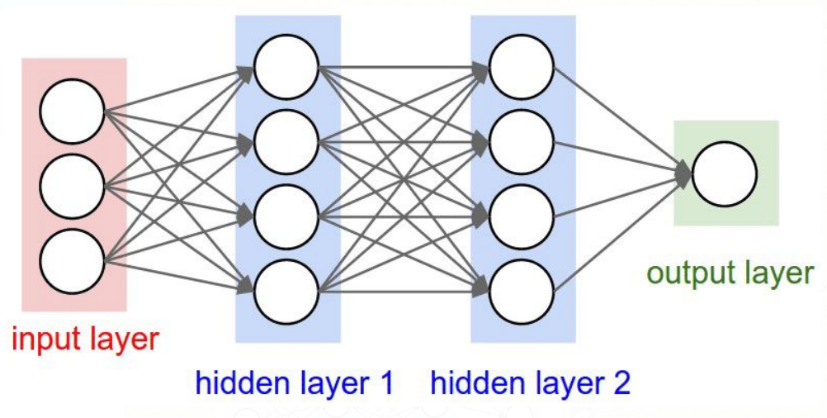
Solution of the architecture
LSTM and GRU
Training – 80%
Testing – 20%
Layers – 2
Hyperparameters:
1st hidden layer – 50
2nd hidden layer – 100
Dropout – 0.1
Scaling – MinMax Scaler
Batch size – 120
Epochs – 100

Slide 7
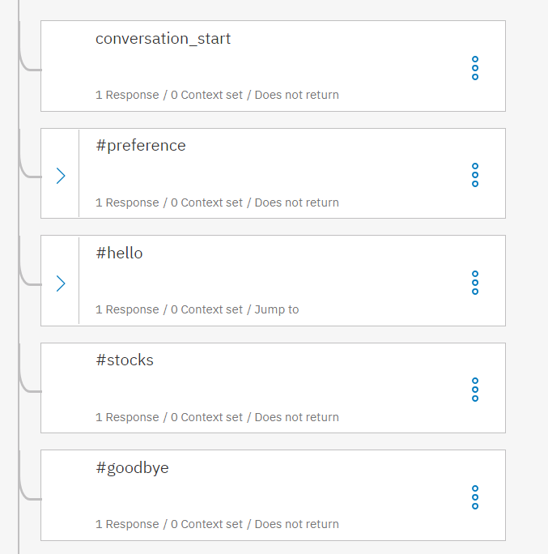
Solution of the architecture
Watson Conversation Services
Python SDK
Dialogs to handle user interaction
Intents
Methodused
Stocks
Preference
Greetings
Farewell

Slide 8
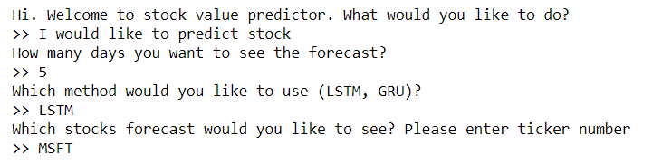
User Input
User may enter number of days for which he/she wants to predict stocks
User may choose which method to use, either LSTM or GRU
User can enter stock ticker for analysis

Slide 9
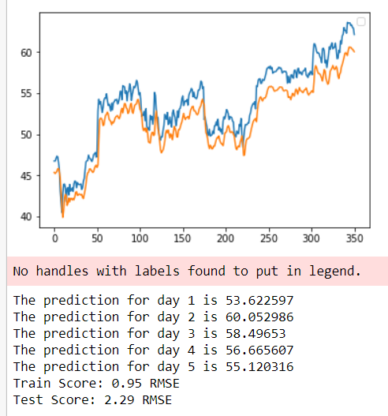
Output
On the output you can see comparison between predicted (orange) and trained (blue) values
User may also view results on daily basis, where Day 1 is today
RMSE errors

Slide 10
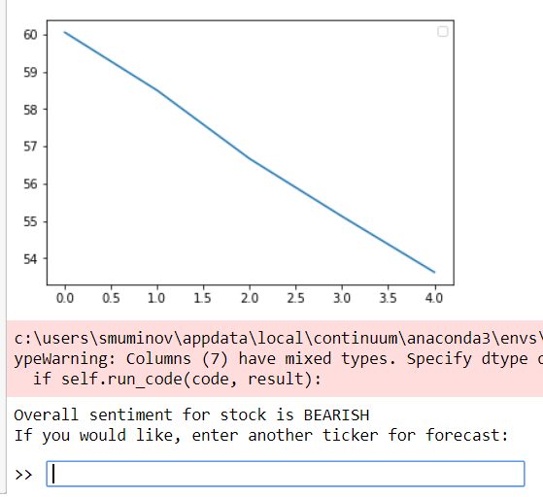
Output
Graph of predicted values
Result of sentiment analysis
BULLISH
BEARISH

Slide 11
Demo and Code flow
- Demo – Sherzod Muminov
Workflow with Example
Comparison between LSTM and GRU
Integration of IBM Watson chat API to interact with the Users
Explanation of result set with metrics
- Code Walkthrough - Nihal Pratap Ghanathe
Code Explanation
Code review for LSTM and GRU with Layers

