Slide 1


Introduction to
Robotic Process Automation
VIDEO SUMMARIZER
220701043
BHARATH KUMAR L
Mrs. J. JINU SOPHIA,
ASSISSTANT PROFESSOR(SG)
COMPUTER SCIENCE OF ENGINEERING

Slide 2
Abstract
This project presents an automated, scalable video summarization solution for education, using UiPath Studio to streamline the process. It begins with video-to-audio conversion via FFmpeg, followed by transcription with Google Speech-to-Text, and text summarization using a natural language processing model from UiPath AI Center. Managed by UiPath Orchestrator, the workflow ensures efficient automation, error handling, and resource optimization. This solution helps students focus on key concepts by providing concise summaries of lengthy videos, benefiting both learners and educators, and advancing educational technology with AI-driven automation.

Slide 3
Need for the Proposed System
Efficient Content Processing: Simplifies the review of lengthy videos by condensing them into concise summaries.
Time-Saving: Reduces the effort and time required for users to consume essential video content.
Automation: Eliminates the need for manual summarization through AI-driven transcription and summarization.
Scalability: Suitable for handling large volumes of digital content in sectors like education, media, and corporate training.
Consistency & Accuracy: Ensures reliable output using Google Speech-to-Text and NLP-based summarization techniques.
Accessibility: Makes video content easier to navigate and understand, enhancing user experience.

Slide 4
Advantages of the Proposed System
Time Efficiency:
Automates video summarization, reducing manual effort and processing time.
Scalability:
Handles large volumes of video content seamlessly.
Consistent Quality:
Ensures uniform accuracy through AI-driven processing.
Accessibility:
Provides multi-language support, catering to diverse users.
Cost Reduction:
Lowers operational expenses by minimizing human intervention.
Enhanced Usability:
Delivers concise, easy-to-understand summaries for varied applications.

Slide 5
Main Objective
The primary objective of your project is to develop an automated video summarization system that efficiently extracts and condenses essential information from lengthy videos, particularly in educational and professional contexts. By integrating tools like Google Speech-to-Text for transcription and natural language processing (NLP) models for summarization, the system aims to save time, enhance accessibility, and provide consistent, scalable solutions for processing large volumes of digital content.

Slide 6
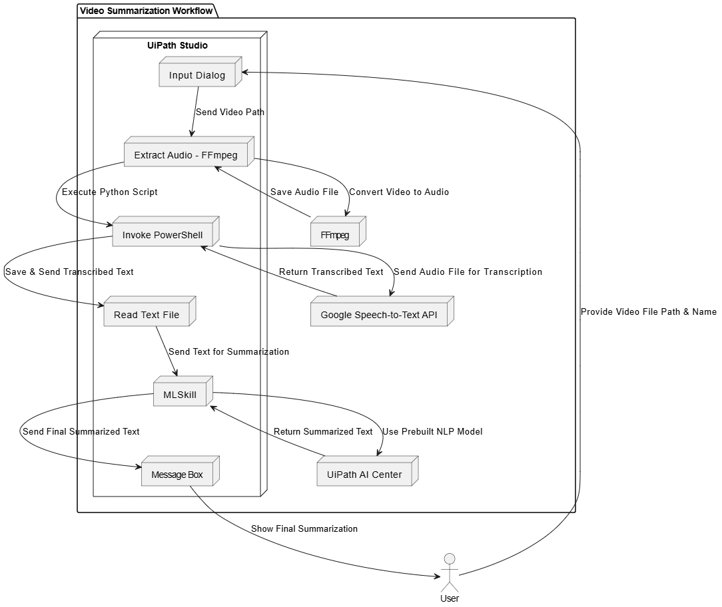
Architecture

Slide 7
System Requirements
Software:
UiPath Studio (Version 24.10.5 or above)
Python 3.7 or above
FFmpeg
Hardware:
Processor: Intel i3 or above
RAM: 4 GB minimum
Disk Space: 500 MB for tools and dependencies

Slide 8
Functional Description
Module-1: Video-to-Audio Conversion
Tool Used: Ffmpeg
Function: Extracts the audio stream from video files and converts it into a format suitable for further processing, such as .wav.
Module-2: Audio Transcription
Tool Used: Google Speech-to-Text API
Function: Converts the extracted audio into accurate text transcription, supporting multiple accents and languages.
Module-3: Text Summarization
Tool Used: UiPath AI Center Pre-Built Model
Function: Summarizes the transcribed text into a concise and meaningful summary using advanced natural language processing techniques.

Slide 9
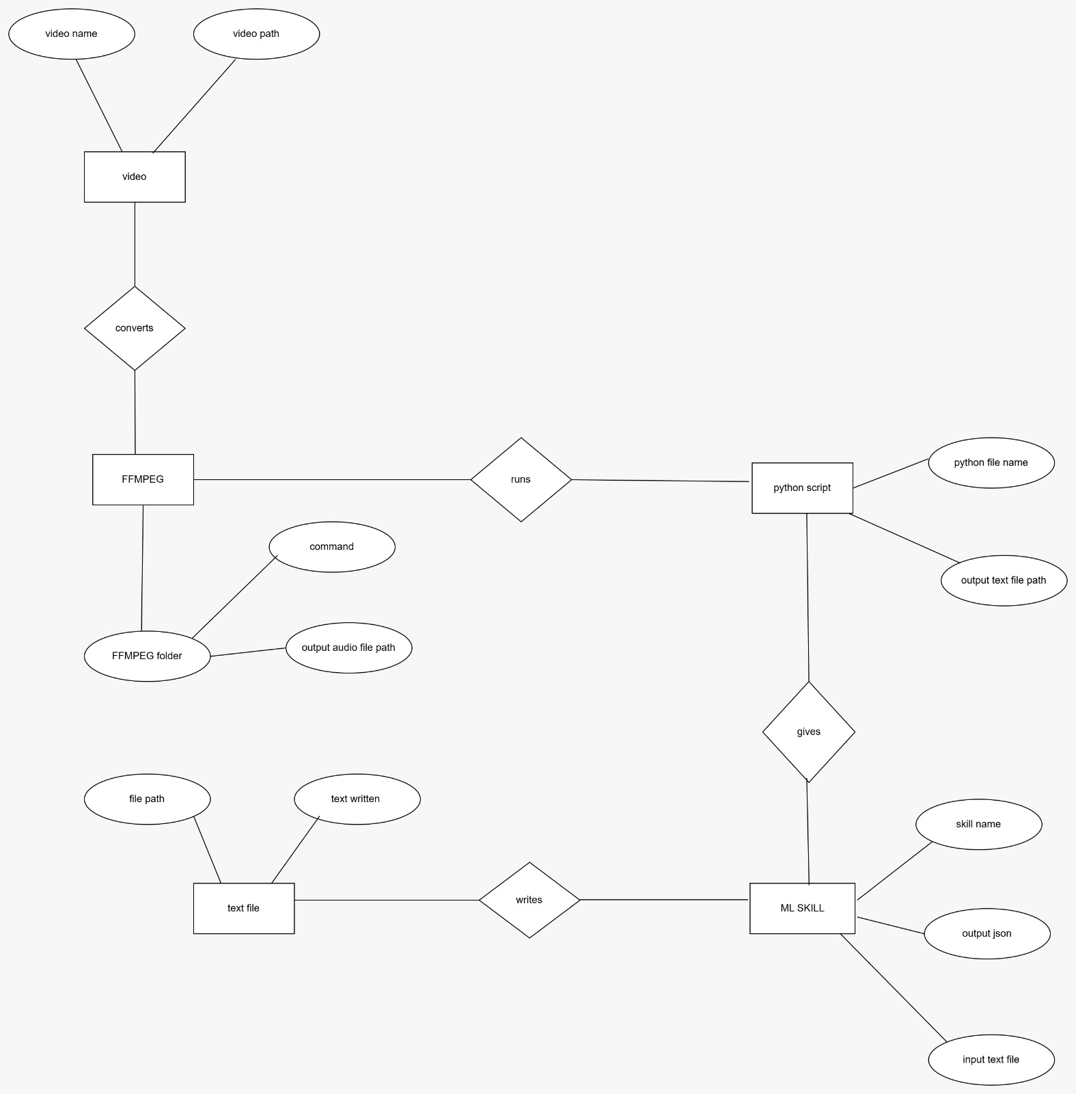
E-R DIAGRAM

Slide 10
Process Design
MAIN PROCESS: Video Summarization Workflow
Input Video Processing: Accept the video file and collect output filename through a user dialog.
Audio Extraction: Extract the audio from the video using FFmpeg.
Audio Transcription: Convert the extracted audio into text using Python and Google Speech-to-Text API.
Text Summarization: Process the transcribed text for summarization using a UiPath AI Center ML Skill.
Output Display: Present the summarized text through a message box or save it to a file.

Slide 11
Process Design
SUB-PROCESSES:
1.File Handling:
Ensure unique filenames for output files.
Verify file existence before overwriting.
2.Audio-to-Text Conversion:
Run a Python script to handle transcription using the Google Speech-to-Text API.
3.Summarization Model:
Utilize the ML Skill to summarize text with AI capabilities.

Slide 12
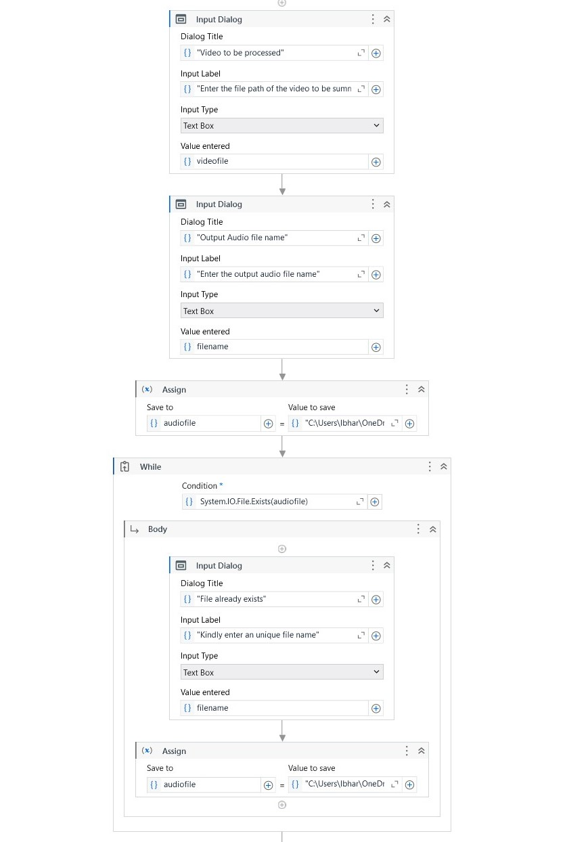
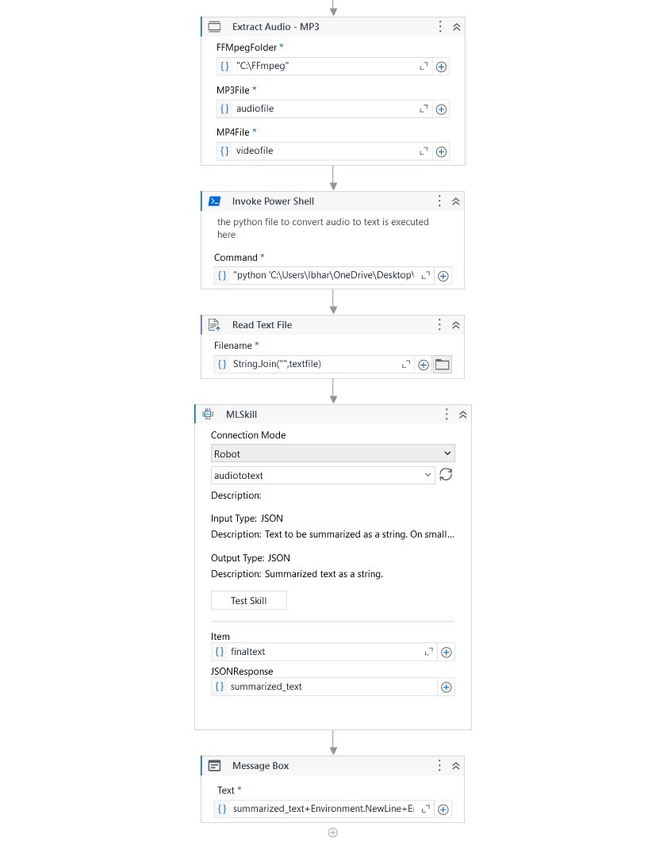
Implementation

Slide 13
Conclusions
Objective Achieved: Developed an AI-driven solution for efficient video summarization, addressing the growing demand for time-efficient content consumption.
Technological Integration: Successfully integrated tools like FFmpeg, Google Speech-to-Text API, and UiPath AI Center for automation and accuracy.
Efficiency & Scalability: The system saves time and resources, enabling users to process lengthy videos quickly while retaining essential information.
User-Centric Approach: Provides accessibility and ease of use, suitable for various sectors like education, corporate training, and media.

Slide 14
Future Enhancement
Integration with UiPath Orchestrator:
Automation Management: Implement UiPath Orchestrator to centrally monitor, schedule, and manage the video summarization workflows.
Scheduling: Enable automatic scheduling of video processing tasks for predefined times, eliminating manual intervention.
Enhanced Collaboration: Allow teams to manage and track processes collaboratively using Orchestrator's shared environment.
Cloud Integration: Deploy workflows in a cloud environment for better accessibility and seamless updates.

Slide 15
References
Kumar, P., Sharma, A., & Singhal, S. (2020). Automated video summarization using deep learning. IEEE Transactions on Multimedia, 22(9), 2310-2321.
Chen, Z., Xu, C., & Lu, C. (2019). Video summarization: A comprehensive review. Journal of Visual Communication and Image Representation, 60, 231-246.
Yu, M., Li, Y., & Chen, X. (2021). Real-time video summarization using machine learning techniques. Journal of Machine Learning Research, 22(1), 123-139.
Singh, S., Mishra, P., & Choudhury, P. (2022). AI-driven summarization systems for multimedia data. AI & Data Science, 7(3), 56-64.
Sharma, N., Rani, R., & Singh, A. (2020). AI in video content analysis: Current trends and future applications. Journal of AI Research, 37(4), 1125-1139.

Slide 16
Queries

Slide 17
Demonstration

Slide 18
Thank You

