Slide 1

Table of contents
Problem statement
Dataset description
Data pre-processing
Regression models
Accuracy measures of models
Deploying model in GUI and AWS
Conclusion

Slide 2
Problem statement
Car price prediction is a vital aspect of the automotive industry, as it helps various stakeholders make informed decisions. The process of predicting car prices is complex, as it is influenced by several factors, including the car's make, model, year, features, mileage and many other factors . However, with the help of machine learning models, car price prediction can be accomplished accurately.
Machine learning models analyze past car sales data to identify patterns and features that influence car prices. The models use various data points, to predict the prices of new or used cars.
Car dealers, manufacturers, and buyers can benefit from accurate car price predictions. Accurate car price predictions can help these stakeholders make better-informed decisions, leading to improved efficiency and profitability in the automotive industry.

Slide 3
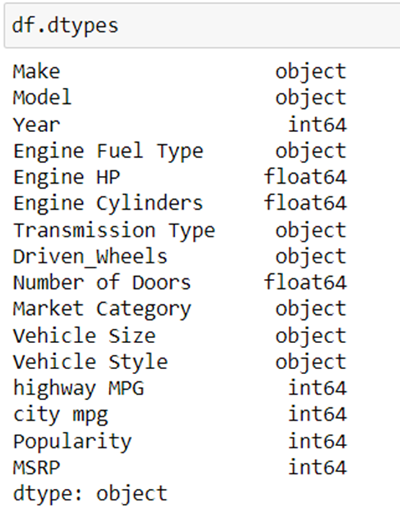
Dataset description
The Cars dataset consists of 11,914 rows and 16 columns, which contains various car features including Make, Model, Year, Engine Fuel Type, Engine HP, and more. These features are utilized to predict the price of the car accurately.
Dataset contains Categorical and Numerical (both Discrete and Continuous) attributes. This project can be framed as Regression Problem, where the objective is to predict the continuous target attribute "msrp," representing the price of the car.
Dataset link - Car_Features_and_Price.xlsx

Slide 4
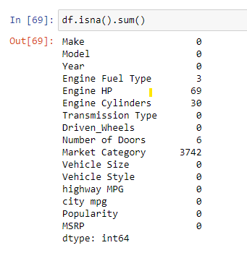
Data cleaning
Data cleaning is a step that focuses on identifying and handling missing values, outliers, and inconsistencies in the dataset.
There are 715 duplicate rows in dataset. So, we dropped those rows from our dataset.
There are missing values in Dataset in [‘Engine Fuel Type’, ‘Engine HP’, ‘Engine cylinders’, ‘Number of Doors’, ’Market Category’].
For Categorical attributes i.e., [‘Number of Doors’, ’Market Category’, ‘Engine Fuel Type’], we replaced with mode. For continuous attributes [‘Engine HP’, ‘Engine cylinders’] are following Normal distribution histogram. So, we replaced with mean.
There are outliers for the [‘Year’, ‘Engine HP’, ‘Engine cylinders’, ‘Highway MPG’, ‘city mpg’, ‘Popularity’] . We used 1.5*IQR rule to identify the outliers. Then the median value is used to replace the outliers.
There are Unknown values in Transmission type column. So, we dropped those rows which having Transmission type as unknown.

Slide 5
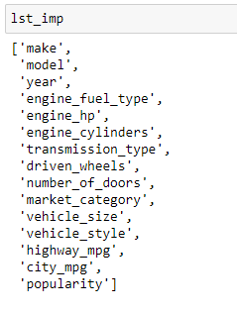
Feature selection
Feature selection is the process of selecting a subset of relevant features from a larger set of features in a dataset to improve the performance of a machine learning model.
For continuous data, feature selection can be done using correlation or Regplot(). In our dataset continuous attributes are ['year', 'engine_hp', 'highway_mpg', 'city_mpg', 'popularity’]
For categorical data, feature selection can be done using the Boxplot or ANOVA test. In our dataset categorical attributes are ['make', 'model', 'engine_fuel_type', 'transmission_type', 'driven_wheels', 'market_category', 'vehicle_size', 'vehicle_style', 'engine_cylinders', 'number_of_doors’].
[‘msrp’] is our target variable.
[‘year’, 'engine_hp', 'highway_mpg', 'city_mpg’] are better correlated with target variable [‘msrp’]
All the categorical attributes are having significant impact on target variable [‘msrp’].

Slide 6
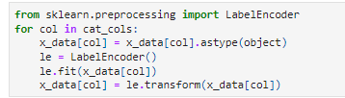
Feature engineering
Feature engineering involves creating new features or transforming existing features in a dataset to improve the performance of a machine learning model.
For categorical columns, we are doing the label encoding to convert categorical data into numerical values that can be used in machine learning algorithms.
First, we convert the data type to object using the ‘astype’ method, which is required for the Label Encoder to work properly. Then we use ‘fit’ function to fit the encoder to the unique values in that column. Finally, ‘transform’ method is used to transform each categorical value in the column into its corresponding numerical label.

Slide 7
Regression models
The dataset is divided into training and testing sets, with a split of 85% for training and 15% for testing.
Although we initially tried multiple regression models including multi-linear regression, multi-polynomial regression, Lasso regression, and Ridge regression, we did not obtain satisfactory results. Therefore, we decided to implement ensemble techniques to improve the accuracy and robustness of our predictions.
In our implementation of ensemble techniques, we employed various methods such as Average Voting, Weighted Average Voting, Stacking, Blending, Bagging Regressor, AdaBoost, Gradient Boosting, and XGBoost.
R2 and MSE are commonly used metrics to evaluate the performance of a regression model. A higher value of R2 indicates a better fit of the model to the data, while a lower value of MSE indicates that the model's predictions are closer to the true values.
To determine the best model, we typically look for the model with the highest R2 and the lowest MSE on both the training and testing datasets.
Bagging Regressor is the best performing model with the highest R2 and the lowest MSE on both the training and testing datasets

Slide 8
Accuracy measures of models
Model name | R2 (train) | R2 (test) | MSE(train) | MSE(test)
Bagging Regressor | 0.97 | 0.96 | 104663146.17 | 172759573.02
XGBoost Regressor | 0.99 | 0.92 | 15527962.04 | 332855063.50
Stacking | 0.98 | 0.91 | 58859281.06 | 384840980.16
Blending | 0.98 | 0.89 | 58859281.06 | 484260569.46
AVG voting | 0.98 | 0.89 | 58859281.06 | 472484396.93
Gradient Boosting | 0.97 | 0.89 | 104663146.17 | 496381765.96
Random Forest Regressor | 0.97 | 0.86 | 104663146.17 | 172759573.02
Weighted AVG voting | 0.98 | 0.80 | 58859281.06 | 862329357.93
AdaBoost Regression | 0.97 | 0.67 | 104663146.17 | 1417708992.1
Multi Linear Regression | 0.21 | 0.23 | 2914954082.7 | 3376604907.3
Multi Polynomial Regression | 0.98 | -0.04 | 44383718.99 | 4607542511.0
Lasso Regression | 0.84 | 0.85 | 599096480.10 | 643623666.88
Ridge Regression | 0.98 | -0.94 | 58859281.06 | 8540728211.8

Slide 9
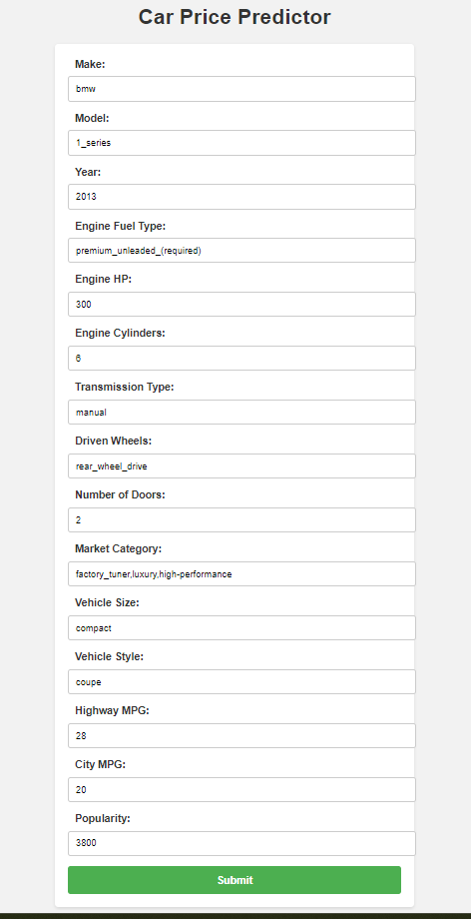
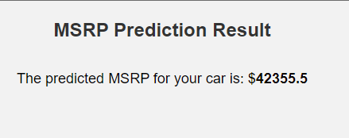
Deploying model in GUI using Flask
We utilized pickle files containing the trained Bagging Regressor model and label encoding technique for preprocessing.
These pickle files were integrated into our Flask-based GUI, enabling users to input car features for price prediction.
The Flask app processes the inputs, transforming them into a structured data frame and encoding categorical columns using label encoders.
The Bagging Regressor model predicts the car's price based on the processed inputs, and the result is displayed to the user. Additionally, the car details are stored in a MySQL database for efficient management.

Slide 10
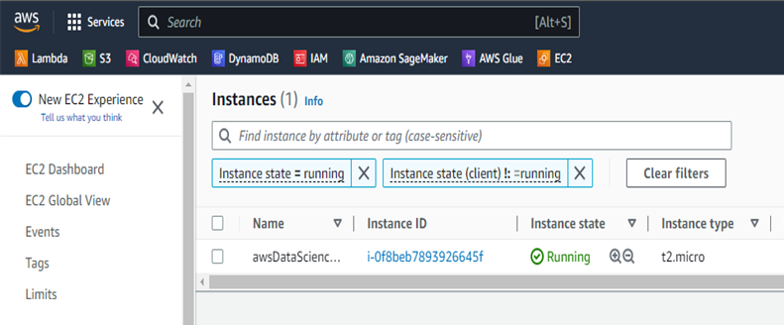
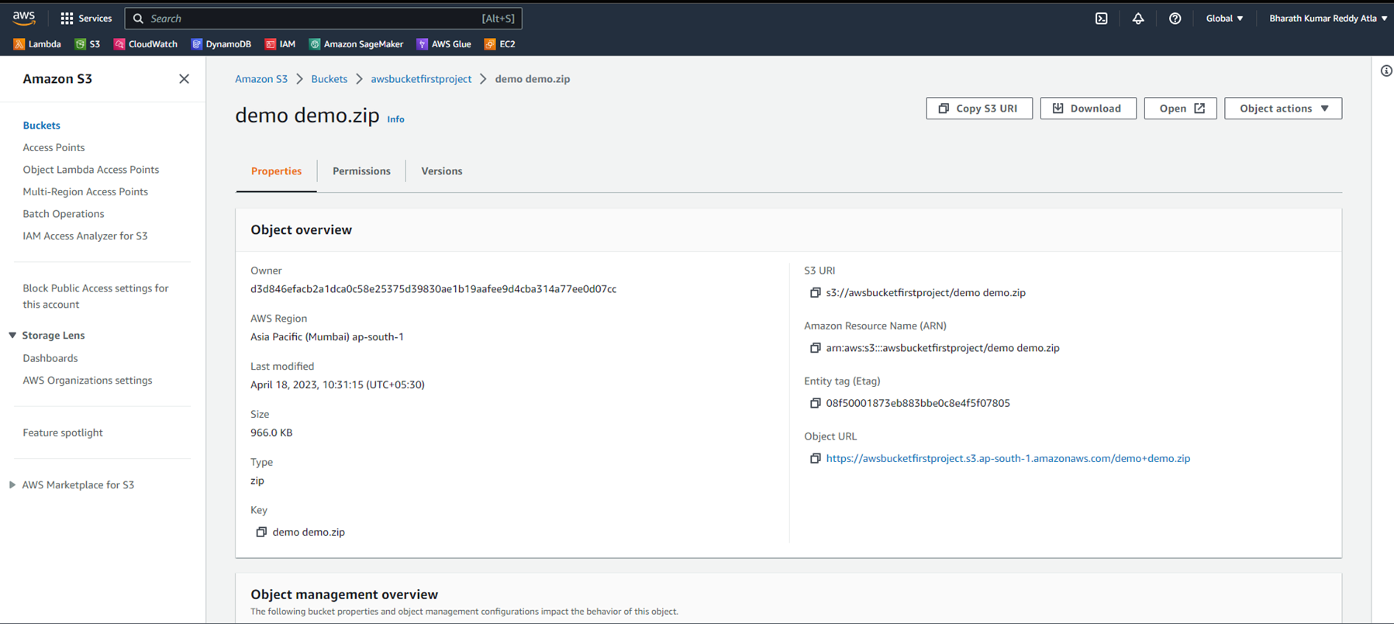
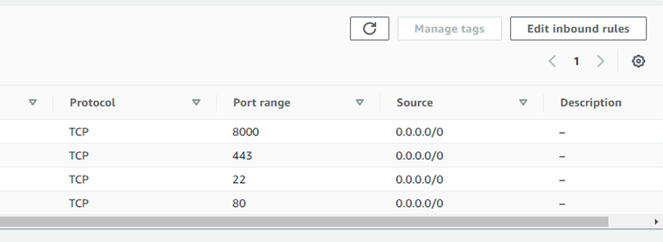
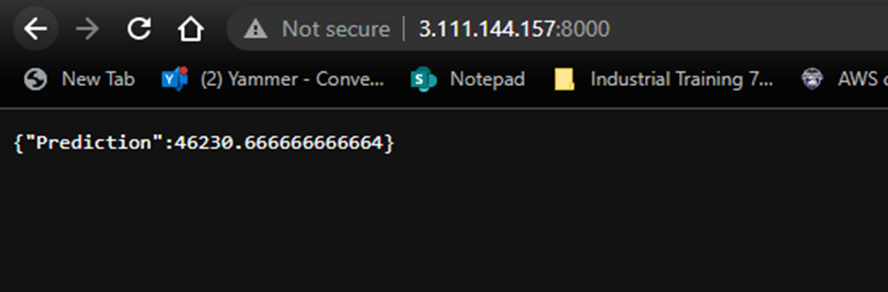
Deploying model in AWS using FastAPI
We deployed our model on AWS using FastAPI to enable car price predictions.
1) EC2 instance created and running.
2) Uploaded zip file to S3 Bucket.
3) Added inbound rule for port 8000 for browser access.
4) Successfully running on Public IPv4 address

Slide 11
Conclusion
In this car price prediction project, we performed data cleaning and feature selection on the dataset. We trained and evaluated multiple machine learning models, ultimately selecting the best performing bagging Regressor model. To make the model accessible, we developed a user-friendly GUI using Flask and integrated it with a MySQL database for data storage. The project was deployed on AWS using FastAPI, ensuring scalability and reliability. Users can input car features and receive accurate price predictions through the web interface.
Overall, the project demonstrates the successful application of machine learning in predicting car prices and highlights the benefits of cloud-based deployment for scalability and accessibility.
Additionally, I am currently working on an AWS-based data ingestion project, which focuses on developing a streamlined pipeline for data collection and processing

Slide 12





Thank You
Special Mention
Dr. Ankit Shrivastava

