Slide 1

Brain Tumor MRI Classification
Deep Learning-Based End-to-End System
Brain Tumor MRI Classification Using Deep Learning
Reproducible Modeling and Streamlit Deployment
Bharath Linga Reddy Palem (23STUCHH010306)
Guide: Dr. Pavan Kumar
B.Tech Data Science and Artificial Intelligence
IFHE University, Hyderabad
IFHE University, Hyderabad | B.Tech Data Science and Artificial Intelligence

Slide 2
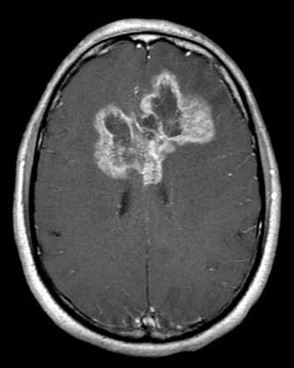
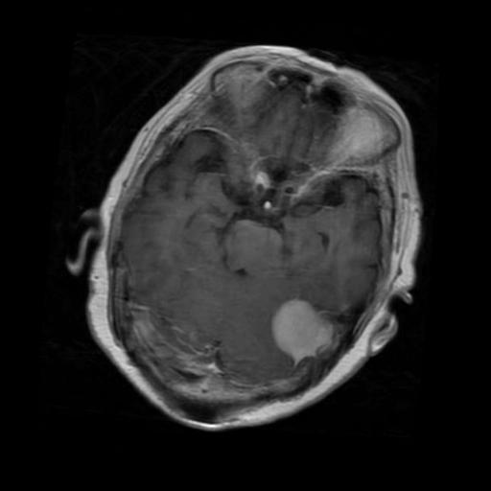
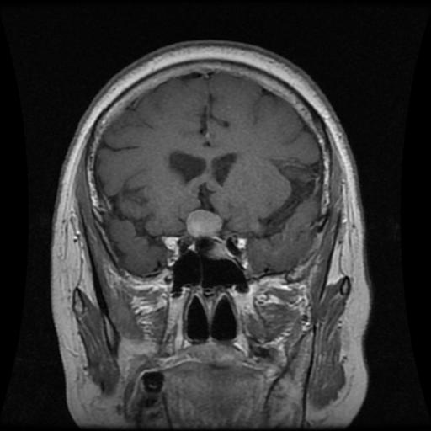
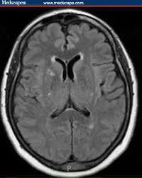
Problem Statement
Manual MRI interpretation is time-consuming and specialist-dependent.
Subtype overlap (glioma vs meningioma) causes classification difficulty.
Need a reliable 4-class automated pipeline with deployment readiness.
Goal: Accurate model + practical web application for real-time inference.
IFHE University, Hyderabad | B.Tech Data Science and Artificial Intelligence

Slide 3
Objectives and Key Contributions
Develop a robust 4-class MRI classifier: glioma, meningioma, pituitary, no-tumor.
Perform structured hyperparameter optimization using Optuna.
Compare Basic CNN, ResNet50, and EfficientNet-B0 under one pipeline.
Deploy model using Streamlit with single and batch prediction features.
Integrate user/admin workflows, prediction history, and explainability support.
IFHE University, Hyderabad | B.Tech Data Science and Artificial Intelligence

Slide 4
Dataset Overview
Class | Train | Test | Total
Glioma | 1400 | 400 | 1800
Meningioma | 1400 | 400 | 1800
Pituitary | 1400 | 400 | 1800
No Tumor | 1400 | 400 | 1800
Total Images: 7200
Balanced class distribution improves fairness across macro metrics.
IFHE University, Hyderabad | B.Tech Data Science and Artificial Intelligence

Slide 5
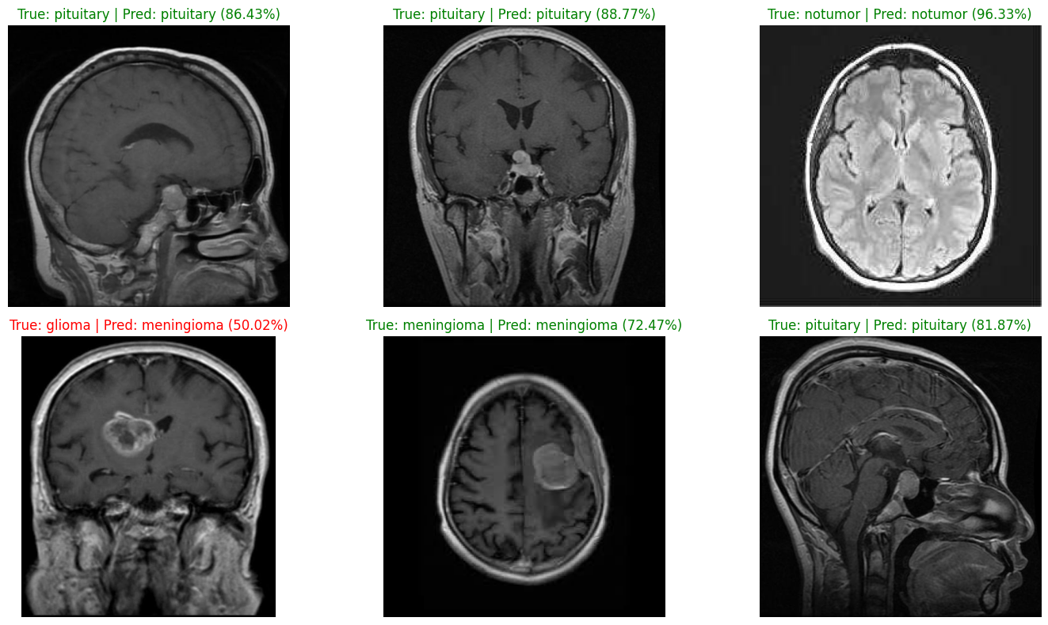
Preprocessing and Augmentation
Resize to 224 x 224 and convert to RGB tensor format.
Normalization and deterministic inference transforms.
Augmentations: random resized crop, rotation, H/V flips.
Persistent class mapping ensures training-deployment consistency.
IFHE University, Hyderabad | B.Tech Data Science and Artificial Intelligence

Slide 6
Model Architecture and Candidates
Final deployed model: Custom Basic CNN.
Blocks: Conv(32) -> Conv(64) -> Conv(128) -> Conv(256).
Classifier: Flatten -> Dense(512) -> Dropout -> 4-class output.
Compared with ResNet50 and EfficientNet-B0 for fairness.
Input MRI -> CNN Feature Blocks -> FC Head -> Softmax -> Class Label
IFHE University, Hyderabad | B.Tech Data Science and Artificial Intelligence

Slide 7
Hyperparameter Tuning with Optuna
Optimization objective: Validation Macro F1 score.
Total trials: 40 | Trial epochs: 10 | Final retraining: 25 epochs.
Search space: model family, batch size, LR, weight decay, optimizer, scheduler.
Best trials consistently favored Basic CNN with AdamW + plateau scheduler.
Best validation macro F1
~ 0.9626
Selected for final deployment pipeline
IFHE University, Hyderabad | B.Tech Data Science and Artificial Intelligence

Slide 8
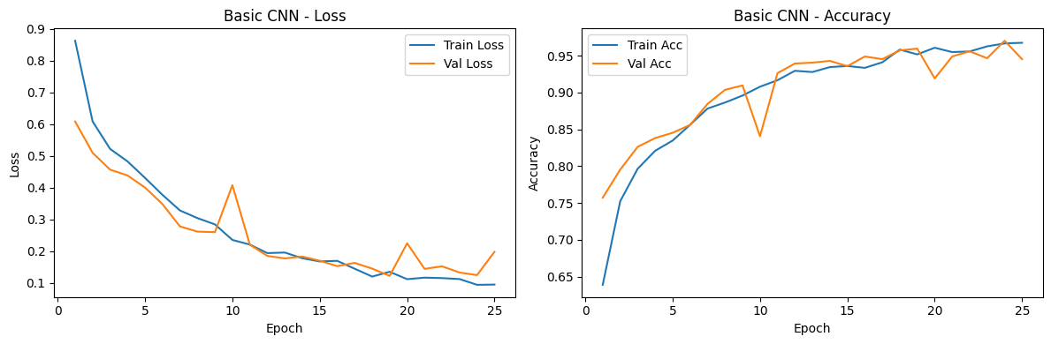
Training and Validation Curves
Stable convergence across epochs.
Validation trend follows training without severe overfitting.
Model selected from tuned checkpoints.
IFHE University, Hyderabad | B.Tech Data Science and Artificial Intelligence

Slide 9
Model Comparison on Test Set
Model | Accuracy | Macro Precision | Macro Recall | Macro F1
ResNet50 | 0.8313 | 0.8418 | 0.8313 | 0.8260
Basic CNN | 0.9256 | 0.9270 | 0.9256 | 0.9244
EfficientNet-B0 | 0.8363 | 0.8426 | 0.8362 | 0.8333
Basic CNN achieved the best overall metrics and class balance.
Selected as final production model for Streamlit deployment.
IFHE University, Hyderabad | B.Tech Data Science and Artificial Intelligence

Slide 10
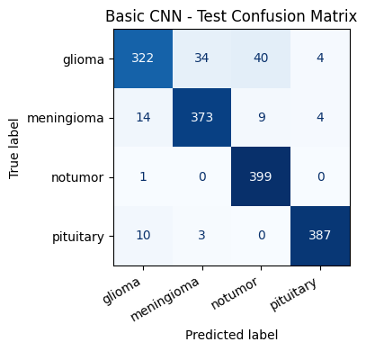
Confusion Matrix and Error Analysis
No-tumor and pituitary classes show highest reliability.
Most confusion appears between glioma and meningioma.
Future improvement: stronger subtype discrimination and calibration.
IFHE University, Hyderabad | B.Tech Data Science and Artificial Intelligence

Slide 11
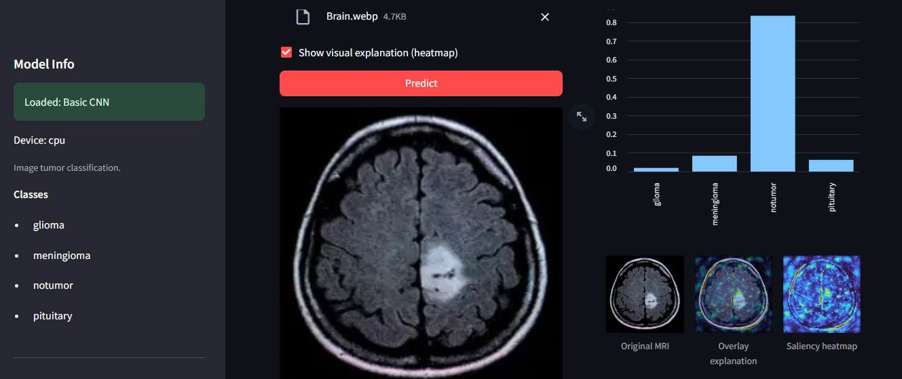
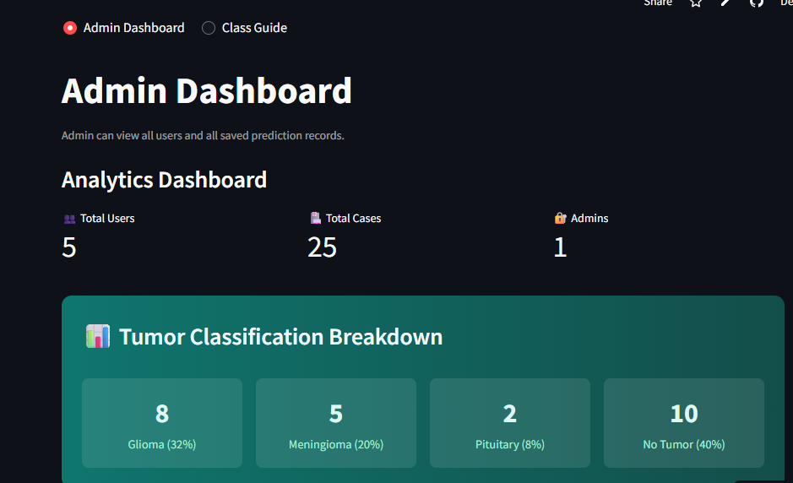
Deployment: Streamlit Application
Supports single prediction, batch inference, prediction history, and admin analytics.
IFHE University, Hyderabad | B.Tech Data Science and Artificial Intelligence

Slide 12
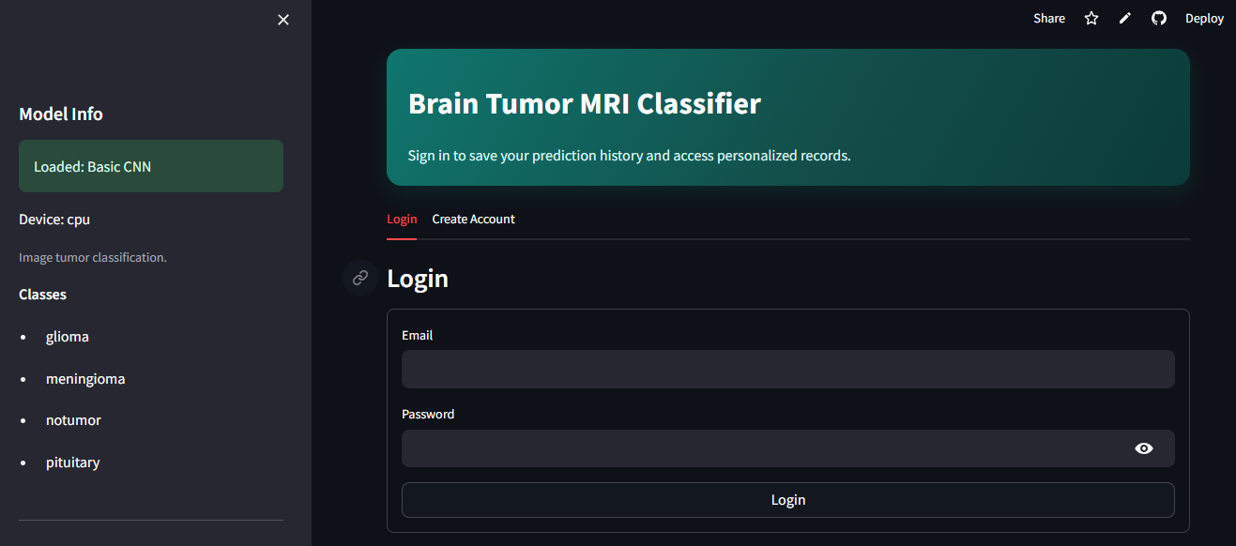
Conclusion and Future Scope
Delivered an end-to-end 4-class MRI brain tumor classification solution.
Achieved strong test performance with deployable Basic CNN model.
Built a practical Streamlit interface for real-time usage.
Future scope: external validation, 3D context modeling, uncertainty estimation.
Thank You - Questions?
IFHE University, Hyderabad | B.Tech Data Science and Artificial Intelligence

